Slide 1

DS 4440
Deep Learning

Slide 2
Evolving SOTA in Image Classification

Slide 3
Concepts to Know So Far
McCoullough-Pitts neuron model (weighted sum then nonlinearity)
Binary logic neural networks
Universal computations (two+ layers and nonlinearities are needed)
Gradient descent
Modular machine learning: Pytorch tensors, autograd, and modules
Losses: what makes a good/bad loss; MSE, L1, and cross-entropy loss
The backpropagation algorithm: computational graphs, backward pass, upstream/internal/downstream gradients, accumulation
First-order optimization: gradient descent, SGD, Momentum, ADAM
Conditioning gradients: nonlinearities, initialization, whitening
Symmetries: data augmentation, invariances
Convolutions: 1d, 2d convolutional kernels

Slide 4
Today
State-of-the-art image classification approaches
The ImageNet benchmark
AlexNet
Stacking convolutions. Striding, pooling.
Receptive field. What a deep convolution sees.
Symmetry of equivariance
Later:
Dropout
Resnet
Batchnorm
Residual connections

Slide 5
Convolution Layer
3x32x32 image: preserve spatial structure
32
height
32
width
3
depth / channels
Slide credit: D Fouhey & J Johnson

Slide 6
Convolution Layer
3x32x32 image
3x5x5 filter
Convolve the filter with the image: “slide over the image spatially, computing dot products”
32
height
32
width
3
depth / channels
Slide credit: D Fouhey & J Johnson

Slide 7
Convolution Layer
Filters always extend the full depth of the input volume
3x32x32 image
3x5x5 filter
Convolve the filter with the image: “slide over the image spatially, computing dot products”
32
height
32
width
3
depth / channels
Slide credit: D Fouhey & J Johnson

Slide 8

Convolution Layer
3x32x32 image
3x5x5 filter
1 number:
the result of taking a dot product between the filter and a small 3x5x5 chunk of the image
(i.e. 3*5*5 = 75-dimensional dot product + bias)
32
32
3
$$w^{T}x+b$$
Slide credit: D Fouhey & J Johnson

Slide 9
Convolution Layer
1x28x28 activation map
3x32x32 image
3x5x5 filter
28
convolve (slide) over all spatial locations
32
28
32
1
3
Slide credit: D Fouhey & J Johnson

Slide 10
Convolution Layer
1x28x28 activation map
3x32x32 image
3x5x5 filter
28
convolve (slide) over all spatial locations
32
28
32
1
3
Convolution Layer vs Image Filtering:
>1 input and output channels
Forget about convolution vs cross-correlation
Slide credit: D Fouhey & J Johnson

Slide 11
Convolution Layer
two 1x28x28 activation map
3x32x32 image
Consider repeating with a second (green) filter:
3x5x5 filter
28
28
convolve (slide) over all spatial locations
32
28
32
1
1
3
Slide credit: D Fouhey & J Johnson

Slide 12
Convolution Layer
6 activation maps,
each 1x28x28
3x32x32 image
Consider 6 filters, each 3x5x5
Convolution Layer
32
32
6x3x5x5 filters
Stack activations to get a 6x28x28 output image!
3
Slide credit: D Fouhey & J Johnson

Slide 13
Convolution Layer
6 activation maps,
each 1x28x28
3x32x32 image
Also 6-dim bias vector:
Convolution Layer
32
32
6x3x5x5 filters
Stack activations to get a 6x28x28 output image!
3
Slide credit: D Fouhey & J Johnson

Slide 14
Convolution Layer
28x28 grid, at each point a 6-dim vector
3x32x32 image
Also 6-dim bias vector:
Convolution Layer
32
32
6x3x5x5 filters
Stack activations to get a 6x28x28 output image!
3
Slide credit: D Fouhey & J Johnson

Slide 15
Convolution Layer
2x6x28x28
Batch of outputs
2x3x32x32
Batch of images
Also 6-dim bias vector:
Convolution Layer
32
32
3
6x3x5x5 filters
Slide credit: D Fouhey & J Johnson

Slide 16
Convolution Layer
N x C_{out} x H’ x W’
Batch of outputs
N x C_{in} x H x W
Batch of images
Bias: C_{out}-dim vector:
Convolution Layer
H
W
C_{out}
C_{in}
Weight:
C_{out} x C_{in}x K_{w} x K_{h}
Slide credit: D Fouhey & J Johnson

Slide 17
Stacking Convolutions
32
28
26
….
Conv
Conv
Conv
W₁: 6x3x5x5
b₁: 6
W₂: 10x6x3x3
b₂: 10
W₃: 12x10x3x3
b₃: 12
32
28
26
3
6
10
Input:
N x 3 x 32 x 32
First hidden layer:
N x 6 x 28 x 28
Second hidden layer:
N x 10 x 26 x 26
Slide credit: D Fouhey & J Johnson

Slide 18
Stacking Convolutions
Q: What happens if we stack two convolution layers?
32
28
26
….
Conv
Conv
Conv
W₁: 6x3x5x5
b₁: 6
W₂: 10x6x3x3
b₂: 10
W₃: 12x10x3x3
b₃: 12
32
28
26
3
6
10
Input:
N x 3 x 32 x 32
First hidden layer:
N x 6 x 28 x 28
Second hidden layer:
N x 10 x 26 x 26
Slide credit: D Fouhey & J Johnson

Slide 19
Stacking Convolutions
(Recall y=W₂W₁x is linear)
Q: What happens if we stack two convolution layers?
A: It’s equivalent to just one convolution layer!
32
28
26
….
Conv
Conv
Conv
W₁: 6x3x5x5
b₁: 6
W₂: 10x6x3x3
b₂: 10
W₃: 12x10x3x3
b₃: 12
32
28
26
3
6
10
Input:
N x 3 x 32 x 32
First hidden layer:
N x 6 x 28 x 28
Second hidden layer:
N x 10 x 26 x 26
Slide credit: D Fouhey & J Johnson

Slide 20
Stacking Convolutions
Q: What happens if we stack two convolution layers?
A: It’s equivalent to just one convolution layer!
32
28
26
….
Conv
ReLU
Conv
ReLU
Conv
ReLU
W₁: 6x3x5x5
b₁: 6
W₂: 10x6x3x3
b₂: 10
W₃: 12x10x3x3
b₃: 12
32
28
26
3
6
10
Input:
N x 3 x 32 x 32
First hidden layer:
N x 6 x 28 x 28
Second hidden layer:
N x 10 x 26 x 26
Solution: Add a nonlinearity between each conv layer
Slide credit: D Fouhey & J Johnson

Slide 21


Fully-connected Layer vs Convolution Layer
Input
$$w^{T}x$$
Output
1
3072
1 x 3072
weights
1
3x32x32 image
3x5x5 filter
$$w^{T}x$$
1 number:
the result of taking a dot product between the filter and a small 3x5x5 chunk of the image
32
32
What if the kernel size is 32*32? What is the number of parameters?
3
A fully-connected layer is equivalent to a convolution layer.

Slide 22
Fully-connected Layer vs Convolution Layer
Fully connected layer
Convolution layer
feature map
image
image

Slide 23
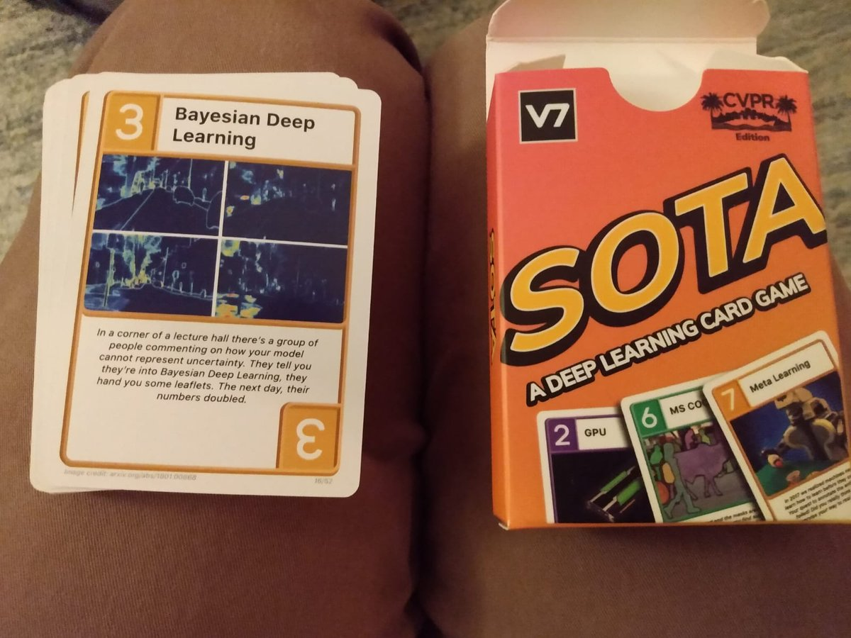
The SOTA Card Game
What makes a good game: clear rules, anybody can play
[v7labs.com]

Slide 24
The Story of Imagenet and AlexNet

Slide 25
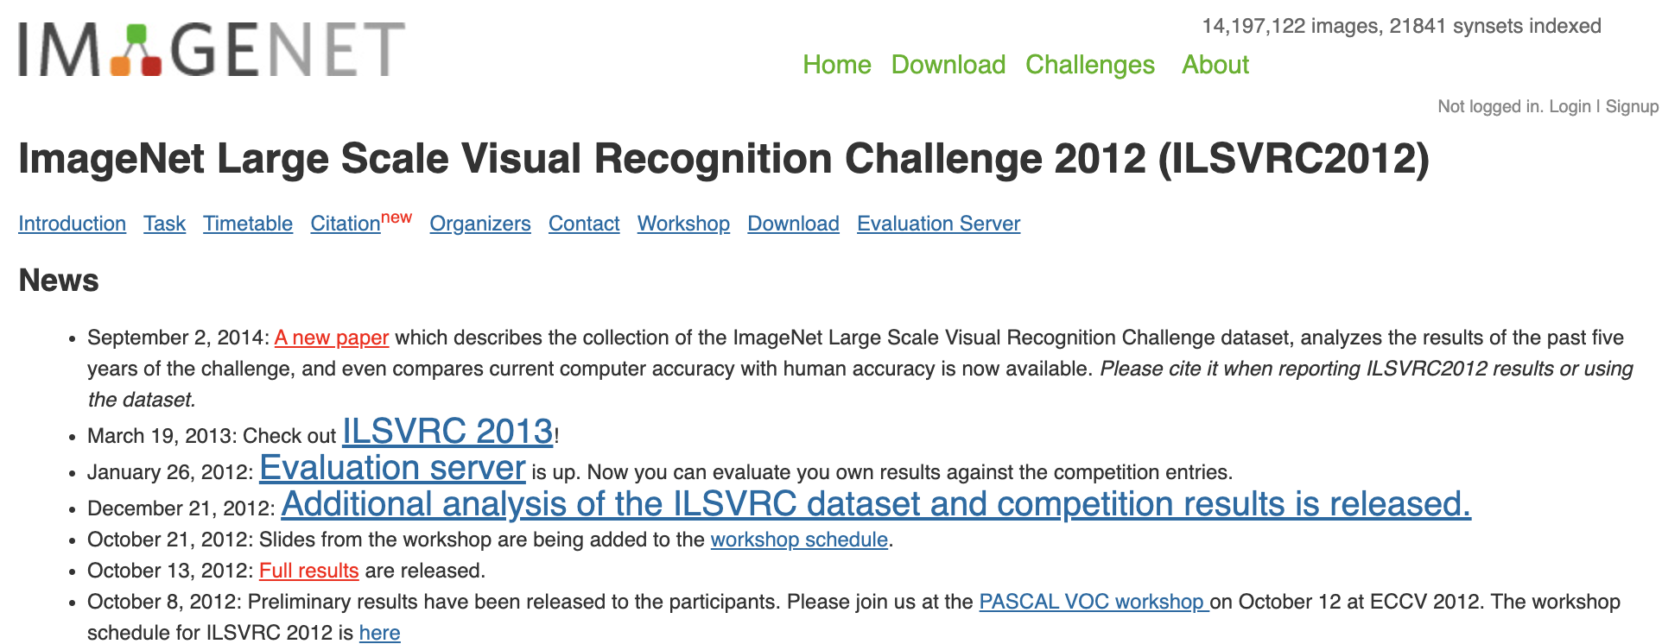
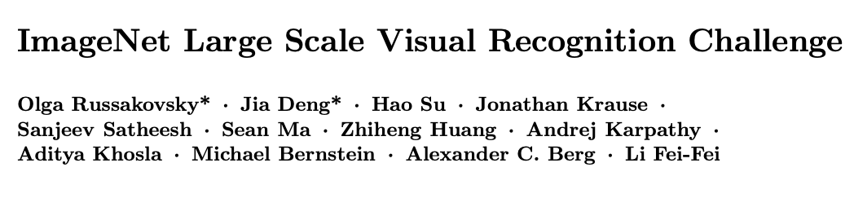

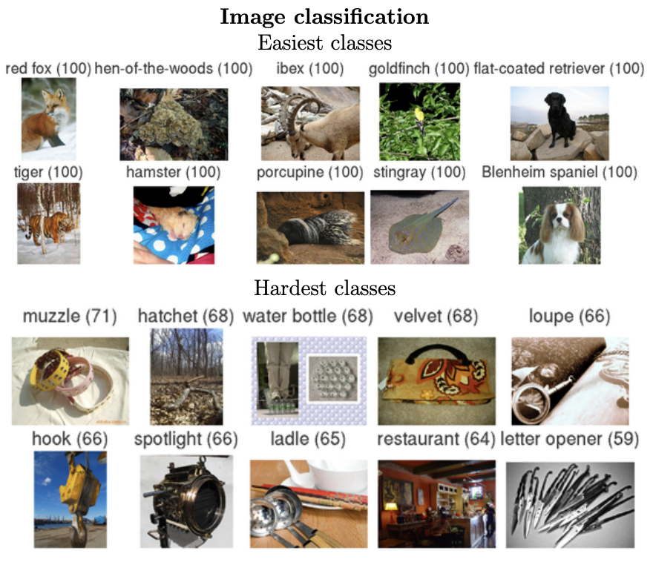
2010-2017:
Russovsky, Deng, etal:
Imagenet LSVR Challenge
Li Feifei and Olga Russovsky

Slide 26
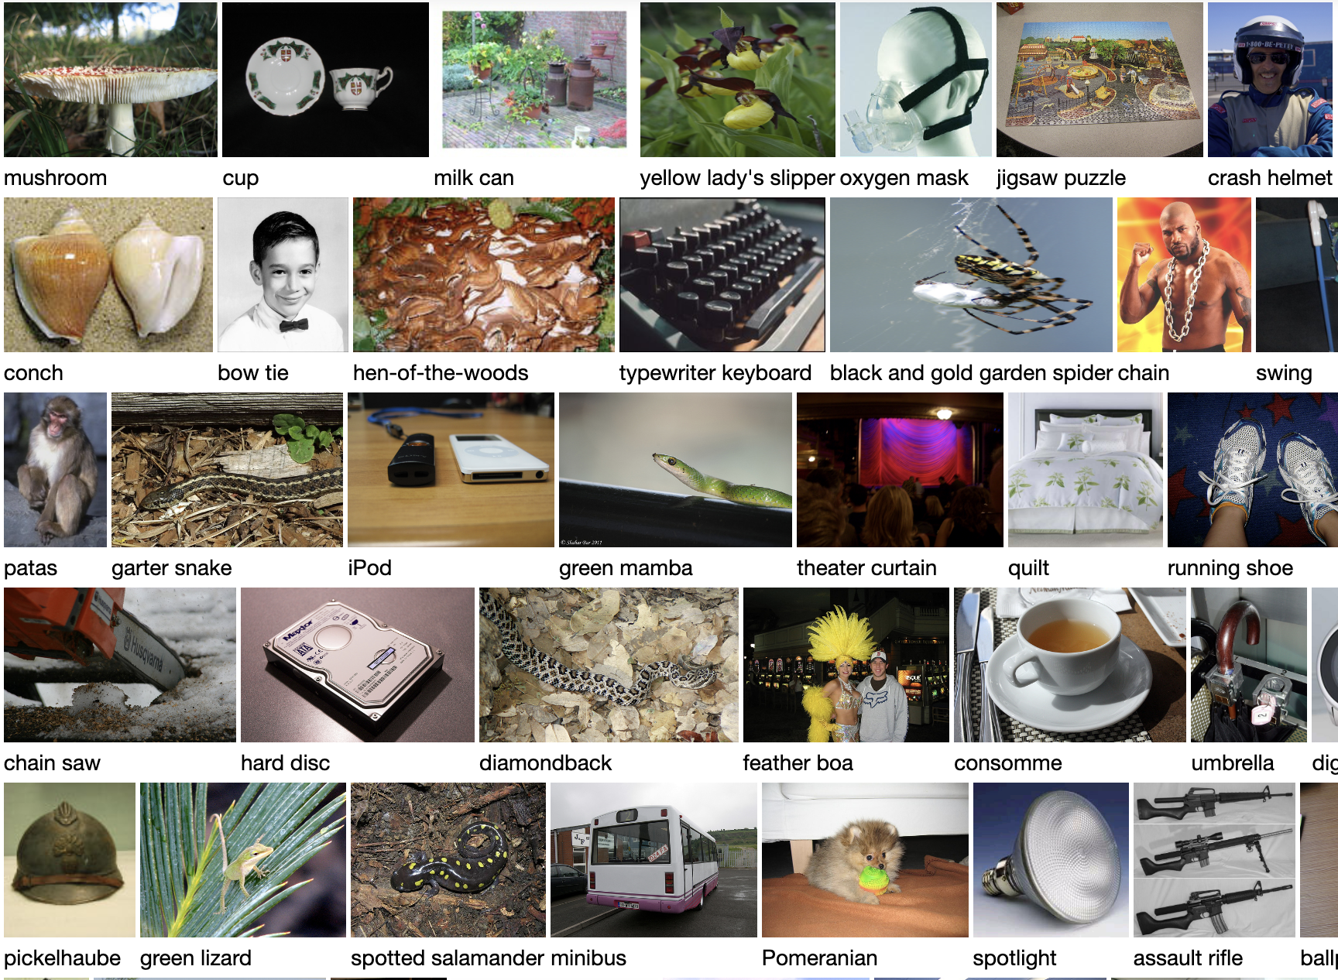
The structure of the ILSVR2012 contest task
Training data: 1.28 million images in 1000 classes
How do we measure genuine learning?
How can we tell if a computer has learned the actual difference between a “spotted salamander” and a “diamondback”?
Is it cheating to just store and memorize all 1.28 million cases?

Slide 27
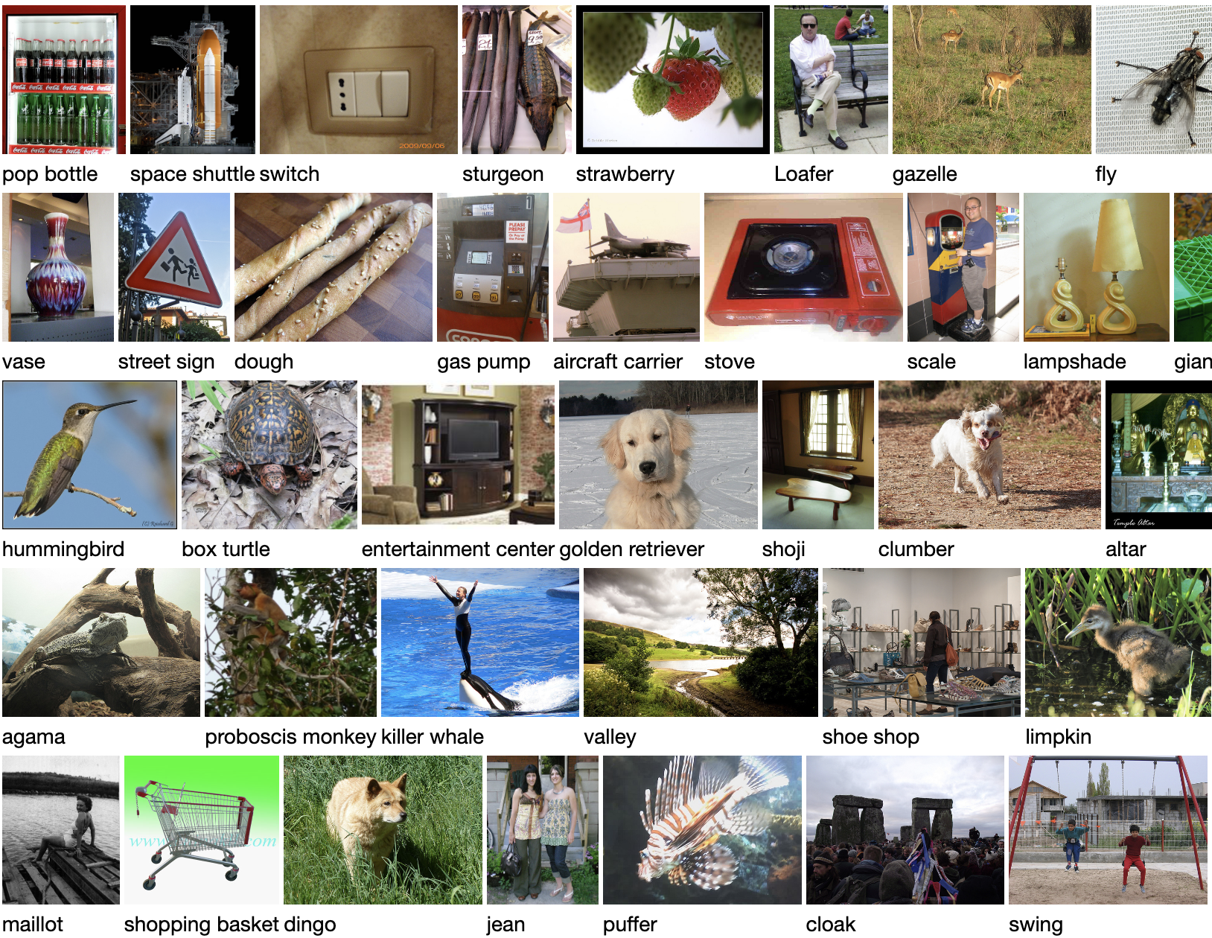
The key goal: Generalization
Training data: 1.28 million images in 1000 classes
How do we measure genuine learning?
Test data: 52,000 held out images

Slide 28
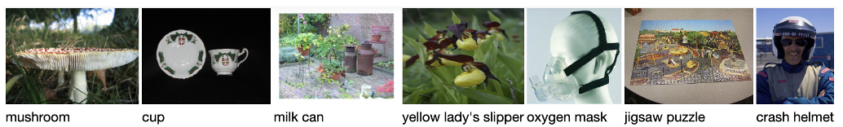
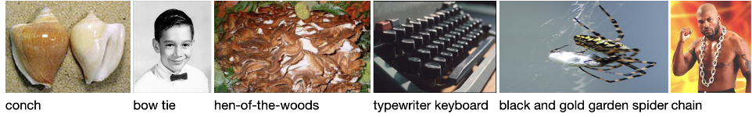
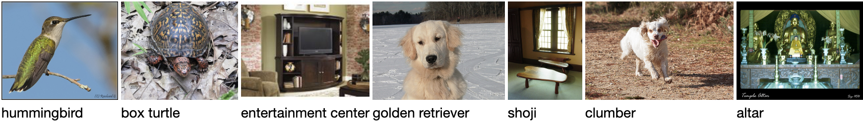
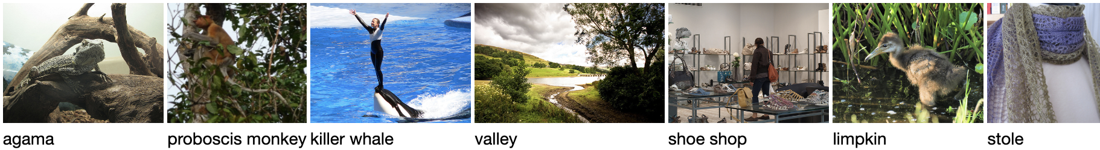
The rules of the classification game
The computer is allowed to learn from the training set.
Performance is tested on a held-out test set unseen during training.
In a formal contest, there are two test sets.
  A labeled validation set used by contestants to measure their algorithms
  A test set with labels that are never revealed to contestants.
[What is not tested by this contest?]

Slide 29
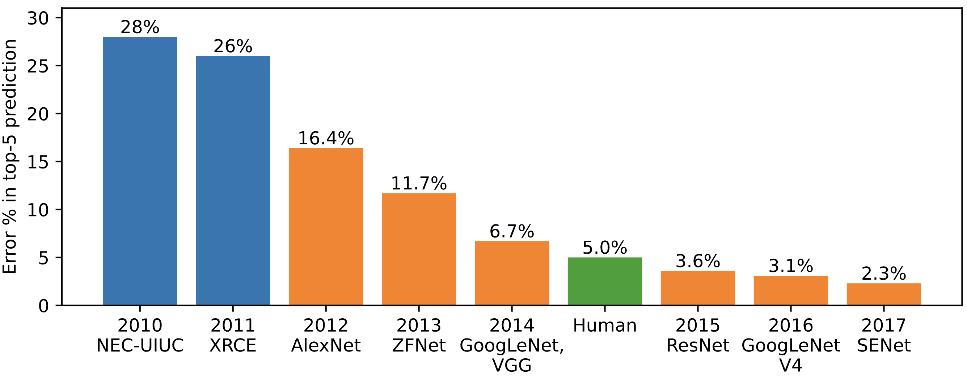
Imagenet Contest Results
ILSVRC was really hard.
Instead of measuring accuracy, they had to report “Top-5 accuracy”.
On 26% of test cases, the world’s best vision algorithms could not guess the right label even given five chances to try.
Traditional
computer vision

Slide 30
Imagenet Contest Results
ILSVRC was really hard.
Then in 2012, a shock.
Neural networks had been written off by the community. But Alex Krizhevsky’s network from Hinton’s lab made ILSVRC look like a much easier problem.
Shock
Shock
Traditional
computer vision

Slide 31
Imagenet Contest Results
Shock
Shock
Traditional
computer vision
That year, the whole field flipped to convolutional nets

Slide 32
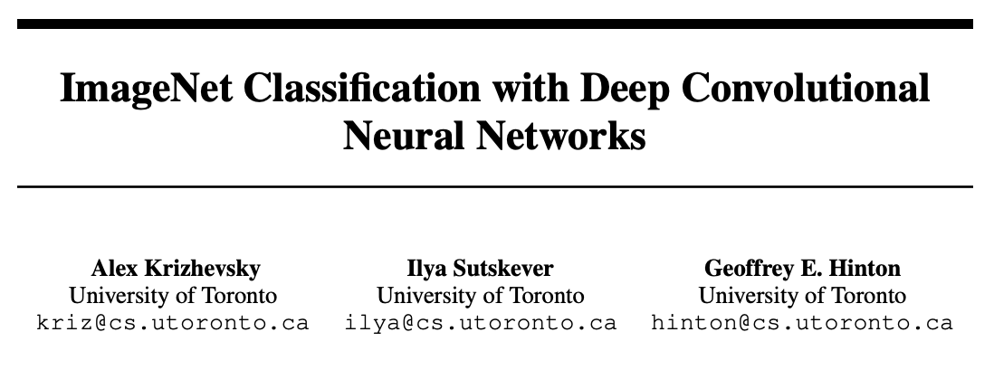
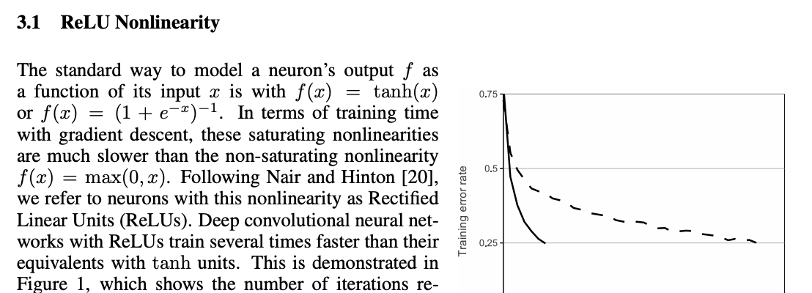
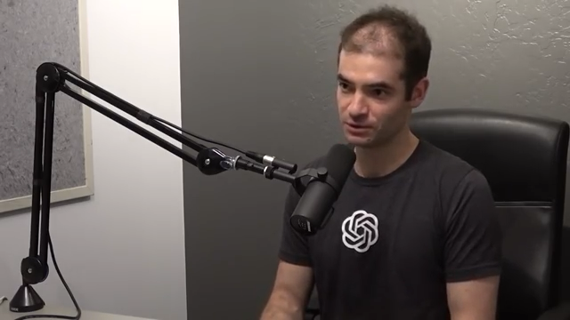
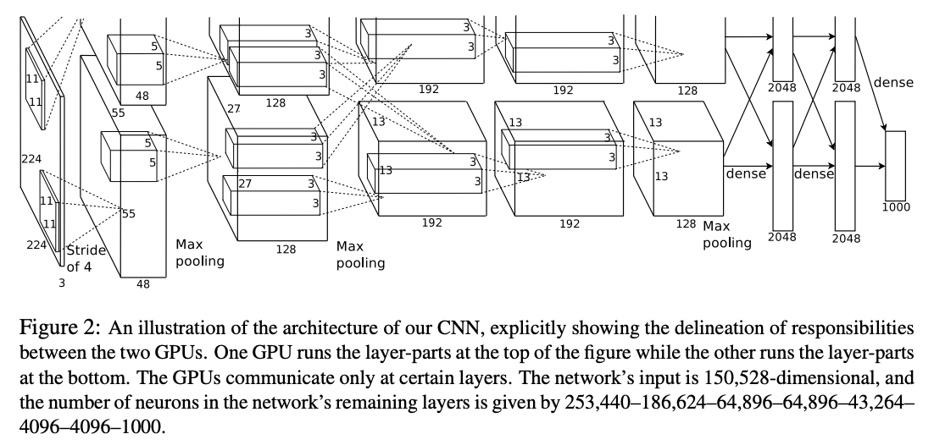
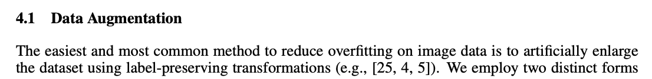
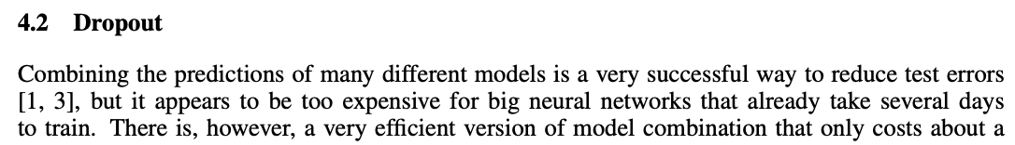
2012:
Krizhevsky Sutskever Hinton
Alexnet wins ILSVRC
Illya Sutskever

Slide 33
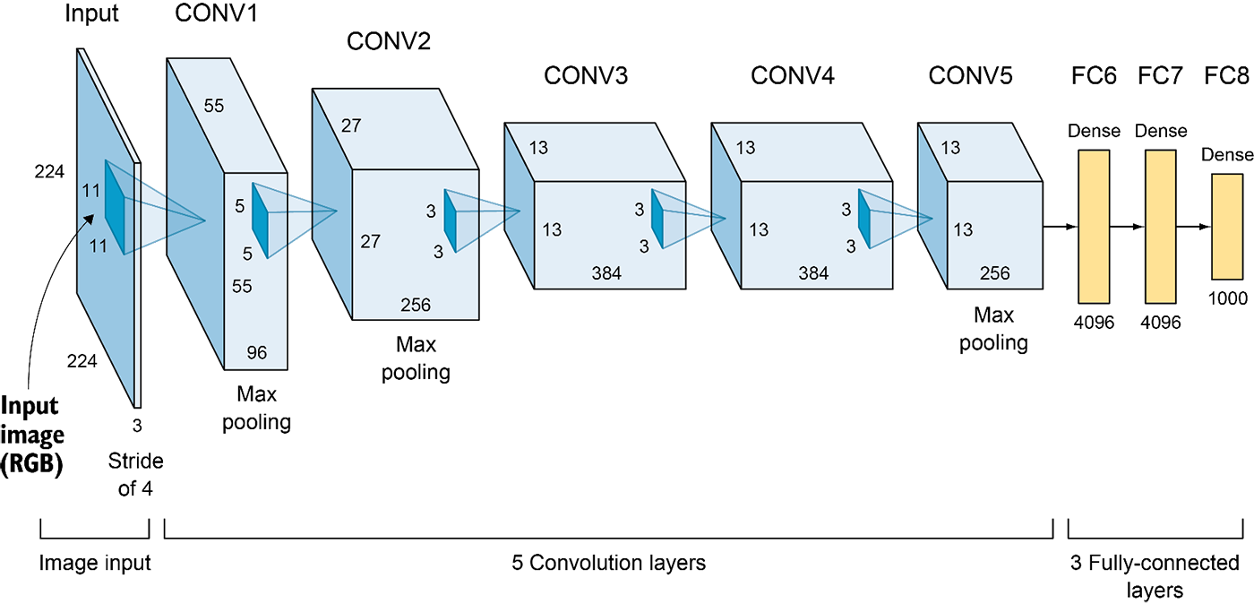
Alexnet architecture
(strided to 13x13)
(strided to 6x6)
(strided to 27x27)
Question: how many parameters in conv3?
3x3x256x384 = 884,736
How many parameters in fc6?
256x6x6x4096 = 37,748,376 (!!!!!!)

Slide 34
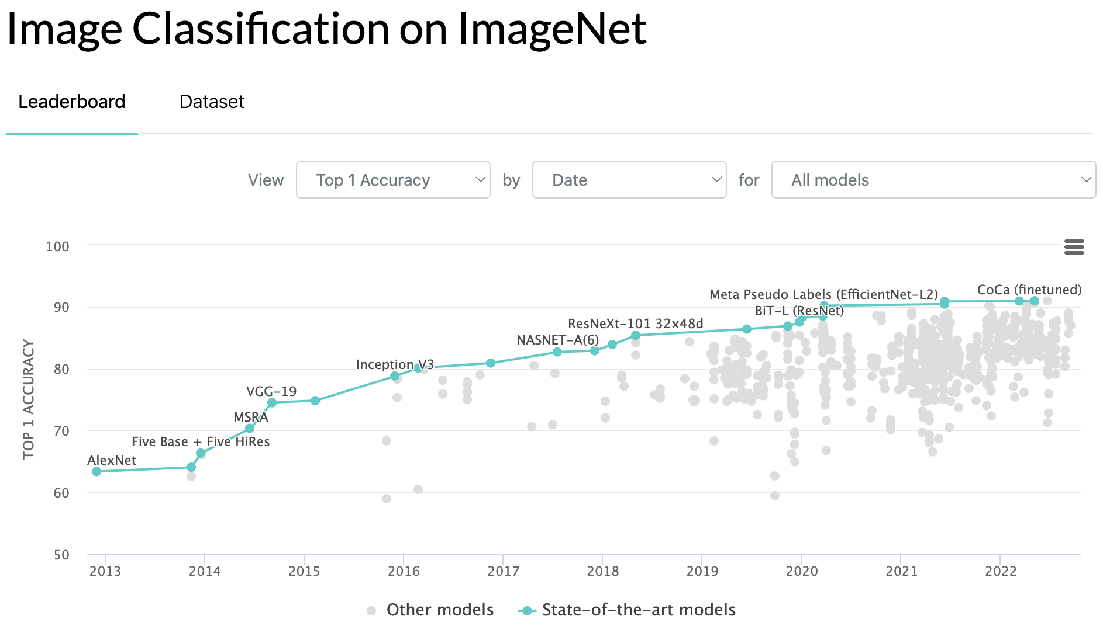
The SOTA Game
https://paperswithcode.com/sota/image-classification-on-imagenet

Slide 35
Seven spicy ingredients for SOTA
Symmetric data augmentation
  Make training data go farther by making random symmetry transforms.
Convolutions
  Use economical convolutions to guarantee equivariances.
Weight decay
  Improve generalization and simpler solutions by encouraging small parameters.
Dropout
  Train the network to be robust to missing features by randomly dropping neurons.
Batchnorm
  Improve the geometry of learning by normalizing internal signals.
Residual connections
  Distribute gradients quickly into deep layers by exploiting the addition operator.
ADAM optimizer
  Update weights by making faster updates when you can exploit a smooth gradient.

Slide 36
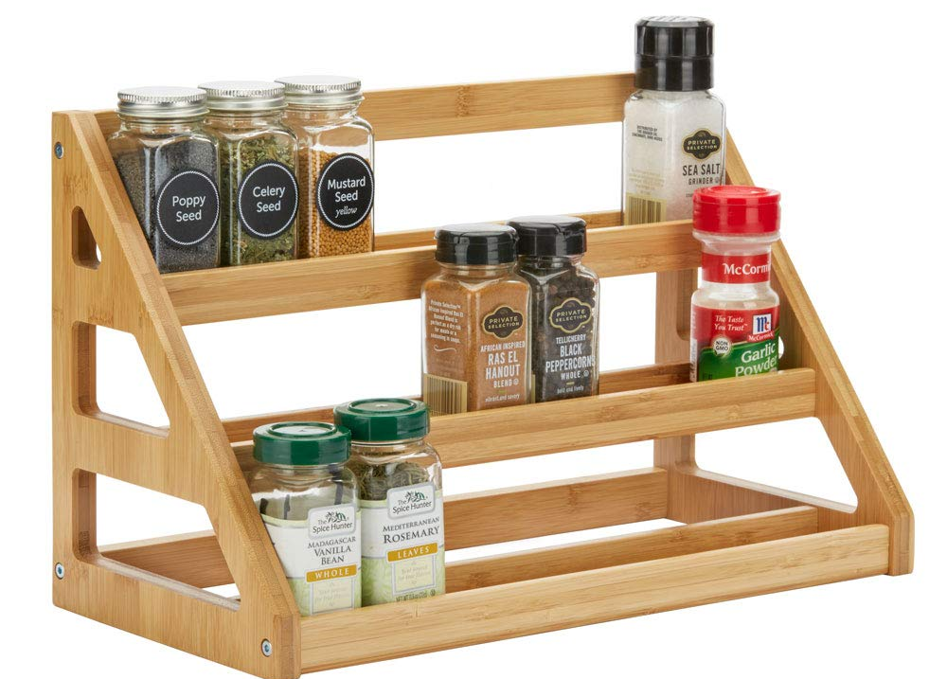
Resi
dual
Batch
norm
Convolution
Data
augmentation
ADAM
Weight
decay
Drop
out
SOTA spice rack

Slide 37
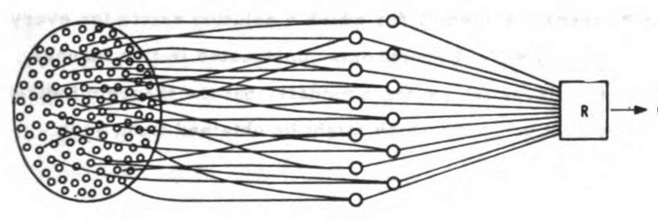
Balancing data and parameters for generalization
Small model
Huge training data
If the model is too small:
there will not enough computational capacity to learn the problem

Slide 38
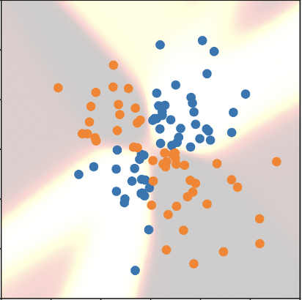
Balancing data and parameters for generalization
Huge training data
Massive deep net
If the model is too big:
it will overfit to the examples instead of learning generalizable rules

Slide 39
Balancing data and parameters for generalization
Huge training data
somehow
somehow
Massive deep net
So we must make big models smaller (exploiting symmetries)
and make huge data even bigger (exploiting symmetries)

Slide 40
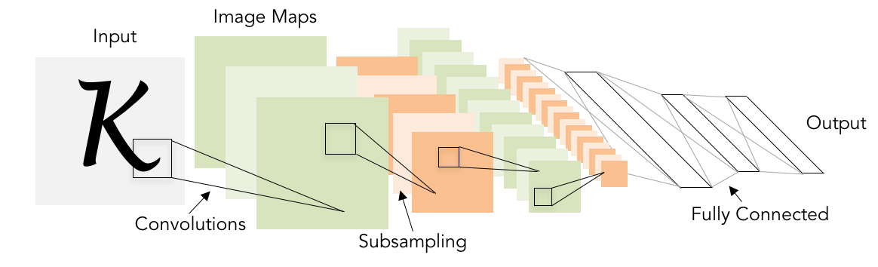
But we want to shrink the data!
Classic architecture:
[Conv, ReLU, Pool] x N, flatten, [FC, ReLU] x N, FC
Example: Yann LeCun’s LeNet-5
Lecun et al, “Gradient-based learning applied to document recognition”, 1998
Slide credit: D Fouhey & J Johnson

Slide 41
Receptive fields when composing convolutions
For convolution with kernel size K, each element in the output depends on a K x K receptive field in the input
Input
Output
Slide credit: D Fouhey & J Johnson

Slide 42
Receptive fields when composing convolutions
Each successive convolution adds K – 1 to the receptive field size
With L layers the receptive field size is 1 + L * (K – 1)
Input
Output
Careful – ”receptive field in the input”
vs “receptive field in the previous layer”
Hopefully clear from context!
Slide credit: D Fouhey & J Johnson

Slide 43
Receptive fields when composing convolutions
Each successive convolution adds K – 1 to the receptive field size
With L layers the receptive field size is 1 + L * (K – 1)
Input
Output
Problem: For large images we need many layers for each output to “see” the whole image image
Slide credit: D Fouhey & J Johnson

Slide 44
Receptive fields when composing convolutions
Each successive convolution adds K – 1 to the receptive field size
With L layers the receptive field size is 1 + L * (K – 1)
Input
Output
Problem: For large images we need many layers for each output to “see” the whole image image
Solution: Downsample inside the network
Slide credit: D Fouhey & J Johnson

Slide 45
Strided convolution
Input: 7x7
Filter: 3x3
Stride: 2
Slide credit: D Fouhey & J Johnson

Slide 46
Strided convolution
Input: 7x7
Filter: 3x3
Stride: 2
Slide credit: D Fouhey & J Johnson

Slide 47
Strided convolution
Input: 7x7
Filter: 3x3
Stride: 2
Output: 3x3
Slide credit: D Fouhey & J Johnson

Slide 48
Strided convolution
Input: 7x7
Filter: 3x3
Stride: 2
Output: 3x3
In general:
Input: W
Filter: K
Padding: P
Stride: S
Output: (W – K + 2P) / S + 1
Slide credit: D Fouhey & J Johnson

Slide 49

What do Conv Filters Learn?
Linear classifier:
One template per class
32
28
Conv
ReLU
W₁: 6x3x5x5
b₁: 6
32
28
3
6
Input:
N x 3 x 32 x 32
First hidden layer:
N x 6 x 28 x 28
Slide credit: D Fouhey & J Johnson

Slide 50
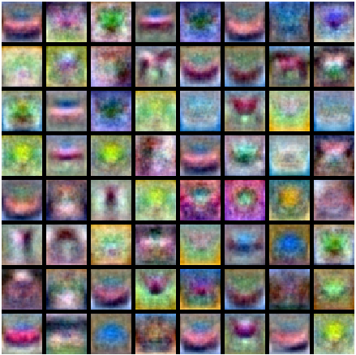
What do Conv Filters Learn?
MLP: Bank of whole-image templates
32
28
Conv
ReLU
W₁: 6x3x5x5
b₁: 6
32
28
3
6
Input:
N x 3 x 32 x 32
First hidden layer:
N x 6 x 28 x 28
Slide credit: D Fouhey & J Johnson

Slide 51
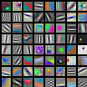
What do Conv Filters Learn?
First-layer conv filters: local image templates
(Often learns oriented edges, opposing colors)
32
28
Conv
ReLU
W₁: 6x3x5x5
b₁: 6
32
28
3
6
Input:
N x 3 x 32 x 32
First hidden layer:
N x 6 x 28 x 28
AlexNet: 64 filters, each 3x11x11
Slide credit: D Fouhey & J Johnson

Slide 52
Convolution data size example
Input volume: 3 x 32 x 32
10 5x5 filters with stride 1, pad 2
Output volume size: ?
Slide credit: D Fouhey & J Johnson

Slide 53
Convolution data size example
Input volume: 3 x 32 x 32
10 5x5 filters with stride 1, pad 2
Output volume size:
(32+2*2-5)/1+1 = 32 spatially, so
10 x 32 x 32
Slide credit: D Fouhey & J Johnson

Slide 54
Convolution data size example
Input volume: 3 x 32 x 32
10 5x5 filters with stride 1, pad 2
Output volume size: 10 x 32 x 32
Number of learnable parameters: ?
Slide credit: D Fouhey & J Johnson

Slide 55
Convolution data size example
Input volume: 3 x 32 x 32
10 5x5 filters with stride 1, pad 2
Output volume size: 10 x 32 x 32
Number of learnable parameters: 760
Parameters per filter: 3*5*5 + 1 (for bias) = 76
10 filters, so total is 10 * 76 = 760
Slide credit: D Fouhey & J Johnson

Slide 56
Convolution data size example
Input volume: 3 x 32 x 32
10 5x5 filters with stride 1, pad 2
Output volume size: 10 x 32 x 32
Number of learnable parameters: 760
Number of multiply-add operations: ?
Slide credit: D Fouhey & J Johnson

Slide 57
Convolution data size example
Input volume: 3 x 32 x 32
10 5x5 filters with stride 1, pad 2
Output volume size: 10 x 32 x 32
Number of learnable parameters: 760
Number of multiply-add operations: 768,000
10*32*32 = 10,240 outputs; each output is the inner product of two 3x5x5 tensors (75 elems); total = 75*10240 = 768K
Slide credit: D Fouhey & J Johnson

Slide 58
Interaction – try out AlexNet
https://bit.ly/vis-conv

Slide 59
What Does a Deep Convoluion See?
?
Sky?
Trees?
Grassy Field?
[VGG-16, Simonyan 2014]
Notes:
We want to KNOW. Is the network LOOKNIG for TREES?
Is it looking for GRASS?
There is an OLD CLASSIC idea from NEUROSCIENCE
that we will USE for INSPIRATION.
The IDEA is that EVERYTHING you PERCEIVE is
[click] DUE to the COMPUTATIONS of SOME neuron in your BRAIN.
[click, click]
So WHEN we ask, does NETWORK perceive TREES, we can START by asking,
[click]
is there a neuron for for the concept of TREES?

Slide 60

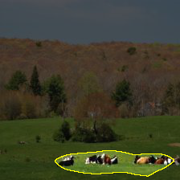
What Does Convolution 122 See?
Trace activation
of unit 122
Upsampled and
shown with input
Notes:
HERE is how we can LOOK for CONCEPT neurons
We PICK a NEURON, and we SEE how it ACTIVATAES when we SHOW it an IMAGE.
In a CONVOLUTIONAL network, we can see WHERE a neuron is active
THROUGHOOUT the image in a HEATMAP like THIS one..
The RED bar means that THIS unit FIRES ii the LOWER-RIGHT part of the IMAGE.
<>IT LOOKS like it is RESPPONDNIG to some COLORS in the GRASS.
Then we can TESST on MORE images.

Slide 61
What Does Convolution 122 See?
No activation
Trace activation
of unit 122
Notes:
The neruon DOESN’T reallyl activate on THIS image

Slide 62
What Does Convolution 122 See?
No activation
Trace activation
of unit 122
Notes:
OR on THIS imagee EITHER.
MOST neurons are slient MOST of the time..

Slide 63
What Does Convolution 122 See?
Notes:
But the neuron IS active on THIS image.
It’s a really DARK image, but it’s a picture of a HORSE.

Slide 64
What Does Convolution 122 See?
Trace activation
of unit 122
Upsampled and
shown with input
Notes:
The neuron ALSO activates HERE.
It ACTIVATES it in TWO areas.
NOTICE it SEEMs to be RESPONDING to where the HORSES are.
could THIS be a NEURON for detecting HORSES?

Slide 65
Broadly and Densely (BRODEN) Annotated Dataset
ADE20K
Zhou et al, CVPR’17
Pascal Context
Mottaghi et al, CVPR’14
Pascal Part
Chen et al, CVPR’14
Open-Surfaces
Bell et al, SIGGRAPH’14
Describable Textures
Cimpoi et al, CVPR’14
Colors
Total = 63,305 images
1,197 visual concepts
Notes:
To Quantify and SCALE up the SEARCH for CONCEPT neurons,
I ASSEMBLED a data set called BRODEN.
The idea of BRODEN is to have IMAGEs where we label a LOT of different visual CONCEPTS.
Both OBBJECTs like HORSES or or FLOWERS, or SCENES like STREET scenes.
Or PARTS like HEADBOARDs or WHEELS.
MATERIALS like WOOD and METAL.
Or TEXTURES like STRIPES and SWIRLS
We have LOTS of EXAMPLE images of EACH visual CONCEPT so we can SEE if neurons ACTIVATE on them.
In TOTAL, there are more than 60 THOUSAND images with more than one THOUSAND visual concepts labeled.

Slide 66
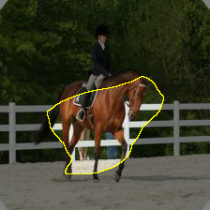
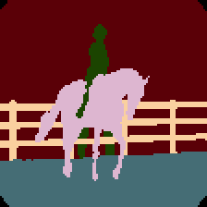
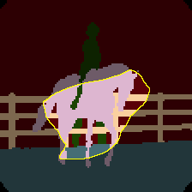
What Does Unit 122 See?
Trace activation
of unit 122
Agreement
person
tree
horse
fence
Human annotation
of visual concepts
Notes:
We can use this to QUANTIFY how well a neuron MATCHES horses,
<> Because in BRODEN we have labeled EXACTLY where the HORSES are.
<> So we can RUN the broden images
<> And just CHECK to see if the NEURON agrees with the ANNOTATIONs.
When we do this on ALL the images....

Slide 67
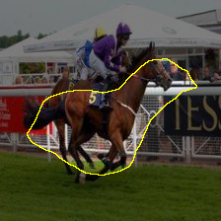
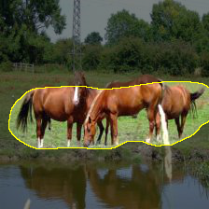
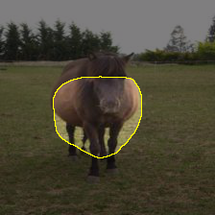
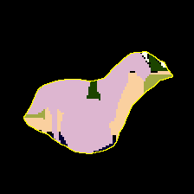
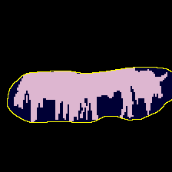

Quantifying the Sensitivity of Unit 122
Unit 122 matches Horse annotations with IoU: 0.11
racecourse
watering hole
pasture
farm
corral
Notes:
It GIVES us some DATA that we can use to SCORE the quality of the MATCH.
I use a RATIO called IoU. PERFECT is 1.0 so this neuron is NOT perfect.
But it is still PRETTY good. It LOCATES HORSES better than it matches ANY other CONCEPT.
The REASON this HORSE neuron is so INTERESTNIG, is We did NOT explicitly TEACH the network about HORSES.
<> AT the bottom you can see PLACE classes that the network WAS trained on.
You can SEE, the HORSE neuron fires on ALL of them.
The NEURON is NOT SELCTIVE for ANY ONE training CLASS.
What it *IS* selective for - is HORSES.

Slide 68
Single Units for Food, Cars
Unit 348 matches “Food” with IoU: 0.138.
Unit 248 matches “Car” with IoU: 0.092.
Notes:
And it is NOT the only UNIT that DETECTS something INTERESTING.
We have a unit for FOOD.
We have a unit for CARS.

Slide 69
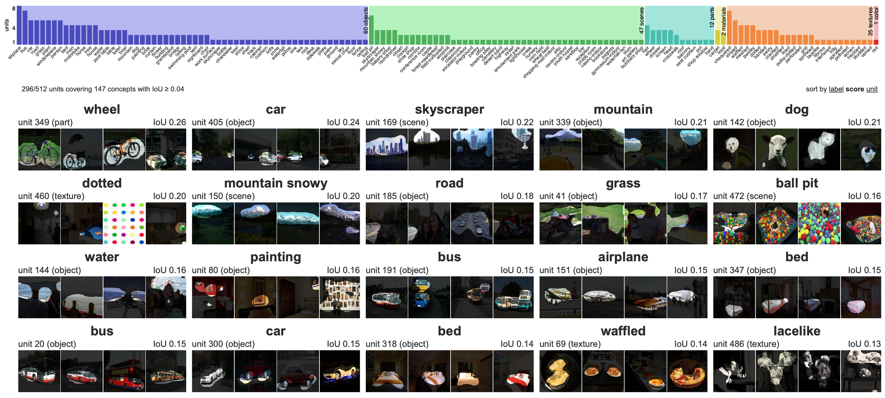
Dissection Report
Notes:
By testing ALL the neurons against ALL the concepts we can make a REPORT.
HERE is a report for ALL the neurons in a VGG classidier.
The FULL report scrolls DOWN and lists MORE than I can SHOW on the SLIDE.
There is ONE neuron per BLOCK.
So you see a WHEEL neuron, a CAR neuron, SKYSCRAPERs, DOGS, DOTS, MOUNTAINS, ETC.
At the TOP is a BAR graph summarizing ALL the neurons in the LAYER. Each COLUMN is one DETECTED concept,
and the HEIGHT of each bar is the NUMBER of neurons that match that CONCEPT.
IMMEDIATELY the report lets us ANSWER some QUESTIONS.
For EXAMPLE, is there JUST ONE neuron for each CONCEPT?
The answer is NO, LOTS of concepts have MULTPLE NEURONS.
For EXAMPLE, there are several AIRPLANE neurons.
There are several CAR neurons.

Slide 70
Hierarchy of
Detectors in Layers of a Classsifier
VGG-16 architecture
input image
object
part
material
color
convolution
pooling
unit 10 activation
(from layer conv5_3)
view one unit
fully connected layers
fc6, fc7, fc8
← matched visual concepts for all units →
“conference room”
scene prediction
conv5_3 summary
single units tested on scenes
unit 150 “airplane” (object)
unit 208 “person top” (part)
unit 141 “fur” (material)
Role of Individual Units [Bau et al., PNAS 2020]
Notes:
We can ALSO answer OTHER question about the network.
For EXAMPLE, WHAT concept are at WHICH layers?
HERE we see that CONCEPTS in the LAYERs of a network go from
SIMPLE to COMPLEX.
On EARLY layers we get COLOR and TEXTURE.
Then at LATE layers, more OBJECTS appear.

Slide 71
Convolution summary
Input: C_{in} x H x W
Hyperparameters:
Kernel size: K_{H} x K_{W}
Number filters: C_{out}
Padding: P
Stride: S
Weight matrix: C_{out} x C_{in} x K_{H} x K_{W} giving C_{out} filters of size C_{in} x K_{H} x K_{W}
Bias vector: C_{out}
Output size: C_{out} x H’ x W’ where:
H’ = (H – K + 2P) / S + 1
W’ = (W – K + 2P) / S + 1
Slide credit: D Fouhey & J Johnson

Slide 72
Convolution summary
Input: C_{in} x H x W
Hyperparameters:
Kernel size: K_{H} x K_{W}
Number filters: C_{out}
Padding: P
Stride: S
Weight matrix: C_{out} x C_{in} x K_{H} x K_{W} giving C_{out} filters of size C_{in} x K_{H} x K_{W}
Bias vector: C_{out}
Output size: C_{out} x H’ x W’ where:
H’ = (H – K + 2P) / S + 1
W’ = (W – K + 2P) / S + 1
Common settings:
K_{H} = K_{W} (Small square filters)
P = (K – 1) / 2 (”Same size” padding)
C_{in}, C_{out} = 32, 64, 128, 256 (powers of 2)
K = 3, P = 1, S = 1 (3x3 conv)
K = 1, P = 0, S = 1 (1x1 conv)
K = 3, P = 1, S = 2 (Downsample by 2)
Number of multiply-add operations:
C_{out} x C_{in} x K_{H} x K_{W} x H’ x W’
a lot of calculation!
Slide credit: D Fouhey & J Johnson

Slide 73
Understanding the symmetries of convolutions

Slide 74
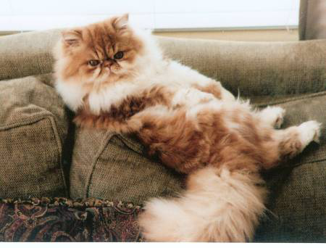


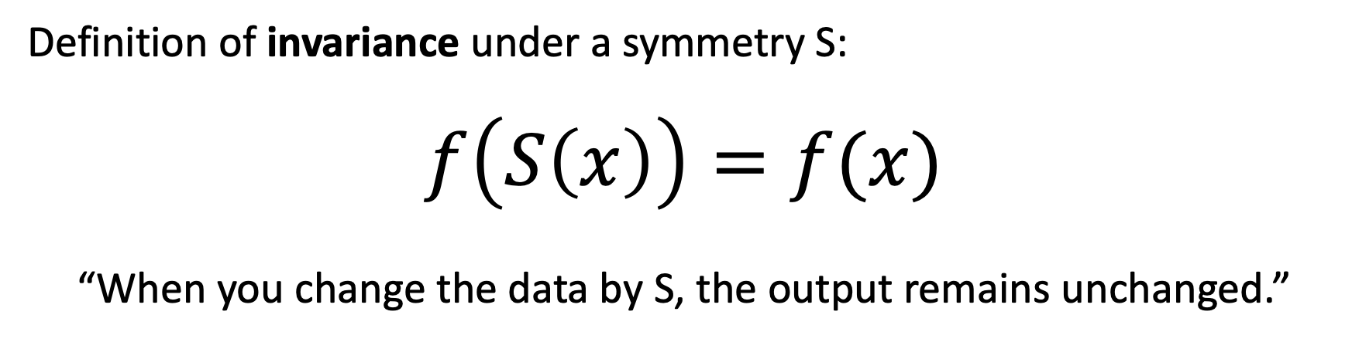
What is a symmetry $S(x)$?
Definition of invariance under a symmetry S:
$$f\left(S\left(x\right)\right)=f(x)$$
“When you change the data by S, the output remains unchanged.”
$f\left(x\right)=$“is x a photo of a Persian cat?”
$f\left(S(x)\right)=$ yes. $f\left(x\right)=$ yes too.
There are just
2 horizontal
reflection images
A “cat recognizer”
should treat the two
reflections the same

Slide 75
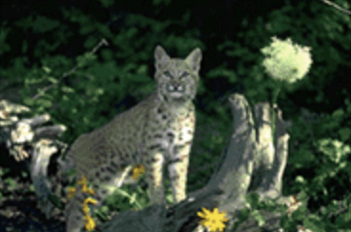
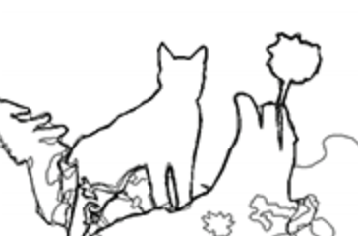

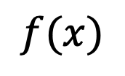

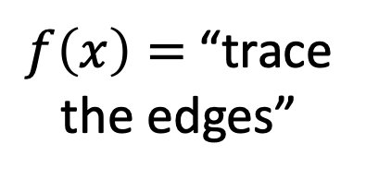
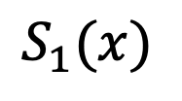



What if $f\left(x\right)$ outputs an image?
$$S_{1}$$
reflection
$$x$$
$$S_{1}(x)$$
$f\left(x\right)=$“trace
the edges”
$$f$$
$$f$$
We don’t want
the output to be
exactly the same...
$$f(x)$$
[Image from Xe and Tu 2015]

Slide 76

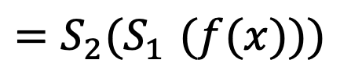

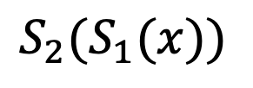
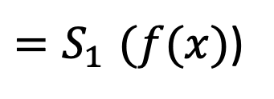

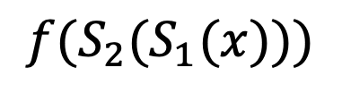

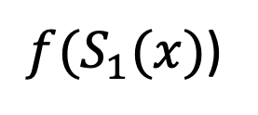
What if $f\left(x\right)$ outputs an image?
$$S_{1}$$
$$S_{2}$$
reflection
translation
$$x$$
$$S_{1}(x)$$
$${S_{2}(S}_{1}(x))$$
$f\left(x\right)=$“trace
the edges”
$$f$$
$$f$$
$$f$$
$$S_{1}$$
$$S_{2}$$
reflection
translation
$$f(x)$$
${f(S}_{1}(x)$)
$$f({S_{2}(S}_{1}(x)))$$
${=S}_{1}(f(x)$)
$${=S_{2}(S}_{1}(f(x)))$$
[Image from Xe and Tu 2015]

Slide 77


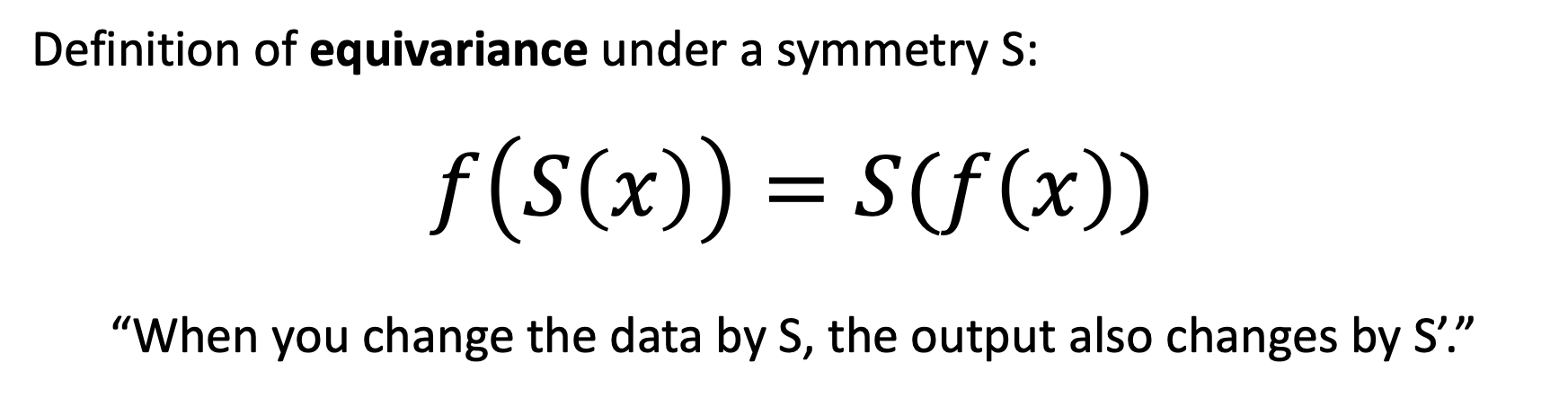

What operations will guarantee symmetry
Definition of equivariance under a symmetry S:
$$f\left(S\left(x\right)\right)=S(f\left(x\right))$$
“When you change the data by S, the output also changes by S’.”
$$S$$
translation
$$f$$
$$f$$
$$S$$
translation

Slide 78
Discussion: what equivariances does convolution have?
weighted sum
INPUT
OUTPUT

Slide 79
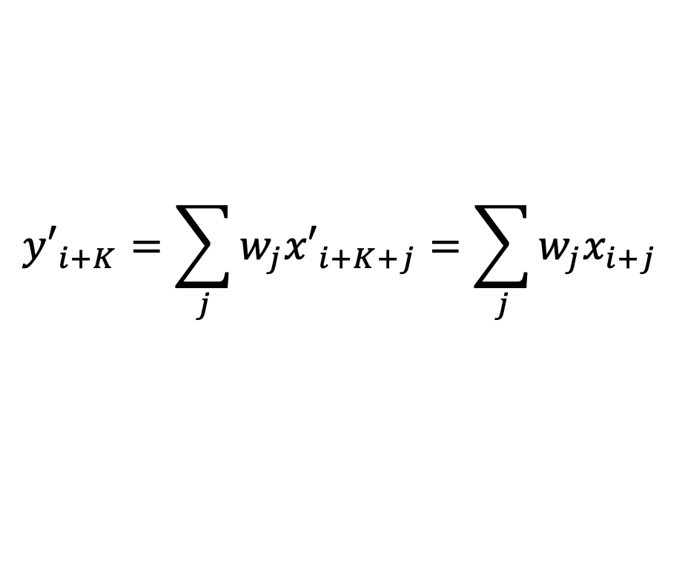







Reasoning about translation equivariance
$$x_{i−1}$$
$$x_{i}$$
$$x_{i+1}$$
0
0
0
0
0
0
1
2
1
0
1
1
0
0
0
0
0
0
0
0
weighted
sum
$$y_{i}=\sum_{j}{w_{j}x_{i+j}}$$
-0.5
+1.0
-0.5
0.0
0.0
0.0
0.0
0.0
-0.5
0.0
+1.0
0.0
-1.0
+0.5
+0.5
-0.5
0.0
0.0
0.0
0.0
0.0
0.0
0.0
$$y_{i}$$
$${y′}_{i+K}=\sum_{j}{w_{j}{x′}_{i+K+j}}=\sum_{j}{w_{j}x_{i+j}}$$
$${x′}_{i+K}=x_{i}$$
$${=y}_{i}={y′}_{i+K}$$
translate the input...
gives weighted sums of shifted data...
translates output!

Slide 80






“Max pooling” is also equivariant
$$x_{i−1}$$
$$x_{i}$$
$$x_{i+1}$$
0
0
0
0
0
0
1
2
1
0
1
1
0
0
0
0
0
0
0
0
max over
a window
$$y_{i}=\max_{−1≤j≤1}{x_{i}}$$
$$≤$$
$$≤$$
$$≤$$
0.0
0.0
0.0
0.0
0.0
+1.0
+2.0
+2.0
+2.0
+1.0
+1.0
+1.0
+1.0
0.0
0.0
0.0
0.0
0.0
0.0
0.0
$$y_{i}$$
$${x′}_{i+K}=x_{i}$$
$${y′}_{i+K}=\max_{−1≤j≤1}{{x′}_{i+K}}=\max_{−1≤j≤1}{x_{i}}$$
$${=y}_{i}={y′}_{i+K}$$
translate the input...
gives windowed max of shifted data...
translates output!

Slide 81

Caveat about translation equivariance
This argument assumes no edges...
[Ed Miracle, “I told you so”]

Slide 82
Convolution spatial dimensions
Input: 7x7
Filter: 3x3
Q: How big is output?
7
7
Slide credit: D Fouhey & J Johnson

Slide 83
Convolution spatial dimensions
Input: 7x7
Filter: 3x3
Q: How big is output?
7
7
Slide credit: D Fouhey & J Johnson

Slide 84
Convolution spatial dimensions
Input: 7x7
Filter: 3x3
Q: How big is output?
7
7
Slide credit: D Fouhey & J Johnson

Slide 85
Convolution spatial dimensions
Input: 7x7
Filter: 3x3
Q: How big is output?
7
7
Slide credit: D Fouhey & J Johnson

Slide 86
Convolution spatial dimensions
Input: 7x7
Filter: 3x3
Output: 5x5
7
7
Slide credit: D Fouhey & J Johnson

Slide 87
Convolution spatial dimensions
Input: 7x7
Filter: 3x3
Output: 5x5
Problem: Feature maps “shrink” with each layer!
In general:
Input: W
Filter: K
Output: W – K + 1
7
7
Slide credit: D Fouhey & J Johnson

Slide 88
Convolution spatial dimensions
Input: 7x7
Filter: 3x3
Output: 5x5
0 | 0 | 0 | 0 | 0 | 0 | 0 | 0 | 0
0 |  |  |  |  |  |  |  | 0
0 |  |  |  |  |  |  |  | 0
0 |  |  |  |  |  |  |  | 0
0 |  |  |  |  |  |  |  | 0
0 |  |  |  |  |  |  |  | 0
0 |  |  |  |  |  |  |  | 0
0 |  |  |  |  |  |  |  | 0
0 | 0 | 0 | 0 | 0 | 0 | 0 | 0 | 0
Problem: Feature maps “shrink” with each layer!
In general:
Input: W
Filter: K
Padding: P
Solution: padding
Add zeros around the input
Slide credit: D Fouhey & J Johnson

Slide 89
Convolution spatial dimensions
Input: 7x7
Filter: 3x3
Output: 5x5
0 | 0 | 0 | 0 | 0 | 0 | 0 | 0 | 0
0 |  |  |  |  |  |  |  | 0
0 |  |  |  |  |  |  |  | 0
0 |  |  |  |  |  |  |  | 0
0 |  |  |  |  |  |  |  | 0
0 |  |  |  |  |  |  |  | 0
0 |  |  |  |  |  |  |  | 0
0 |  |  |  |  |  |  |  | 0
0 | 0 | 0 | 0 | 0 | 0 | 0 | 0 | 0
In general:
Input: W
Filter: K
Padding: P
Output: W – K + 1 + 2P
Very common: “same padding”
Set P = (K – 1) / 2
Then output size = input size
Slide credit: D Fouhey & J Johnson

Slide 90

VGG architecture: “fully convolutional”
Giant
1x1 conv,
same as FC
Idea: 3x3 convolutions all the way down
More equivariance than a “flatten 13x13” layer at the end

Slide 91

Resnet architecture: super-deep convs
No more
FC layer!
Several tricks to make backprop effective at 100+ 3x3 layers

Slide 92
Balancing data and parameters for generalization
Huge training data
Data
augmentations
Lightweight convolutions
Massive deep net
Now we have made big models smaller (exploiting symmetries)
and made huge data even bigger (exploiting symmetries)

Slide 93



Weight decay
When parameters get too large, they learn a bumpy function
Classic solution from regression:
$$ℒ_{WD}=\sum_{i}{{\left\|w_{i}\right\|}^{2}}$$
$$ℒ_{total}={ℒ_{classification}+λℒ}_{WD}$$
Pushes weights toward zero.

Slide 94


More tricks for generalization
Huge training data
Data
augmentations
Weight decay
Lightweight convolutions
Dropout
Massive deep net
Simulate data that is even more diverse
using dropout (feature randomization)

Slide 95

Regularization: Dropout
“randomly set some neurons to zero in the forward pass”
Randomly set the output value of some neurons to be 0
[Srivastava et al., 2014]
Slide credit: E. Learned-Miller, originally developed by Andrej Karpathy, Justin Johnson, Fei-Fei Li

Slide 96

Waaaait a second…
How could this possibly be a good idea?
Slide credit: E. Learned-Miller, originally developed by Andrej Karpathy, Justin Johnson, Fei-Fei Li

Slide 97
Waaaait a second…
How could this possibly be a good idea?
Forces the network to have a redundant representation.
has an ear
X
has a tail
is furry
X
cat
score
has claws
X
mischievous
look
Slide credit: E. Learned-Miller, originally developed by Andrej Karpathy, Justin Johnson, Fei-Fei Li

Slide 98









Training with occlusions?
Slide credit: E. Learned-Miller, originally developed by Andrej Karpathy, Justin Johnson, Fei-Fei Li

Slide 99
Waaaait a second…
How could this possibly be a good idea?
Another interpretation:
Dropout is training a large ensemble of models (that share parameters).
Each binary mask is one model, gets trained on only ~one datapoint.
Slide credit: E. Learned-Miller, originally developed by Andrej Karpathy, Justin Johnson, Fei-Fei Li

Slide 100
Dropout: Test Time
Can in fact do this with a single forward pass! (approximately)
Leave all input neurons turned on (no dropout).
Q: Suppose that with all inputs present at test time the output of this neuron is a.
What would its output be during training time, in expectation? (e.g. if p = 0.5)
Slide credit: E. Learned-Miller, originally developed by Andrej Karpathy, Justin Johnson, Fei-Fei Li

Slide 101
Dropout: Test Time
Can in fact do this with a single forward pass! (approximately)
Leave all input neurons turned on (no dropout).
during test: a = w₀*x + w₁*y
during train:
E[a] = ¼ * (w₀*0 + w₁*0 +
w₀*0 + w₁*y +
w₀*x + w₁*0 +
w₀*x + w₁*y)
= ¼ * (2 w₀*x + 2 w₁*y)
= ½ * (w₀*x + w₁*y)
a
w0
w1
x
y
Slide credit: E. Learned-Miller, originally developed by Andrej Karpathy, Justin Johnson, Fei-Fei Li

Slide 102
At test time….
Can in fact do this with a single forward pass! (approximately)
Leave all input neurons turned on (no dropout).
during test: a = w₀*x + w₁*y
during train:
E[a] = ¼ * (w₀*0 + w₁*0 +
w₀*0 + w₁*y +
w₀*x + w₁*0 +
w₀*x + w₁*y)
= ¼ * (2 w₀*x + 2 w₁*y)
= ½ * (w₀*x + w₁*y)
With p=0.5, using all inputs in the forward pass would inflate the activations by 2x from what the network was “used to” during training!
=> Have to compensate by scaling the activations back down by ½
a
w1
w0
x
y
Slide credit: E. Learned-Miller, originally developed by Andrej Karpathy, Justin Johnson, Fei-Fei Li

Slide 103
✓
Resi
dual
Batch
norm
Convolution
✓
Data
augmentation
ADAM
✓
✓
Weight
decay
Drop
out
SOTA spice rack

