Slide 1

DS 4440
Deep Learning

Slide 2
Concepts to Know So Far
McCoullough-Pitts neuron model (weighted sum then nonlinearity)
Binary logic neural networks
Universal computations (two+ layers and nonlinearities are needed)
Gradient descent
Modular machine learning: Pytorch tensors, autograd, and modules
Losses: what makes a good/bad loss; MSE, L1, and cross-entropy loss
The backpropagation algorithm: computational graphs, backward pass, upstream/internal/downstream gradients, accumulation
First-order optimization: gradient descent, SGD, Momentum, ADAM
Conditioning gradients: nonlinearities, initialization, whitening
Symmetries: data augmentation, invariances
Convolutions: 1d, 2d convolutional kernels, receptive field, striding
SOTA Image Classification: CNNs, Pooling, AlexNet

Slide 3
Today
What a deep convnet neuron “sees”
Batchnorm
Resnet
Dropout
Notebook: Debugging use of CNNs in practice
Maybe: Equivariance

Slide 4
What Does a Deep Convoluion See?
?
Sky?
Trees?
Grassy Field?
[VGG-16, Simonyan 2014]
Notes:
We want to KNOW. Is the network LOOKNIG for TREES?
Is it looking for GRASS?
There is an OLD CLASSIC idea from NEUROSCIENCE
that we will USE for INSPIRATION.
The IDEA is that EVERYTHING you PERCEIVE is
[click] DUE to the COMPUTATIONS of SOME neuron in your BRAIN.
[click, click]
So WHEN we ask, does NETWORK perceive TREES, we can START by asking,
[click]
is there a neuron for for the concept of TREES?

Slide 5

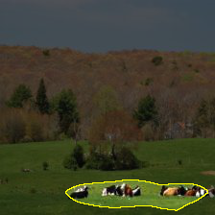
What Does Convolution 122 See?
Trace activation
of unit 122
Upsampled and
shown with input
Notes:
HERE is how we can LOOK for CONCEPT neurons
We PICK a NEURON, and we SEE how it ACTIVATAES when we SHOW it an IMAGE.
In a CONVOLUTIONAL network, we can see WHERE a neuron is active
THROUGHOOUT the image in a HEATMAP like THIS one..
The RED bar means that THIS unit FIRES ii the LOWER-RIGHT part of the IMAGE.
<>IT LOOKS like it is RESPPONDNIG to some COLORS in the GRASS.
Then we can TESST on MORE images.

Slide 6
What Does Convolution 122 See?
No activation
Trace activation
of unit 122
Notes:
The neruon DOESN’T reallyl activate on THIS image

Slide 7
What Does Convolution 122 See?
No activation
Trace activation
of unit 122
Notes:
OR on THIS imagee EITHER.
MOST neurons are slient MOST of the time..

Slide 8
What Does Convolution 122 See?
Notes:
But the neuron IS active on THIS image.
It’s a really DARK image, but it’s a picture of a HORSE.

Slide 9
What Does Convolution 122 See?
Trace activation
of unit 122
Upsampled and
shown with input
Notes:
The neuron ALSO activates HERE.
It ACTIVATES it in TWO areas.
NOTICE it SEEMs to be RESPONDING to where the HORSES are.
could THIS be a NEURON for detecting HORSES?

Slide 10
Broadly and Densely (BRODEN) Annotated Dataset
ADE20K
Zhou et al, CVPR’17
Pascal Context
Mottaghi et al, CVPR’14
Pascal Part
Chen et al, CVPR’14
Open-Surfaces
Bell et al, SIGGRAPH’14
Describable Textures
Cimpoi et al, CVPR’14
Colors
Total = 63,305 images
1,197 visual concepts
Notes:
To Quantify and SCALE up the SEARCH for CONCEPT neurons,
I ASSEMBLED a data set called BRODEN.
The idea of BRODEN is to have IMAGEs where we label a LOT of different visual CONCEPTS.
Both OBBJECTs like HORSES or or FLOWERS, or SCENES like STREET scenes.
Or PARTS like HEADBOARDs or WHEELS.
MATERIALS like WOOD and METAL.
Or TEXTURES like STRIPES and SWIRLS
We have LOTS of EXAMPLE images of EACH visual CONCEPT so we can SEE if neurons ACTIVATE on them.
In TOTAL, there are more than 60 THOUSAND images with more than one THOUSAND visual concepts labeled.

Slide 11
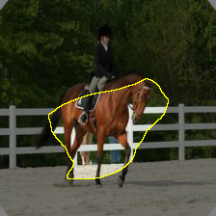
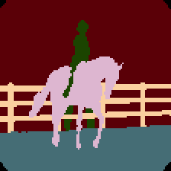
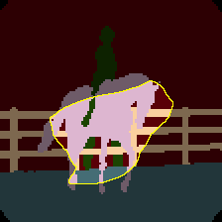
What Does Unit 122 See?
Trace activation
of unit 122
Agreement
person
tree
horse
fence
Human annotation
of visual concepts
Notes:
We can use this to QUANTIFY how well a neuron MATCHES horses,
<> Because in BRODEN we have labeled EXACTLY where the HORSES are.
<> So we can RUN the broden images
<> And just CHECK to see if the NEURON agrees with the ANNOTATIONs.
When we do this on ALL the images....

Slide 12
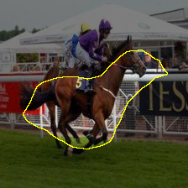
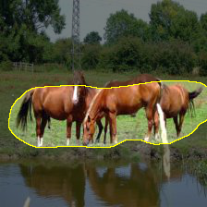
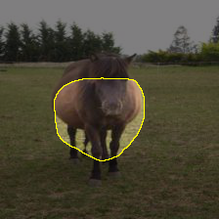
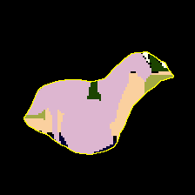
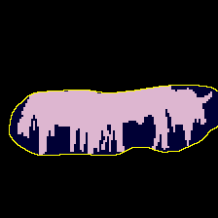

Quantifying the Sensitivity of Unit 122
Unit 122 matches Horse annotations with IoU: 0.11
racecourse
watering hole
pasture
farm
corral
Notes:
It GIVES us some DATA that we can use to SCORE the quality of the MATCH.
I use a RATIO called IoU. PERFECT is 1.0 so this neuron is NOT perfect.
But it is still PRETTY good. It LOCATES HORSES better than it matches ANY other CONCEPT.
The REASON this HORSE neuron is so INTERESTNIG, is We did NOT explicitly TEACH the network about HORSES.
<> AT the bottom you can see PLACE classes that the network WAS trained on.
You can SEE, the HORSE neuron fires on ALL of them.
The NEURON is NOT SELCTIVE for ANY ONE training CLASS.
What it *IS* selective for - is HORSES.

Slide 13
Single Units for Food, Cars
Unit 348 matches “Food” with IoU: 0.138.
Unit 248 matches “Car” with IoU: 0.092.
Notes:
And it is NOT the only UNIT that DETECTS something INTERESTING.
We have a unit for FOOD.
We have a unit for CARS.

Slide 14
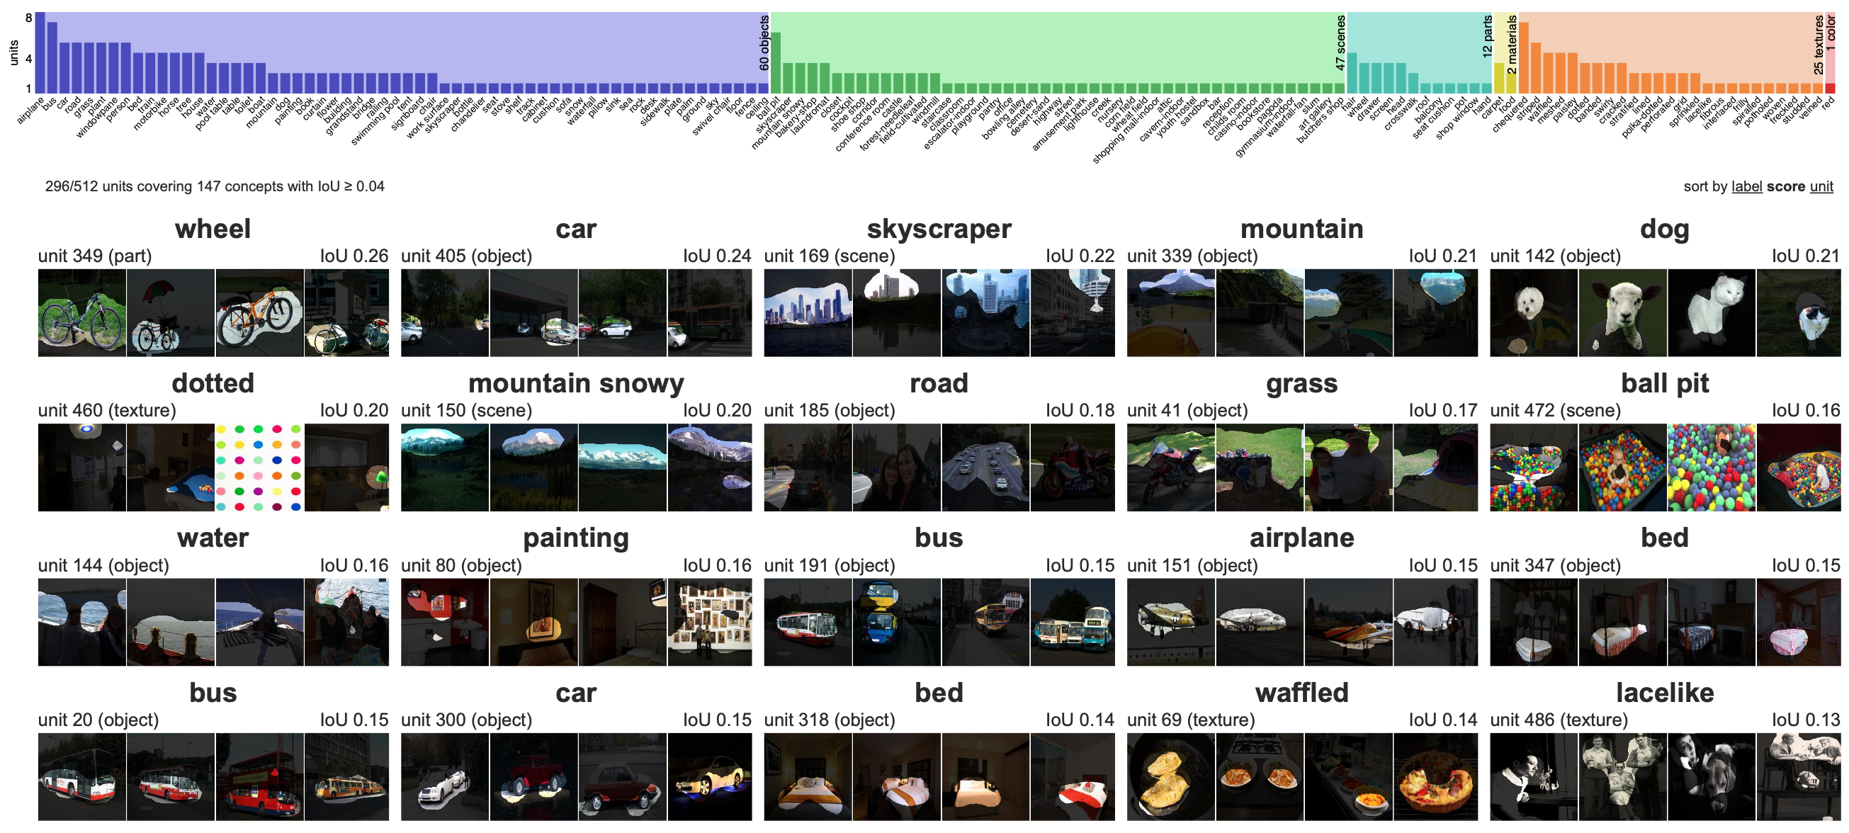
Dissection Report
Notes:
By testing ALL the neurons against ALL the concepts we can make a REPORT.
HERE is a report for ALL the neurons in a VGG classidier.
The FULL report scrolls DOWN and lists MORE than I can SHOW on the SLIDE.
There is ONE neuron per BLOCK.
So you see a WHEEL neuron, a CAR neuron, SKYSCRAPERs, DOGS, DOTS, MOUNTAINS, ETC.
At the TOP is a BAR graph summarizing ALL the neurons in the LAYER. Each COLUMN is one DETECTED concept,
and the HEIGHT of each bar is the NUMBER of neurons that match that CONCEPT.
IMMEDIATELY the report lets us ANSWER some QUESTIONS.
For EXAMPLE, is there JUST ONE neuron for each CONCEPT?
The answer is NO, LOTS of concepts have MULTPLE NEURONS.
For EXAMPLE, there are several AIRPLANE neurons.
There are several CAR neurons.

Slide 15
Hierarchy of
Detectors in Layers of a Classsifier
VGG-16 architecture
input image
object
part
material
color
convolution
pooling
unit 10 activation
(from layer conv5_3)
view one unit
fully connected layers
fc6, fc7, fc8
← matched visual concepts for all units →
“conference room”
scene prediction
conv5_3 summary
single units tested on scenes
unit 150 “airplane” (object)
unit 208 “person top” (part)
unit 141 “fur” (material)
Role of Individual Units [Bau et al., PNAS 2020]
Notes:
We can ALSO answer OTHER question about the network.
For EXAMPLE, WHAT concept are at WHICH layers?
HERE we see that CONCEPTS in the LAYERs of a network go from
SIMPLE to COMPLEX.
On EARLY layers we get COLOR and TEXTURE.
Then at LATE layers, more OBJECTS appear.

Slide 16
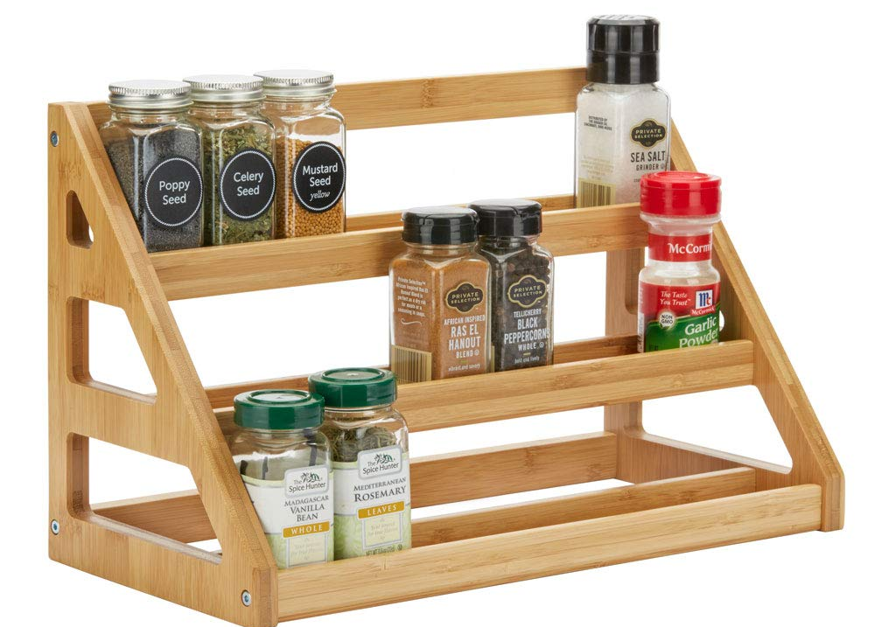
✓
Resi
dual
Batch
norm
Convolution
✓
Data
augmentation
ADAM
✓
✓
Weight
decay
Drop
out
SOTA spice rack

Slide 17
ImageNet Classification Challenge
152 Layer
19 Layer
22 Layer
8 Layer
8 Layer
Shallow
Lin et al
Sanchez & Perronnin
Krizhevsky et al (AlexNet)
Zeiler & Fergus
Simonyan & Zisserman (VGG)
Szegedy et al (GoogLeNet)
He et al (ResNet)
Shao et al
Hu et al
(SENet)
Slide credit: D Fouhey & J Johnson

Slide 18
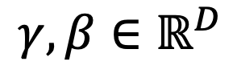


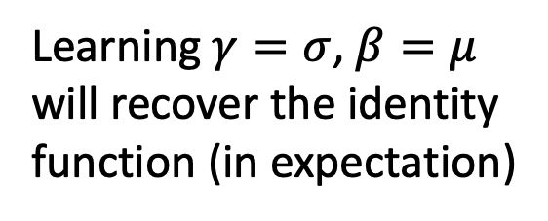

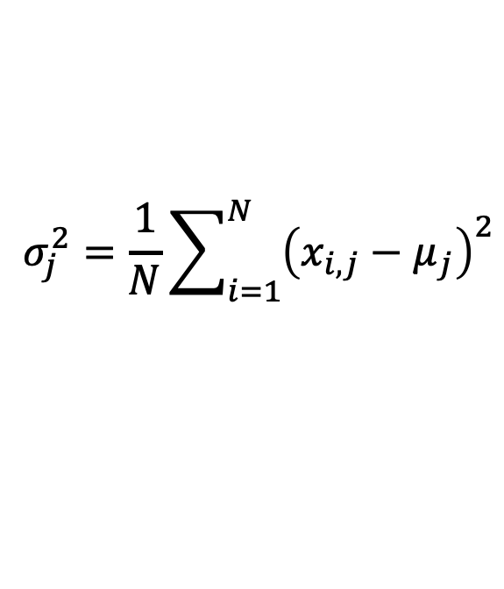
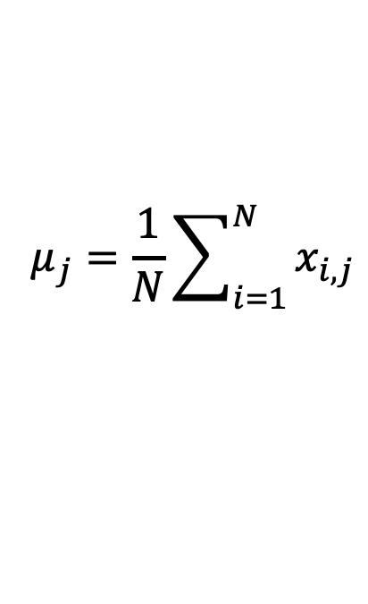
Batch Normalization
Problem: Estimates depend on minibatch; can’t do this at test-time!
Input:
$$μ_{j}=\frac{1}{N}\sum_{i=1}^{N}{x_{i,j}}$$
Per-channel mean, shape is D
$$x∈ℝ^{N×D}$$
Learnable scale and shift parameters:
$$σ_{j}^{2}=\frac{1}{N}\sum_{i=1}^{N}{{\left(x_{i,j}−μ_{j}\right)}^{2}}$$
Per-channel std, shape is D
$$γ,β∈ℝ^{D}$$
$${\hat{x}}_{i,j}=\frac{x_{i,j}−μ_{j}}{\sqrt{σ_{j}^{2}+ε}}$$
Normalized x,
Shape is N x D
Learning $γ=σ$, $β=μ$
will recover the identity function (in expectation)
$$y_{i,j}=γ_{j}{\hat{x}}_{i,j}+β_{j}$$
Output,
Shape is N x D
Slide credit: D Fouhey & J Johnson

Slide 19
Batch Normalization: Test-Time
(Running) average of
values seen during training
Input:
$$μ_{j}=\frac{1}{N}\sum_{i=1}^{N}{x_{i,j}}$$
Per-channel mean, shape is D
$$x∈ℝ^{N×D}$$
Learnable scale and shift parameters:
(Running) average of
values seen during training
$$σ_{j}^{2}=\frac{1}{N}\sum_{i=1}^{N}{{\left(x_{i,j}−μ_{j}\right)}^{2}}$$
Per-channel std, shape is D
$$γ,β∈ℝ^{D}$$
$${\hat{x}}_{i,j}=\frac{x_{i,j}−μ_{j}}{\sqrt{σ_{j}^{2}+ε}}$$
Normalized x,
Shape is N x D
Learning $γ=σ$, $β=μ$
will recover the identity function (in expectation)
$$y_{i,j}=γ_{j}{\hat{x}}_{i,j}+β_{j}$$
Output,
Shape is N x D
Slide credit: D Fouhey & J Johnson

Slide 20
Batch Normalization: Test-Time
(Running) average of
values seen during training
Input:
$$μ_{j}=\frac{1}{N}\sum_{i=1}^{N}{x_{i,j}}$$
Per-channel mean, shape is D
$$x∈ℝ^{N×D}$$
Learnable scale and shift parameters:
(Running) average of
values seen during training
$$σ_{j}^{2}=\frac{1}{N}\sum_{i=1}^{N}{{\left(x_{i,j}−μ_{j}\right)}^{2}}$$
Per-channel std, shape is D
$$γ,β∈ℝ^{D}$$
$${\hat{x}}_{i,j}=\frac{x_{i,j}−μ_{j}}{\sqrt{σ_{j}^{2}+ε}}$$
Normalized x,
Shape is N x D
During testing batchnorm becomes a linear operator!
Can be fused with the previous fully-connected or conv layer
$$y_{i,j}=γ_{j}{\hat{x}}_{i,j}+β_{j}$$
Output,
Shape is N x D
Slide credit: D Fouhey & J Johnson

Slide 21
Residual Networks
Once we have Batch Normalization, we can train networks with 10+ layers. What happens as we go deeper?
He et al, “Deep Residual Learning for Image Recognition”, CVPR 2016
Slide credit: D Fouhey & J Johnson

Slide 22
Residual Networks
Once we have Batch Normalization, we can train networks with 10+ layers. What happens as we go deeper?
Deeper model does worse than shallow model!
Initial guess: Deep model is overfitting since it is much bigger than the other model
Test error
56-layer
20-layer
Iterations
He et al, “Deep Residual Learning for Image Recognition”, CVPR 2016
Slide credit: D Fouhey & J Johnson

Slide 23
Residual Networks
Once we have Batch Normalization, we can train networks with 10+ layers. What happens as we go deeper?
Training error
Test error
56-layer
56-layer
20-layer
20-layer
Iterations
Iterations
In fact the deep model seems to be underfitting since it also performs worse than the shallow model on the training set! It is actually underfitting
He et al, “Deep Residual Learning for Image Recognition”, CVPR 2016
Slide credit: D Fouhey & J Johnson

Slide 24
Residual Networks
A deeper model can emulate a shallower model: copy layers from shallower model, set extra layers to identity
Thus deeper models should do at least as good as shallow models
Hypothesis: This is an optimization problem. Deeper models are harder to optimize, and in particular don’t learn identity functions to emulate shallow models
He et al, “Deep Residual Learning for Image Recognition”, CVPR 2016
Slide credit: D Fouhey & J Johnson

Slide 25
Residual Networks
A deeper model can emulate a shallower model: copy layers from shallower model, set extra layers to identity
Thus deeper models should do at least as good as shallow models
Hypothesis: This is an optimization problem. Deeper models are harder to optimize, and in particular don’t learn identity functions to emulate shallow models
Solution: Change the network so learning identity functions with extra layers is easy!
He et al, “Deep Residual Learning for Image Recognition”, CVPR 2016
Slide credit: D Fouhey & J Johnson

Slide 26
Residual Networks
Solution: Change the network so learning identity functions with extra layers is easy!
H(x)
relu
F(x) + x
conv
conv
F(x)
Additive “shortcut”
relu
relu
conv
conv
X
X
“Plain” block
Residual Block
He et al, “Deep Residual Learning for Image Recognition”, CVPR 2016
Slide credit: D Fouhey & J Johnson

Slide 27
Residual Networks
Solution: Change the network so learning identity functions with extra layers is easy!
H(x)
relu
F(x) + x
If you set these to 0, the whole block will compute the identity function!
conv
conv
F(x)
Additive “shortcut”
relu
relu
conv
conv
X
X
“Plain” block
Residual Block
He et al, “Deep Residual Learning for Image Recognition”, CVPR 2016
Slide credit: D Fouhey & J Johnson

Slide 28
Residual Networks
A residual network is a stack of many residual blocks
Regular design, like VGG: each residual block has two 3x3 conv
Network is divided into stages: the first block of each stage halves the resolution (with stride-2 conv) and doubles the number of channels
Softmax
FC 1000
Pool
3x3 conv, 512
3x3 conv, 512
3x3 conv, 512
relu
3x3 conv, 512
F(x) + x
3x3 conv, 512
3x3 conv, 512, /2
...
3x3 conv
3x3 conv, 128
F(x)
3x3 conv, 128
relu
3x3 conv, 128
3x3 conv, 128
3x3 conv
3x3 conv, 128
3x3 conv, 128, / 2
3x3 conv, 64
3x3 conv, 64
X
3x3 conv, 64
Residual block
3x3 conv, 64
3x3 conv, 64
3x3 conv, 64
Pool
7x7 conv, 64, / 2
Input
He et al, “Deep Residual Learning for Image Recognition”, CVPR 2016
Slide credit: D Fouhey & J Johnson

Slide 29
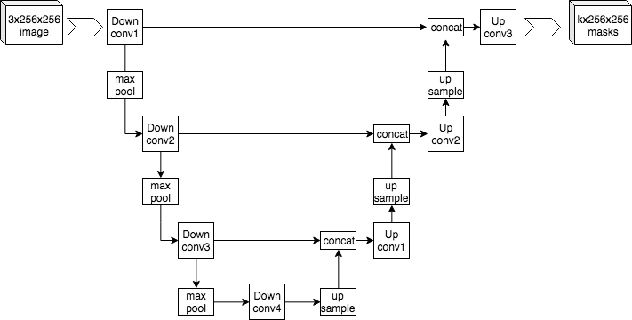
U-Nets; Highway networks the general idea: “skip connections”

Slide 30

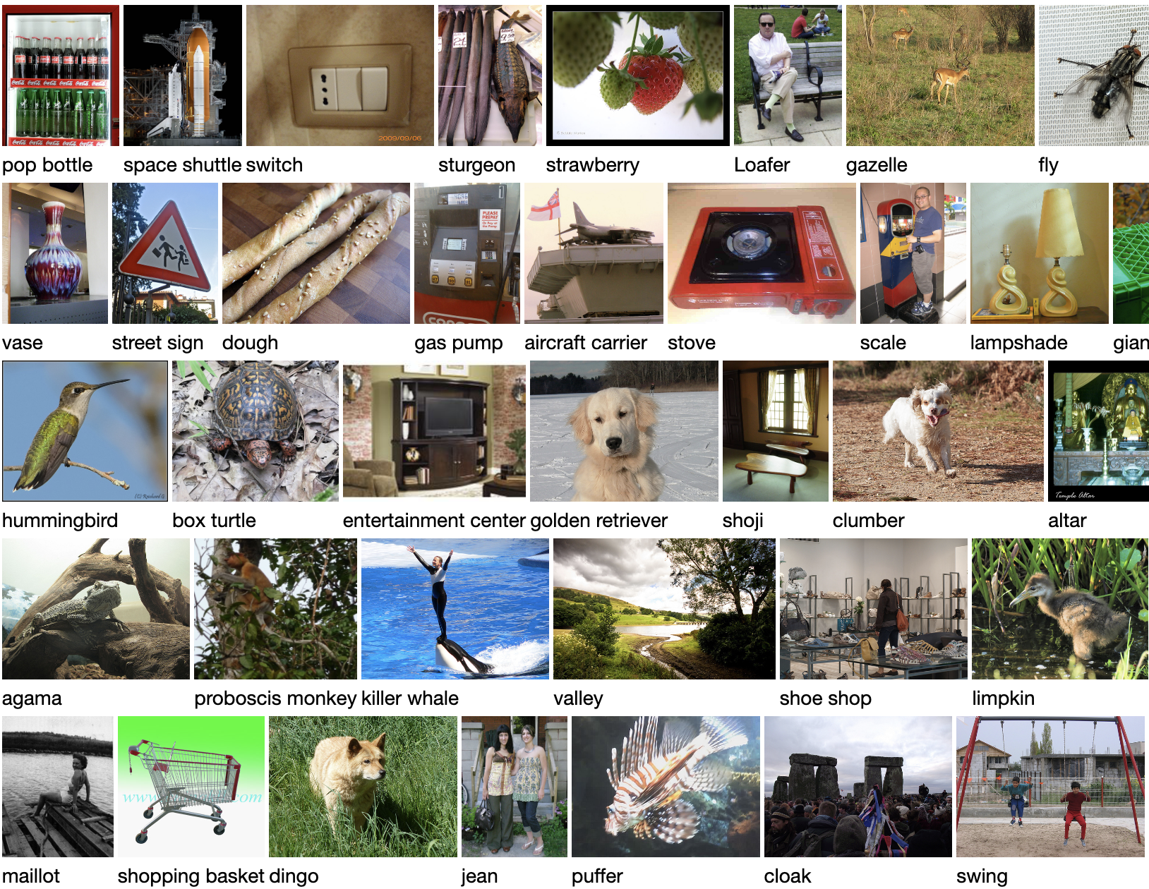
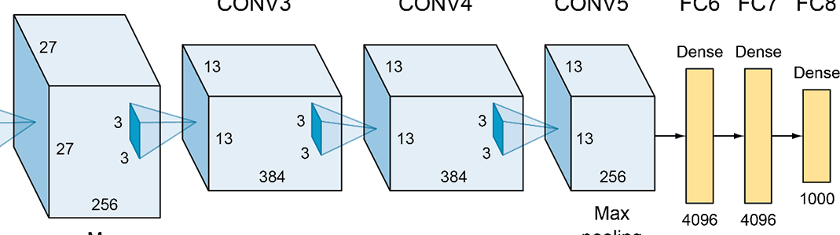
More tricks for generalization
Huge training data
Data
augmentations
Weight decay
Lightweight convolutions
Massive deep net
Make the parameters even lighter
using weight decay (L2 regularization)

Slide 31
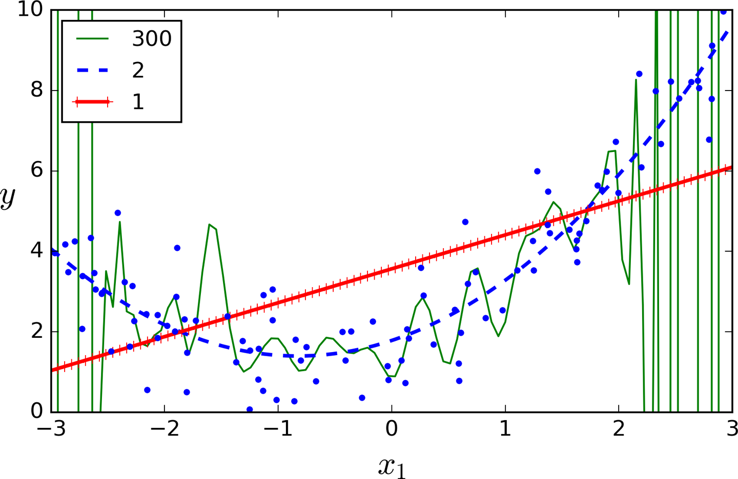
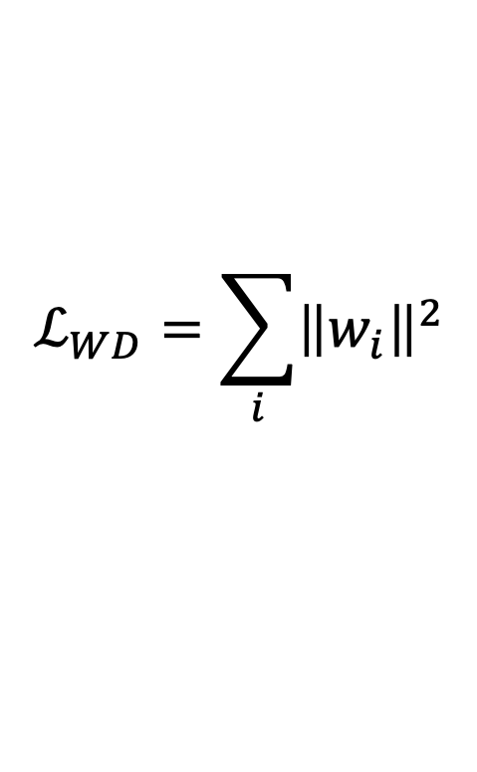

Weight decay
When parameters get too large, they learn a bumpy function
Classic solution from regression:
$$ℒ_{WD}=\sum_{i}{{\left\|w_{i}\right\|}^{2}}$$
$$ℒ_{total}={ℒ_{classification}+λℒ}_{WD}$$
Pushes weights toward zero.

Slide 32
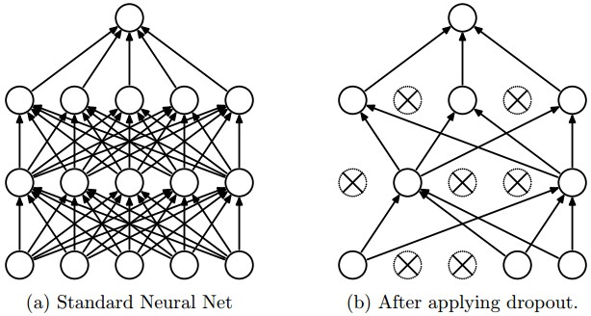
Regularization: Dropout
“randomly set some neurons to zero in the forward pass”
Randomly set the output value of some neurons to be 0
[Srivastava et al., 2014]
Slide credit: E. Learned-Miller, originally developed by Andrej Karpathy, Justin Johnson, Fei-Fei Li

Slide 33
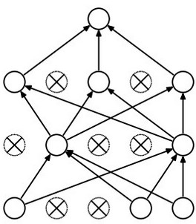
Waaaait a second…
How could this possibly be a good idea?
Slide credit: E. Learned-Miller, originally developed by Andrej Karpathy, Justin Johnson, Fei-Fei Li

Slide 34
Waaaait a second…
How could this possibly be a good idea?
Forces the network to have a redundant representation.
has an ear
X
has a tail
is furry
X
cat
score
has claws
X
mischievous
look
Slide credit: E. Learned-Miller, originally developed by Andrej Karpathy, Justin Johnson, Fei-Fei Li

Slide 35


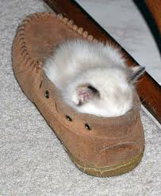
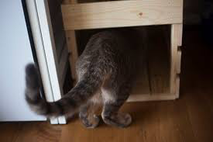

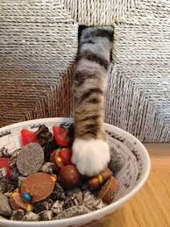
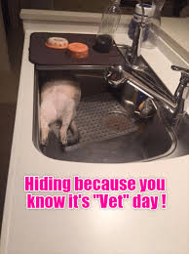

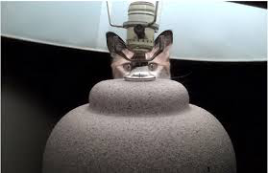
Training with occlusions?
Slide credit: E. Learned-Miller, originally developed by Andrej Karpathy, Justin Johnson, Fei-Fei Li

Slide 36
Waaaait a second…
How could this possibly be a good idea?
Another interpretation:
Dropout is training a large ensemble of models (that share parameters).
Each binary mask is one model, gets trained on only ~one datapoint.
Slide credit: E. Learned-Miller, originally developed by Andrej Karpathy, Justin Johnson, Fei-Fei Li

Slide 37
Dropout: Test Time
Can in fact do this with a single forward pass! (approximately)
Leave all input neurons turned on (no dropout).
Q: Suppose that with all inputs present at test time the output of this neuron is a.
What would its output be during training time, in expectation? (e.g. if p = 0.5)
Slide credit: E. Learned-Miller, originally developed by Andrej Karpathy, Justin Johnson, Fei-Fei Li

Slide 38
Dropout: Test Time
Can in fact do this with a single forward pass! (approximately)
Leave all input neurons turned on (no dropout).
during test: a = w₀*x + w₁*y
during train:
E[a] = ¼ * (w₀*0 + w₁*0 +
w₀*0 + w₁*y +
w₀*x + w₁*0 +
w₀*x + w₁*y)
= ¼ * (2 w₀*x + 2 w₁*y)
= ½ * (w₀*x + w₁*y)
a
w0
w1
x
y
Slide credit: E. Learned-Miller, originally developed by Andrej Karpathy, Justin Johnson, Fei-Fei Li

Slide 39
At test time….
Can in fact do this with a single forward pass! (approximately)
Leave all input neurons turned on (no dropout).
during test: a = w₀*x + w₁*y
during train:
E[a] = ¼ * (w₀*0 + w₁*0 +
w₀*0 + w₁*y +
w₀*x + w₁*0 +
w₀*x + w₁*y)
= ¼ * (2 w₀*x + 2 w₁*y)
= ½ * (w₀*x + w₁*y)
With p=0.5, using all inputs in the forward pass would inflate the activations by 2x from what the network was “used to” during training!
=> Have to compensate by scaling the activations back down by ½
a
w1
w0
x
y
Slide credit: E. Learned-Miller, originally developed by Andrej Karpathy, Justin Johnson, Fei-Fei Li

Slide 40
✓
Resi
dual
Batch
norm
Convolution
✓
Data
augmentation
ADAM
✓
✓
Weight
decay
Drop
out
SOTA spice rack

Slide 41
Notebook: Practical Debugging of AlexNet as ResNet
https://bit.ly/debug-cnn

Slide 42
Defining Invariance and Equivariance

Slide 43
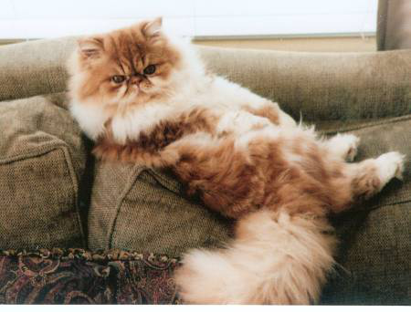

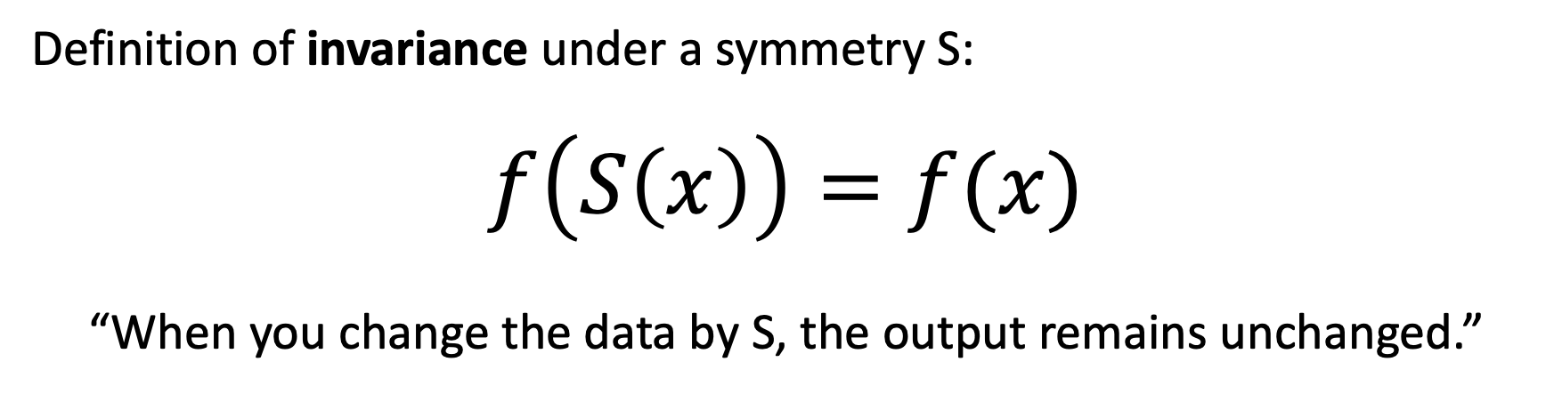
Defining invariance
Definition of invariance under a symmetry S:
$$f\left(S\left(x\right)\right)=f(x)$$
“When you change the data by S, the output remains unchanged.”
$f\left(x\right)=$“is x a photo of a Persian cat?”
$f\left(S(x)\right)=$ yes. $f\left(x\right)=$ yes too.
There are just
2 horizontal
reflection images
A “cat recognizer”
should treat the two
reflections the same

Slide 44
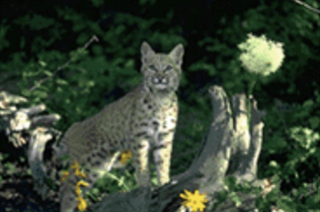
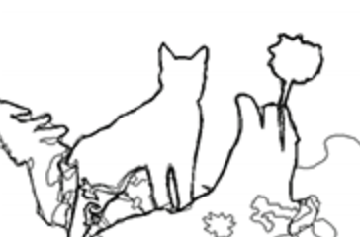

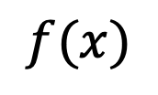
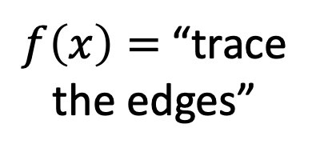
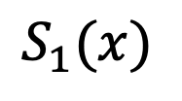



A different kind of symmetry when $f\left(x\right)$ outputs a map
$$S_{1}$$
reflection
$$x$$
$$S_{1}(x)$$
$f\left(x\right)=$“trace
the edges”
$$f$$
$$f$$
We don’t want
the output to be
exactly the same...
$$f(x)$$
[Image from Xe and Tu 2015]

Slide 45

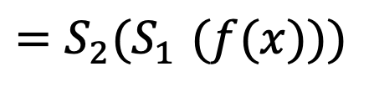

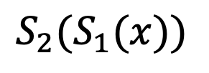
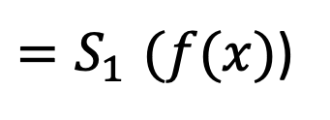

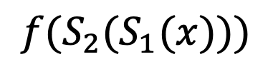

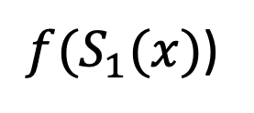
A different kind of symmetry when $f\left(x\right)$ outputs a map
$$S_{1}$$
$$S_{2}$$
reflection
translation
$$x$$
$$S_{1}(x)$$
$${S_{2}(S}_{1}(x))$$
$f\left(x\right)=$“trace
the edges”
$$f$$
$$f$$
$$f$$
$$S_{1}$$
$$S_{2}$$
reflection
translation
$$f(x)$$
${f(S}_{1}(x)$)
$$f({S_{2}(S}_{1}(x)))$$
${=S}_{1}(f(x)$)
$${=S_{2}(S}_{1}(f(x)))$$
[Image from Xe and Tu 2015]

Slide 46


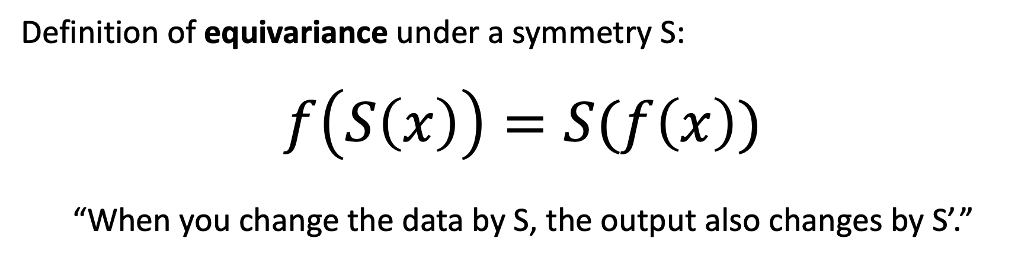

Defining equivariance
Definition of equivariance under a symmetry S:
$$f\left(S\left(x\right)\right)=S(f\left(x\right))$$
“When you change the data by S, the output also changes by S’.”
$$S$$
translation
$$f$$
$$f$$
$$S$$
translation

Slide 47
Discussion: what equivariances does convolution have?
weighted sum
INPUT
OUTPUT

Slide 48
What equivariances if the convolution is a 1x1 kernel?
weighted sum
INPUT
OUTPUT

