Slide 1
DS 4440
Deep Learning

Slide 2
Midterm Review

Slide 3
Concepts to Know So Far
McCoullough-Pitts neuron model (weighted sum then nonlinearity)
Binary logic neural networks
Universal computations (two+ layers and nonlinearities are needed)
Modular machine learning: Pytorch tensors, autograd, and modules. Organization of parameters into module attributes.
Losses: what makes a good/bad loss; MSE, L1, and cross-entropy loss
The backpropagation algorithm: computational graphs, backward pass, upstream/internal/downstream gradients, accumulation
First-order optimization: gradient descent, SGD, Momentum, ADAM
Conditioning gradients: exploding/vanishing gradients, choice and design of nonlinearities, initialization, centering, whitening
Symmetries: data augmentation, invariances
Convolutions: 1d, 2d convolutional kernels, receptive fields, padding, striding
Image Classification: CNNs, Pooling, AlexNet, softmax, Resnet, Dropout, batchnorm, fully-convolutional nets. Debugging and visualizing image classifiers.

Slide 4
Practice midterm
https://ds4440.baulab.info/2024-Spring/review/2022-midterm.pdf

Slide 5
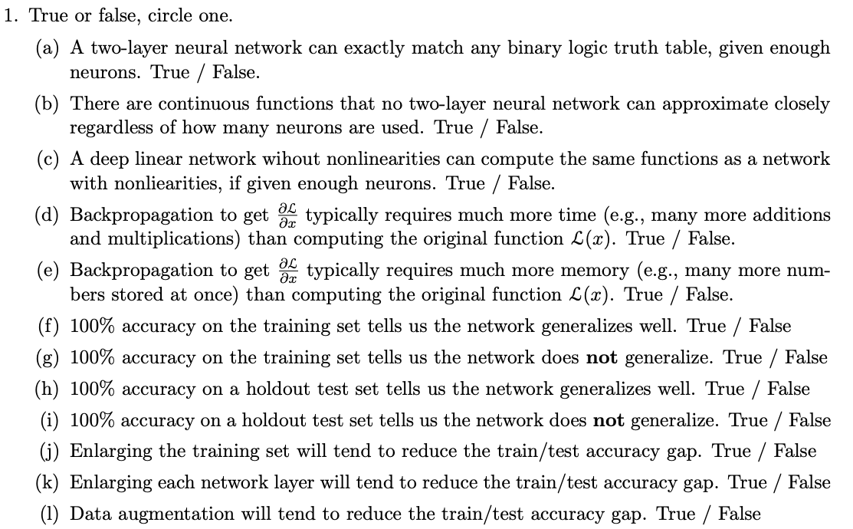
Practice questions

Slide 6
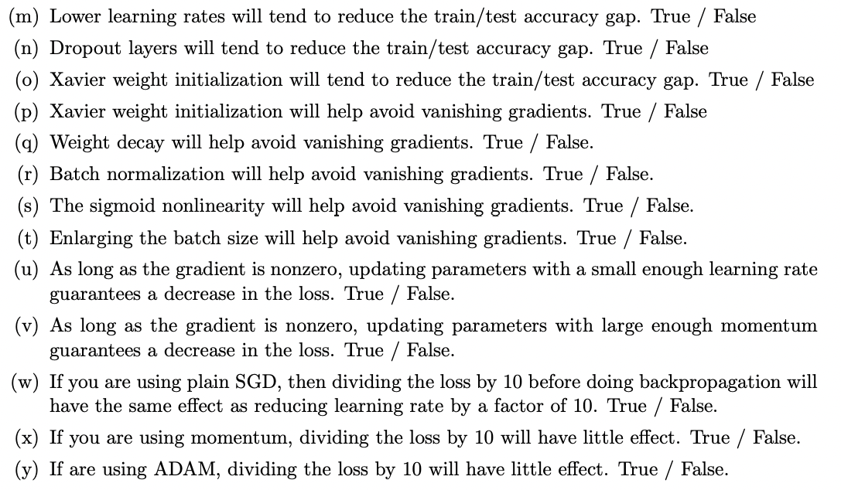
Practice questions

Slide 7
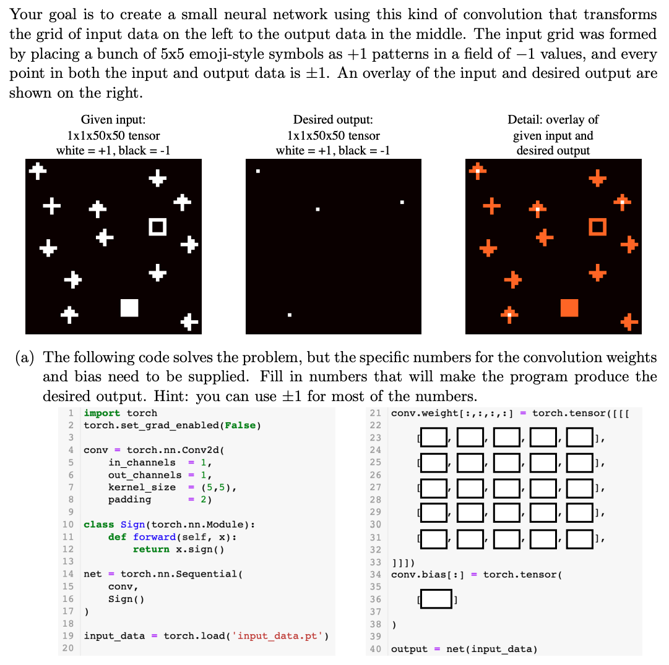
Practice questions

Slide 8
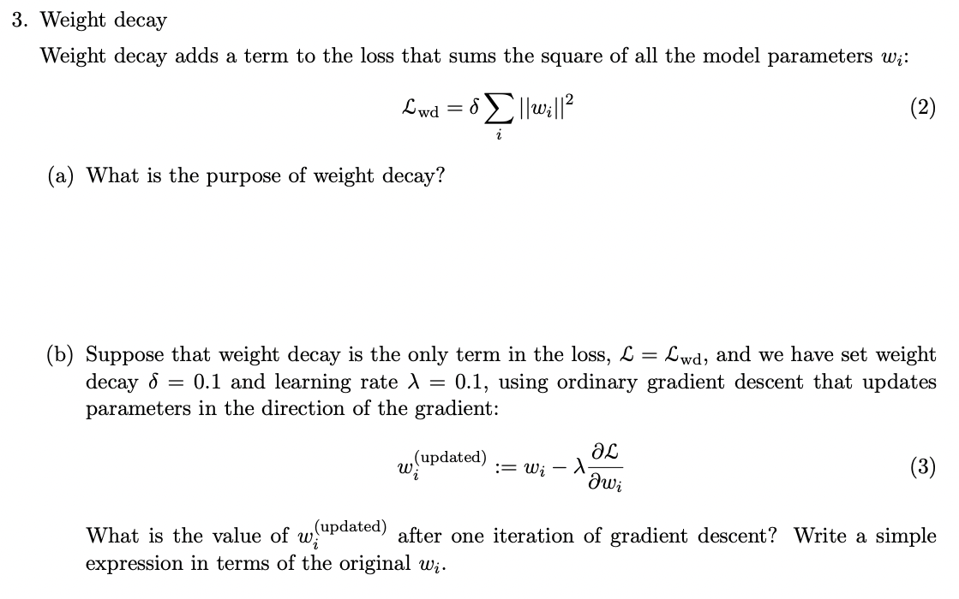
Practice questions

Slide 9
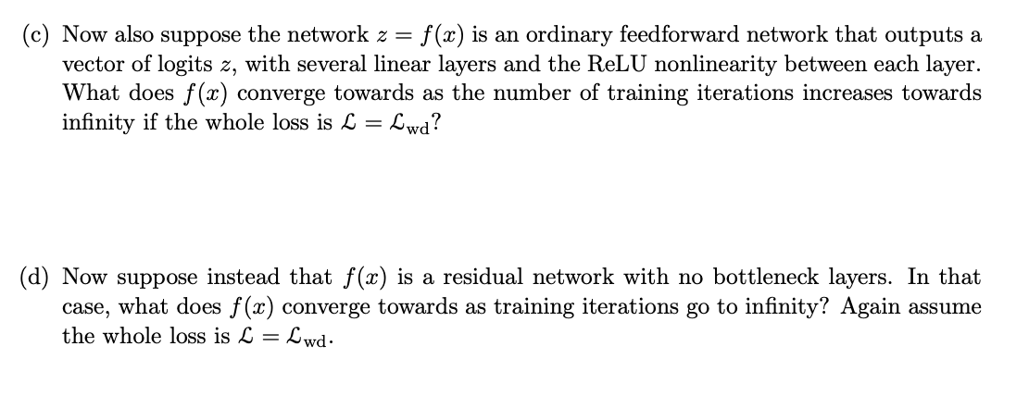
Practice questions

Slide 10
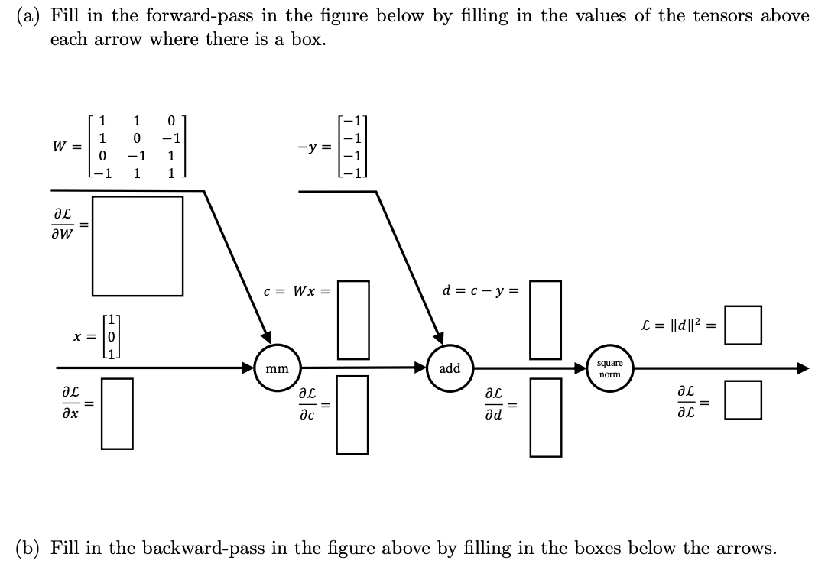
Practice questions

Slide 11
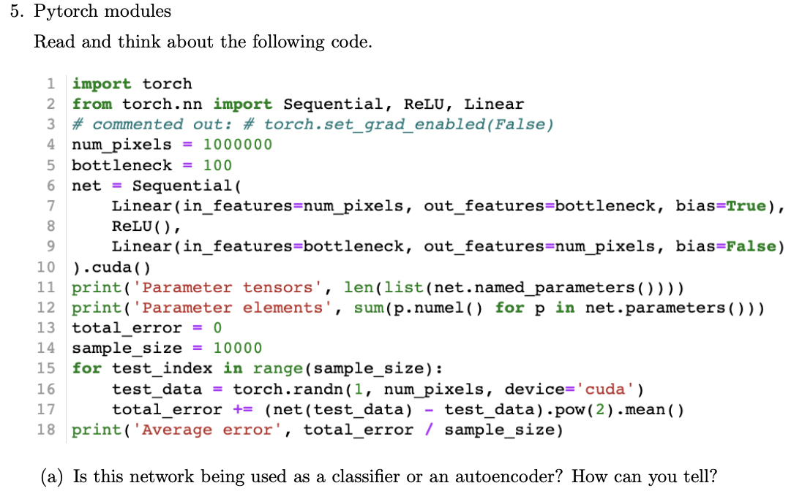
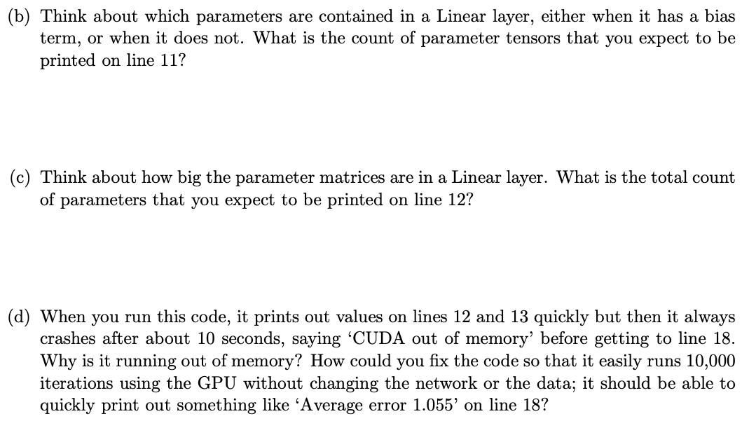
Practice questions

Slide 12
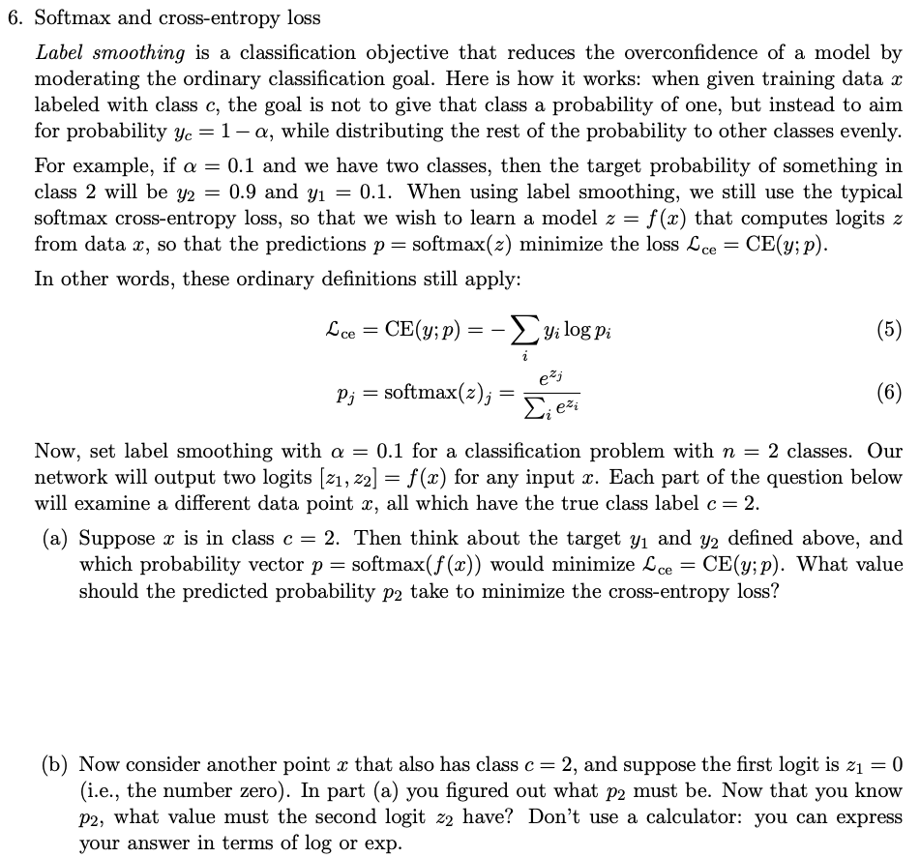
Practice questions

Slide 13
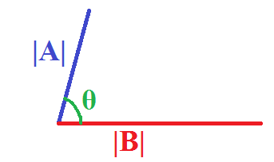
Dot-products are about angles
$$A∙B=\sum_{i}{a_{i}b_{i}}$$
$$\left[\begin{matrix}a_{1} & a_{2} & a_{3}\end{matrix}\right]\left[\begin{matrix}b_{1} \\ b_{2} \\ b_{3}\end{matrix}\right]=a_{1}a_{1}+a_{2}b_{2}+a_{3}b_{3}$$
$$A∙B=|A||B|\cos{θ}$$

Slide 14
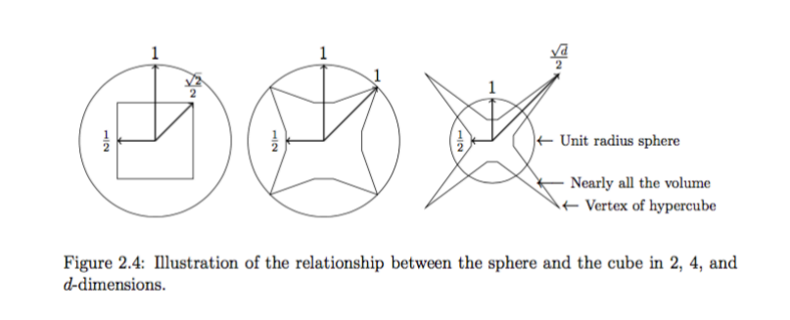
Geometry of high-dimensional space
Notice how a hypercube is very “spiky” in high dimensions. How many spikes? What is the typical dot-product between randomly chosen corners?

