Slide 1
CS 7150
Deep Learning

Slide 2
Project guidelines
Partner with one other student. (Pairs)
Find pairs on piazza now, and during spring break.
Your project should be based on an *existing published paper*
E.g., implement their method and try it out
Or use their pretrained model on new data and evaluate it
Or customize their open-source code to make it do something different
Deliverables:
A webpage report about your project
A github repo with code (could be as small as a notebook, or larger)
A poster/presentation presenting what you’ve done

Slide 3
Post-midterm

Slide 4
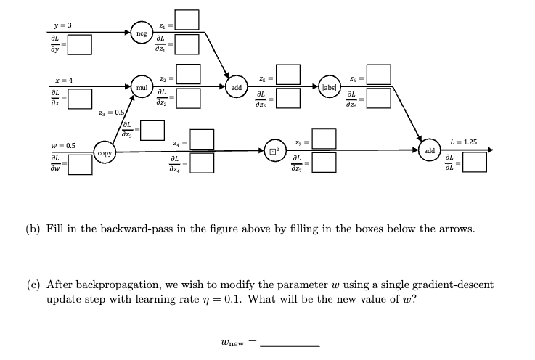
Midterm stats
Mean: 79 points. (34-100)
Hardest questions: 6defgh, 5de, 3bc, 4b

Slide 5
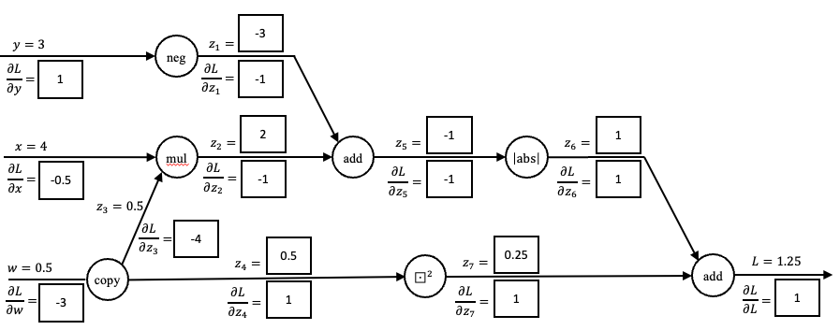
(to work on whiteboard)

Slide 6
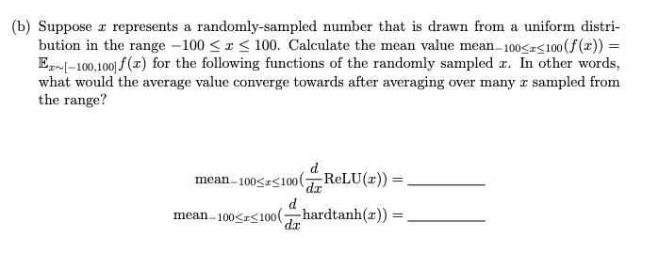
4b

Slide 7
5de

Slide 8
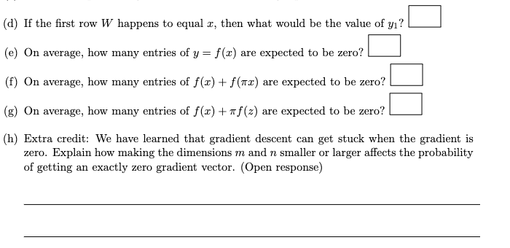
Question 6defgh

Slide 9
Language modeling
Structuring p(x) to model a sequence

Slide 10
Generative goal: models that can create
We want to model big outputs P(X)
.... in contrast to classifiers that modeled big inputs P(Y | X)
X is high-dimensional data
X = a whole paragraph (or image video, audio, etc)
Y = label
Notes:
So TODAY we will talk about GENERATIVE modeling. The WHOLE idea of GENERATIVE modeling is to make models of P(X).
In other words, we want our model to treat some BIG data X as OUTPUT.
<click>
That is DIFFERENT from the CLASSIFICATION setting, where we treat big data X as INPUT.

Slide 11
An example small language model
Suppose this is the full set of things that my chatbot can say randomly:
Make things well
Make it work
Make it go
Let it work
Let me go
Let me see
Make things work
Make things work
Let it go
Let it go
Each possibility has p=0.1
Language modeling algorithm: 1. Pick a number from 1-10
2. Print that item on the list
More likely, duplicated so p=0.2
What if my language has infinite things it can say?

Slide 12
Breaking it down into three steps instead of one
Instead of picking from a list of all 10 possibilities, pick one word at a time.
We need a rule for how to randomize the next word.
This factoring of $p\left(x_{1}x_{2}x_{3}\right)$ shows how we can calculate equivalent rules:
$$p\left(x_{1}x_{2}x_{3}\right)=p\left(x_{1}\right)p\left(x_{2}|x_{1}\right)p\left(x_{3}|x_{1}x_{2}\right)$$
This factorization is exact! It can be done on any sequence of choices.
$$p\left(Make it work\right)=p\left(Make\right)p\left(it|Make\right)p\left(work|Make it\right)$$
Every step depends on the previous choices

Slide 13
An example small language model
Make things well
Make it work
Make it go
Let it work
Let me go
Let me see
Make things work
Make things work
Let it go
Let it go
p=0.5
p=0.5
Make
Let
p=0.6
p=0.4
p=0.6
p=0.4
things
it
it
me
0.33
0.67
0.5
0.67
0.5
0.5
0.33
0.5
well
work
go
see
How to pick what comes after “it” depends on what came before

Slide 14
Factoring the probability distribution
$$p\left(x_{1}x_{2}x_{3}\right)=p\left(x_{1}\right)p\left(x_{2}|x_{1}\right)p\left(x_{3}|x_{1}x_{2}\right)$$
This factorization is exact! It can be done on any sequence distribution.
$$p\left(Make it work\right)=p\left(Make\right)p\left(it|Make\right)p\left(work|Make it\right)$$
Question: why is this step-by-step factorization useful?
$= 0.5 ∙ 0.4$ $∙ 0.5$
$$=0.1$$

Slide 15
We can run it to generate!
p=0.5
p=0.5
Make
Let
p=0.6
p=0.4
p=0.6
p=0.4
things
it
it
me
0.33
0.67
0.5
0.67
0.5
0.5
0.33
0.5
well
work
go
see
Can we store all these rules in a simple table?

Slide 16
Classical language modeling
Simple approach: count word frequencies
Unigram | Frequency | p
Make | 5 | 0.167
Let | 5 | 0.167
it | 5 | 0.167
work | 4 | 0.133
things | 3 | 0.1
go | 3 | 0.1
me | 2 | 0.067
well | 1 | 0.033
see | 1 | 0.033
Make things well
Make it work
Make it go
Let it work
Let me go
Let me see
Make things work
Make things work
Let it go
Let it go

Slide 17
The unigram approximation
$$p\left(Make it work\right)=p\left(Make\right)p\left(it|Make\right)p\left(work|Make it\right)$$
(Very wrong compared to 0.1)
$$≈p_{u}\left(Make\right)p_{u}\left(it\right)p_{u}\left(work\right)$$
$= 0.167 ∙ 0.167$ $∙ 0.133$
$$=0.0037$$

Slide 18
The problem with unigrams
$$p_{u}\left(Make it work\right)=p_{u}(work it Make)$$
Totally insensitive to word order.
Complete lack of context.
$$=p_{u}\left(Make\right)p_{u}\left(it\right)p_{u}\left(work\right)$$

Slide 19
Better classical language modeling: bigrams
“How frequent is every word pair?”
Bigrams seen | Frequency | p(x_{i}|x_{i-1})
<start> → Make | 5 | 0.5
<start> → Let | 5 | 0.5
Make → it | 2 | 0.4
Make → things | 3 | 0.6
Let → it | 3 | 0.6
Let → me | 2 | 0.4
things → well | 1 | 0.33
things → work | 2 | 0.67
it → work | ?
it → go | ?
me → go | 1 | 0.5
me → see | 1 | 0.5
Make things well
Make it work
Make it go
Let it work
Let me go
Let me see
Make things work
Make things work
Let it go
Let it go

Slide 20
Better language modeling (classical approach)
“How frequent is every word pair?”
Bigrams seen | Frequency | p(x_{i}|x_{i-1})
<start> → Make | 5 | 0.5
<start> → Let | 5 | 0.5
Make → it | 2 | 0.4
Make → things | 3 | 0.6
Let → it | 3 | 0.6
Let → me | 2 | 0.4
things → well | 1 | 0.33
things → work | 2 | 0.67
it → work | 2 ← | 0.4
it → go | 3 | 0.6
me → go | 1 | 0.5
me → see | 1 | 0.5
Make things well
Make it work←
Make it go
Let it work←
Let me go
Let me see
Make things work
Make things work
Let it go
Let it go

Slide 21
A bigram model is still a rough approximation
p=0.5
p=0.5
Make
Let
p=0.6
p=0.4
p=0.6
p=0.4
things
it
me
0.33
0.67
0.4
0.6
0.5
0.5
a bit off!
well
work
go
see

Slide 22
The bigram approximation
$$p\left(Make it work\right)=p\left(Make\right)p\left(it|Make\right)p\left(work|Make it\right)$$
(A bit off)
$$≈p_{u}\left(Make\right)p_{u}\left(it|Make\right)p_{u}\left(work|it\right)$$
$= 0.5 ∙ 0.4$ $∙ 0.4$
$$=0.08$$

Slide 23
Much better: trigram, 4-gram models
Trigram prefix seen | Frequency
cent interest per → annum | 3162
driven by the → availability | 1194
driven by the → processes | 167
driven by the → children | 160
the development of → excessive | 2359
the development of → contemporary | 11452
the development of → status | 889
the development of → raised | 446
seems to have → expended | 552
seems to have → formed | 17401
(~40 gigabytes to collect English bigrams, trigrams, 4-grams)
Why not go up to 10-gram or 100-gram models?
[Source: Google books ngrams data]

Slide 24
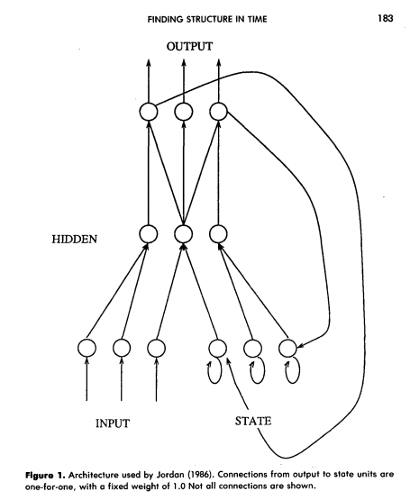
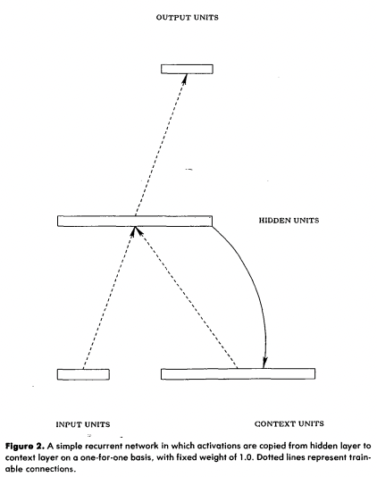
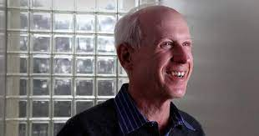
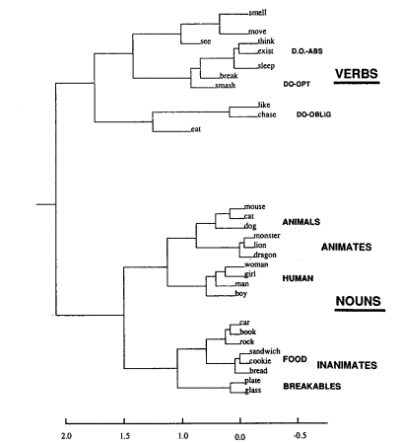
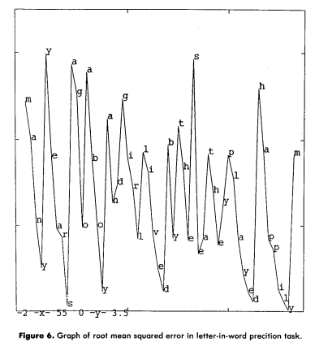
1990: Jeffrey Elman neural language model
[Elman, 1990]

Slide 25
Brief history of neural NLP
Classical counting-based methods performed far better than NNs.
Neural language models were curiosities, but impractical.
Unlike in vision, the change to NN models didn’t happen overnight.
(Large-scale counting works very very well.)
But in 2011-2015, NNs started to outperform large-scale counting.
This led to a large change in natural language processing.
We will pick up in the modern context

Slide 26
Modern idea: use a neural network!
avoid
Great
care
must
be
taken
to

Slide 27
Modern idea: use a neural network!
Two main innovations:
Computation instead of counting
Vector representations for words
avoid
Great
care
must
be
taken
to

Slide 28
Equivariance in language modeling
Great
care
must
be
taken
to
avoid
x
f(x)
enough
.
Great
care
must
be
taken
to
?
S(x)
f(S(x))
What architecture can ensure equivariance and invariance?

Slide 29
Modern idea: use a neural network!
Two main innovations:
Computation instead of counting
Vector representations for words
avoid
Like vision: exploit equivariance
Key issue: how to represent a word as a vector?
Great
care
must
be
taken
to

Slide 30
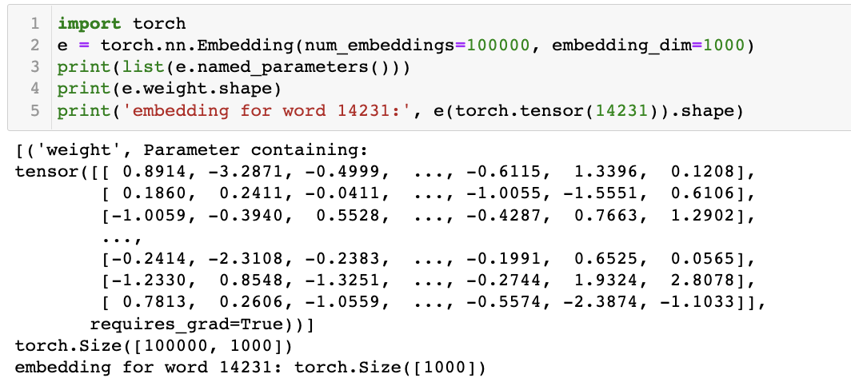
Word embeddings
Mechanically: a simple idea
size of vocab = 100000
dim of vector = 1000
one row for each word
1000 dim vec for each
Just a lookup-table to reduce a big vocabulary to a smaller vector

Slide 31
How to learn word embeddings?
Classical neural language models (Elman, etc):
Just train jointly together with the rest of the neural network.
Then 2012-2019: the pretrained word embedding era
Pretrain word embeddings on a vast corpus, to train your smaller network
2019-today: back to the classic way
Entire language models are pretrained on a vast corpus, including embedding

Slide 32
Skip-gram word2vec embeddings
Task: find vectors ${w_{i}}^{T}w_{j}$to guess when word i appears “near” word j.
“near” = within a fixed window, e.g., within 10 words.
E.g: “ice” appears near “solid” more frequently than “water” does.
maximize: $\log{σ({w_{i}}^{T}w_{j})}+\log{σ({{−w}_{k}}^{T}w_{j})}$
Idea: this trains a very small simple model on a vast amount of text
sample i and j near each other to push this higher
sample random k not near j to push this lower
[Simplification of Mikolov 2013]

Slide 33
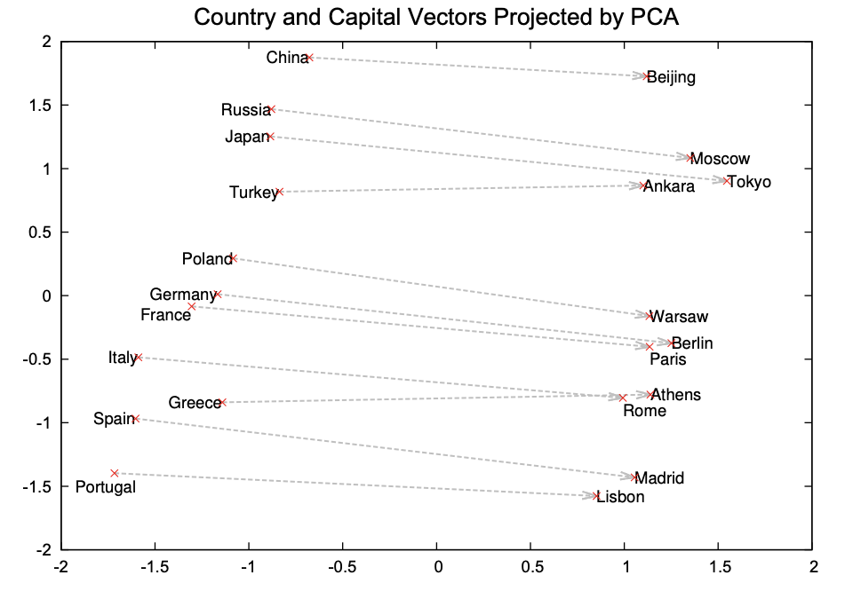
Semantic vector composition
When skip-gram training is done, semantic vector arithmetic emerges:
[Mikolov 2013]

Slide 34
Glove word embeddings
Define $X_{ij}=$ the number of times word i appears “near” word j.
Instead of “training” through random sampling, just count to collect all correlations like this, fully and exactly.
$$\left[\begin{matrix}X_{11} & X_{12} & ⋯ & X_{1n} \\ X_{21} & X_{22} & ⋯ & X_{2n} \\ ⋮ & ⋮ & ⋱ & ⋮ \\ X_{n1} & X_{n2} & ⋯ & X_{nn}\end{matrix}\right]$$
If the definition of “near” is symmetric, this is a nxn symmetric matrix.

Slide 35
Idea of Glove
Define $X_{ij}=$ the number of times word i appears “near” word j.
The ideal vectors $w_{i}$ for the ith word would allow us to directly predict
$${w_{i}}^{T}w_{j}≈\log{X_{ij}}$$
$$\left[\begin{matrix}w_{11} & ⋯ & w_{1d} \\ ⋮ & ⋱ & ⋮ \\ w_{n1} & ⋯ & w_{nd}\end{matrix}\right]\left[\begin{matrix}w_{11} & ⋯ & w_{n1} \\ ⋮ & ⋱ & ⋮ \\ w_{1d} & ⋯ & w_{nd}\end{matrix}\right]≈\log\left[\begin{matrix}X_{11} & ⋯ & X_{1n} \\ ⋮ & ⋱ & ⋮ \\ X_{n1} & ⋯ & X_{nn}\end{matrix}\right]$$
A direct matrix factorization, much faster than stochastic training!
*details: downweight rows of rare words and add bias terms.
[Simplification of Pennington 2014]

Slide 36
Interactive: Use GloVe embedding by hand
https://bit.ly/cs7150-glove

Slide 37
Language Modelling: Feed-forward Neural Net
Neural Approach #1: Feed-forward Neural Net
General Idea: using windows of words, predict the next word
Ex. He went to class after breakfast.
Output layer
$$W$$
Hidden layer
$$V$$
Example input sentence
He
went
to

Slide 38
Language Modelling: Feed-forward Neural Net
Neural Approach #1: Feed-forward Neural Net
General Idea: using windows of words, predict the next word
Ex. He went to class after breakfast.
Output layer
$$\hat{y}=\text{softmax}\left(Wh+b_{2}\right)∈ℝ^{\left|V\right|}$$
$$W$$
Hidden layer
$$h=f(Vx+b_{1})$$
$$V$$
Example input sentence
$$x=[x_{1},x_{2},x_{3}]$$
He
went
to
Concatenated word embeddings

Slide 39
Language Modelling: Feed-forward Neural Net
Neural Approach #1: Feed-forward Neural Net
General Idea: using windows of words, predict the next word
Ex. He went to class after breakfast.
Output layer
$$\hat{y}=\text{softmax}\left(Wh+b_{2}\right)∈ℝ^{\left|V\right|}$$
$$W$$
Hidden layer
$$h=f(Vx+b_{1})$$
$$V$$
Example input sentence
$$x=[x_{1},x_{2},x_{3}]$$
went
to
class
Concatenated word embeddings

Slide 40
Language Modelling: Feed-forward Neural Net
Neural Approach #1: Feed-forward Neural Net
General Idea: using windows of words, predict the next word
Ex. He went to class after breakfast.
Output layer
$$\hat{y}=\text{softmax}\left(Wh+b_{2}\right)∈ℝ^{\left|V\right|}$$
$$W$$
Hidden layer
$$h=f(Vx+b_{1})$$
$$V$$
Example input sentence
$$x=[x_{1},x_{2},x_{3}]$$
to
class
after
Concatenated word embeddings

Slide 41
Language Modelling: Feed-forward Neural Net
Training
$$L=CE({\hat{y}}_{t}, y_{t})$$
Output layer
$$\hat{y}=\text{softmax}\left(Wh+b_{2}\right)∈ℝ^{\left|V\right|}$$
$$W$$
Hidden layer
$$h=f(Vx+b_{1})$$
$$V$$
Example input sentence
$$x=[x_{1},x_{2},x_{3}]$$
$$w_{t−3}$$
$$w_{t−2}$$
$$w_{t−1}$$
Concatenated word embeddings

Slide 42
Language Modelling: Feed-forward Neural Net
$\hat{y}$: are probabilities for each possible word in the vocabulary.
$y:$ is a vector of 0’s and 1.
$$L=\sum_{t=3}^{t}{CE({\hat{y}}_{t}, y_{t})}$$
Training
Output layer
$$\hat{y}=\text{softmax}\left(Wh+b_{2}\right)∈ℝ^{\left|V\right|}$$
$$W$$
Hidden layer
$$h=f(Vx+b_{1})$$
$$V$$
Example input sentence
$$x=[x_{1},x_{2},x_{3}]$$
$$w_{t−3}$$
$$w_{t−2}$$
$$w_{t−1}$$
Concatenated word embeddings

Slide 43
Language Modelling : Feed-forward Neural Net
FFNN STRENGTHS?
No sparsity issues (it’s okay if we’ve never seen a segment of words)
No storage issues (we never store counts)
FFNN ISSUES?
Fixed-window size can never be big enough. Need more context.
Increasing window size adds many more weights
The weights awkwardly handle word position
No concept of time
Requires inputting entire context just to predict one word

Slide 44
Language Modelling
We especially need a system that:
Has an “infinite” concept of the past, not just a fixed window
For each new input, output the most likely next event (e.g., word)

Slide 45
Language Modelling
IDEA: for every individual input, output a prediction
Let’s use the previous hidden state, too
went
Output layer
$$\hat{y}=\text{softmax}\left(Wh+b_{2}\right)∈ℝ^{\left|V\right|}$$
$$W$$
Hidden layer
$$h=f(Vx+b_{1})$$
$$V$$
Example input word
$$x=x_{1}$$
He
single word embedding

Slide 46
Language Modelling: RNNs
Neural Approach #2: Recurrent Neural Network (RNN)
$${\hat{y}}_{1}$$
$${\hat{y}}_{2}$$
$${\hat{y}}_{3}$$
$${\hat{y}}_{4}$$
Output layer
$$W$$
$$W$$
$$W$$
$$W$$
$$U$$
$$U$$
$$U$$
$$U$$
Hidden layer
$$V$$
V
V
V
Input layer
$$x_{1}$$
$$x_{2}$$
$$x_{3}$$
$$x_{4}$$

Slide 47
RNN
Training Process
$$CE\left(y^{i},{\hat{y}}^{i}\right)=−\sum_{w∈W}{y_{w}^{i}\text{log}({\hat{y}}_{w}^{i})}$$
Error
$$CE\left(y^{1},{\hat{y}}^{1}\right)$$
$$CE\left(y^{2},{\hat{y}}^{2}\right)$$
$$CE\left(y^{3},{\hat{y}}^{3}\right)$$
$$CE\left(y^{4},{\hat{y}}^{4}\right)$$
$${\hat{y}}_{1}$$
$${\hat{y}}_{2}$$
$${\hat{y}}_{3}$$
$${\hat{y}}_{4}$$
Output layer
$$W$$
$$W$$
$$W$$
$$W$$
$$U$$
$$U$$
$$U$$
Hidden layer
$$V$$
$$V$$
$$V$$
$$V$$
Input layer
$$x_{1}$$
$$x_{2}$$
$$x_{3}$$
$$x_{4}$$
He
went
to
class

Slide 48
RNN
Training Process
$$CE\left(y^{i},{\hat{y}}^{i}\right)=−\sum_{w∈W}{y_{w}^{i}\text{log}({\hat{y}}_{w}^{i})}$$
Error
$$CE\left(y^{1},{\hat{y}}^{1}\right)$$
$$CE\left(y^{2},{\hat{y}}^{2}\right)$$
$$CE\left(y^{3},{\hat{y}}^{3}\right)$$
$$CE\left(y^{4},{\hat{y}}^{4}\right)$$
$${\hat{y}}_{1}$$
$${\hat{y}}_{2}$$
$${\hat{y}}_{3}$$
$${\hat{y}}_{4}$$
Output layer
$$W$$
$$W$$
$$W$$
$$W$$
$$U$$
$$U$$
$$U$$
Hidden layer
$$V$$
$$V$$
$$V$$
$$V$$
Input layer
$$x_{1}$$
$$x_{2}$$
$$x_{3}$$
$$x_{4}$$
He
went
to
class

Slide 49
RNN
Training Process
$$CE\left(y^{i},{\hat{y}}^{i}\right)=−\sum_{w∈W}{y_{w}^{i}\text{log}({\hat{y}}_{w}^{i})}$$
Error
$$CE\left(y^{1},{\hat{y}}^{1}\right)$$
$$CE\left(y^{2},{\hat{y}}^{2}\right)$$
$$CE\left(y^{3},{\hat{y}}^{3}\right)$$
$$CE\left(y^{4},{\hat{y}}^{4}\right)$$
went?
over?
class?
after?
Output layer
$$\hat{y}$$
$$W$$
$$W$$
$$W$$
$$W$$
$$U$$
$$U$$
$$U$$
Hidden layer
$$V$$
$$V$$
$$V$$
$$V$$
Input layer
$$x_{1}$$
$$x_{2}$$
$$x_{3}$$
$$x_{4}$$
She
went
to
class

Slide 50
RNN (review)
Training Process
$$CE\left(y^{i},{\hat{y}}^{i}\right)=−\sum_{w∈W}{y_{w}^{i}\text{log}({\hat{y}}_{w}^{i})}$$
To update our weights (e.g. $U$), we calculate the gradient of our loss w.r.t. the repeated weight matrix (e.g., $\frac{∂L}{∂U} ).$
Error
$$CE\left(y^{1},{\hat{y}}^{1}\right)$$
$$CE\left(y^{2},{\hat{y}}^{2}\right)$$
$$CE\left(y^{3},{\hat{y}}^{3}\right)$$
$$CE\left(y^{4},{\hat{y}}^{4}\right)$$
went?
over?
class?
after?
Using the chain rule, we trace the derivative all the way back to the beginning, while summing the results.
Output layer
$$\hat{y}$$
$$W$$
$$W$$
$$W$$
$$W$$
$$U$$
$$U$$
$$U$$
Hidden layer
$$V$$
$$V$$
$$V$$
$$V$$
Input layer
$$x_{1}$$
$$x_{2}$$
$$x_{3}$$
$$x_{4}$$
He
went
to
class

Slide 51
RNN (review)
Training Process
Error
$$CE\left(y^{1},{\hat{y}}^{1}\right)$$
$$CE\left(y^{2},{\hat{y}}^{2}\right)$$
$$CE\left(y^{3},{\hat{y}}^{3}\right)$$
$$CE\left(y^{4},{\hat{y}}^{4}\right)$$
went?
over?
class?
after?
Output layer
$$\hat{y}$$
$$W$$
$$W$$
$$W$$
$$W$$
$$U$$
$$U$$
$$U$$
Hidden layer
$$V$$
$$V$$
$$V$$
$$V$$
Input layer
$$x_{1}$$
$$x_{2}$$
$$x_{3}$$
$$x_{4}$$
He
went
to
class

Slide 52
RNN (review)
$\frac{∂L}{∂V}$
Training Process
Error
$$CE\left(y^{1},{\hat{y}}^{1}\right)$$
$$CE\left(y^{2},{\hat{y}}^{2}\right)$$
$$CE\left(y^{3},{\hat{y}}^{3}\right)$$
$$CE\left(y^{4},{\hat{y}}^{4}\right)$$
went?
over?
class?
after?
Output layer
$$\hat{y}$$
$$W$$
$$W$$
$$W$$
$$W$$
$$U$$
$$U$$
$$U$$
Hidden layer
$$V$$
$$V$$
$$V$$
$$V$$
Input layer
$$x_{1}$$
$$x_{2}$$
$$x_{3}$$
$$x_{4}$$
She
went
to
class

Slide 53
RNN (review)
This backpropagation through time (BPTT) process is expensive
Instead of updating after every timestep, we tend to do so every $T$ steps (e.g., every sentence or paragraph)
This isn’t equivalent to using only a window size $T$ (a la n-grams) because we still have ‘infinite memory’

Slide 54
RNN: Generation
We can generate the most likely next event (e.g., word) by sampling from $\hat{y}$
Continue until we generate <EOS> symbol.

Slide 55
RNN: Generation
We can generate the most likely next event (e.g., word) by sampling from $\hat{y}$
Continue until we generate <EOS> symbol.
“Sorry”
Output layer
$$W$$
Hidden layer
$$V$$
Input layer
$$x_{1}$$
<START>

Slide 56
RNN: Generation
We can generate the most likely next event (e.g., word) by sampling from $\hat{y}$
Continue until we generate <EOS> symbol.
“Sorry”
Harry
shouted
panicking
Output layer
$$W$$
$$W$$
$$W$$
$$W$$
$$U$$
$$U$$
$$U$$
Hidden layer
$$V$$
$$V$$
$$V$$
$$V$$
Input layer
$$x_{1}$$
$$x_{2}$$
$$x_{3}$$
$$x_{4}$$
<START>
“Sorry”
“Harry”
shouted,

Slide 57
RNN: Generation
NOTE: the same input (e.g., “Harry”) can easily yield different outputs, depending on the context (unlike FFNNs and n-grams).
“Sorry”
Harry
shouted
panicking
Output layer
$$W$$
$$W$$
$$W$$
$$W$$
$$U$$
$$U$$
$$U$$
Hidden layer
$$V$$
$$V$$
$$V$$
$$V$$
Input layer
$$x_{1}$$
$$x_{2}$$
$$x_{3}$$
$$x_{4}$$
<START>
“Sorry”
“Harry”
“shouted,”

Slide 58
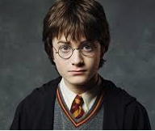
RNN: Generation
When trained on Harry Potter text, it generates:
Source: https://medium.com/deep-writing/harry-potter-written-by-artificial-intelligence-8a9431803da6

Slide 59
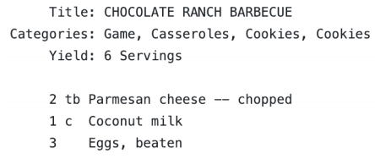
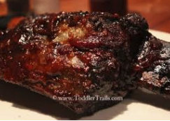
RNN: Generation
When trained on recipes
Source: https://gist.github.com/nylki/1efbaa36635956d35bcc

Slide 60
RNNs: Overview
RNN STRENGTHS?
Can handle infinite-length sequences (not just a fixed-window)
Has a “memory” of the context (thanks to the hidden layer’s recurrent loop)
Same weights used for all inputs, so word order isn’t wonky (like FFNN)
RNN ISSUES?
Slow to train (BPTT)
Due to ”infinite sequence”, gradients can easily vanish or explode
Has trouble actually making use of long-range context

Slide 61
RNNs: Vanishing and Exploding Gradients (review)
$\frac{∂L^{4}}{∂V^{1}}$
$\frac{∂L^{4}}{∂V^{1}}= ?$
$$CE\left(y^{4},{\hat{y}}^{4}\right)$$
Output layer
$$\hat{y}$$
$$U$$
$$U$$
$$U$$
$$U$$
$$V^{1}$$
$$V^{2}$$
$$V^{3}$$
Hidden layer
$$W$$
$$W$$
$$W$$
$$W$$
Input layer
She
went
to
class

Slide 62
RNNs: Vanishing and Exploding Gradients (review)
$\frac{∂L^{4}}{∂V^{1}}$
$\frac{∂L^{4}}{∂V^{1}}=\frac{∂L^{4}}{∂V^{3}}$
$$CE\left(y^{4},{\hat{y}}^{4}\right)$$
Output layer
$$\hat{y}$$
$$U$$
$$U$$
$$U$$
$$U$$
$$V^{1}$$
$$V^{2}$$
$$V^{3}$$
Hidden layer
$$W$$
$$W$$
$$W$$
$$W$$
Input layer
She
went
to
class

Slide 63
RNNs: Vanishing and Exploding Gradients (review)
$\frac{∂L^{4}}{∂V^{1}}$
$\frac{∂L^{4}}{∂V^{1}}=\frac{∂L^{4}}{∂V^{3}}\frac{∂V^{3}}{∂V^{2}}$
$$CE\left(y^{4},{\hat{y}}^{4}\right)$$
Output layer
$$\hat{y}$$
$$U$$
$$U$$
$$U$$
$$U$$
$$V^{1}$$
$$V^{2}$$
$$V^{3}$$
Hidden layer
$$W$$
$$W$$
$$W$$
$$W$$
Input layer
She
went
to
class

Slide 64
RNNs: Vanishing and Exploding Gradients (review)
$\frac{∂L^{4}}{∂V^{1}}$
$\frac{∂L^{4}}{∂V^{1}}=\frac{∂L^{4}}{∂V^{3}}\frac{∂V^{3}}{∂V^{2}}$ $\frac{∂V^{2}}{∂V^{1}}$
$$CE\left(y^{4},{\hat{y}}^{4}\right)$$
Output layer
$$\hat{y}$$
$$U$$
$$U$$
$$U$$
$$U$$
$$V^{1}$$
$$V^{2}$$
$$V^{3}$$
Hidden layer
$$W$$
$$W$$
$$W$$
$$W$$
Input layer
She
went
to
class

Slide 65
RNNs: Vanishing and Exploding Gradients (review)
To address RNNs’ finnicky nature with long-range context, we turned to an RNN variant named LSTMs (long short-term memory)
But first, let’s recap what we’ve learned so far

