Slide 1
DS 4440
Deep Learning

Slide 2
Weekend Workshop
Weekend workshop on how to do interpretability experiments using https://nnsight.net/ - could be one option for a project.
(Run by Dmitry, Koyena, Jaden)
This Saturday 1pm Ryder hall
sign up:
https://bit.ly/nns-workshop

Slide 3
Language modeling
Structuring p(x) to model a sequence

Slide 4
Generative goal: models that can create
We want to model big outputs P(X)
.... in contrast to classifiers that modeled big inputs P(Y | X)
X is high-dimensional data
X = a whole paragraph (or image video, audio, etc)
Y = label
Notes:
So TODAY we will talk about GENERATIVE modeling. The WHOLE idea of GENERATIVE modeling is to make models of P(X).
In other words, we want our model to treat some BIG data X as OUTPUT.
<click>
That is DIFFERENT from the CLASSIFICATION setting, where we treat big data X as INPUT.

Slide 5
An example small language model
Suppose this is the full set of things that my chatbot can say randomly:
Make things well
Make it work
Make it go
Let it work
Let me go
Let me see
Make things work
Make things work
Let it go
Let it go
A probability distribution

Slide 6
An example small language model
Suppose this is the full set of things that my chatbot can say randomly:
Make things well
Make it work
Make it go
Let it work
Let me go
Let me see
Make things work
Make things work
Let it go
Let it go
Each possibility has p=0.1
Language modeling algorithm: 1. Pick a number from 1-10
2. Print that item on the list
More likely, duplicated so p=0.2
What if my language has infinite things it can say?

Slide 7
Breaking it down into three steps instead of one
Instead of picking from a list of all 10 possibilities, pick one word at a time.
We need a rule for how to randomize the next word.
This factoring of $p\left(x_{1}x_{2}x_{3}\right)$ shows how we can calculate equivalent rules:
$$p\left(x_{1}x_{2}x_{3}\right)=p\left(x_{1}\right)p\left(x_{2}|x_{1}\right)p\left(x_{3}|x_{1}x_{2}\right)$$
This factorization is exact! It can be done on any sequence of choices.
$$p\left(Make it work\right)=p\left(Make\right)p\left(it|Make\right)p\left(work|Make it\right)$$
Every step depends on the previous choices

Slide 8
An example small language model
Make things well
Make it work
Make it go
Let it work
Let me go
Let me see
Make things work
Make things work
Let it go
Let it go
p=0.5
p=0.5
Make
Let
p=0.6
p=0.4
p=0.6
p=0.4
things
it
it
me
0.33
0.67
0.5
0.67
0.5
0.5
0.33
0.5
well
work
go
see
How to pick what comes after “it” depends on what came before

Slide 9
Factoring the probability distribution
$$p\left(x_{1}x_{2}x_{3}\right)=p\left(x_{1}\right)p\left(x_{2}|x_{1}\right)p\left(x_{3}|x_{1}x_{2}\right)$$
This factorization is exact! It can be done on any sequence distribution.
$$p\left(Make it work\right)=p\left(Make\right)p\left(it|Make\right)p\left(work|Make it\right)$$
Question: why is this step-by-step factorization useful?
$= 0.5 ∙ 0.4$ $∙ 0.5$
$$=0.1$$

Slide 10
We can run it to generate!
p=0.5
p=0.5
Make
Let
p=0.6
p=0.4
p=0.6
p=0.4
things
it
it
me
0.33
0.67
0.5
0.67
0.5
0.5
0.33
0.5
well
work
go
see
Can we store all these rules in a simple table?

Slide 11
Classical language modeling
Simple approach: count word frequencies
Unigram | Frequency | p
Make | 5 | 0.167
Let | 5 | 0.167
it | 5 | 0.167
work | 4 | 0.133
things | 3 | 0.1
go | 3 | 0.1
me | 2 | 0.067
well | 1 | 0.033
see | 1 | 0.033
Make things well
Make it work
Make it go
Let it work
Let me go
Let me see
Make things work
Make things work
Let it go
Let it go

Slide 12
The unigram approximation
$$p\left(Make it work\right)=p\left(Make\right)p\left(it|Make\right)p\left(work|Make it\right)$$
(Very wrong compared to 0.1)
$$≈p_{u}\left(Make\right)p_{u}\left(it\right)p_{u}\left(work\right)$$
$= 0.167 ∙ 0.167$ $∙ 0.133$
$$=0.0037$$

Slide 13
The problem with unigrams
$$p_{u}\left(Make it work\right)=p_{u}(work it Make)$$
Totally insensitive to word order.
Complete lack of context.
$$=p_{u}\left(Make\right)p_{u}\left(it\right)p_{u}\left(work\right)$$

Slide 14
Better classical language modeling: bigrams
“How frequent is every word pair?”
Bigrams seen | Frequency | p(x_{i}|x_{i-1})
<start> → Make | 5 | 0.5
<start> → Let | 5 | 0.5
Make → it | 2 | 0.4
Make → things | 3 | 0.6
Let → it | 3 | 0.6
Let → me | 2 | 0.4
things → well | 1 | 0.33
things → work | 2 | 0.67
it → work | ?
it → go | ?
me → go | 1 | 0.5
me → see | 1 | 0.5
Make things well
Make it work
Make it go
Let it work
Let me go
Let me see
Make things work
Make things work
Let it go
Let it go

Slide 15
Better language modeling (classical approach)
“How frequent is every word pair?”
Bigrams seen | Frequency | p(x_{i}|x_{i-1})
<start> → Make | 5 | 0.5
<start> → Let | 5 | 0.5
Make → it | 2 | 0.4
Make → things | 3 | 0.6
Let → it | 3 | 0.6
Let → me | 2 | 0.4
things → well | 1 | 0.33
things → work | 2 | 0.67
it → work | 2 ← | 0.4
it → go | 3 | 0.6
me → go | 1 | 0.5
me → see | 1 | 0.5
Make things well
Make it work←
Make it go
Let it work←
Let me go
Let me see
Make things work
Make things work
Let it go
Let it go

Slide 16
A bigram model is still a rough approximation
p=0.5
p=0.5
Make
Let
p=0.6
p=0.4
p=0.6
p=0.4
things
it
me
0.33
0.67
0.4
0.6
0.5
0.5
a bit off!
well
work
go
see

Slide 17
The bigram approximation
$$p\left(Make it work\right)=p\left(Make\right)p\left(it|Make\right)p\left(work|Make it\right)$$
(A bit off)
$$≈p_{u}\left(Make\right)p_{u}\left(it|Make\right)p_{u}\left(work|it\right)$$
$= 0.5 ∙ 0.4$ $∙ 0.4$
$$=0.08$$

Slide 18
Much better: trigram, 4-gram models
Trigram prefix seen | Frequency
cent interest per → annum | 3162
driven by the → availability | 1194
driven by the → processes | 167
driven by the → children | 160
the development of → excessive | 2359
the development of → contemporary | 11452
the development of → status | 889
the development of → raised | 446
seems to have → expended | 552
seems to have → formed | 17401
(~40 gigabytes to collect English bigrams, trigrams, 4-grams)
Why not go up to 10-gram or 100-gram models?
[Source: Google books ngrams data]

Slide 19
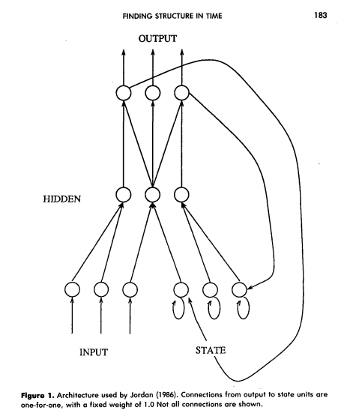
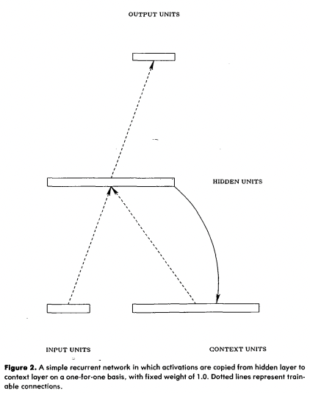
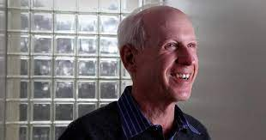
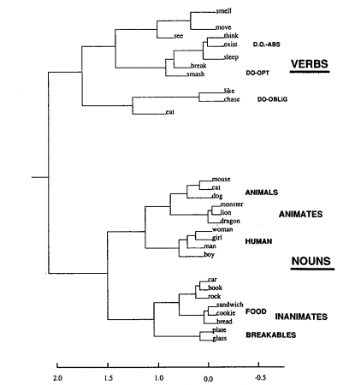
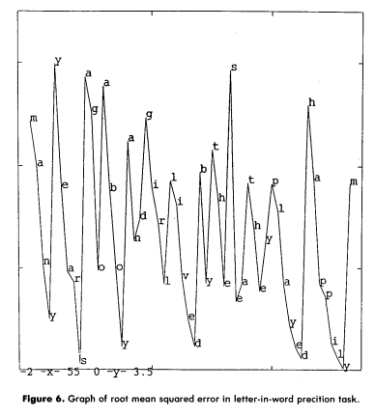
1990: Jeffrey Elman neural language model
[Elman, 1990]

Slide 20
Brief history of neural NLP
Classical counting-based methods performed far better than NNs.
Neural language models were curiosities, but impractical.
Unlike in vision, the change to NN models didn’t happen overnight.
(Large-scale counting works very very well.)
But in 2011-2015, NNs started to outperform large-scale counting.
This led to a large change in natural language processing.
We will pick up in the modern context

Slide 21
Modern idea: use a neural network!
avoid
Great
care
must
be
taken
to

Slide 22
Modern idea: use a neural network!
Two main innovations:
Computation instead of counting
Vector representations for words
avoid
Great
care
must
be
taken
to

Slide 23
Equivariance in language modeling
Great
care
must
be
taken
to
avoid
x
f(x)
enough
.
Great
care
must
be
taken
to
?
S(x)
f(S(x))
What architecture can ensure equivariance and invariance?

Slide 24
Modern idea: use a neural network!
Two main innovations:
Computation instead of counting
Vector representations for words
avoid
Like vision: exploit equivariance
Key issue: how to represent a word as a vector?
Great
care
must
be
taken
to

Slide 25
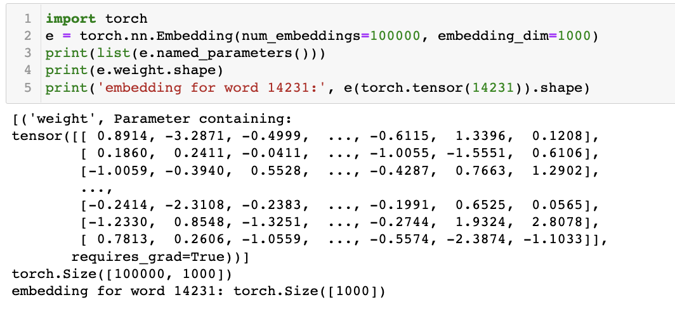
Word embeddings
Mechanically: a simple idea
size of vocab = 100000
dim of vector = 1000
one row for each word
1000 dim vec for each
Just a lookup-table to reduce a big vocabulary to a smaller vector

Slide 26
How to learn word embeddings?
Classical neural language models (Elman, etc):
Just train jointly together with the rest of the neural network.
Then 2012-2019: the pretrained word embedding era
Pretrain word embeddings on a vast corpus, to train your smaller network
2019-today: back to the classic way
Entire language models are pretrained on a vast corpus, including embedding

Slide 27
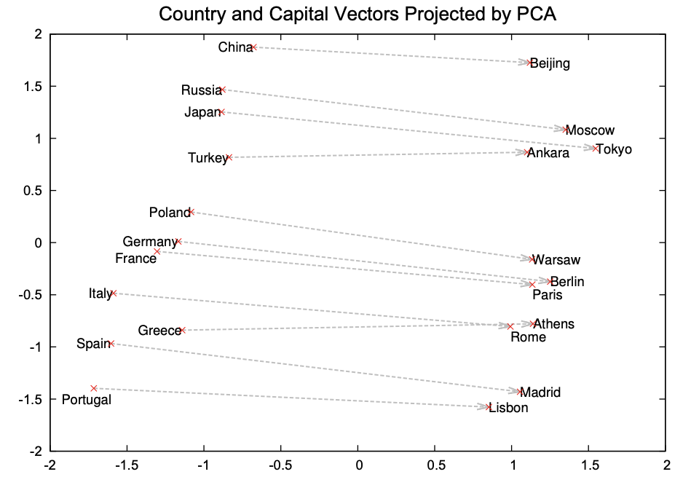
Semantic vector composition
When skip-gram training is done, semantic vector arithmetic emerges:
[Mikolov 2013]

Slide 28
Language Models Notebook
https://bit.ly/langmodels

