Slide 1
CS 7150
Deep Learning

Slide 2
Transformers

Slide 3
Neural Language Model Structure
The
Space
Need
le
is
in
downtown
Seattle

Slide 4
Training a Transformer
Attention in detail
Learnable neural connections: Queries, Keys and Values
Position encoding
Masks for “causal attention”
Multi-headed attention
The rest of the pieces
Tokenizing text
Forming the classification loss
Running generation

Slide 5
Language Modelling: Feed-forward Neural Net
Neural Approach #1: Feed-forward Neural Net
General Idea: using windows of words, predict the next word
Ex. He went to class after breakfast.
Output layer
$$W$$
Hidden layer
$$V$$
Example input sentence
He
went
to

Slide 6
Language Modelling: Feed-forward Neural Net
Neural Approach #1: Feed-forward Neural Net
General Idea: using windows of words, predict the next word
Ex. He went to class after breakfast.
Output layer
$$\hat{y}=\text{softmax}\left(Wh+b_{2}\right)∈ℝ^{\left|V\right|}$$
$$W$$
Hidden layer
$$h=f(Vx+b_{1})$$
$$V$$
Example input sentence
$$x=[x_{1},x_{2},x_{3}]$$
He
went
to
Concatenated word embeddings

Slide 7
Language Modelling: Feed-forward Neural Net
Neural Approach #1: Feed-forward Neural Net
General Idea: using windows of words, predict the next word
Ex. He went to class after breakfast.
Output layer
$$\hat{y}=\text{softmax}\left(Wh+b_{2}\right)∈ℝ^{\left|V\right|}$$
$$W$$
Hidden layer
$$h=f(Vx+b_{1})$$
$$V$$
Example input sentence
$$x=[x_{1},x_{2},x_{3}]$$
went
to
class
Concatenated word embeddings

Slide 8
Language Modelling: Feed-forward Neural Net
Neural Approach #1: Feed-forward Neural Net
General Idea: using windows of words, predict the next word
Ex. He went to class after breakfast.
Output layer
$$\hat{y}=\text{softmax}\left(Wh+b_{2}\right)∈ℝ^{\left|V\right|}$$
$$W$$
Hidden layer
$$h=f(Vx+b_{1})$$
$$V$$
Example input sentence
$$x=[x_{1},x_{2},x_{3}]$$
to
class
after
Concatenated word embeddings

Slide 9
Language Modelling: Feed-forward Neural Net
Training
$$L=CE({\hat{y}}_{t}, y_{t})$$
Output layer
$$\hat{y}=\text{softmax}\left(Wh+b_{2}\right)∈ℝ^{\left|V\right|}$$
$$W$$
Hidden layer
$$h=f(Vx+b_{1})$$
$$V$$
Example input sentence
$$x=[x_{1},x_{2},x_{3}]$$
$$w_{t−3}$$
$$w_{t−2}$$
$$w_{t−1}$$
Concatenated word embeddings

Slide 10
Language Modelling: Feed-forward Neural Net
$\hat{y}$: are probabilities for each possible word in the vocabulary.
$y:$ is a vector of 0’s and 1.
$$L=\sum_{t=3}^{t}{CE({\hat{y}}_{t}, y_{t})}$$
Training
Output layer
$$\hat{y}=\text{softmax}\left(Wh+b_{2}\right)∈ℝ^{\left|V\right|}$$
$$W$$
Hidden layer
$$h=f(Vx+b_{1})$$
$$V$$
Example input sentence
$$x=[x_{1},x_{2},x_{3}]$$
$$w_{t−3}$$
$$w_{t−2}$$
$$w_{t−1}$$
Concatenated word embeddings

Slide 11
Language Modelling : Feed-forward Neural Net
FFNN STRENGTHS?
No sparsity issues (it’s okay if we’ve never seen a segment of words)
No storage issues (we never store counts)
FFNN ISSUES?
Fixed-window size can never be big enough. Need more context.
Increasing window size adds many more weights
The weights awkwardly handle word position
No concept of time
Requires inputting entire context just to predict one word

Slide 12
Language Modelling
We especially need a system that:
Has an “infinite” concept of the past, not just a fixed window
For each new input, output the most likely next event (e.g., word)

Slide 13
Language Modelling
IDEA: for every individual input, output a prediction
Let’s use the previous hidden state, too
went
Output layer
$$\hat{y}=\text{softmax}\left(Wh+b_{2}\right)∈ℝ^{\left|V\right|}$$
$$W$$
Hidden layer
$$h=f(Vx+b_{1})$$
$$V$$
Example input word
$$x=x_{1}$$
He
single word embedding

Slide 14
Language Modelling: RNNs
Neural Approach #2: Recurrent Neural Network (RNN)
$${\hat{y}}_{1}$$
$${\hat{y}}_{2}$$
$${\hat{y}}_{3}$$
$${\hat{y}}_{4}$$
Output layer
$$W$$
$$W$$
$$W$$
$$W$$
$$U$$
$$U$$
$$U$$
$$U$$
Hidden layer
$$V$$
V
V
V
Input layer
$$x_{1}$$
$$x_{2}$$
$$x_{3}$$
$$x_{4}$$

Slide 15
RNN
Training Process
$$CE\left(y^{i},{\hat{y}}^{i}\right)=−\sum_{w∈W}{y_{w}^{i}\text{log}({\hat{y}}_{w}^{i})}$$
Error
$$CE\left(y^{1},{\hat{y}}^{1}\right)$$
$$CE\left(y^{2},{\hat{y}}^{2}\right)$$
$$CE\left(y^{3},{\hat{y}}^{3}\right)$$
$$CE\left(y^{4},{\hat{y}}^{4}\right)$$
$${\hat{y}}_{1}$$
$${\hat{y}}_{2}$$
$${\hat{y}}_{3}$$
$${\hat{y}}_{4}$$
Output layer
$$W$$
$$W$$
$$W$$
$$W$$
$$U$$
$$U$$
$$U$$
Hidden layer
$$V$$
$$V$$
$$V$$
$$V$$
Input layer
$$x_{1}$$
$$x_{2}$$
$$x_{3}$$
$$x_{4}$$
He
went
to
class

Slide 16
RNN
Training Process
$$CE\left(y^{i},{\hat{y}}^{i}\right)=−\sum_{w∈W}{y_{w}^{i}\text{log}({\hat{y}}_{w}^{i})}$$
Error
$$CE\left(y^{1},{\hat{y}}^{1}\right)$$
$$CE\left(y^{2},{\hat{y}}^{2}\right)$$
$$CE\left(y^{3},{\hat{y}}^{3}\right)$$
$$CE\left(y^{4},{\hat{y}}^{4}\right)$$
$${\hat{y}}_{1}$$
$${\hat{y}}_{2}$$
$${\hat{y}}_{3}$$
$${\hat{y}}_{4}$$
Output layer
$$W$$
$$W$$
$$W$$
$$W$$
$$U$$
$$U$$
$$U$$
Hidden layer
$$V$$
$$V$$
$$V$$
$$V$$
Input layer
$$x_{1}$$
$$x_{2}$$
$$x_{3}$$
$$x_{4}$$
He
went
to
class

Slide 17
RNN
Training Process
$$CE\left(y^{i},{\hat{y}}^{i}\right)=−\sum_{w∈W}{y_{w}^{i}\text{log}({\hat{y}}_{w}^{i})}$$
Error
$$CE\left(y^{1},{\hat{y}}^{1}\right)$$
$$CE\left(y^{2},{\hat{y}}^{2}\right)$$
$$CE\left(y^{3},{\hat{y}}^{3}\right)$$
$$CE\left(y^{4},{\hat{y}}^{4}\right)$$
went?
over?
class?
after?
Output layer
$$\hat{y}$$
$$W$$
$$W$$
$$W$$
$$W$$
$$U$$
$$U$$
$$U$$
Hidden layer
$$V$$
$$V$$
$$V$$
$$V$$
Input layer
$$x_{1}$$
$$x_{2}$$
$$x_{3}$$
$$x_{4}$$
She
went
to
class

Slide 18
RNN
Training Process
$$CE\left(y^{i},{\hat{y}}^{i}\right)=−\sum_{w∈W}{y_{w}^{i}\text{log}({\hat{y}}_{w}^{i})}$$
To update our weights (e.g. $U$), we calculate the gradient of our loss w.r.t. the repeated weight matrix (e.g., $\frac{∂L}{∂U} ).$
Error
$$CE\left(y^{1},{\hat{y}}^{1}\right)$$
$$CE\left(y^{2},{\hat{y}}^{2}\right)$$
$$CE\left(y^{3},{\hat{y}}^{3}\right)$$
$$CE\left(y^{4},{\hat{y}}^{4}\right)$$
went?
over?
class?
after?
Using the chain rule, we trace the derivative all the way back to the beginning, while summing the results.
Output layer
$$\hat{y}$$
$$W$$
$$W$$
$$W$$
$$W$$
$$U$$
$$U$$
$$U$$
Hidden layer
$$V$$
$$V$$
$$V$$
$$V$$
Input layer
$$x_{1}$$
$$x_{2}$$
$$x_{3}$$
$$x_{4}$$
He
went
to
class

Slide 19
RNN
Training Process
Error
$$CE\left(y^{1},{\hat{y}}^{1}\right)$$
$$CE\left(y^{2},{\hat{y}}^{2}\right)$$
$$CE\left(y^{3},{\hat{y}}^{3}\right)$$
$$CE\left(y^{4},{\hat{y}}^{4}\right)$$
went?
over?
class?
after?
Output layer
$$\hat{y}$$
$$W$$
$$W$$
$$W$$
$$W$$
$$U$$
$$U$$
$$U$$
Hidden layer
$$V$$
$$V$$
$$V$$
$$V$$
Input layer
$$x_{1}$$
$$x_{2}$$
$$x_{3}$$
$$x_{4}$$
He
went
to
class

Slide 20
RNN
$\frac{∂L}{∂V}$
Training Process
Error
$$CE\left(y^{1},{\hat{y}}^{1}\right)$$
$$CE\left(y^{2},{\hat{y}}^{2}\right)$$
$$CE\left(y^{3},{\hat{y}}^{3}\right)$$
$$CE\left(y^{4},{\hat{y}}^{4}\right)$$
went?
over?
class?
after?
Output layer
$$\hat{y}$$
$$W$$
$$W$$
$$W$$
$$W$$
$$U$$
$$U$$
$$U$$
Hidden layer
$$V$$
$$V$$
$$V$$
$$V$$
Input layer
$$x_{1}$$
$$x_{2}$$
$$x_{3}$$
$$x_{4}$$
She
went
to
class

Slide 21
RNN
This backpropagation through time (BPTT) process is expensive
Instead of updating after every timestep, we tend to do so every $T$ steps (e.g., every sentence or paragraph)
This isn’t equivalent to using only a window size $T$ (a la n-grams) because we still have ‘infinite memory’

Slide 22
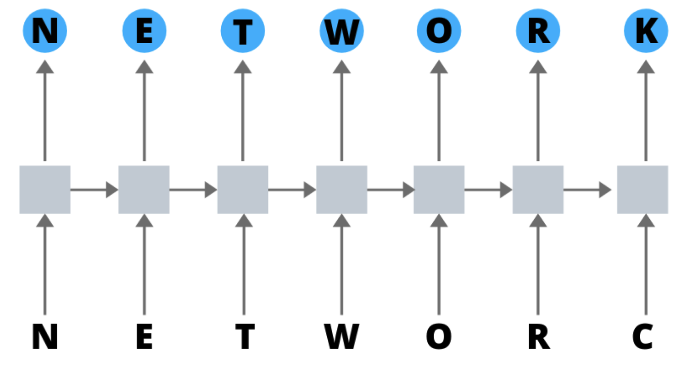
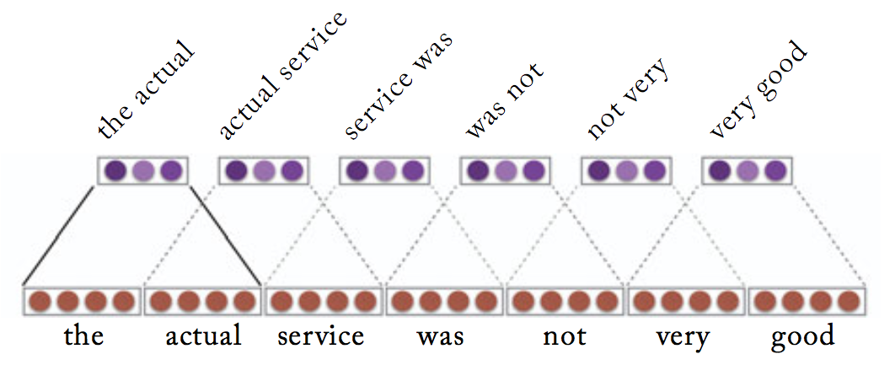
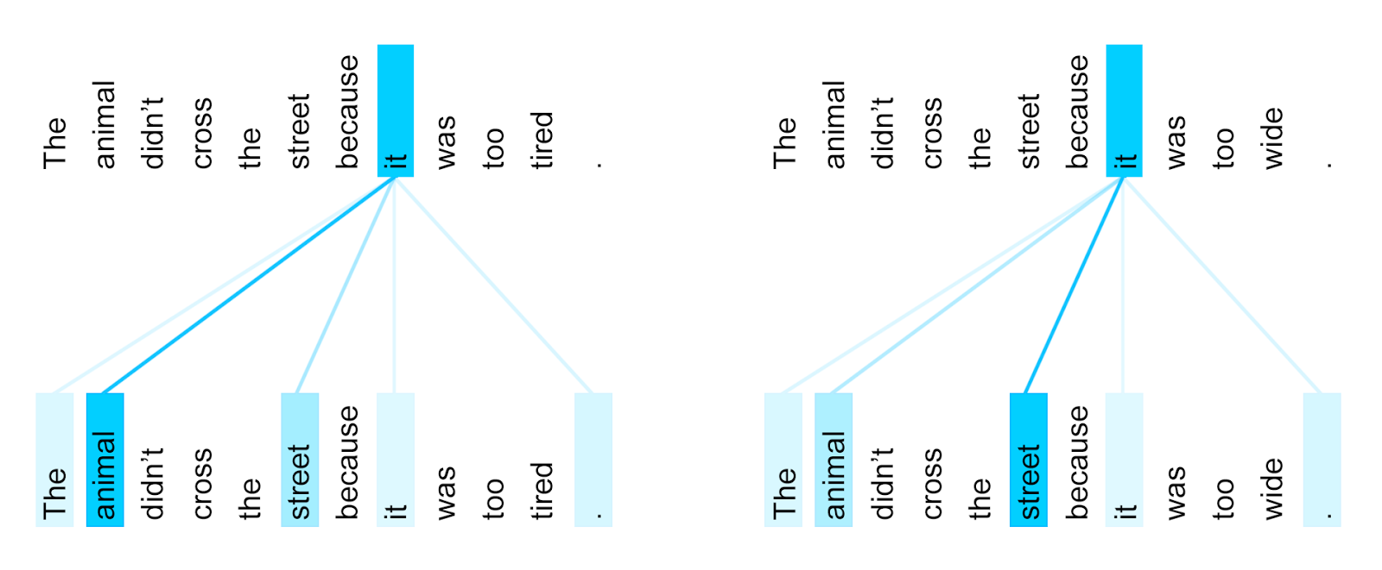
History of NLP architectures
RNN: Represent “Everything seen so far” Attend to last encoding, recursively.
Convolution: Represent “Everything seen nearby” Attend to nearby encodings, in parallel.
Attention: Represent “Everything relevant” Attend to relevant encodings, in parallel.

Slide 23
Details of Self-Attention
Attention operates on queries, keys, and values.
We have some queries 𝑞 , 𝑞 , … , 𝑞 . Each query is 𝑞_{i} ∈ ℝ^{𝑑}
We have some keys 𝑘₁, 𝑘₂, … , 𝑘_{𝑇}. Each key is 𝑘_{𝑖} ∈ ℝ^{𝑑}
We have some values 𝑣₁, 𝑣₂, … , 𝑣_{𝑇}. Each value is 𝑣_{𝑖} ∈ ℝ^{𝑑}
1 2 𝑇
In self-attention, the queries, keys, and values are drawn from the same source.
For example, if the output of the previous layer is 𝑥₁, … , 𝑥_{𝑇}, (one vec per word) we could let 𝑣_{𝑖} = 𝑘_{𝑖} = 𝑞_{𝑖} = 𝑥_{𝑖} (that is, use the same vectors for all of them!)
The (dot product) self-attention operation is as follows:
exp(𝑒_{𝑖𝑗})
𝑒 = 𝑞_{i}^{𝖳}𝑘 𝛼 =
output = Σ _{𝑗} 𝛼 𝑣
𝑖𝑗 𝑗
𝑖𝑗
𝑖 𝑖𝑗 𝑗
𝑖
Σ
_{𝑗'}
exp(𝑒_{𝑖𝑗’} )
Compute outputs as weighted sum of values
Compute key- query affinities
Compute attention weights from affinities
(softmax)
John Hewitt

Slide 24
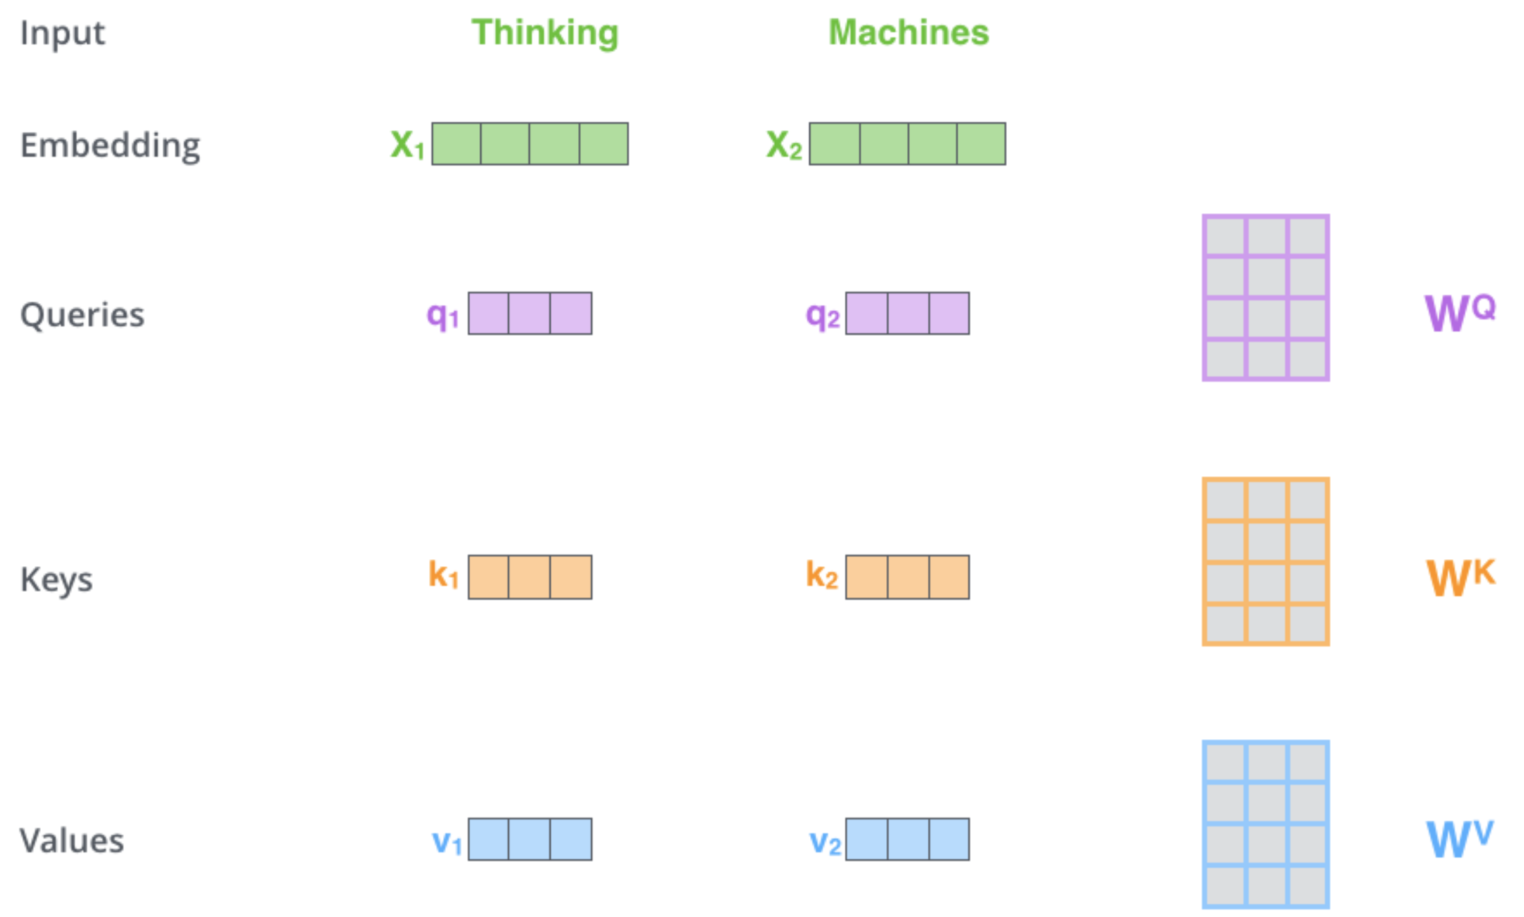
Self-Attention Details
While processing each word it allows to look at other positions in the input sequence for clues to build a better encoding for this word.
Step1: create three vectors from each of the encoder’s input vectors:
Query, a Key, Value (typically smaller dimension).
by multiplying the embedding by three matrices that we trained during the training process.
Notes:
As the model processes each word (each position in the input sequence), self attention allows it to look at other positions in the input sequence for clues that can help lead to a better encoding for this word.
If you’re familiar with RNNs, think of how maintaining a hidden state allows an RNN to incorporate its representation of previous words/vectors it has processed with the current one it’s processing. Self-attention is the method the Transformer uses to bake the “understanding” of other relevant words into the one we’re currently processing.
The first step in calculating self-attention is to create three vectors from each of the encoder’s input vectors (in this case, the embedding of each word). So for each word, we create a Query vector, a Key vector, and a Value vector. These vectors are created by multiplying the embedding by three matrices that we trained during the training process.
Notice that these new vectors are smaller in dimension than the embedding vector. Their dimensionality is 64, while the embedding and encoder input/output vectors have dimensionality of 512. They don’t HAVE to be smaller, this is an architecture choice to make the computation of multiheaded attention (mostly) constant.

Slide 25
Self-Attention
Step 2: calculate a score (like we have seen for regular attention!) how much focus to place on other parts of the input sentence as we encode a word at a certain position.
Take dot product of the query vector with the key vector of the respective word we’re scoring.
E.g., Processing the self-attention for word “Thinking” in position #1, the first score would be the dot product of q1 and k1. The second score would be the dot product of q1 and k2.
Notes:
The second step in calculating self-attention is to calculate a score. Say we’re calculating the self-attention for the first word in this example, “Thinking”. We need to score each word of the input sentence against this word. The score determines how much focus to place on other parts of the input sentence as we encode a word at a certain position.
The score is calculated by taking the dot product of the query vector with the key vector of the respective word we’re scoring. So if we’re processing the self-attention for the word in position #1, the first score would be the dot product of q1 and k1. The second score would be the dot product of q1 and k2.

Slide 26
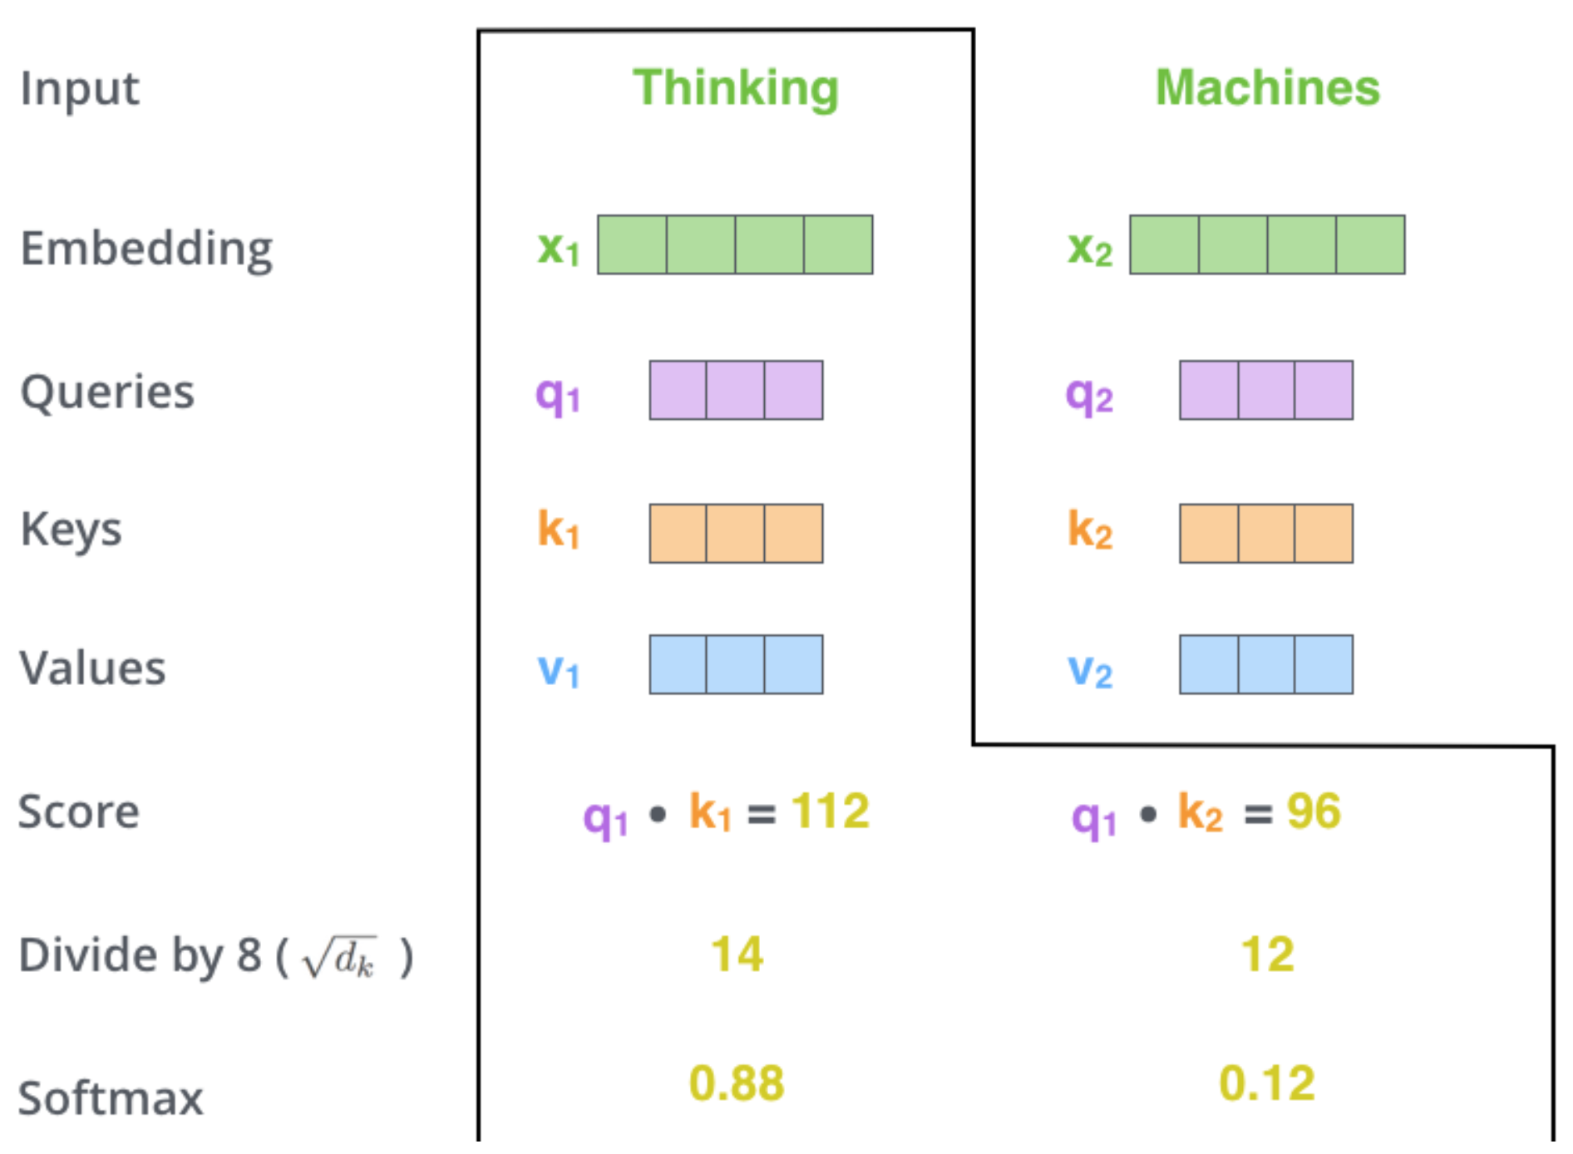
Self Attention
Step 3 divide scores by the square root of the dimension of the key vectors (more stable gradients).
Step 4 pass result through a softmax operation. (all positive and add up to 1)
Intuition: softmax score determines how much each word will be expressed at this position.
Notes:
The third and forth steps are to divide the scores by 8 (the square root of the dimension of the key vectors used in the paper – 64. This leads to having more stable gradients. There could be other possible values here, but this is the default), then pass the result through a softmax operation. Softmax normalizes the scores so they’re all positive and add up to 1

Slide 27
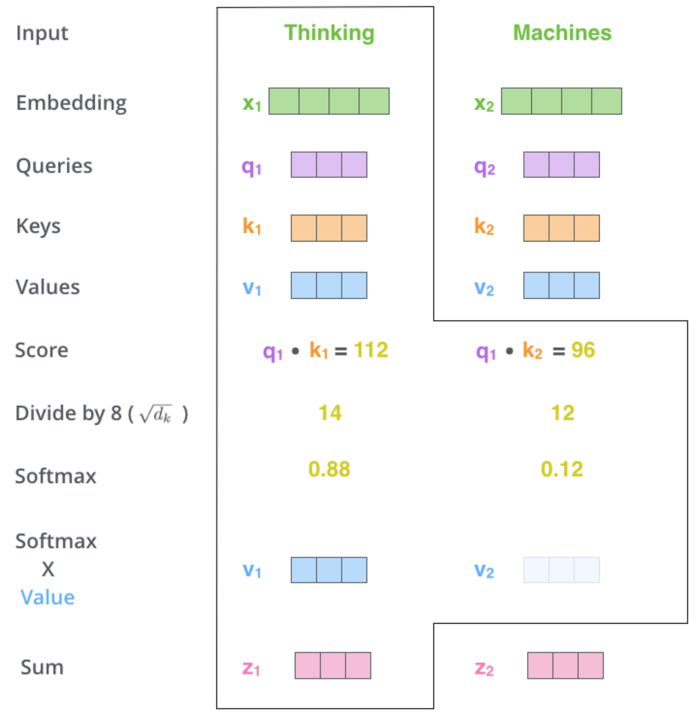
Self Attention
Step6 : sum up the weighted value vectors. This produces the output of the self-attention layer at this position
More details:
What we have seen for a word is done for all words (using matrices)
Need to encode position of words
And improved using a mechanism called “multi-headed” attention
(kind of like multiple filters for CNN)
see https://jalammar.github.io/illustrated-transformer/
Notes:
The third and forth steps are to divide the scores by 8 (the square root of the dimension of the key vectors used in the paper – 64. This leads to having more stable gradients. There could be other possible values here, but this is the default), then pass the result through a softmax operation. Softmax normalizes the scores so they’re all positive and add up to 1

Slide 28
Is Self-Attention All You Need? Not yet.
In the diagram at the right, we have stacked self-attention blocks, like we might stack LSTM layers.
Can self-attention be a drop-in
replacement for recurrence?
No. It has a few issues, which
we’ll go through.
First, self-attention is an operation on sets. It has no inherent notion of order.
self-attention
𝑞₁
𝑘₁ 𝑣₁
𝑘₂
𝑞₂
𝑞₃
𝑞_{𝑇}
𝑣₂ 𝑘₃ 𝑣₃
𝑘_{𝑇}
𝑣_{𝑇}
…
self-attention
𝑘₂ 𝑣₂ 𝑘₃ 𝑞₃ 𝑣₃
𝑞₁
𝑘₁ 𝑣₁
𝑞₂
𝑘_{𝑇}
𝑞_{𝑇}
𝑣_{𝑇}
…
𝑤₁
The
𝑤₂
chef
𝑤₃
who
𝑤_{𝑇}
food
Self-attention doesn’t know the order of its inputs.
John Hewitt

Slide 29
Position Encoding
Sinusoidal position representations: concatenate sinusoidal functions of varying periods:
sin(ω₁ t) cos(ω₁ t)
𝑝_{𝑖} =
Dimension
sin(ω_{d/2} t)
cos(ω_{d/2} t)
Index in the sequence
Why?
We chose this function because we hypothesized it would allow the model to easily learn to attend by relative positions, since for any fixed offset $φ$, PE_{pos+𝜙} can be represented as a linear function of PE_{pos}.
John Hewitt
Image: https://timodenk.com/blog/linear-relationships-in-the-transformers-positional-encoding/

Slide 30
Masking Attention to the Future
We can look at these (not greyed out) words
To use self-attention in decoders, we need to ensure we can’t peek at the future.
−∞ | −∞ | −∞ | −∞
 | −∞ | −∞ | −∞
 |  | −∞ | −∞
 |  |  | −∞
[START]
At every timestep, we could change the set of keys and queries to include only past words. (Inefficient!)
To enable parallelization, we mask out attention to future words by setting attention scores to −∞.
𝑒_{𝑖𝑗} =
The
For encoding these words
chef
who
𝑞^{𝖳}𝑘_{𝑗}, 𝑗 < 𝑖
𝑖
−∞, 𝑗 ≥ 𝑖
John Hewitt

Slide 31
Feed-Forward Modules
Note that there are no elementwise nonlinearities in self-attention; stacking more self-attention layers just re-averages value vectors
Easy fix: add a feed-forward network
to post-process each output vector.
FF
FF
FF
self-attention
FF
…
FF
FF
FF
self-attention
FF
𝑚_{𝑖} = 𝑀𝐿𝑃 output_{𝑖}
= 𝑊₂ ∗ ReLU 𝑊₁ × output_{𝑖} + 𝑏₁
…
+ 𝑏₂
𝑤₁
The
𝑤₂
chef
𝑤₃
who
𝑤_{𝑇}
food
Intuition: the FF network processes the result of attention
John Hewitt

Slide 32
Let’s try training a transformer
https://bit.ly/1htt

Slide 33
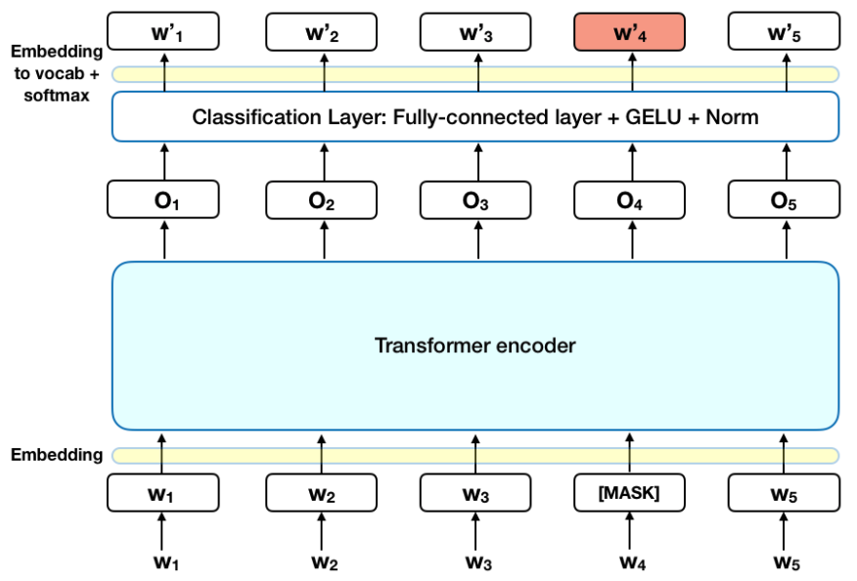
One vector for every token, through a stack of layers
Analogous to a convnet without any resolution change.
Input: one vec for every token.
Output: one vec for every token.
Computation: a stack of neural network layers.
Objective: correctly predict the next word (or other similar obj.)

Slide 34
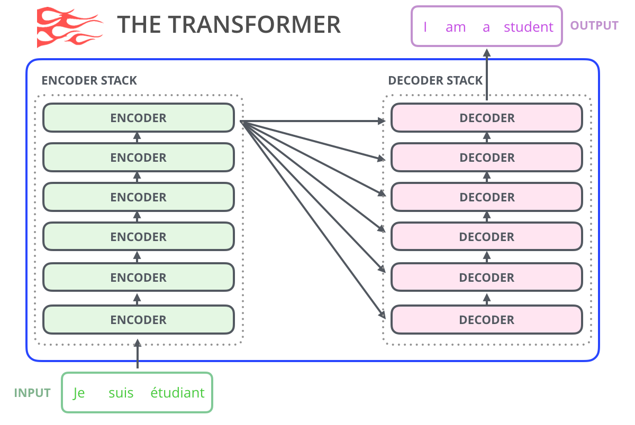
Attention is All You Need (Vaswani 2017 - Google)
Natural Language Translation
Start with an independent encoding for each word.
Improve each word’s encoding by incorporating context, using a stack of six encoders.
Generate target sentence using a stack of six decoders.
Overview figure from Jay Alammar’s blog

Slide 35
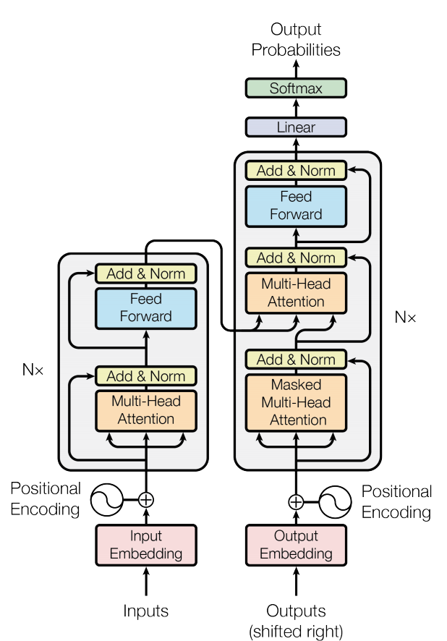
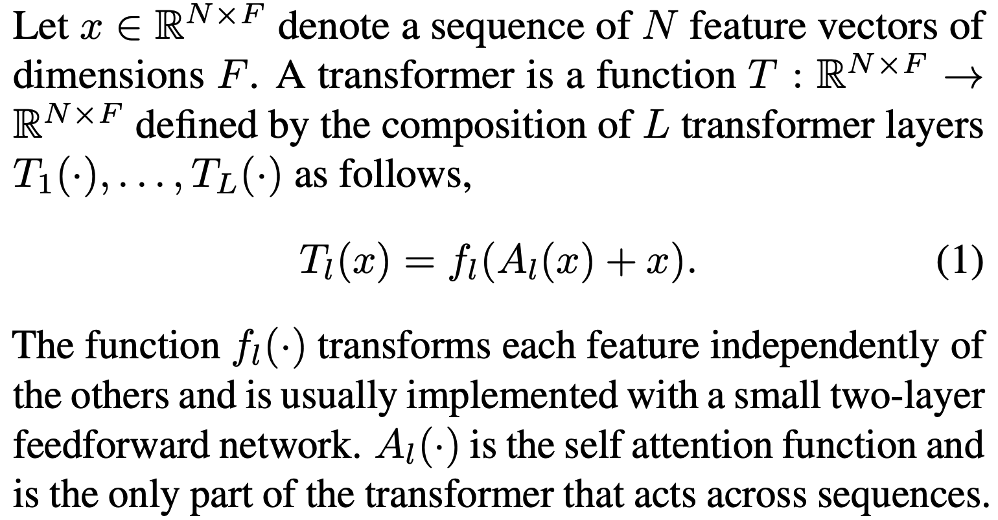
The Two Steps Inside Each Layer
Figure from original Vaswani paper
(1) Attend with A, then (2) Map w/ f.
Each word: F-dimensional feature
f
6⨉
6⨉
A
Clean formula from: Katharopoulos 2020 “Transformers are RNNs”
N⨉

Slide 36
Transformers attend over the grid of states
h_{i}^{(l)} state
The
attention
Space
MLP
Need
le
is
in
downtown
Seattle (correct output)

Slide 37
Transformer Overview
Attention is all you need. 2017. Aswani, Shazeer, Parmar, Uszkoreit, Jones, Gomez, Kaiser, Polosukhin https://arxiv.org/pdf/1706.03762.pdf
Non-recurrent sequence-to- sequence encoder-decoder model
Task: machine translation with parallel corpus
Predict each translated word
Final cost/error function is standard cross-entropy error on top of a softmax classifier
This and related figures from paper ⇑
Christopher Manning

Slide 38
Transformer Encoder
For encoder, at each block, we apply the Q, K and V
on states from the previous layer
Blocks are repeated 6 times (in vertical stack)
Christopher Manning

Slide 39
Transformer Decoder
2 sublayer changes in decoder
Masked decoder self-attention on previously generated outputs:
Encoder-Decoder Attention, where queries come from previous decoder layer and keys and values come from output of encoder
Blocks repeated 6 times also
Christopher Manning

Slide 40
Parallelizing Attention over All Tokens
Let’s look at how key-query-value attention is computed, in matrices.
Let 𝑋 = 𝑥₁; … ; 𝑥_{𝑇} ∈ ℝ^{𝑇×𝑑} be the concatenation of input vectors.
First, note that 𝑋𝐾 ∈ ℝ^{𝑇×𝑑}, 𝑋𝑄 ∈ ℝ^{𝑇×𝑑}, 𝑋𝑉 ∈ ℝ^{𝑇×𝑑}.
𝖳
The output is defined as output = softmax 𝑋𝑄 𝑋𝐾 ^{T} × 𝑋𝑉.
First, take the query-key dot products in one matrix
All pairs of attention scores!
= 𝑋𝑄𝐾^{𝖳} 𝑋^{𝖳}
𝑋𝑄
multiplication: 𝑋𝑄 𝑋𝐾
𝖳
_{𝐾}𝖳 _{𝑋}𝖳
∈ ℝ
𝑇×𝑇
Next, softmax, and compute the weighted average with another matrix multiplication.
softmax
𝑋𝑄𝐾^{𝖳} 𝑋^{𝖳}
𝑋𝑉
=
output ∈ ℝ^{𝑇×𝑑}
John Hewitt

Slide 41
Parallelizing Multiple Attention Heads
What if we want to look in multiple places in the sentence at once?
For word 𝑖, self-attention “looks” where 𝑥^{𝖳}𝑄^{𝖳}𝐾𝑥_{𝑗} is high, but maybe we want
𝑖
to focus on different 𝑗 for different reasons?
We’ll define multiple attention “heads” through multiple Q,K,V matrices
𝑑
Let, 𝑄_{𝑃}, 𝐾_{𝑃}, 𝑉_{𝑃} ∈ ℝ ^{ℎ}, where ℎ is the number of attention heads, and 𝑃 ranges
from 1 to ℎ.
Each attention head performs attention independently:
𝑑×
Then the outputs of all the heads are combined!
Each head gets to “look” at different things, and construct value vectors
differently.
John Hewitt

Slide 42
Parallelizing Multiple Attention Heads
What if we want to look in multiple places in the sentence at once?
For word 𝑖, self-attention “looks” where 𝑥^{𝖳}𝑄^{𝖳}𝐾𝑥_{𝑗} is high, but maybe we want to focus on different 𝑗 for different reasons?
𝑖
We’ll define multiple attention “heads” through multiple Q,K,V matrices
Single-head attention
(just the query matrix)
Multi-head attention
(just two heads here)
Same amount of computation as single-head self- attention!
𝑋
=
𝑋𝑄
𝑋
𝑄₁ 𝑄₂ =
𝑋𝑄₁ 𝑋𝑄₂
𝑄
John Hewitt

Slide 43
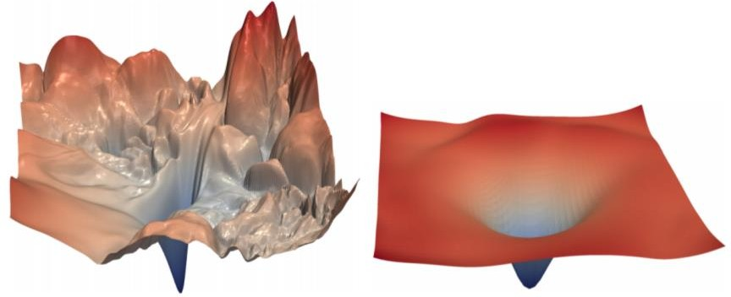
Transformers Use a Residual Stream
Residual connections are a trick to help models train better.
Instead of 𝑋^{(𝑖)} = Layer(𝑋 ^{𝑖−1} ) (where 𝑖 represents the layer)
_{𝑋}(𝑖−1) _{𝑋}(𝑖)
Layer
We let 𝑋^{(𝑖)} = 𝑋^{(𝑖−1)} + Layer(𝑋 ^{𝑖−1} ) (so we only have to learn “the residual”
from the previous layer)
_{𝑋}(𝑖−1) _{𝑋}(𝑖)
Layer
+
Residual connections are thought to make the loss landscape considerably smoother (thus easier training!)
[no residuals] [residuals]
[Loss landscape visualization, Li et al., 2018, on a ResNet]
John Hewitt

Slide 44
Attention and MLP contribute to the Residual Stream
h_{i}^{(l)} state
The
attention
Space
MLP
Need
le
is
in
downtown
Seattle (correct output)

Slide 45
Transformers use Layer Normalization
Layer normalization is a trick to help models train faster.
Idea: cut down on uninformative variation in hidden vector values by normalizing to unit mean and standard deviation within each layer.
LayerNorm’s success may be due to its normalizing gradients [Xu et al., 2019]
Let 𝑥 ∈ ℝ^{𝑑} be an individual (word) vector in the model.
Let 𝜇 = Σ_{j=1}^{𝑑} 𝑥_{𝑗} ; this is the mean; 𝜇 ∈ ℝ.
1
𝑑
Σ^{d}
2
𝑥 − 𝜇 ; this is the standard deviation; 𝜎 ∈ ℝ.
Let 𝜎 =
Let 𝛾 ∈ ℝ^{𝑑} and 𝛽 ∈ ℝ^{𝑑} be learned “gain” and “bias” parameters. (Can omit!)
Then layer normalization computes:
𝑗=1
𝑗
𝑥 − 𝜇
∗ 𝛾 + 𝛽
output =
∗ 𝛾 + 𝛽
Modulate by learned elementwise gain and bias
𝜎 + 𝜖
Normalize by scalar mean and variance
Modulate by learned elementwise gain and bias
John Hewitt

Slide 46
Transformers use Scaled Dot Product
“Scaled Dot Product” attention is a final variation to aid in Transformer training.
When dimensionality 𝑑 becomes large, dot products between vectors become large, inputs to the softmax function can be large, making gradients small.
Instead of the self-attention function we’ve seen:
output_{𝑃} = softmax 𝑋𝑄_{𝑃}𝐾^{𝖳}𝑋^{𝖳} ∗ 𝑋𝑉_{𝑃}
𝑃
We divide the attention scores by 𝑑/ℎ, to stop the scores from becoming large
just as a function of 𝑑/ℎ (The dimensionality divided by the number of heads.)
output_{𝑃} = softmax
𝑋𝑄_{𝑃}𝐾^{𝖳}𝑋^{𝖳}
∗ 𝑋𝑉_{𝑃}
𝑃
𝑑/ℎ
John Hewitt

Slide 47
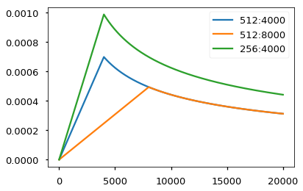
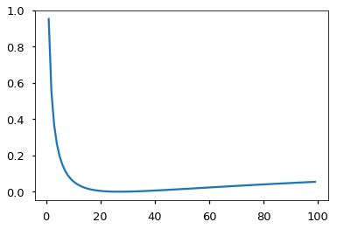
A few more training tricks for Transformers
Learning Rate Schedule
Smoothed Loss (penalize overconfidence)

Slide 48
The Transformer Encoder-Decoder (Vaswani et al., 2017)
Looking back at the whole model, zooming in on an Encoder block:
[predictions!]
Transformer Encoder
Transformer Decoder
[decoder attends to encoder states]
Transformer
Encoder
Transformer Decoder
Word Embeddings
+
Position Representations
Word
Embeddings
+
Position
Representations
[input sequence]
[output sequence]
John Hewitt

Slide 49
The Transformer Encoder-Decoder (Vaswani et al., 2017)
Looking back at the whole model, zooming in on an Encoder block:
Transformer
Encoder
[predictions!]
Transformer Decoder
Residual + LayerNorm
[decoder attends to encoder states]
Feed-Forward
Residual + LayerNorm
Transformer Decoder
Multi-Head Attention
Word Embeddings
+
Position Representations
Word
Embeddings
+
Position
Representations
[input sequence]
[output sequence]
John Hewitt

Slide 50
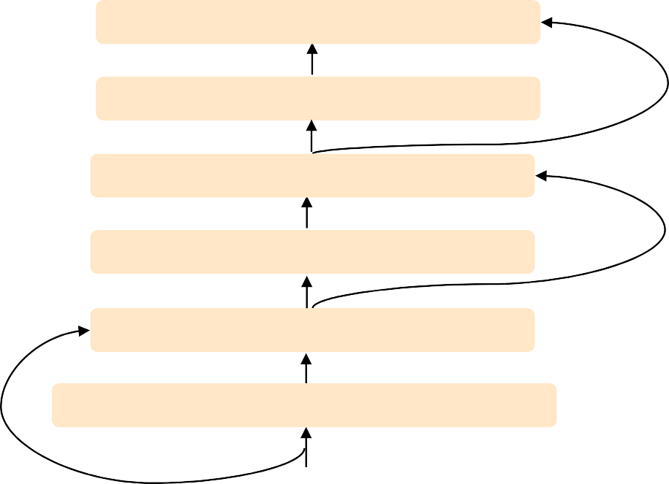
The Transformer Encoder-Decoder (Vaswani et al., 2017)
Looking back at the whole model, zooming in on a Decoder block:
Transformer Encoder
[predictions!]
Transformer Decoder
Residual + LayerNorm Feed-Forward Residual + LayerNorm
Multi-Head Cross-Attention Residual + LayerNorm
Masked Multi-Head Self-Attention
Transformer
Encoder
Word Embeddings
+
Position Representations
Word
Embeddings
+
Position
Representations
[input sequence]
[output sequence]
John Hewitt

Slide 51
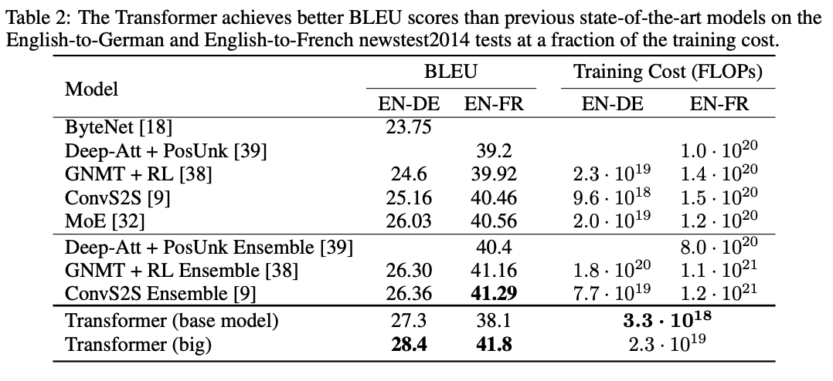
Transformers for Translation: better, faster, cheaper

Slide 52
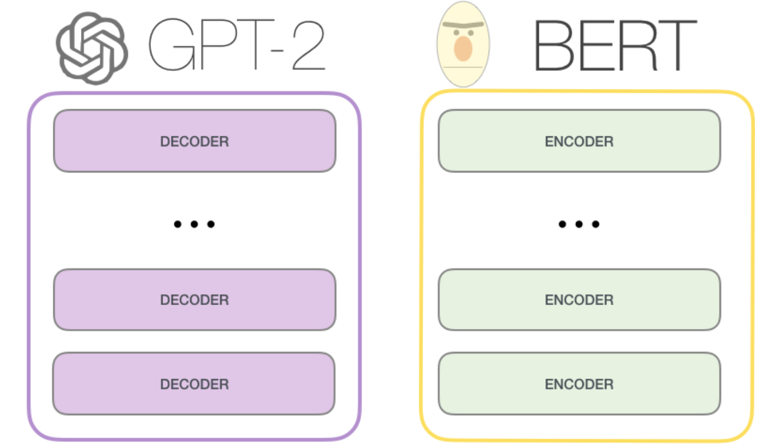
After Transformer: GPT-2 (Decode only), BERT (Encode only)
Transformer architecture has been remarkably stable: GPT, BERT use transformer essentially unchanged.
GPT-2 is a left-to-right language model trained on huge texts.
BERT is trained on masked-word-reconstruction and next-sentence classification on books and wikipedia..

Slide 53
Decoder task: Predict the Next Word (GPT-1,2,3)
GPT-1: Radford 2018 “Improving Language Understanding..”
GPT-2: Radford 2019 “LMs are Unsupervised Multitask Learners”
GPT-3: Brown 2020 “LMs are Few-Shot Learners”

Slide 54
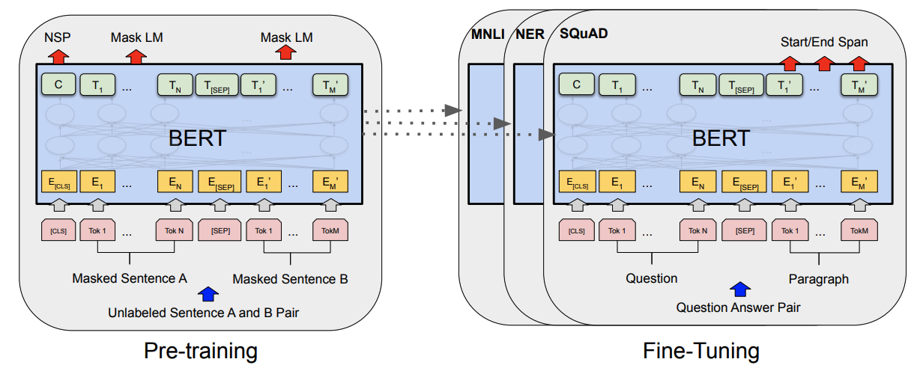
The BERT encoder training task. (Devlin 2018)
Input: two sentences from wikipedia+books corpus.
15% words targeted, 80% replaced with [MASK], 10% replaced with random token, 10% left real. Task: reconstruct targeted words.
Classify actually adjacent sentences versus random unrelated sentences.

Slide 55
A discussion of transformer efficiency… Or inefficiency
Looking at everything naively would be O(n²d²).
Attention gets us to n²d ; paper argues that is pretty good, but it is not great.
The n² makes scaling up the size of input+output very expensive.
One approach is to factorize attention operation to reduce complexity: “Sparse Attention” - O(n^{1.5}) - used by GPT-3 to make very massive models

Slide 56
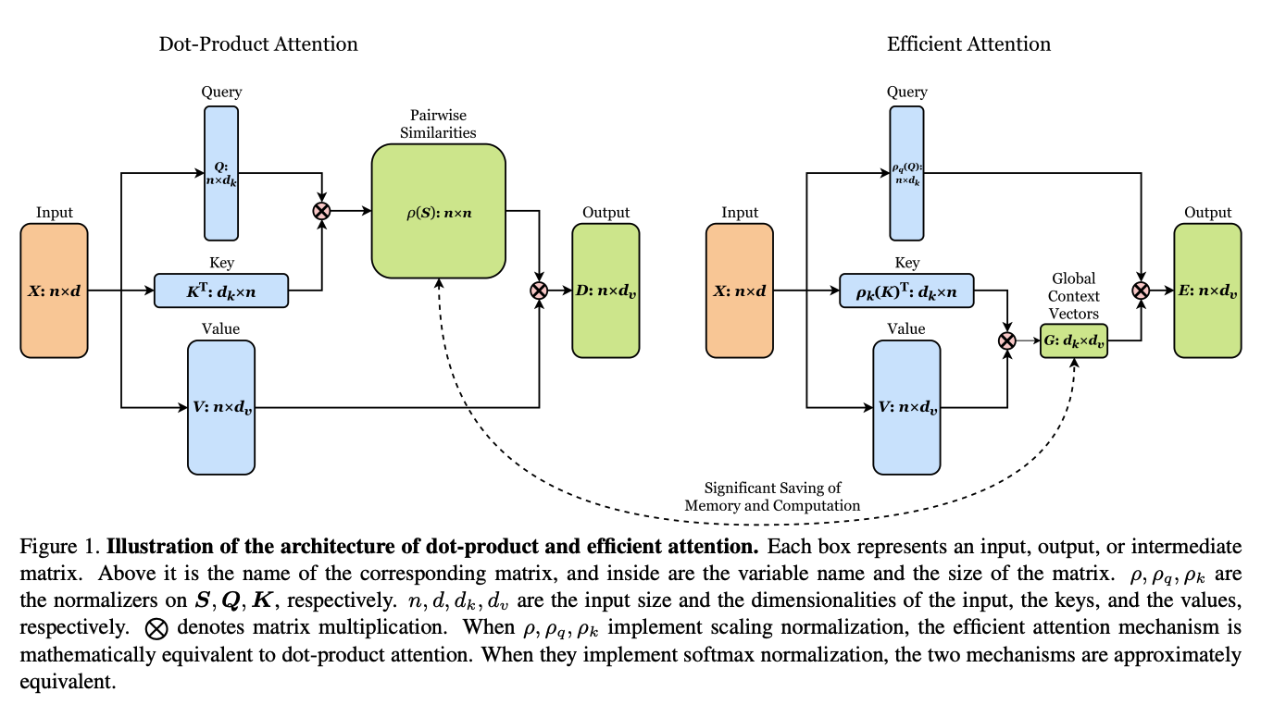
Recent ideas on efficiency: O(ndm) [linear time] attention
Shen 2020 “Efficient Attention”; Katharopoulos 2020 “Transformers are RNNs”

Slide 57
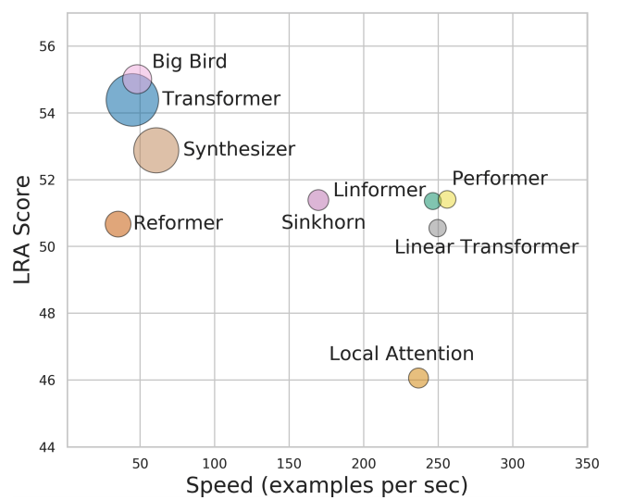
Efficiency survey (Tay 2020)
LRA, or Long Range Arena, is a benchmark for transformer performance on tasks w/ long-range dependencies (to test the n^2 blowup). Models with high LRA are large & slow.

Slide 58
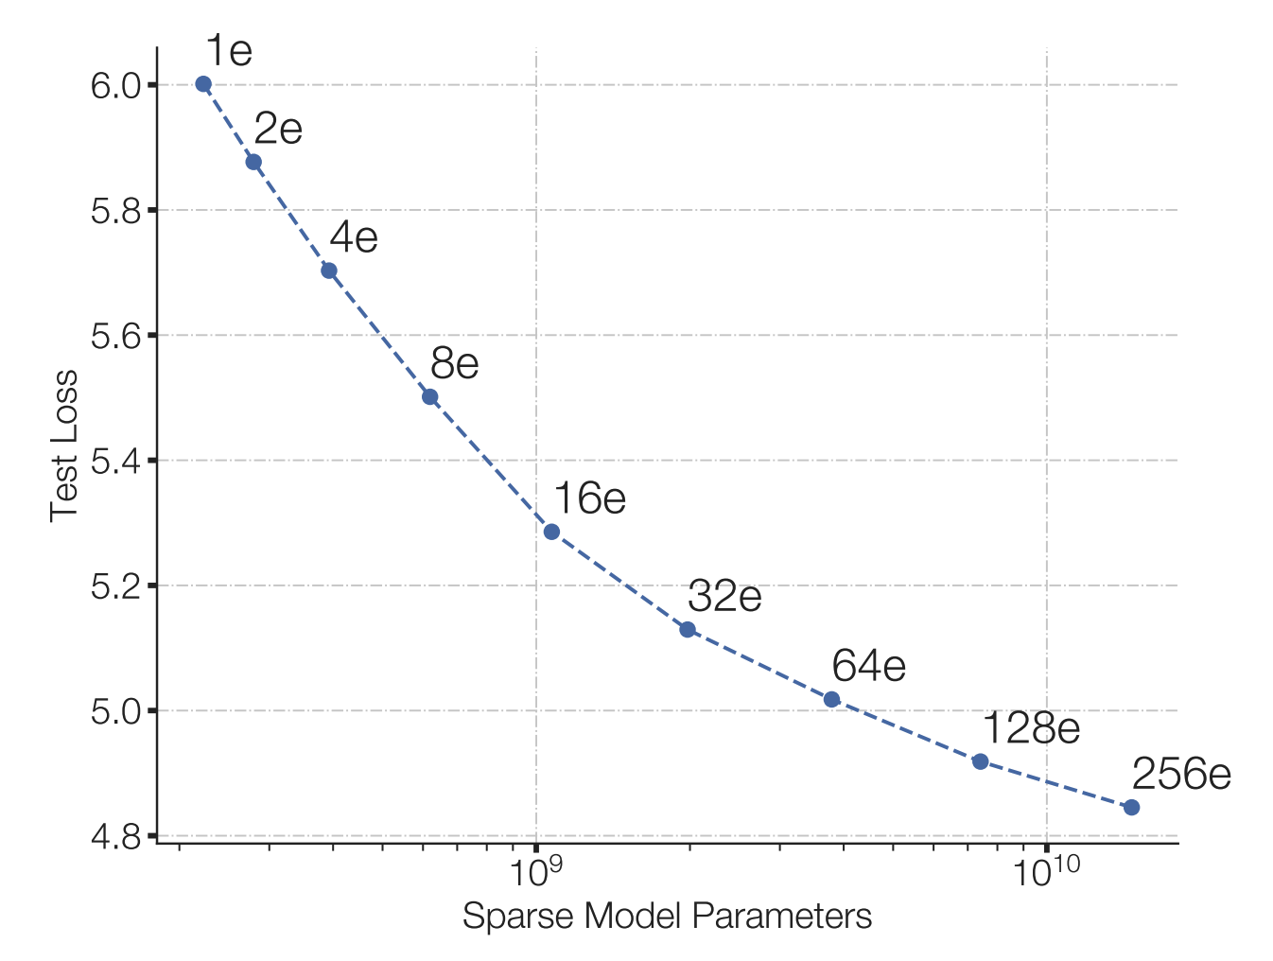
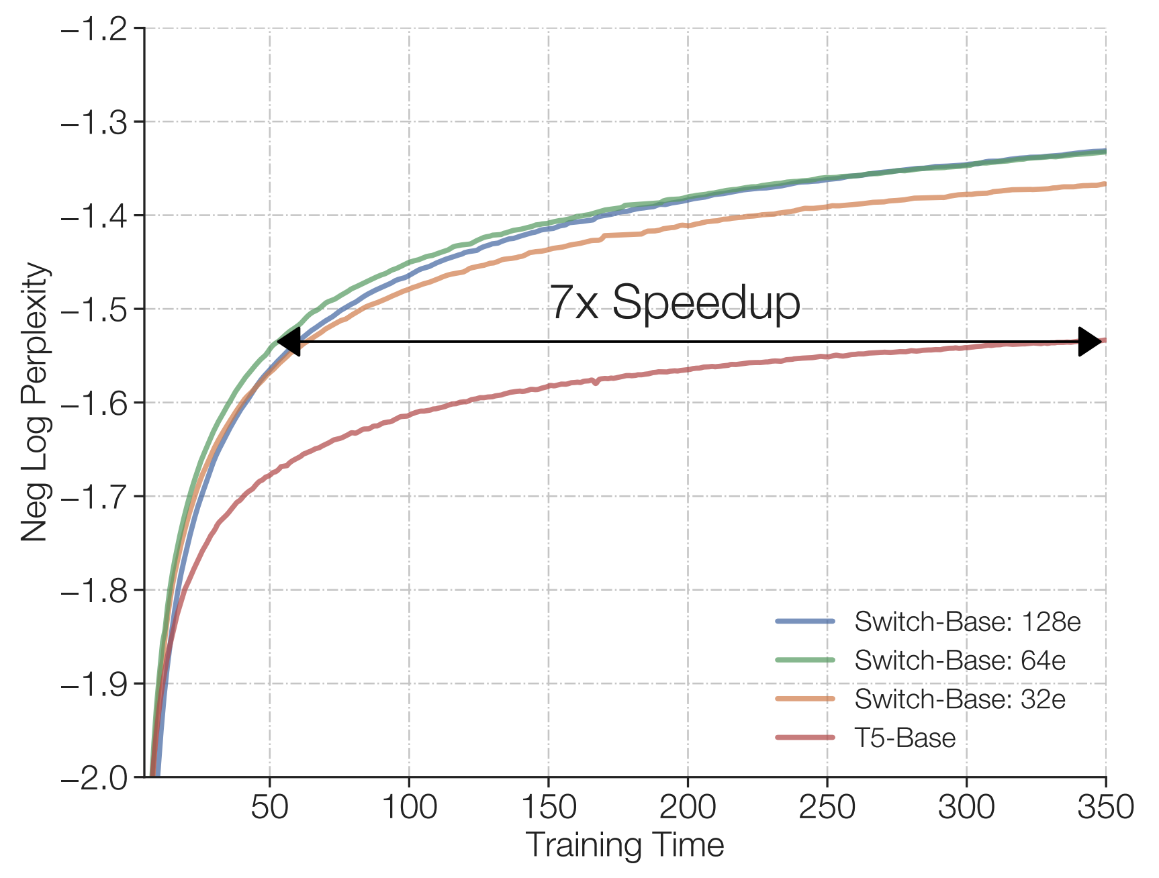
More observations on efficiency (Fedus 2021)
“Switched Transformers”
cheap!
Under a fixed compute budget, it is better to have a (much) bigger model and stop earlier.
Early-stopping of huge models, strategy inspired by Kaplan 2020 “Scaling laws for neural language models”

Slide 59
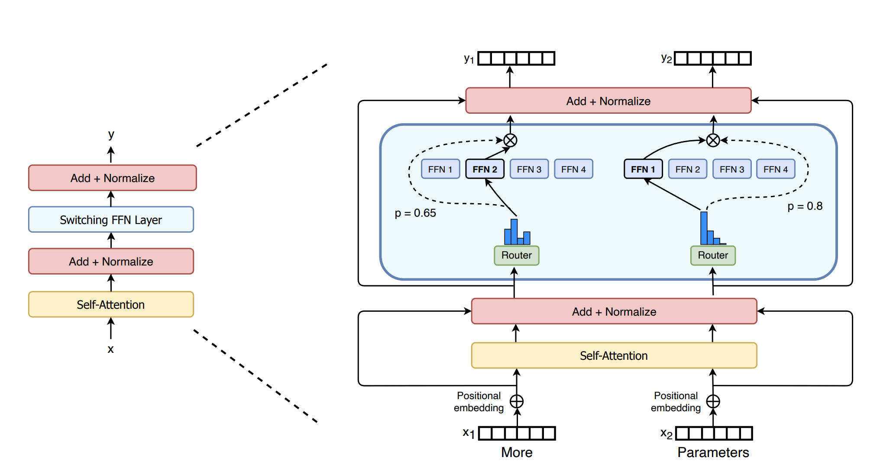
Switch Transformers: enlarge parameters (Fedus 2021)
Make the FF layer much larger by using a Mixture of Experts architecture.
Ideas: (1) don’t mix. Just one expert. (2) Only router loss is to load-balance.

Slide 60
What is so great about scaling up: Amazing GPT tricks
Priming is basically few-shot learning! Show GPT a few example inputs/outputs, and it figures out how to respond to future queries.
The “primer”
Without any pre-training, it “learns” to write MC questions with quality distractors & the correct answer!

Slide 61
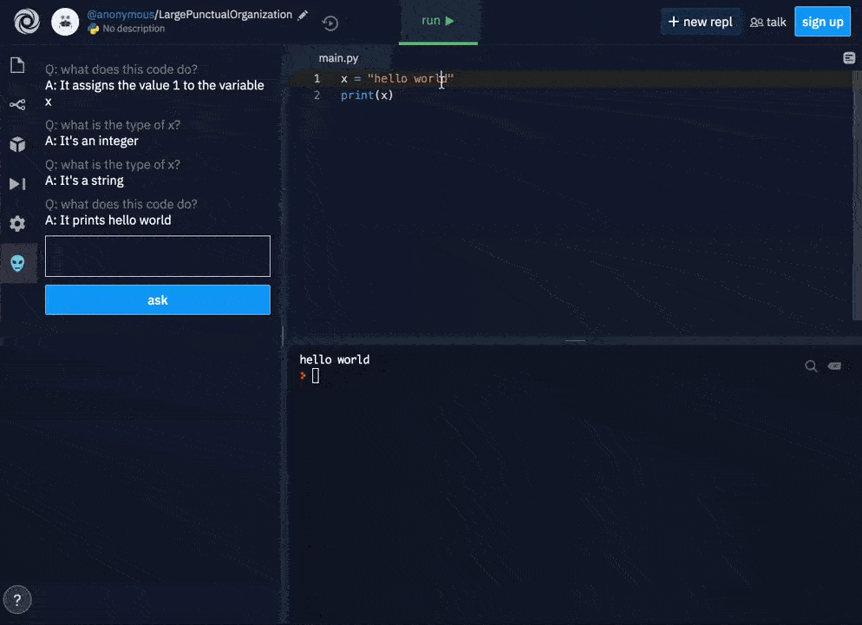
What is so great about scaling up: Amazing GPT tricks

Slide 62
What is so great about scaling up: Amazing GPT tricks

Slide 63
A Library for Priming GPT3: Example with Latex
github.com/shreyashankar/gpt3-sandbox
# Construct GPT object and show some examples
gpt = GPT(engine="davinci",
temperature=0.5,
max_tokens=100)
gpt.add_example(Example('Two plus two equals four', '2 + 2 = 4'))
gpt.add_example(Example('The integral from zero to infinity', '\\int_0^{\\infty}'))
gpt.add_example(Example('The gradient of x squared plus two times x with respect to x', '\\nabla_x x^2 + 2x'))
gpt.add_example(Example('The log of two times x', '\\log{2x}'))
gpt.add_example(Example('x squared plus y squared plus equals z squared', 'x^2 + y^2 = z^2'))
# Define UI configuration
config = UIConfig(description="Text to equation",
button_text="Translate",
placeholder="x squared plus 2 times x")
demo_web_app(gpt, config)

Slide 64
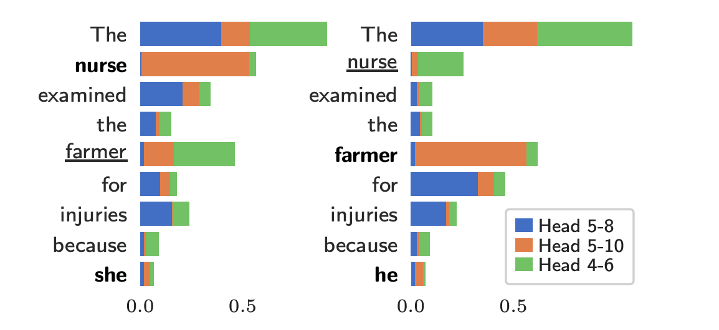
Some Interpretability Results
Individual attention heads have specific purposes, e.g., inferring gender for pronouns. (Vig 2020, Causal Mediation).
In some networks, most heads can be pruned with little damage (Voita 2019, Analyzing Multi-Head).
Maybe the community will use Linear-Time attention and Head-Pruning to make even more massive models with less computation.

Slide 65
Image GPT/Generative Pretraining from Pixels (Chen 2020)
Two explored training objectives
Autoregressive: predict next pixel value in raster order
BERT-Style: predict values of masked pixels (15%)
Key observation: iGPT learns really good representations via generative pretraining! Done without inductive bias in NN architecture (c.f. CNNs, where locality is enforced)

Slide 66
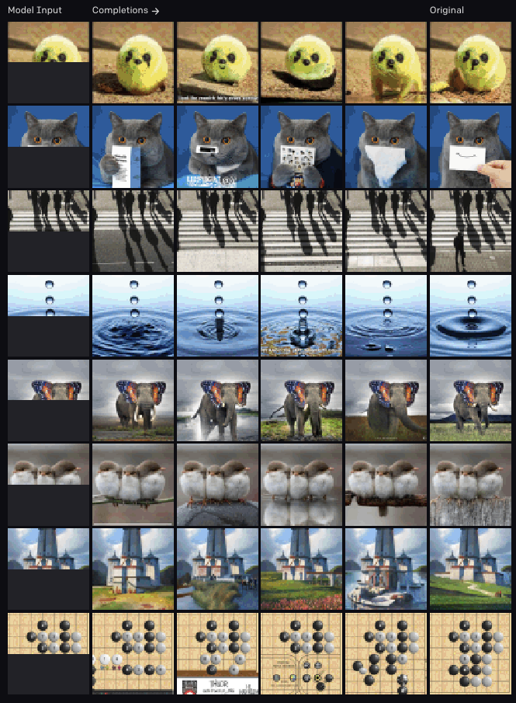
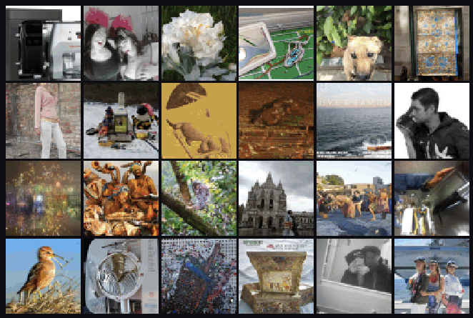
Image GPT/Generative Pretraining from Pixels (Chen 2020)
← Fill-in-the-blank
↓ Generations

Slide 67
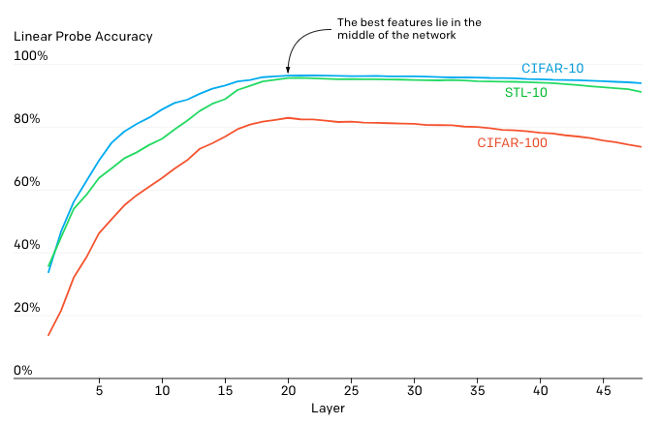
Image GPT/Generative Pretraining from Pixels (Chen 2020)
Feature quality is examined via a linear probe.
Hypothesis: iGPT operates in 2 phases
Gradually build a global representation
Use it to solve a specific task

Slide 68
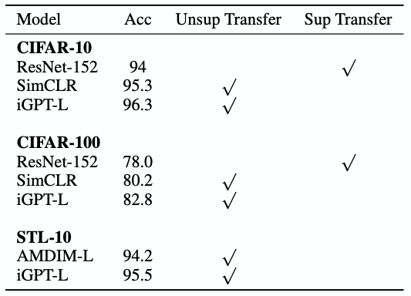
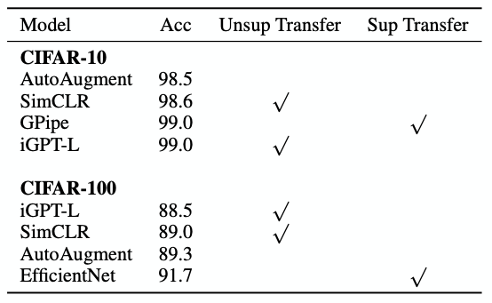
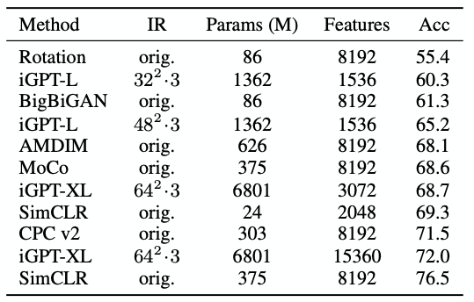
Image GPT/Generative Pretraining from Pixels (Chen 2020)
Results on autoregressive tasks
Linear Probe w/ ImageNet Pretraining
Full Fine-Tuning w/ ImageNet Pretraining
Linear Probe on ImageNet (High Res)
(In)efficiency of attention is prohibitive!
Features work well on 32x32 datasets
Poor performance on ImageNet (~500^2 pixels/image). Hacks are required to remain competitive, e.g. concatenating features from multiple layers

Slide 69
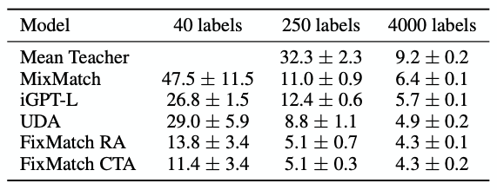
Image GPT/Generative Pretraining from Pixels (Chen 2020)
What about low-data fine-tuning?
* Values are error rates
iGPT outperforms 2 other low-data semi-supervised methods, simply using learned reprs + linear classifier
Achieved without using special tricks (e.g. data augmentation, pseudo-labeling)

Slide 70
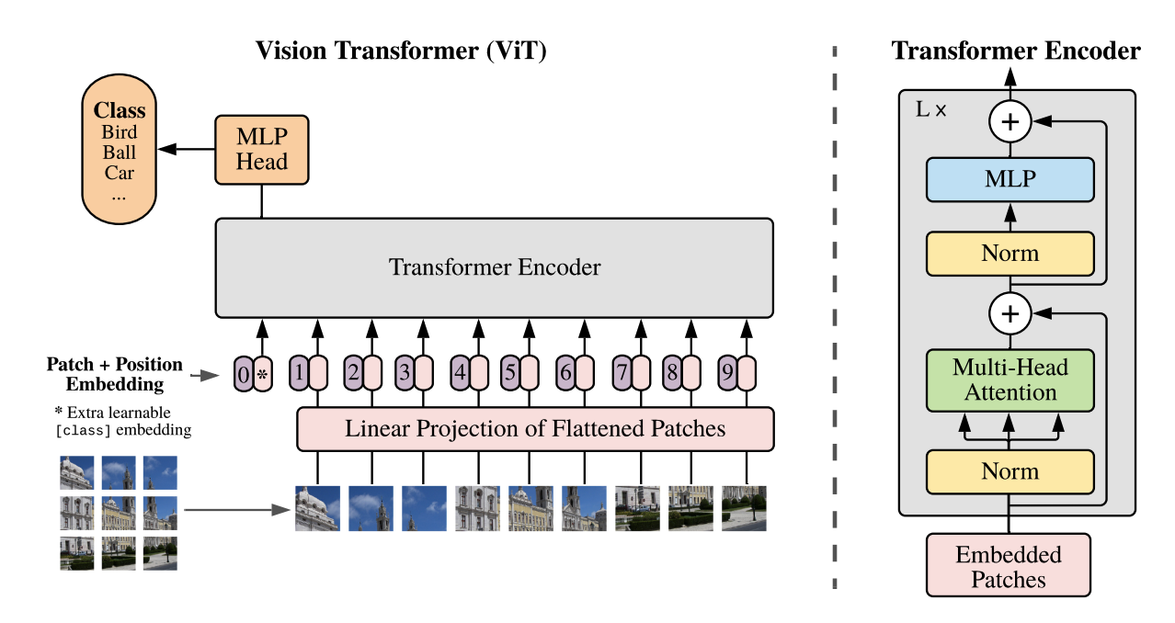
Vision Transformer (Dosovitskiy 2020)
Treat each 14x14 patch as a word, embedded to 64-dim feature.
Train supervised, to classify.
Unlike BERT, reconstruction pretraining does not do as well.
* Pixels can also be replaced with CNN feature maps
“Hybrid Model”

Slide 71
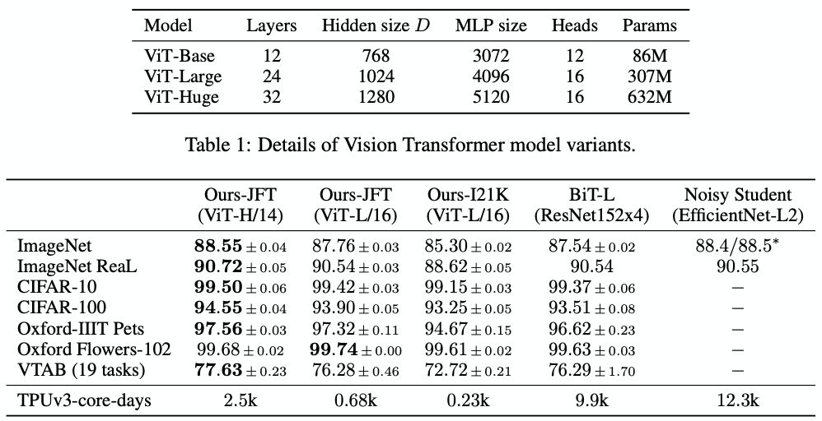
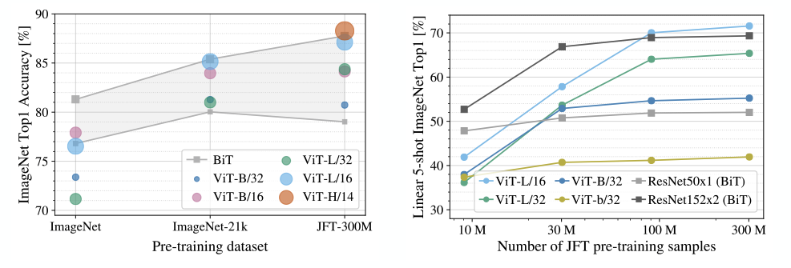
Vision Transformer
A huge model with a huge dataset wins out (though ViT-H is still smaller than BiT-L: 600M vs. 900M)
ViT scales better with training set size, eventually winning, but starts w/ a disadvantage

Slide 72
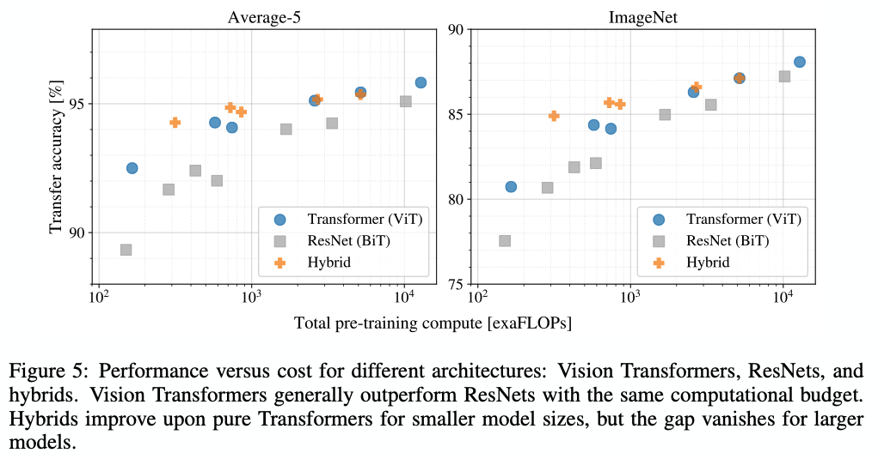
Vision Transformer (Dosovitskiy 2020)
ViT yields better performance per exaFLOP, compared to ResNets

Slide 73
What’s next? Patch Generative Transformers.
Patch representation seems better than pixels, but Vision Transformer is not generative. VQ-VAE (van den Oord 2017) shows how to fit a generative patch representation with discrete words: quantize to a finite vocabulary of embeddings.
DALL-E 1 seems to use this technique.
Transformer generates: “A chair shaped like an avocado.<start-image>0 0 0 1 0 3 0 0 2 0 53 0 0”

Slide 74
Our main question:
Can we do an impossible thing?
... and how can we do it?

Slide 75
Subject to understand

Slide 76
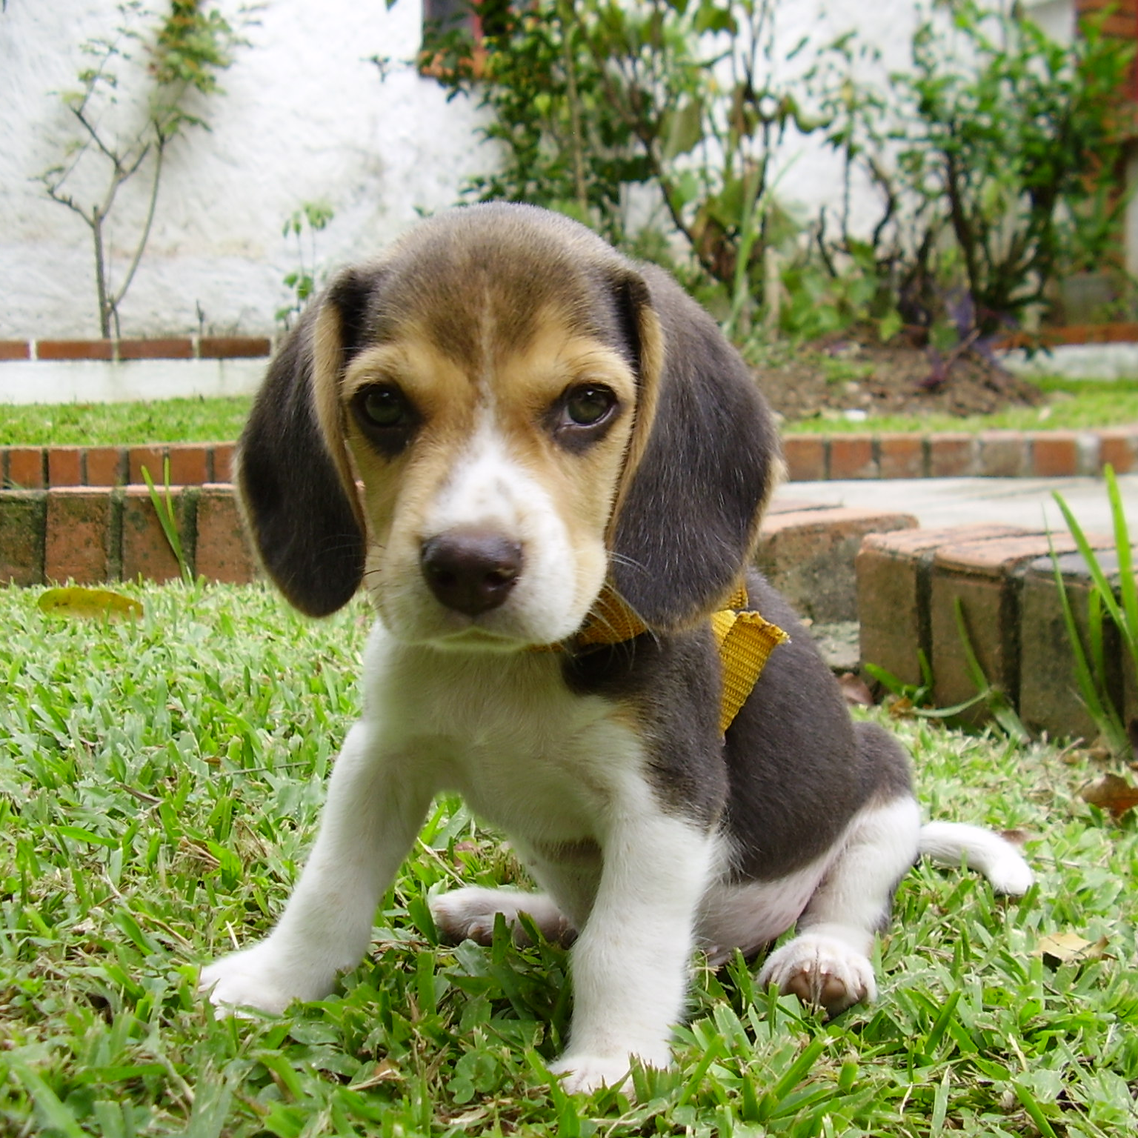
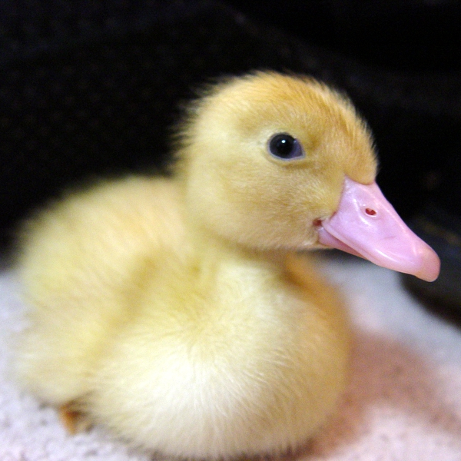
Process figure
Can a machine see?
“This is a dog”
“This is a duck”

