Slide 1
Diffusion Models
Rohit Gandikota

Slide 2
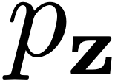
How to generate data?
Generative Adversarial Networks (GAN)
Model
Model

Slide 3
How to generate data?
Model
Model
Model
Model
Model
Model
Diffusion Models

Slide 4
"Astronaut in a jungle, cold color palette, muted colors, detailed, 8k"

Slide 5
Traditional Visualization of the Generative Process

Slide 6
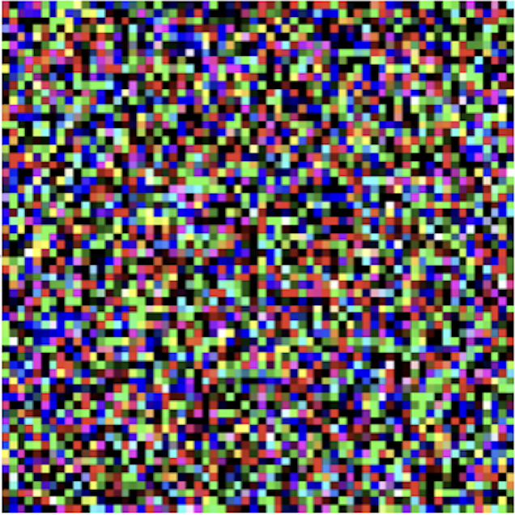
Diffusion Step
$$x_{t}$$
Diffusion Model
“Picture of a sports car”
$$ϵ$$
$$\frac{1}{\sqrt{α_{t}}}(x_{t}-\frac{1-α_{t}}{\sqrt{1-\overline{α_{t}}}}ϵ)$$

Slide 7
They are not built overnight!

Slide 8
Generative Modeling vs Representation Learning
Embedding
Representation learning:
mapping data to abstract representations
(analysis)
Representation learning
Generative modeling
Generative modeling:
mapping abstract representations to data (synthesis)
z
Data
[Slides for this lecture from Phillip Isola]

Slide 9
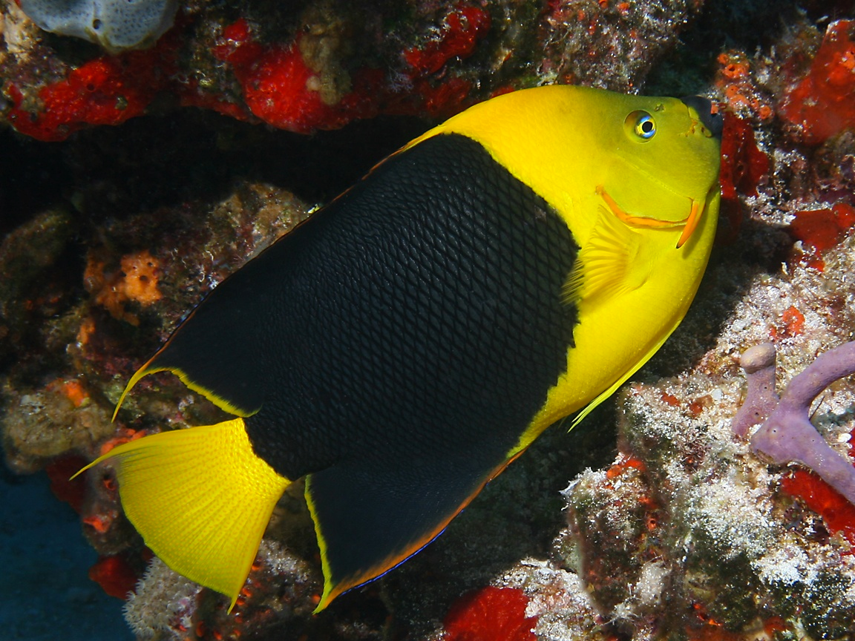
Representation Learning
“Coral”
“Fish”
Image
Compact mental representation
Slide from Prof. Bau
Notes:
it’s a really parsimonious mental representation.

Slide 10
Unsupervised Representation Learning
compressed image code (vector z)
Image
Slide from Prof. Bau
Notes:
it’s a really parsimonious mental representation.

Slide 11
Unsupervised Representation Learning
compressed image code (vector z)
Image
Reconstructed
image
“Autoencoder”
Slide from Prof. Bau

Slide 12
Autoencoders
Image
Reconstructed
image
Reconstruction Loss:
Slide from Prof. Bau
Notes:
Well these is a very popular method for representation learning without labels.
Problem: Requires a bottleneck. Learns low-level compression.
f^* = \argmin_{f \in \mathcal{F}} \sum_{i=1}^N \mathcal{L}(f(x_i), y_i)

Slide 13
Image
Reconstructed
image
“Fish”
“Coral”
Slide from Prof. Bau
Notes:
Well these is a very popular method for representation learning without labels.
Problem: Requires a bottleneck. Learns low-level compression.

Slide 14
Representation learning
Data space
Representation space
Encoder
Generative modeling
Representation space
Data space
Generator
Slide from Prof. Bau
Notes:
p(\mathbf{z}) = \int_{\mathbf{x}} p(\mathbf{z|x})p_{\texttt{data}}(\mathbf{x})d\mathbf{x}

Slide 15
The VAE idea vs the GAN idea
x
z
z
G
$$x^{*}$$
D
y
x
E
G
$$x^{*}$$
GAN
VAE
Slide from Prof. Bau

Slide 16
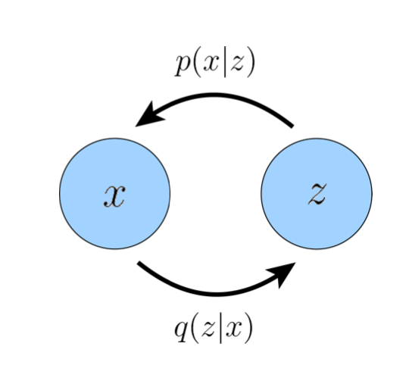
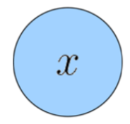
How is VAE different from AE?
Both have similar objective
$$||x-x^{*}||^{2}$$
But VAE adds a regularization to the latent vector
$$D_{KL}(q(z|x)||p(z))$$
(usually gaussian)
But why Gaussians?
They are natural
They are tractable
The math always works out!
*

Slide 17
Let’s take a closer look at VAE
They maximize the modeled probability of the data x
$$p(x)$$
How are they modeled?
What is the main objective?

Slide 18
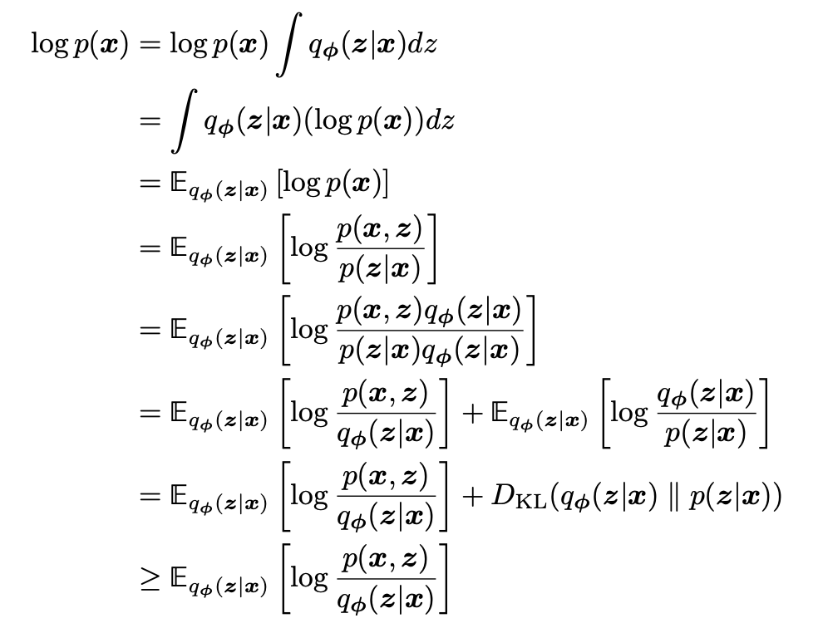
Evidence Lower Bound
(ELBO)
Evidence
>= 0
Lower Bound

Slide 19
How do we solve the ELBO?
Instead of relying on neural networks to follow a distribution,
Let’s parameterize!

Slide 20
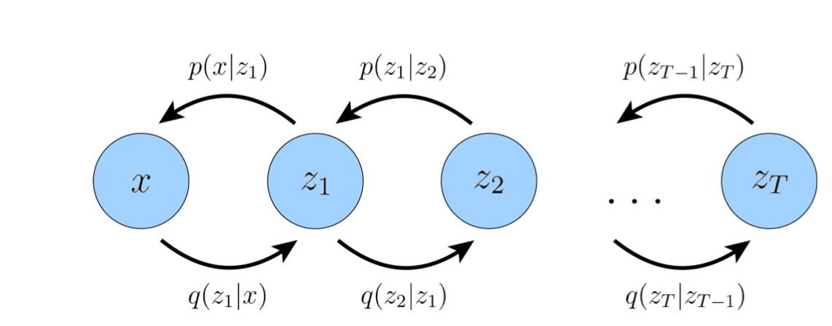
Single step vs Hierarchical
NN
NN
NN
NN
NN
NN
NN
NN

Slide 21
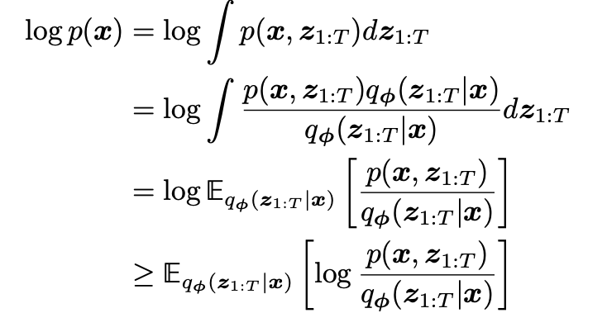
ELBO for Hierarchical VAE

Slide 22
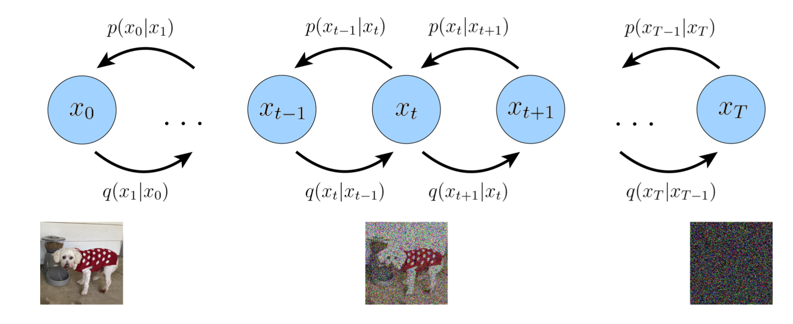
Diffusion is not far from VAE!
NN
NN
NN
NN
G
G
G
G
3 Key Differences
Latent Dimensions are same as input
Encoder is a simple gaussian noising model
Parameters of encoder vary over time to ensure x_T to be gaussian

Slide 23
Let’s look at the actual diffusion motivation!

Slide 24
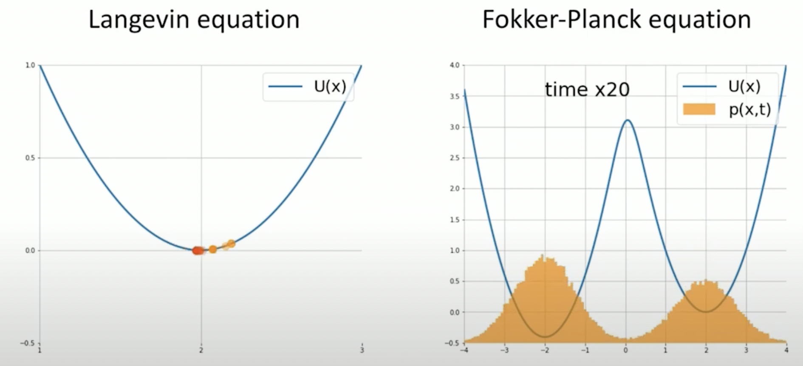
Motivation from Particle Physics

Slide 25
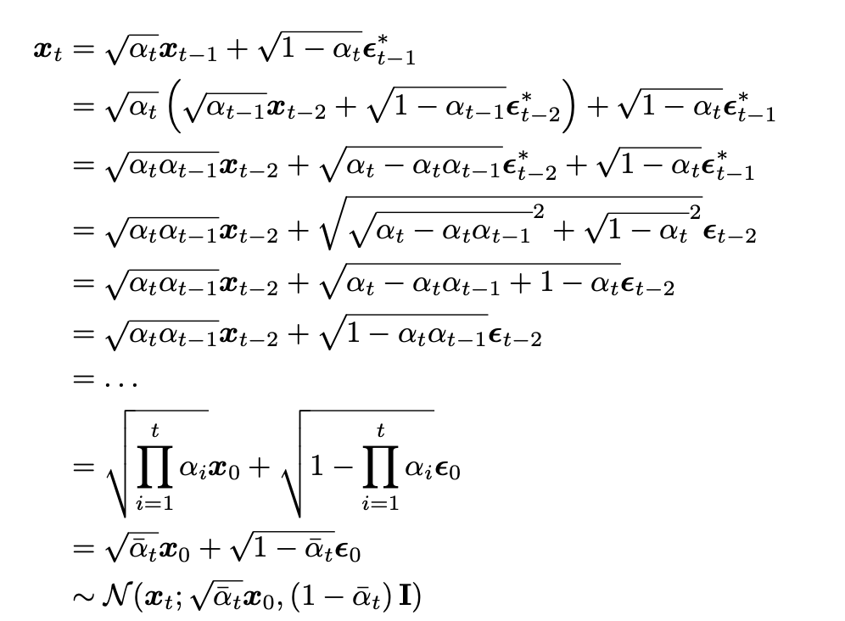
Forward Diffusion (Encoder)
At timestep 0 - we need the original image x0
At timestep T - we need gaussian noise xT
For the sake of simplicity let’s assume this how we add noise

Slide 26
Forward Noise in Diffusion
Training Sample
Gaussian Noise
Uniformly Sampled Timestep
Partially Noised
$$t$$
$$ϵ$$
$$x_{t}$$
$$x_{0}$$

Slide 27
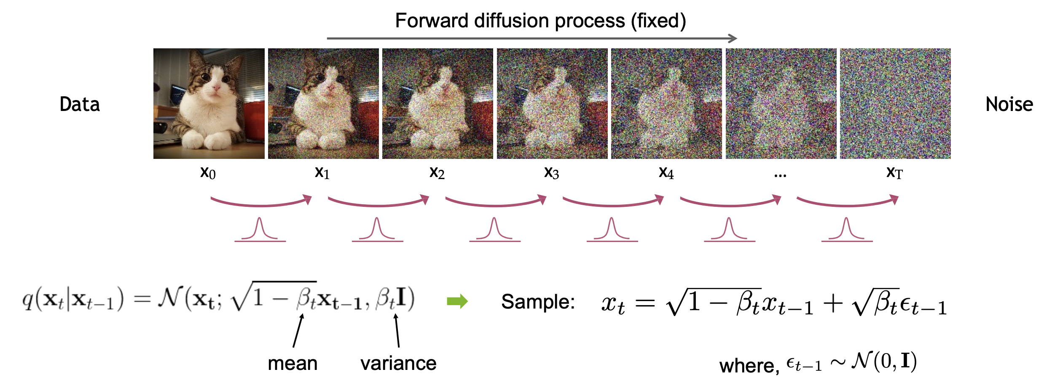
Forward Diffusion Process
Formal definition of the forward diffusion process:

Slide 28
Diffusion Kernel
Sum of Gaussian noise can be applied in one step.

Slide 29
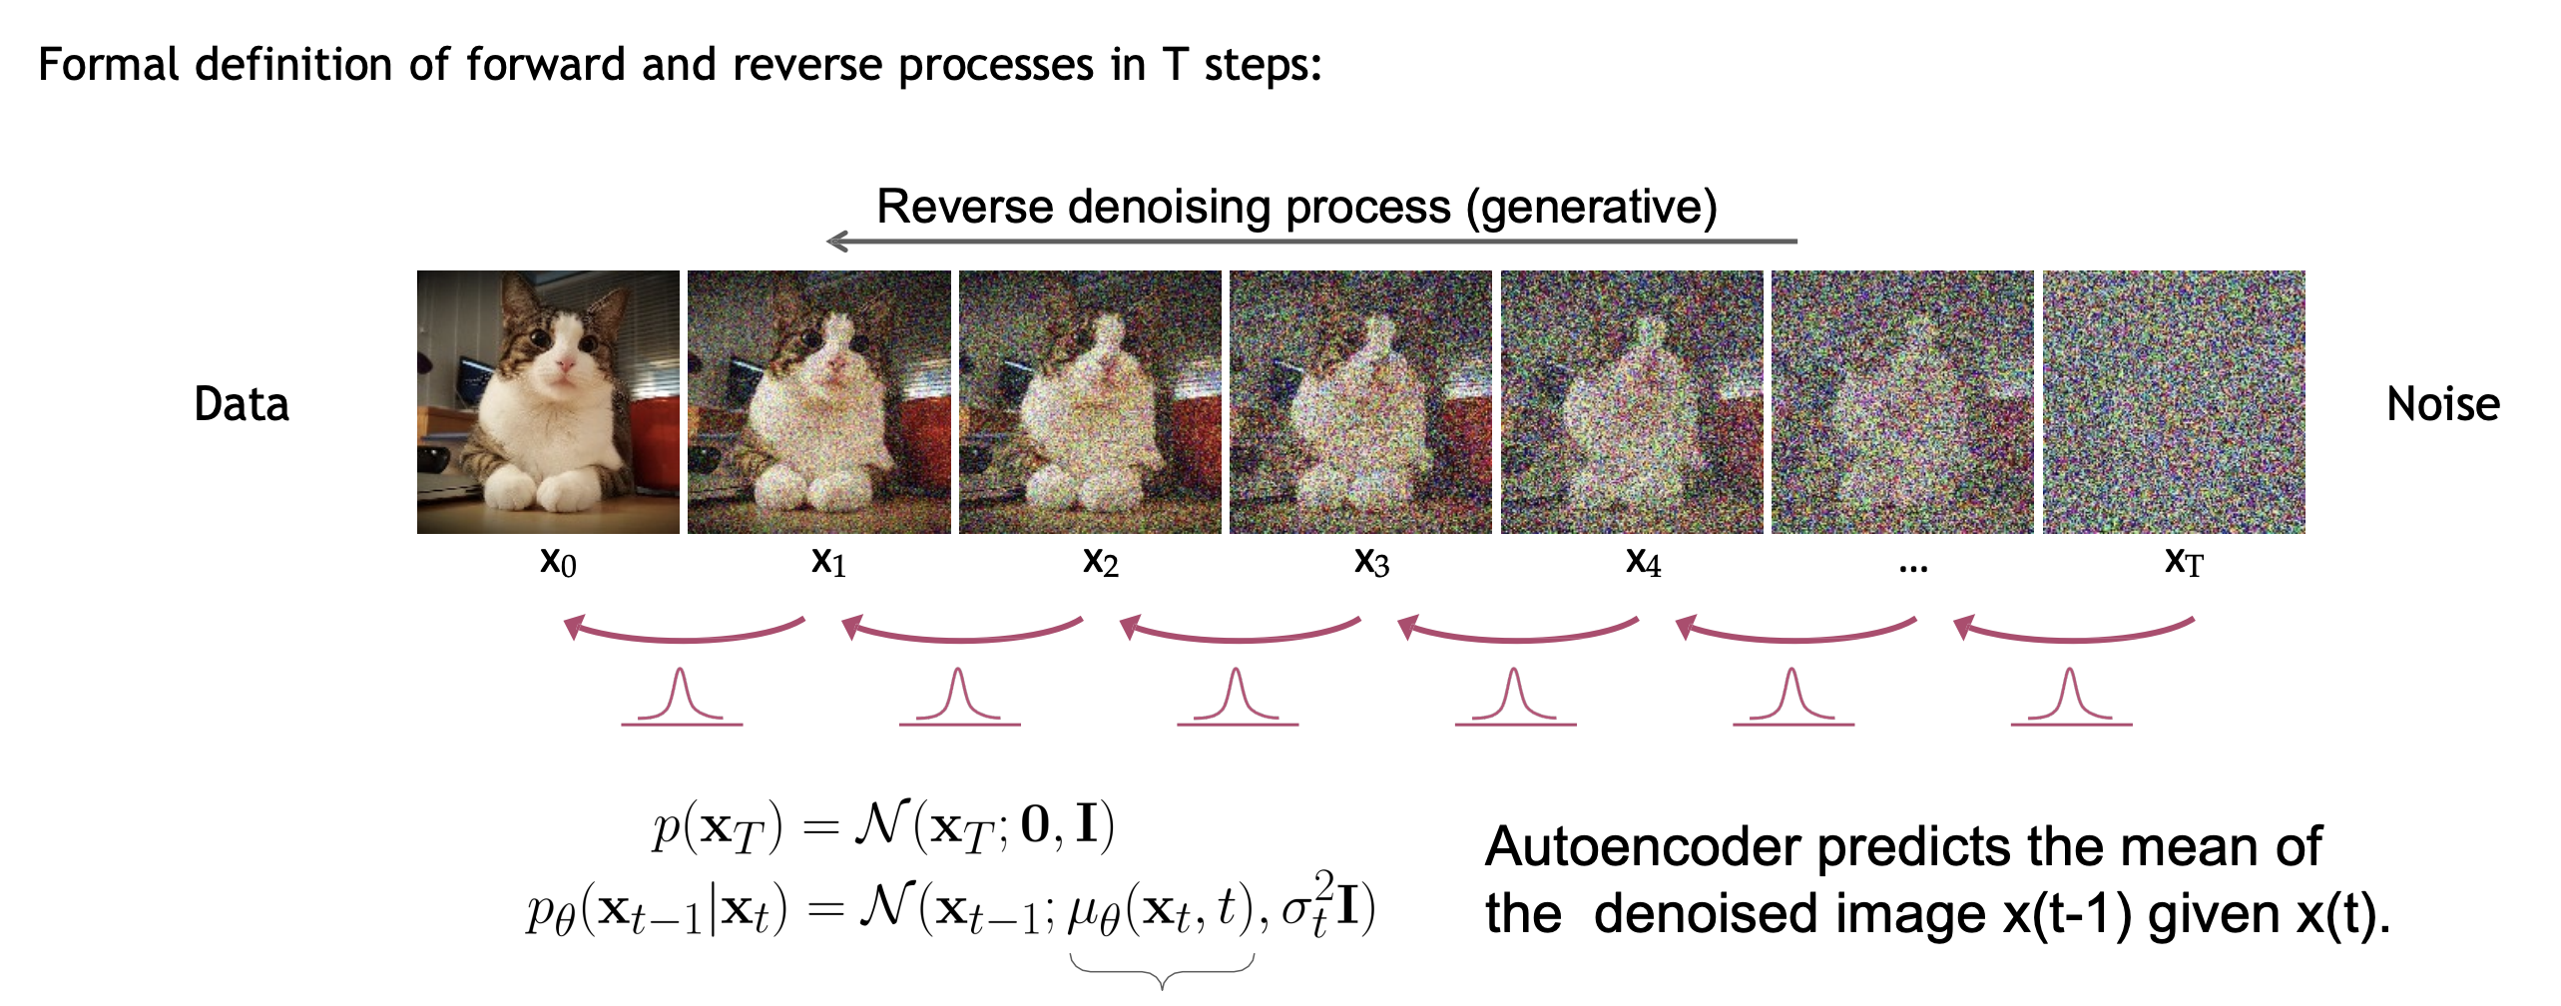
Reverse Denoising Process

Slide 30
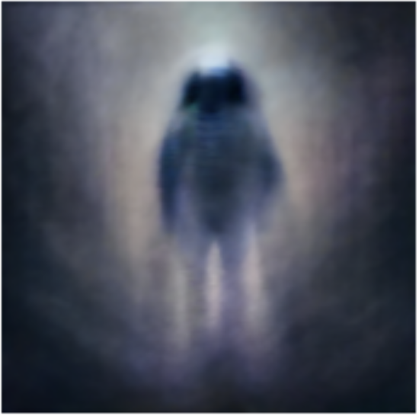

Slide 31
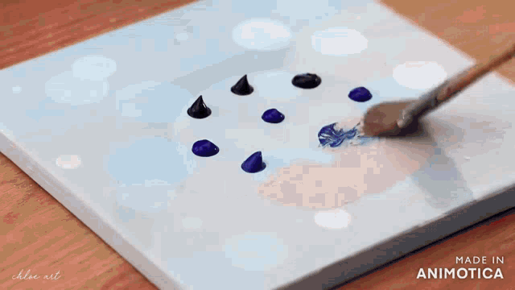
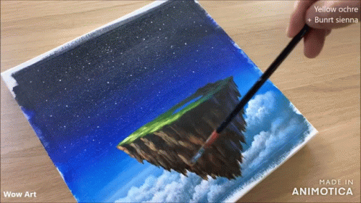
Are Diffusion Models better than GANs?
Slower Inference
Easier Training Objective
Higher Image Quality
Mode Collapse
Unstable Training
Faster Inference

Slide 32
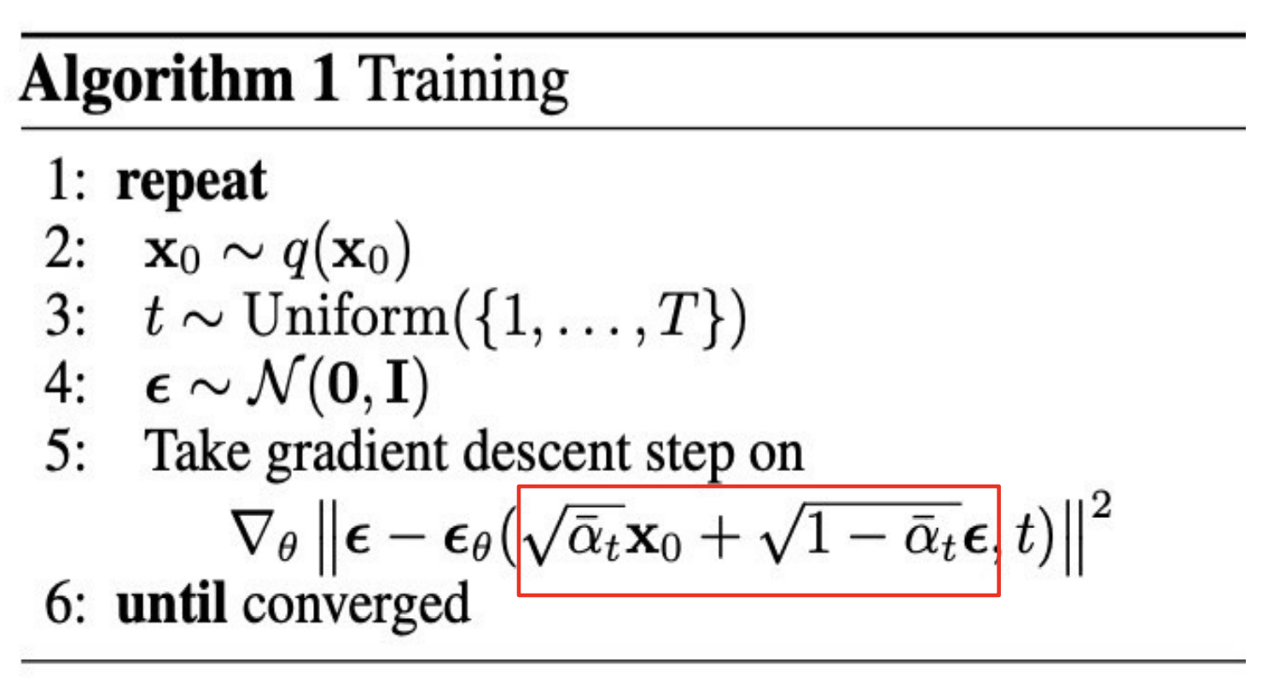
How do we train?
Pick a random real image x₀
Form noised x_{t} as input
Predict the noise
Gradient based on MSE loss
Simple!

Slide 33
Training of Diffusion Models
Training Sample
Gaussian Noise
Uniformly Sampled Timestep
Partially Noised
$$t$$
$$ϵ$$
$$x_{t}$$
$$x_{0}$$
Diffusion Model
L2 Loss
$$t$$
“photo of a convertible car driving by a forest”
$$ϵ_{θ}(x_{t},c,t)$$

Slide 34
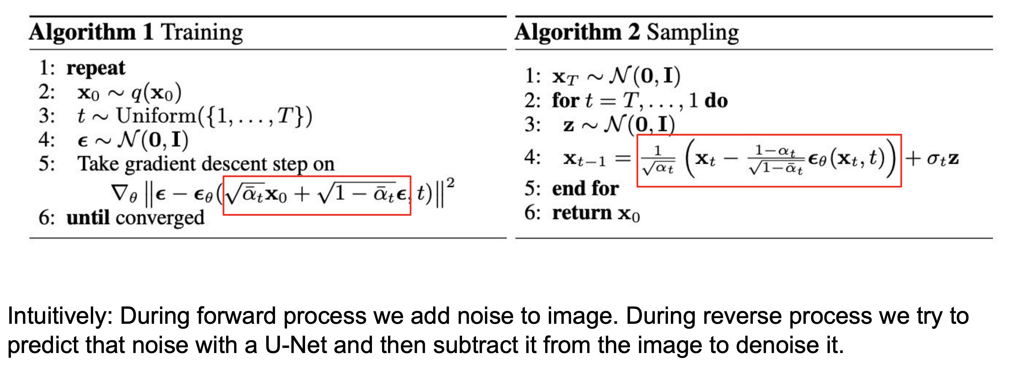
How do we Generate?

Slide 35
In Practice: Network Architecture

Slide 36
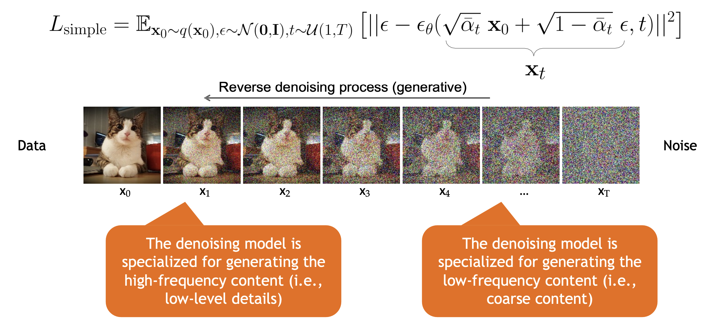
Content-Detail Tradeoff

Slide 37
Connection to VAEs

Slide 38
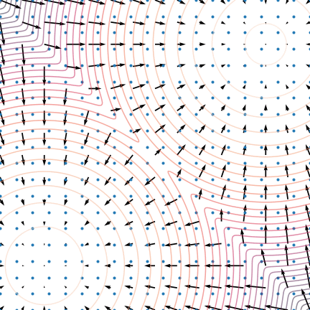
Score-Matching formulation: $∇\log{p}$
red: lines of equal probability density
arrows: the score function vector field
blue: Langevin dynamics, score-based sampling

Slide 39
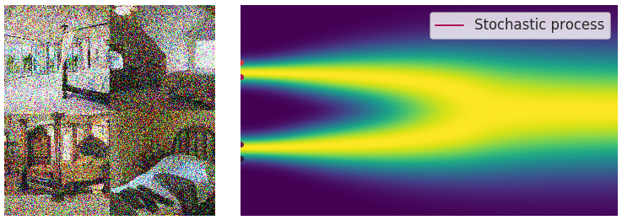
Perturbing the image by adding noise

Slide 40
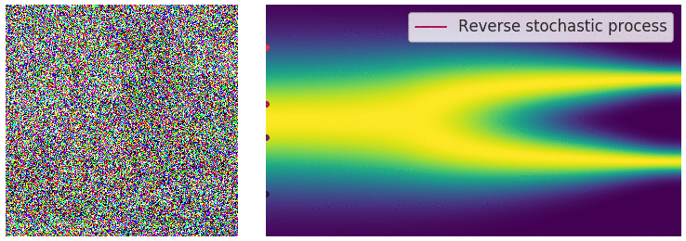
Denoising with Langevin Dynamics

Slide 41
The Problem With Diffusion Models
They are slow!
Consuming ~1000 iterations of the network to generate a single image.

Slide 42
From DDPM to DDIM
Summary: DDIM uses the same training as DDPM
But it runs inference differently, without noise.

Slide 43
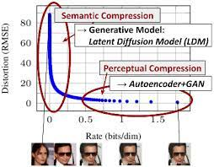
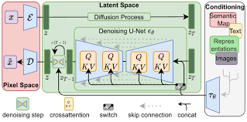
Efficient high-resolution diffusion
Rombach 2022 - Stable Diffusion

Slide 44
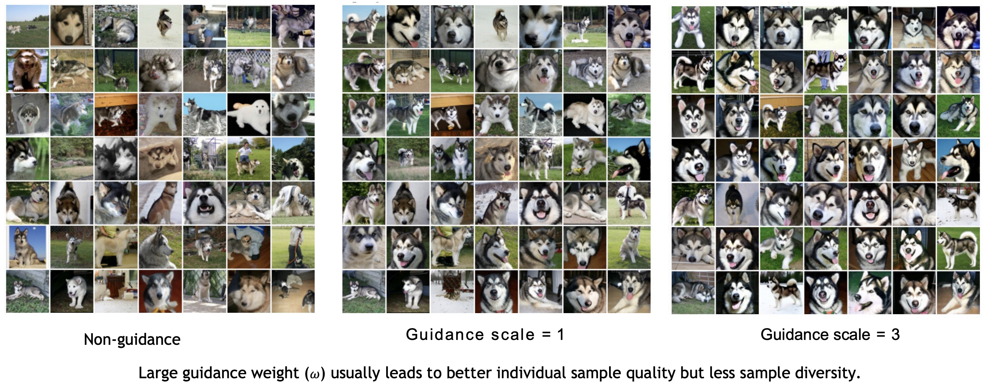
Controlling a Diffusion Model
Text-conditioning: add cross-attention to the denoising U-Net to train it conditioned on a caption.
“Classifier-free guidance” – run the model twice at each iteration, once without conditioning and once with, and amplify the results.

Slide 45
Guidance
So far, we have seen unconditional diffusion models
$$p(x)$$
But more interest in conditional models
$$p(x/c)$$
Simple way to add conditionality

Slide 46
Classifier Guidance

Slide 47
Classifier Free Guidance

Slide 48
But what is happening?

Slide 52
How can we customize these models?

Slide 54
AI Safety and Policy Control

Slide 55
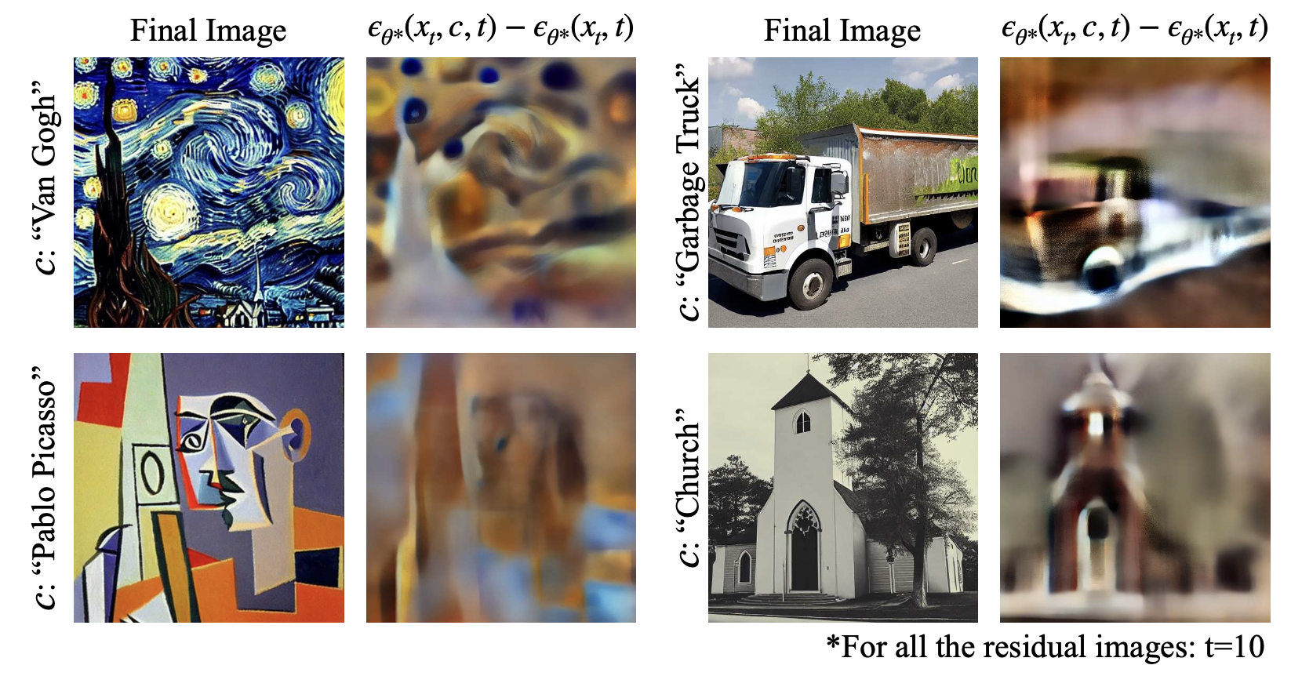
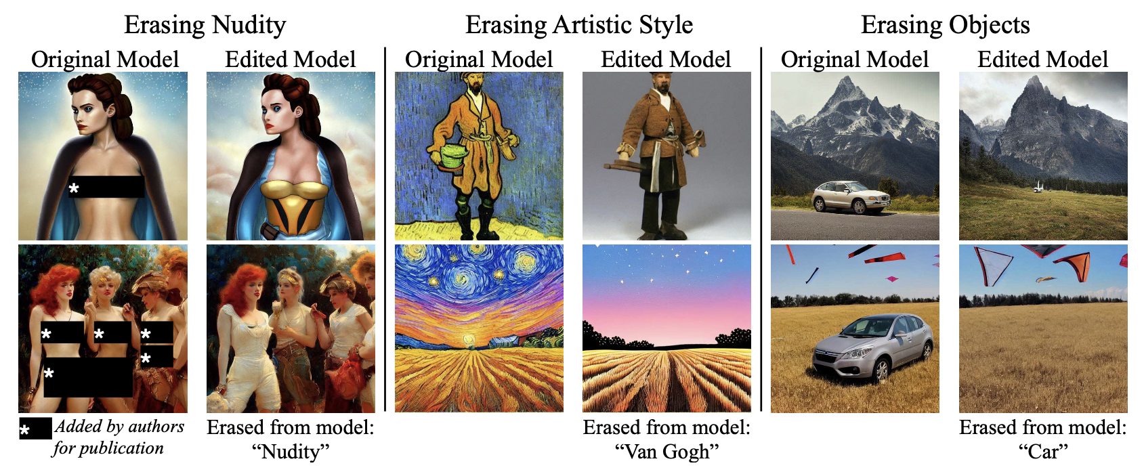

Slide 56
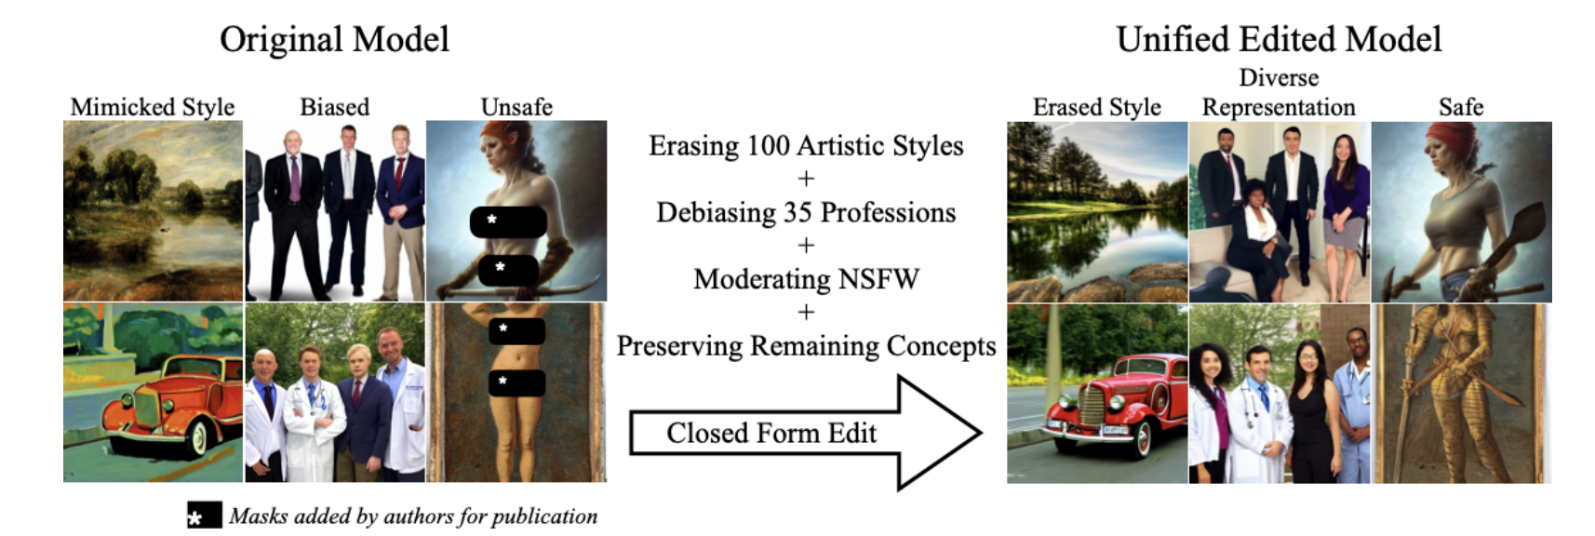
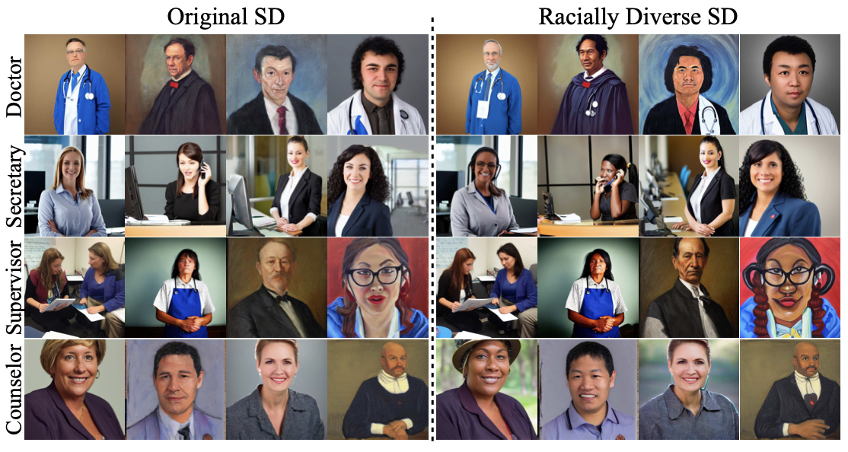
Unified Concept Editing in Diffusion Models
Rohit Gandikota, Hadas Orgad, Yonatan Belinkov,
Joanna Materzynska, David Bau
$$\min_{W}\overset{m}{\underset{i=0}{∑}}||Wc_{i}-v_{i}^{*}||_{2}^{2}$$
Concepts to Edit
$$c_{i}∈E$$
$$Wc_{i}$$
$$v_{i}^{*}$$
$$W$$
$$c_{j}∈P$$
Cross Attention
$$Wc_{j}$$
Improving Racial Diversity
Concepts to Preserve
$$\min_{W}\overset{n}{\underset{j=0}{∑}}||Wc_{j}-W_{v}^{old}c_{j}||_{2}^{2}$$
+
Minimizing in Closed Form

Slide 57
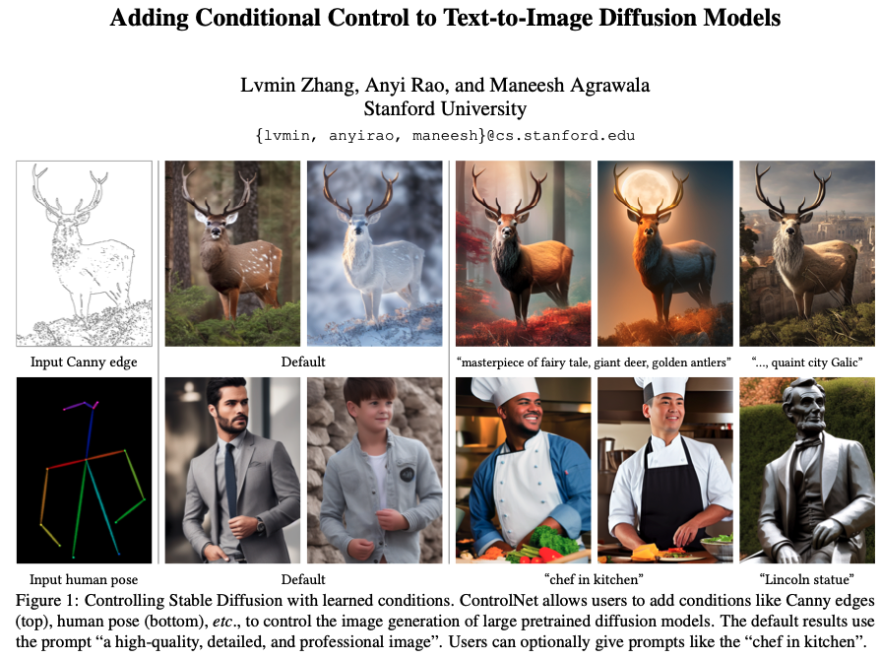
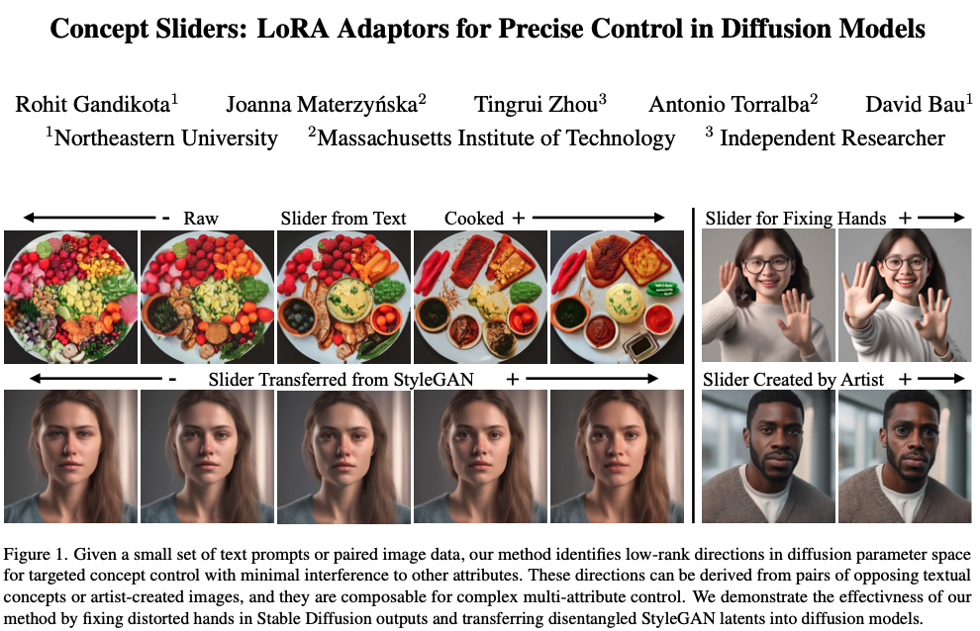
Artistic Control
ControlNet (Zhang et al., 2023)

Slide 58
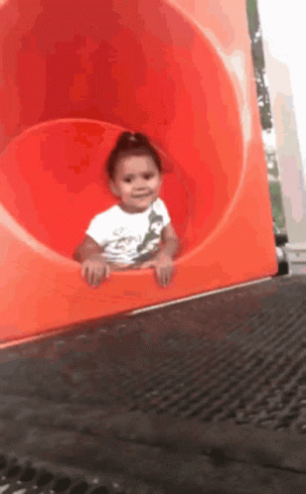
Thank You

