Slide 1
Self-supervised Representation Learning
From Denoising to BERT, Contrastive Learning, to CLIP

Slide 2
Supervised vs Unsupervised Learning
Supervised learning – learning with labeled data
  Approach: collect a large dataset, manually label the data, train a model, deploy
  It is the dominant form of ML at present
  Learned feature representations on large datasets are often transferred via pre-trained models to smaller domain-specific datasets
Unsupervised learning – learning with unlabeled data
  Approach: discover patterns in data either via clustering similar instances, or density estimation, or dimensionality reduction …
Self-supervised learning – representation learning with unlabeled data
  Learn useful feature representations from unlabeled data through pretext tasks
  The term “self-supervised” refers to creating its own supervision (i.e., without supervision, without labels)
  Self-supervised learning is one category of unsupervised learning

Slide 3
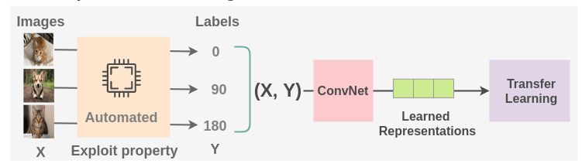
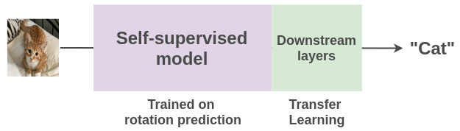
Self-Supervised Learning
Self-supervised learning example
  Pretext task: train a model to predict the rotation degree of rotated images with cats and dogs (we can collect million of images from internet, labeling is not required)
  Downstream task: use transfer learning and fine-tune the learned model from the pretext task for classification of cats vs dogs with very few labeled examples
Picture from: Amit Chaudhary – The Illustrated Self-Supervised Learning

Slide 4
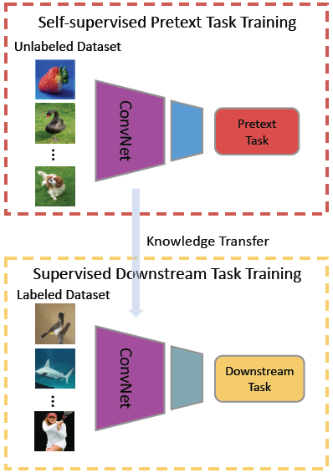
Self-Supervised Learning
One more depiction of the general pipeline for self-supervised learning is shown in the figure
  For the downstream task, re-use the trained ConvNet base model, and fine-tune the top layers on a small labeled dataset
Picture from: Jing and Tian (2019) Self-supervised Visual Feature Learning with Deep Neural Networks: A Survey

Slide 5
Self-Supervised Learning
Why self-supervised learning?
  Creating labeled datasets for each task is an expensive, time-consuming, tedious task
    Requires hiring human labelers, preparing labeling manuals, creating GUIs, creating storage pipelines, etc.
    High quality annotations in certain domains can be particularly expensive (e.g., medicine)
  Self-supervised learning takes advantage of the vast amount of unlabeled data on the internet (images, videos, text)
    Rich discriminative features can be obtained by training models without actual labels
  Self-supervised learning can potentially generalize better because we learn more about the world
Challenges for self-supervised learning
  How to select a suitable pretext task for an application
  There is no gold standard for comparison of learned feature representations
  Selecting a suitable loss functions, since there is no single objective as the test set accuracy in supervised learning

Slide 6
Self-Supervised Learning
Self-supervised learning versus unsupervised learning
  Self-supervised learning (SSL)
    Aims to extract useful feature representations from raw unlabeled data through pretext tasks
    Apply the feature representation to improve the performance of downstream tasks
  Unsupervised learning
    Discover patterns in unlabeled data, e.g., for clustering or dimensionality reduction
  Note also that the term “self-supervised learning” is sometimes used interchangeably with “unsupervised learning”
Self-supervised learning versus transfer learning
  Transfer learning is often implemented in a supervised manner
    E.g., learn features from a labeled ImageNet, and transfer the features to a smaller dataset
  SSL is a type of transfer learning approach implemented in an unsupervised manner
Self-supervised learning versus data augmentation
  Data augmentation is often used as a regularization method in supervised learning
  In SSL, image rotation of shifting are used for feature learning in raw unlabeled data

Slide 7
BERT
BERT is a bidirectional (Transformer encoder) model,
trained to learn representations of sentences.
K
V
Q

Slide 8
BERT
BERT is a bidirectional (Transformer encoder) model.
K
V
Q

Slide 9
BERT
BERT is trained with two types of loss:
Word prediction: 15% of input words are removed and then re-predicted

Slide 10
BERT
BERT has a second pretext task:
Next sentence prediction: from an actual corpus of consecutive sentence pairs, create a dataset with 50% real pairs, and 50% “fake” pairs (where the second sentence is a random one).

Slide 11
BERT Task specialization

Slide 12
BERT Task specialization

Slide 13
BERT Task specialization

Slide 14
BERT Performance
BERT Base: L=12, H=768, A=12, total param =110M
BERT Large: L=24, H=1024, A=16, total param=340M
L=number of layers, H=model dimension, A=number of multi-attention heads
Glue tasks

Slide 15
BERT Performance
SQuAD

Slide 16
Image-Based Approaches
Image based approaches
  Geometric transformation recognition
    Image rotation
  Patches
    Relative patch position, image jigsaw puzzle
  Generative modeling
    Context encoders, image colorization, cross-channel prediction, image super-resolution
  Automated label generation
    Deep clustering, synthetic imagery
  Contrastive learning
    Contrastive predictive coding (CPC), SimCLR, and other contrastive approaches

Slide 17
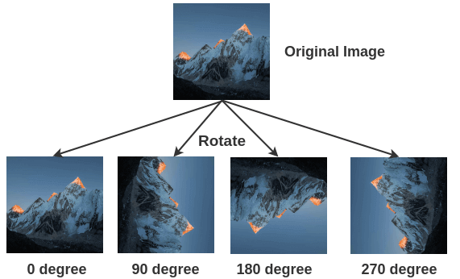
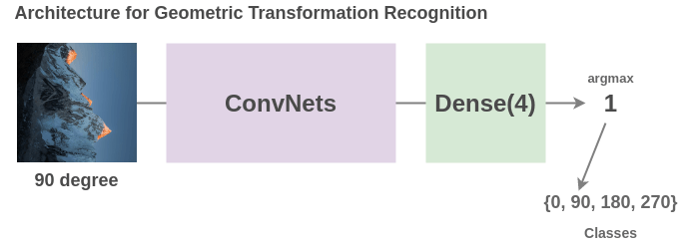
Image Rotation
Geometric transformation recognition
  Gidaris (2018) - Unsupervised Representation Learning by Predicting Image Rotations
Training data: images rotated by a multiple of 90° at random
  This corresponds to four rotated images at 0°, 90°, 180°, and 270°
Pretext task: train a model to predict the rotation degree that was applied
  Therefore, it is a 4-class classification problem
Picture from: Amit Chaudhary – The Illustrated Self-Supervised Learning

Slide 18
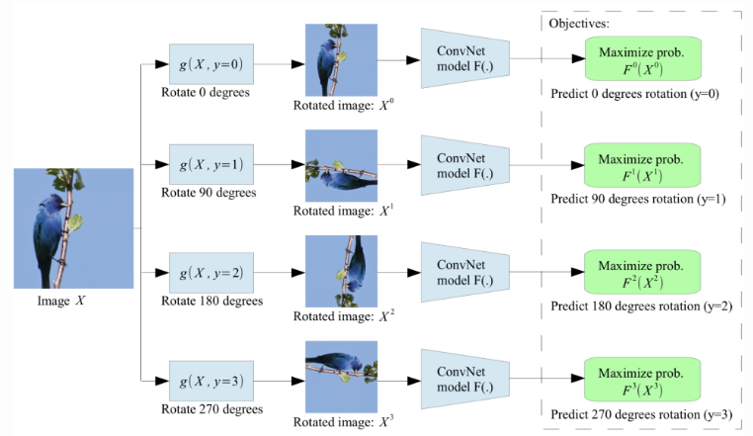
Image Rotation
A single ConvNet model is used to predict one of the four rotations
  The model needs to understand the location and type of the objects in images to determine the rotation degree

Slide 19
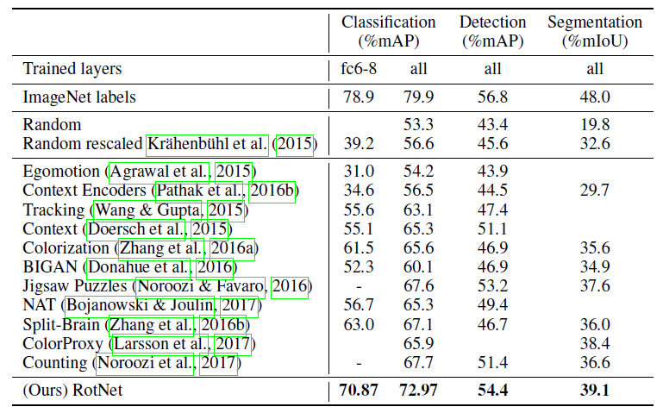
Image Rotation
Evaluation on the PASCAL VOC dataset for classification, detection, and segmentation tasks
  The model (RotNet) is trained in SSL manner, and fine-tuned afterwards
  RotNet outperformed all other SSL methods
  The learned features are not as good as the supervised learned
Supervised feature learning
Proposed self-supervised feature learning

Slide 20
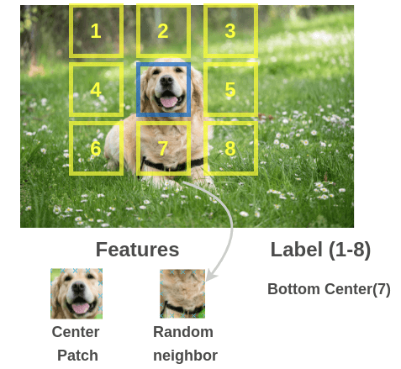
Relative Patch Position
Dorsch (2015) Unsupervised Visual Representation Learning
Training data: multiple patches extracted from images
Pretext task: predict the relationship between the patches
  E.g., predict the relative position of the selected patch

Slide 21
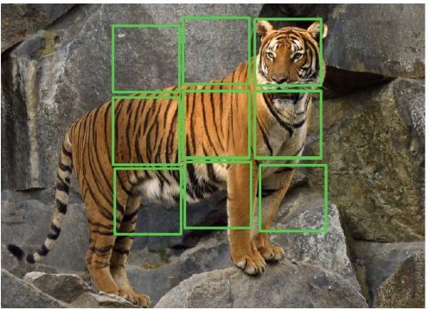
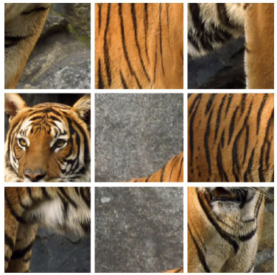
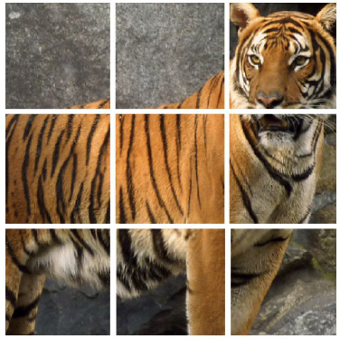
Image Jigsaw Puzzle
Noroozi (2016) Unsupervised Learning of Visual Representations Training data: 9 patches extracted in images
Pretext task: predict the positions of all 9 patches
  Instead of predicting the relative position of only 2 patches, this approach uses the grid of 3×3 patches and solves a jigsaw puzzle

Slide 22
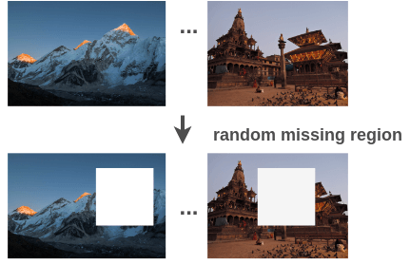
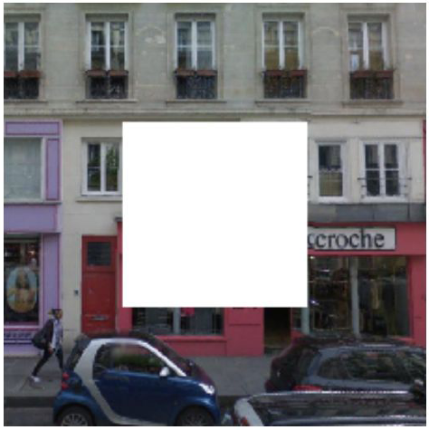
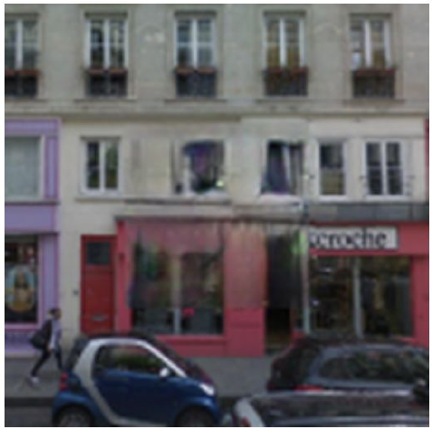
Context Encoders
Predict missing pieces, also known as inpainting
  Pathak (2016) Context Encoders: Feature Learning by Inpainting
Training data: remove a random region in images
Pretext task: fill in a missing piece in the image
Picture from: Amit Chaudhary – The Illustrated Self-Supervised Learning

Slide 23
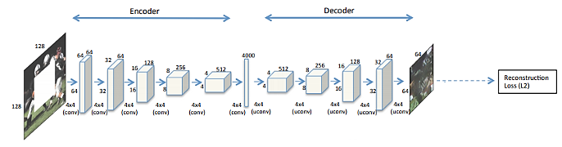
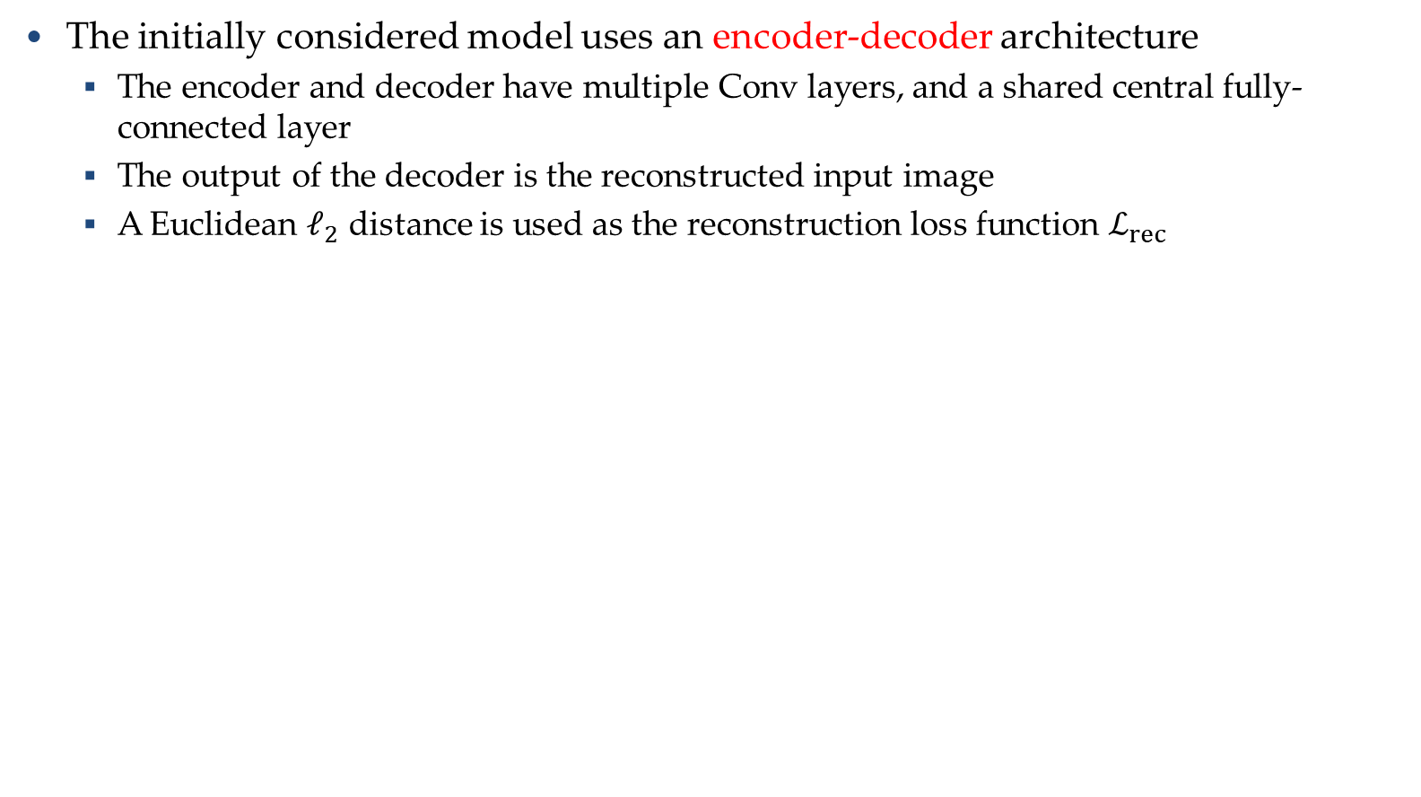
Context Encoders
The initially considered model uses an encoder-decoder architecture
  The encoder and decoder have multiple Conv layers, and a shared central fully-connected layer
  The output of the decoder is the reconstructed input image
  A Euclidean $ℓ_{2}$ distance is used as the reconstruction loss function $ℒ_{rec}$

Slide 24
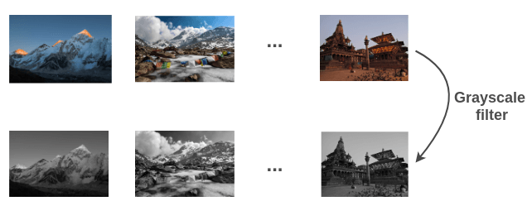
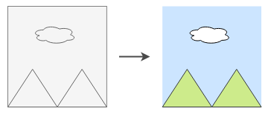
Image Colorization
Zhang (2016) Colorful Image Colorization
Training data: pairs of color and grayscale images
Pretext task: predict the colors of the objects in grayscale images
Sky is blue
Cloud is white
Mountain is green
Picture from: Amit Chaudhary – The Illustrated Self-Supervised Learning

Slide 25
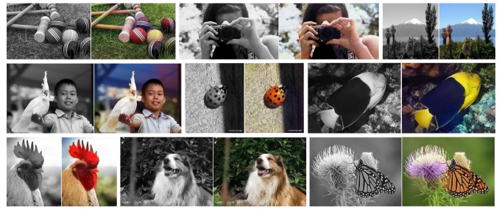
Image Colorization
Input examples

Slide 26
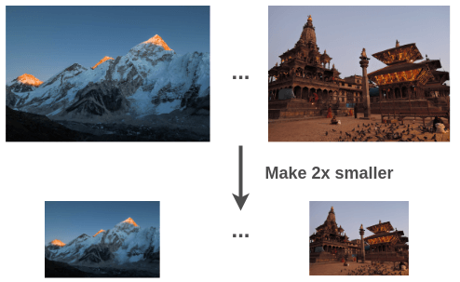
Image Super-Resolution
Ledig (2017) Photo-Realistic Single Image Super-Resolution Using a Generative Adversarial Network
Training data: regular and downsampled low-resolution images
Pretext task: predict high-resolution image from low-resolution
Picture from: Amit Chaudhary – The Illustrated Self-Supervised Learning

Slide 27
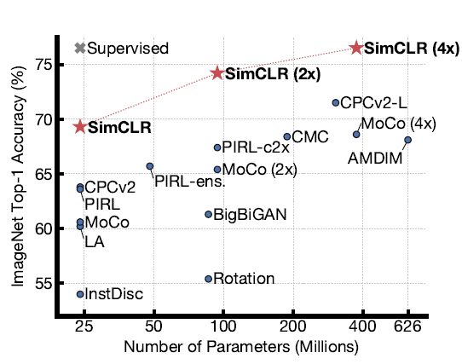
SimCLR, contrastive learning
Chen (2020) A Simple Framework for Contrastive Learning of Visual Representations
It achieved state-of-the-art in SSL, surpassing the Top-1 accuracy by a supervised ResNet-50 on ImageNet

Slide 28
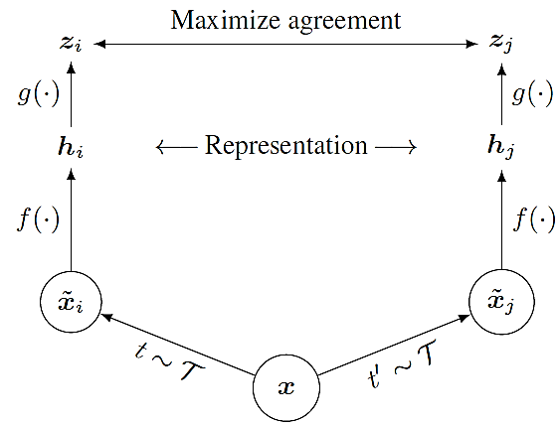
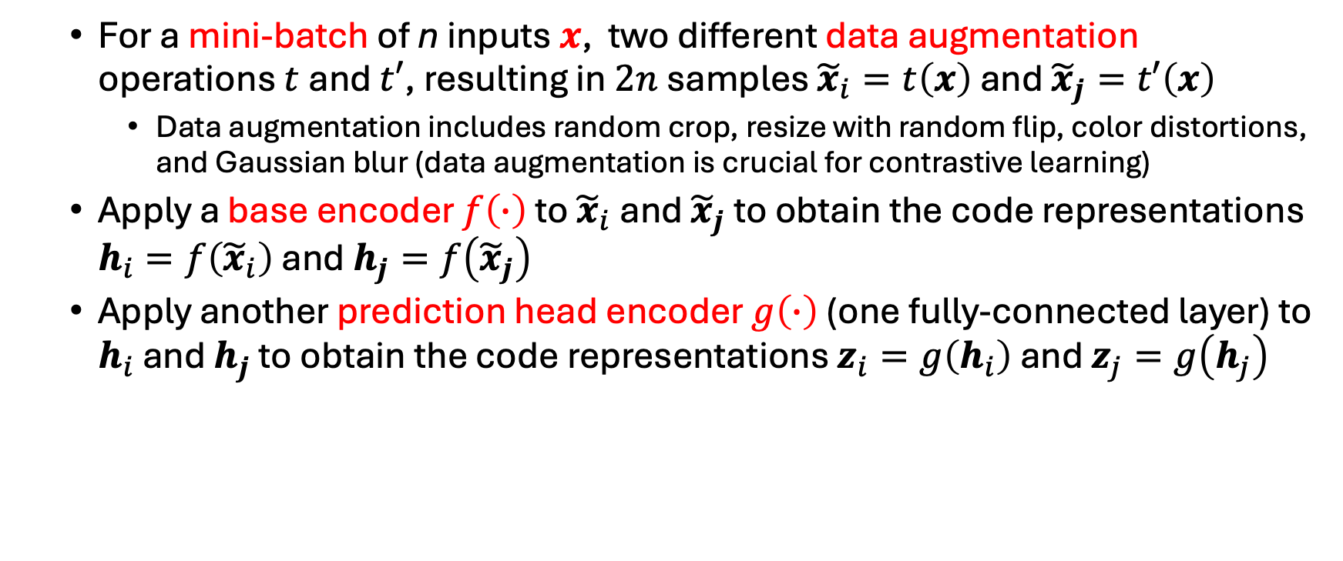
SimCLR
  For a mini-batch of n inputs $x$, two different data augmentation operations $t$and $t′$, resulting in $2n$samples ${\tilde{x}}_{i}=t\left(x\right)$ and ${\tilde{x}}_{j}=t′\left(x\right)$
    Data augmentation includes random crop, resize with random flip, color distortions, and Gaussian blur (data augmentation is crucial for contrastive learning)
  Apply a base encoder $f\left(∙\right)$ to ${\tilde{x}}_{i}$and ${\tilde{x}}_{j}$ to obtain the code representations $h_{i}=f\left({\tilde{x}}_{i}\right)$ and $h_{j}=f\left({\tilde{x}}_{j}\right)$
  Apply another prediction head encoder $g\left(∙\right)$ (one fully-connected layer) to $h_{i}$ and $h_{j}$ to obtain the code representations $z_{i}=g\left(h_{i}\right)$ and $z_{j}=g\left(h_{j}\right)$
Prediction head g:
One fully-connected layer
Base encoder f:
ResNet + global average pooling

Slide 29
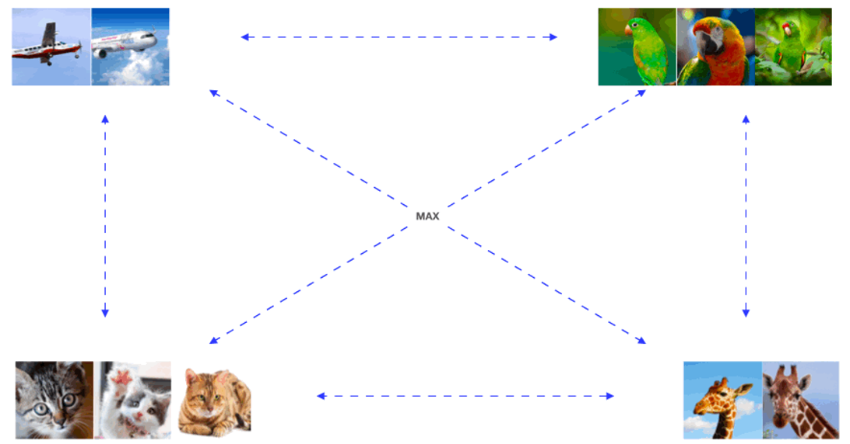
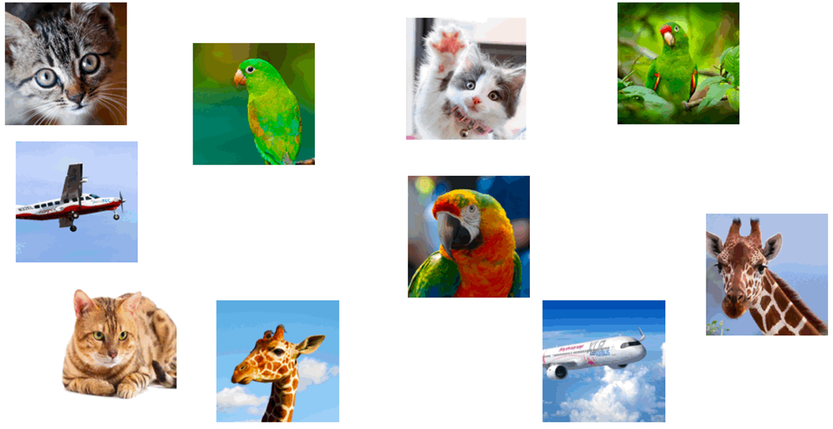
Contrastive Learning
Contrastive learning is based on grouping similar examples
  E.g., cluster the shown images into groups of similar images
Noise-Contrastive Estimation (NCE) loss minimizes the distance between similar images (positive examples) and maximizes the distance to dissimilar images (negative examples)
Maximize distance
Picture from: William Falcon – A Framework for Contrastive Self-Supervised Learning and Designing a New Approach

Slide 30
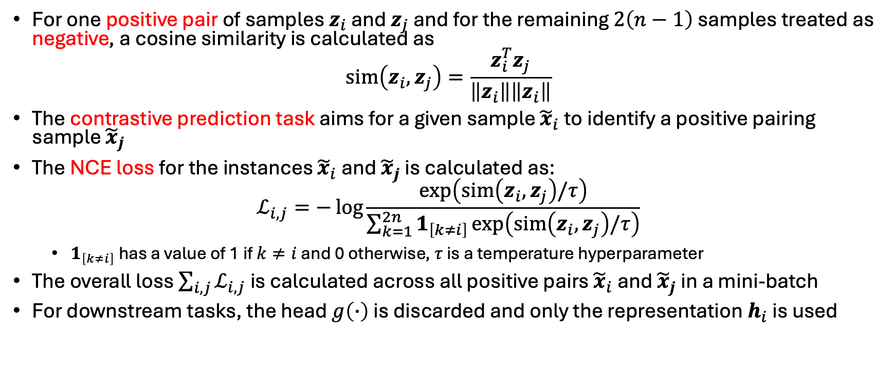
SimCLR: noise contrastive loss
For one positive pair of samples $z_{i}$ and $z_{j}$ and for the remaining $2\left(n−1\right)$ samples treated as negative, a cosine similarity is calculated as
$$sim\left(z_{i},z_{j}\right)=\frac{z_{i}^{T}z_{j}}{\left\|z_{i}\right\|\left\|z_{i}\right\|}$$
The contrastive prediction task aims for a given sample ${\tilde{x}}_{i}$to identify a positive pairing sample ${\tilde{x}}_{j}$
The NCE loss for the instances ${\tilde{x}}_{i}$and ${\tilde{x}}_{j}$ is calculated as:
$$ℒ_{i,j}=−\log{\frac{exp\left(sim\left(z_{i},z_{j}\right)/τ\right)}{\sum_{k=1}^{2n}{1_{\left[k≠i\right]}}exp\left(sim\left(z_{i},z_{j}\right)/τ\right)}}$$
  $1_{\left[k≠i\right]}$ has a value of 1 if $k≠i$ and 0 otherwise, $τ$ is a temperature hyperparameter
The overall loss $\sum_{i,j}{ℒ_{i,j}}$is calculated across all positive pairs ${\tilde{x}}_{i}$and ${\tilde{x}}_{j}$in a mini-batch
For downstream tasks, the head $g\left(∙\right)$ is discarded and only the representation $h_{i}$ is used

Slide 31
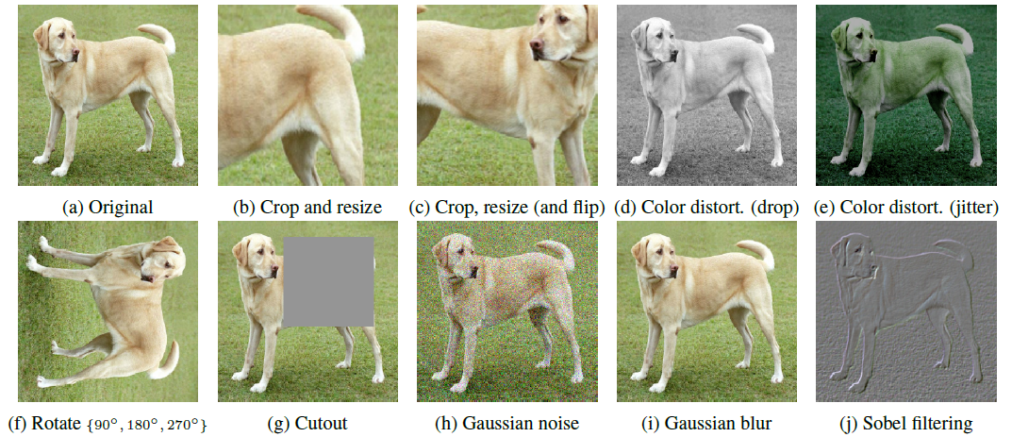
SimCLR
Data augmentation

Slide 32
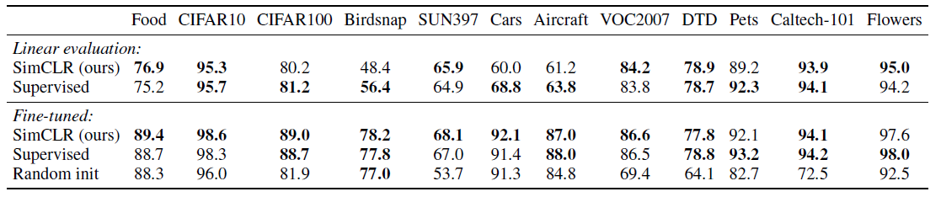
SimCLR
Experimental results on 10 image datasets
  SimCLR outperformed supervised models on most datasets

Slide 33
CLIP: Learning Transferrable Models from Natural Language Supervision (Radford et al. 2021)
Joint multimodal representation learning: text and images

Slide 34
Key idea: contrastive loss to match text features to image
Use small transformer language model (76M parameters for base)
Matching task with large batch (size = 32,768)
  Each image and text from batch is encoded
  Similarity score obtained for 32K x 32K image-text pairings
  Loss is cross-entropy on matching each image to its text, and each text to its image
Contrastive task formulations is a good general way to learn when exact target is unpredictable

Slide 36
Training cost
“The largest ResNet model RN50x64, took 18 days to train on 592 V100 GPUs, while the largest Vision Transformer took 12 days on 256 V100 GPUs”
  ~$91K for Transformer model; $300K for ResNet model

Slide 37
Key idea 2: zero-shot classification
Every batch of training is like a novel classification task, matching 32K classes to 32K images
To create a new classification task:
Convert class labels into captions and encode the text
Encode the image
Assign the image to the label whose caption matches best

Slide 38
Four ways to adapt CLIP to a new task
Zero-shot: convert labels to text and use text-image similarity
Linear probe: freeze the image encoder and train a linear layer on its features
Nearest neighbor (not in paper): record features of training examples and use K-NN classifier
Fine-tune CLIP encoder for the new task (but then it completely loses its generality)

Slide 39
Zero shot prediction examples

Slide 40
Zero-shot clip performs as well as a strong baseline trained on 16 examples per class
Linear probe needs 4 examples to reach zero-shot performance (on average)

Slide 43
What to remember
Instead of training a model directly on a task x->y we can:
Get a pretrained encoder e for a feature representation
  z = e(x)
Use the encoding z to solve the problem by either
  Using it directly (e.g. zero-shot, nearest neighbor, etc)
  Or training a small model on top of the representation
  y = f(z) = f(e(x))

Slide 44
Try out CLIP, BERT
https://bit.ly/clip-and-bert

