Slide 1
CS 7150
Deep Learning

Slide 2
Remember: “Or” and “And” neurons are easy
Pick a very negative bias that is restrictive
a | b | c | sum | out
-1 | -1 | -1 |  | -1
-1 | -1 | +1 |  | -1
-1 | +1 | -1 |  | -1
-1 | +1 | +1 |  | -1
+1 | -1 | -1 |  | -1
+1 | -1 | +1 |  | -1
+1 | +1 | -1 |  | -1
+1 | +1 | +1 |  | +1
-11 -7 -7 -3 -7 -3 -3 +1
a
w_{a} = 2
bias =
-5
w_{b} = 2
b
out
sign
w_{c} = 2
c
out = a ∧ b ∧ c

Slide 3
Puzzle
How many layers of McCullough-Pitts neurons are needed to be able to express all truth tables on d inputs?

Slide 4
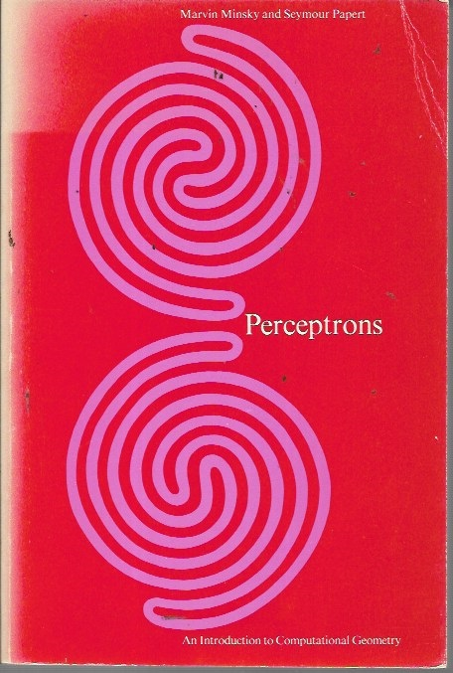
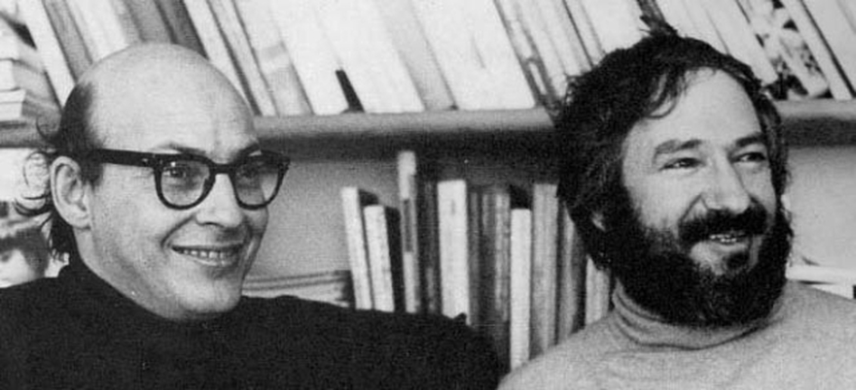
1969: Minsky and Papert prove limitations
[Minksy, Perceptrons, 1969]

Slide 5
Unsolved in 1969: how to learn non-linear problems
Non-linearly separable data cannot be classified by the perceptron algorithm.

Slide 6
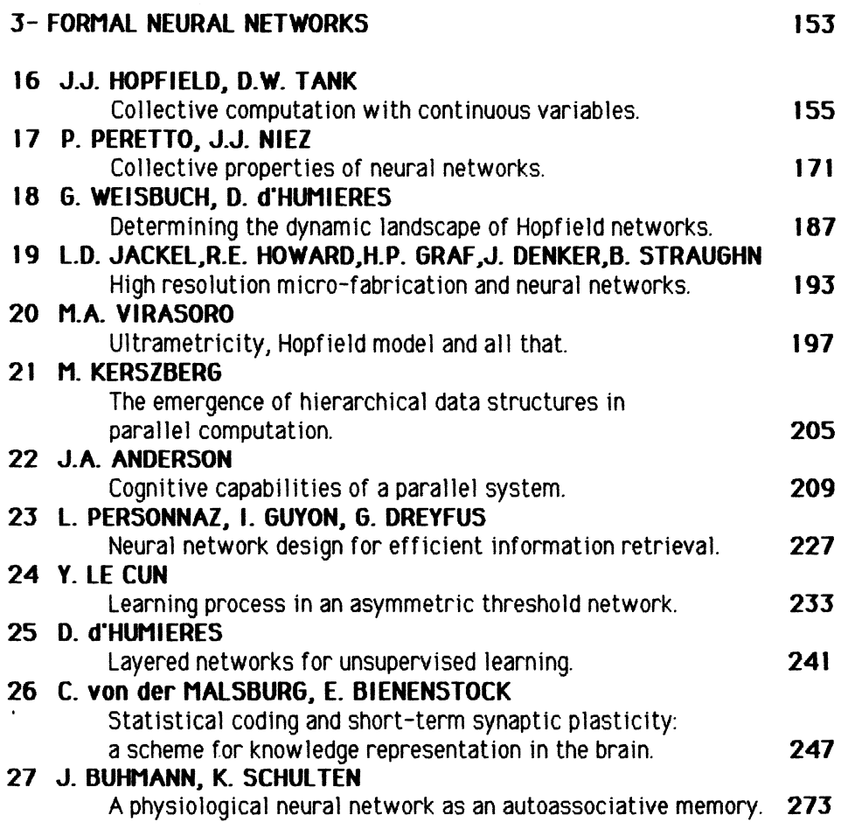
The first AI winter: 1969 to 1985
After Minksy+Paper point out that single-neuron models are weak
LeCun observes a “decrease in interest in this field for.. 15 years”

Slide 7
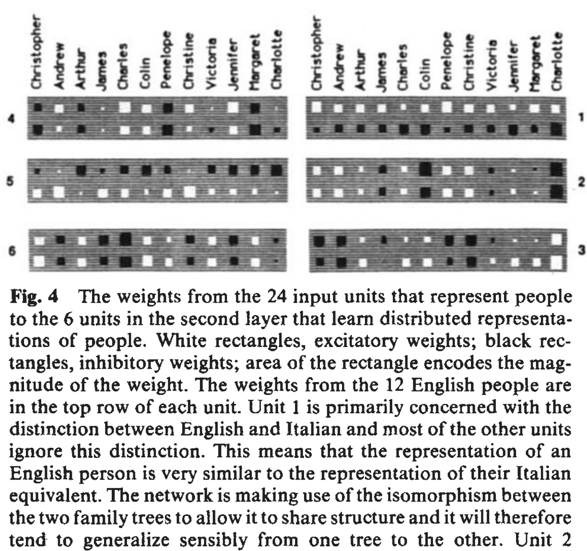
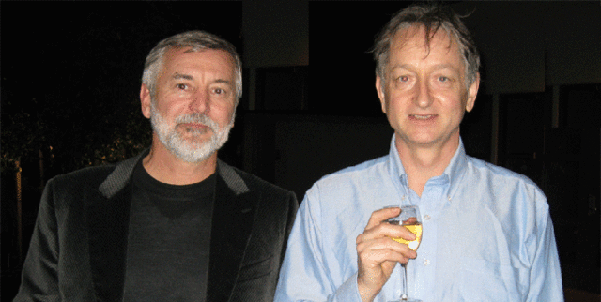
1986: Rumelhart and Hinton find that backprop works
[Rumelhart Hinton Williams, 1986]

Slide 8
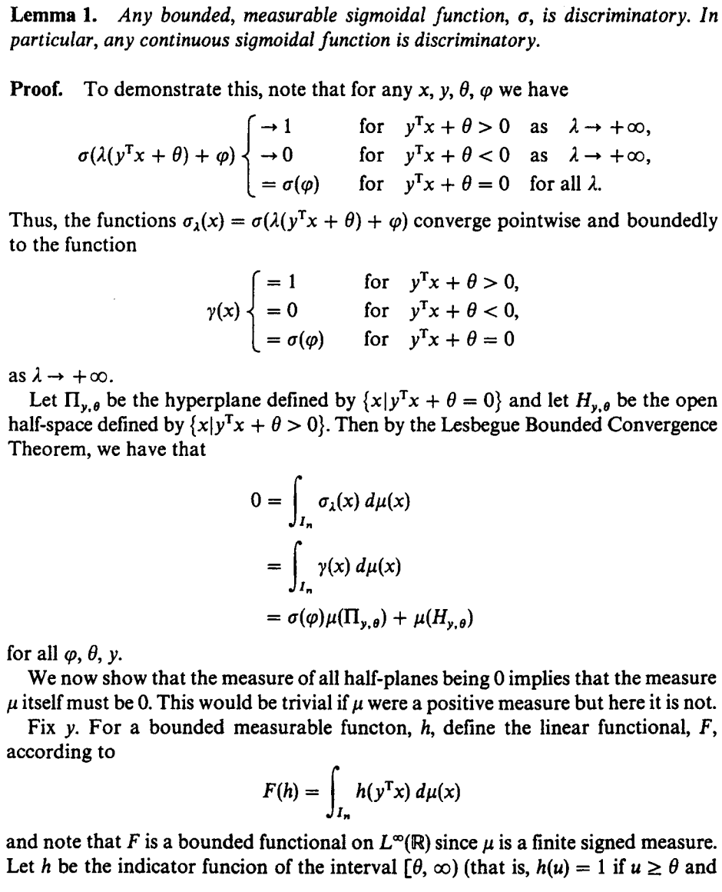
1989: George Cybenko proves universality
[Cybenko, 1989]

Slide 9
Universal Approximation Theorem
Given:
any continuous function $f:ℝ^{n}→ℝ^{m}$, a compact input domain $X⊂$ $ℝ^{n}$ and an error interval $ε>0$
There is guaranteed to be:
a finite network of neurons $g: ℝ^{n}→ℝ^{m}$ that approximates $\left|g\left(x\right)−f\left(x\right)\right|<ε$ for all $x∈X$
Cybenko, 1989 proves this for sigmoid/step neurons
Hornik, 1991 proves almost any nonlinearity will work

Slide 10
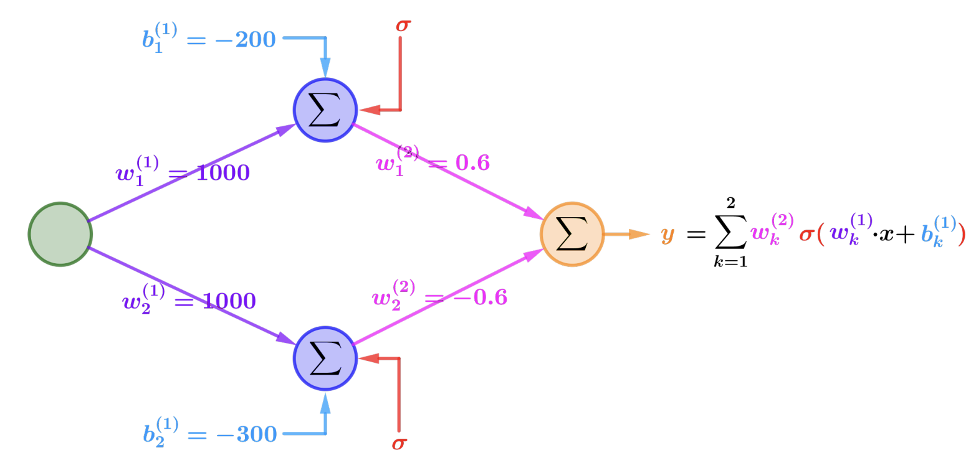
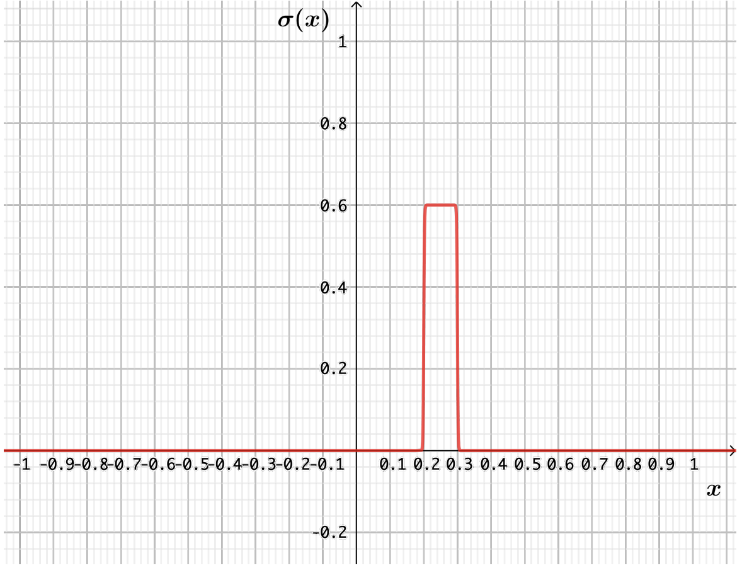
Visual Proof (Figures from Andrea Lörke)
Step 1. Two neurons (step-up, step-down) can be summed to make a bump
[https://www.mathematik.uni-wuerzburg.de/fileadmin/10040900/2019/Seminar__Artificial_Neural_Network__24_9__.pdf]

Slide 11
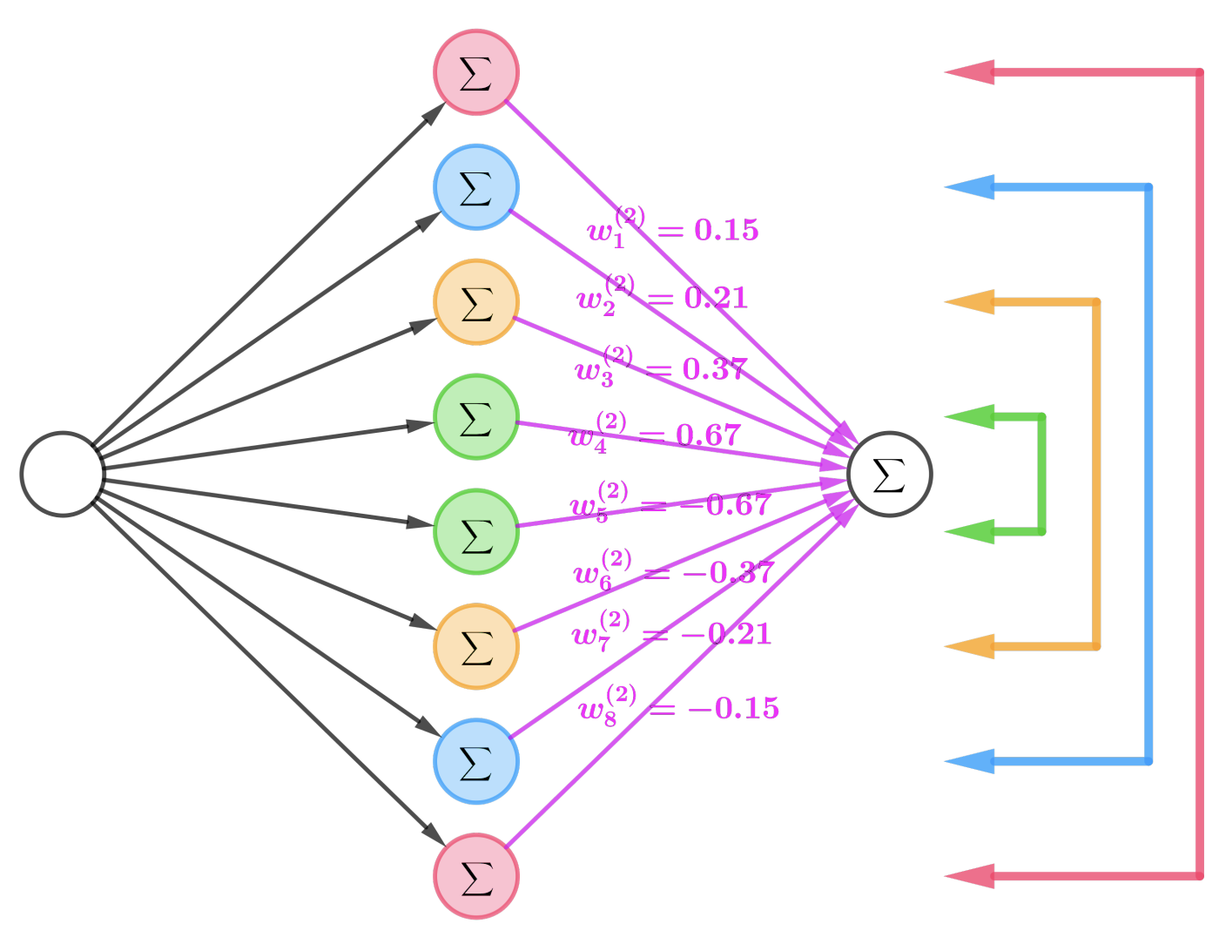
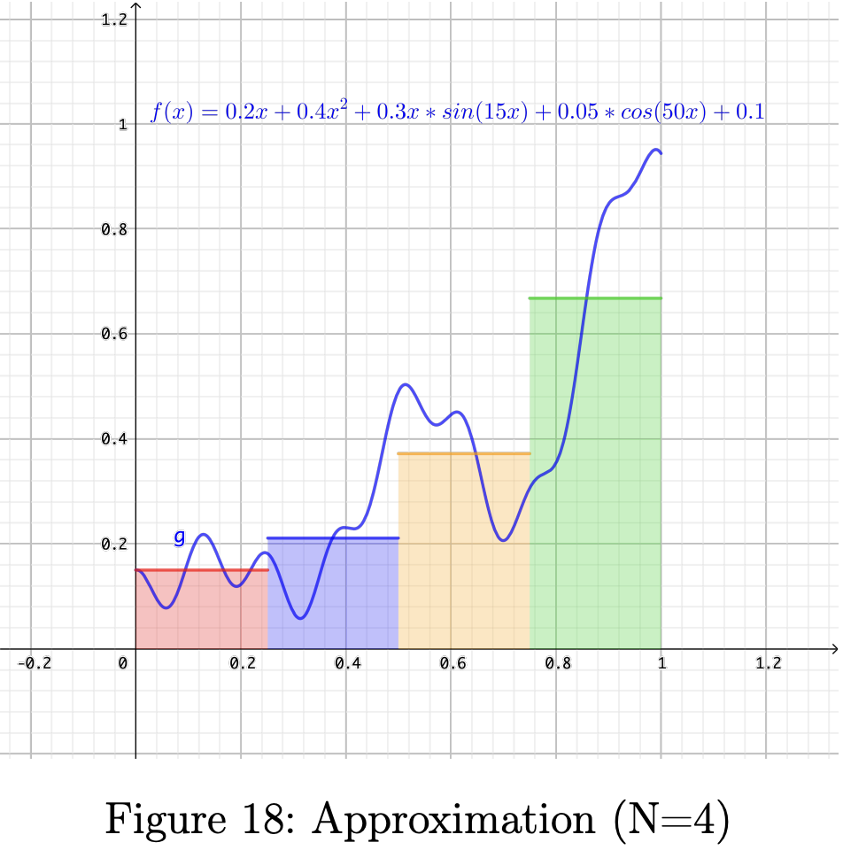
Visual Proof (Figures from Andrea Lörke)
Step 2. Many pairs of neurons can be summed to sum up bumps.
[https://www.mathematik.uni-wuerzburg.de/fileadmin/10040900/2019/Seminar__Artificial_Neural_Network__24_9__.pdf]

Slide 12
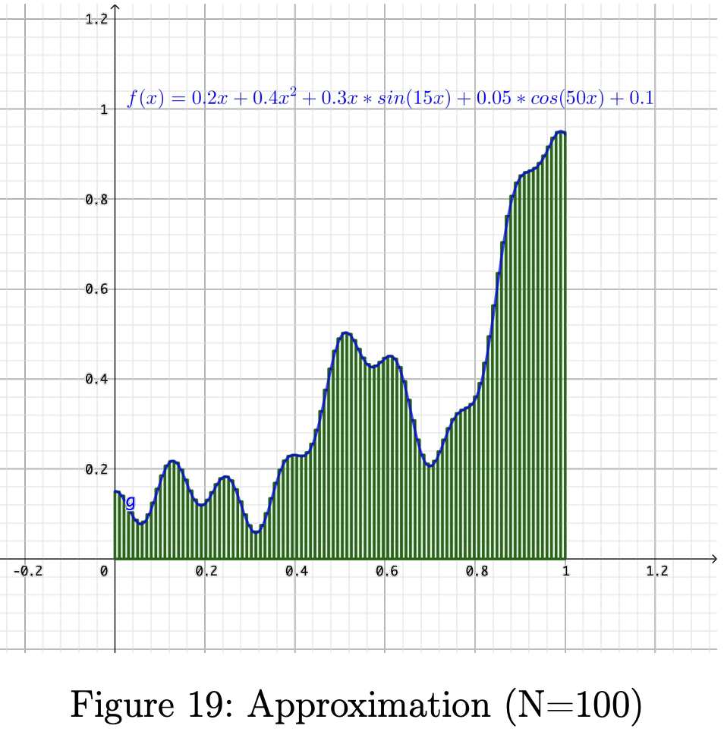
Visual Proof (Figures from Andrea Lörke)
Step 3. By increasing the number of neurons, error can be made $<ε$.
[https://www.mathematik.uni-wuerzburg.de/fileadmin/10040900/2019/Seminar__Artificial_Neural_Network__24_9__.pdf]

Slide 13
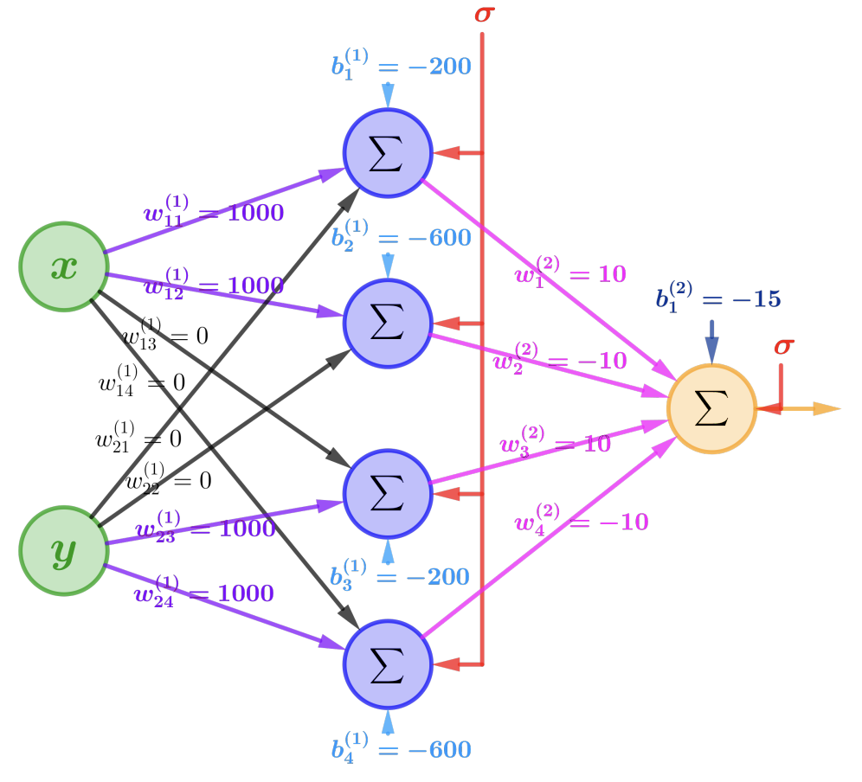
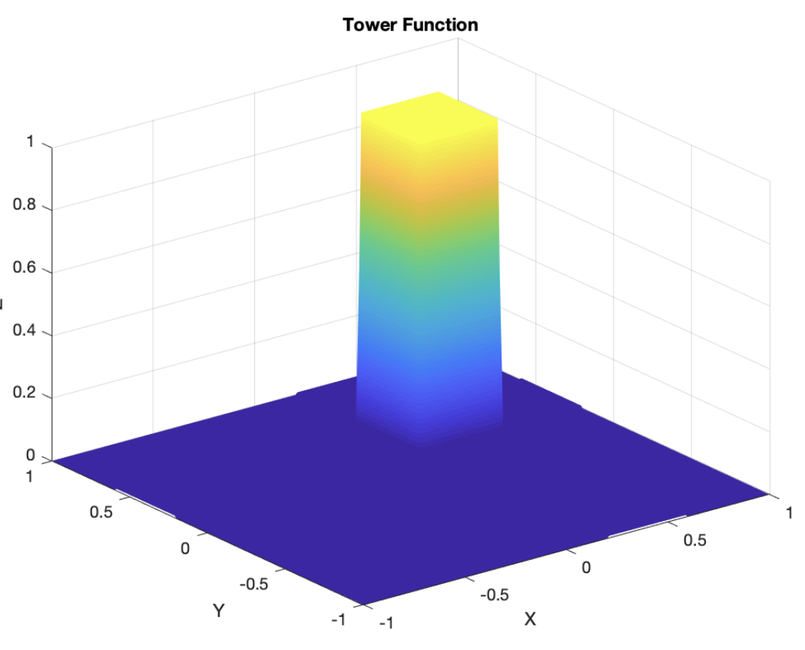
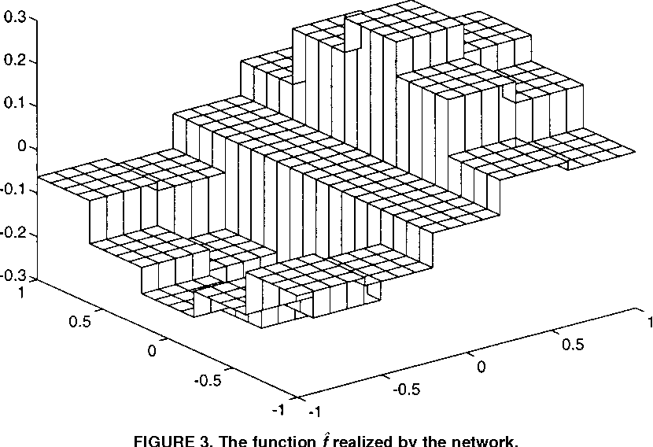
Visual Proof (Figures from Lörke and Scarselli)
Step 4. Similar bump functions can be made in higher dimensions.
[Figure 3 from Scarselli, Tsoi, Universal Approximation, 1998]
[https://www.mathematik.uni-wuerzburg.de/fileadmin/10040900/2019/Seminar__Artificial_Neural_Network__24_9__.pdf]

Slide 14
Bottom line: Networks of neurons can be used to approximate any function.
(And by the way, two layers is enough!)

Slide 15
Questions on Rumelhart 1986

Slide 16
Rumelhart, Williams, Hinton 1986 Learning representations by back-propagating errors
Longer treatment of the work is in the chapter 8 of the Parallel Distributed Processing book: http://www.cs.toronto.edu/~hinton/absps/pdp8.pdf

Slide 17
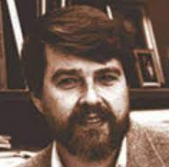
Did Hinton invent backprop?
Uncredited similar research by
Seppo Linainmaa
PhD 1970 in CS
Thesis described backprop
... as a way to fix rounding errors
David Rumelhart
PhD 1967 in Psychology
Professor of Psychology at UC San Diego
Made computer simulations of perception
Wrote “Parallel Distributed Processing” book
Paul Werbos
Economics Harvard 1982: backprop on NN’s
Geoff Hinton
BA 1970 in Psychology; PhD 1978 in Artificial Intelligence
Professor of Computer Science at Carnegie Mellon
had visited UC San Diego in 1980
Turing Award recognizes this work among others
Jurgen Schmidhuber asks:
Why did Hinton win the Turing award?
Ronald J Williams
Institute for Cognitive Science, UC San Diego
“Feature discovery through error-correcting learning” in May 1985
Later Professor of Computer Science at Northeastern

Slide 18
How to Read Pytorch

Slide 19
This class is fully interactive
How to read pytorch
https://bit.ly/howto-pytorch

Slide 20
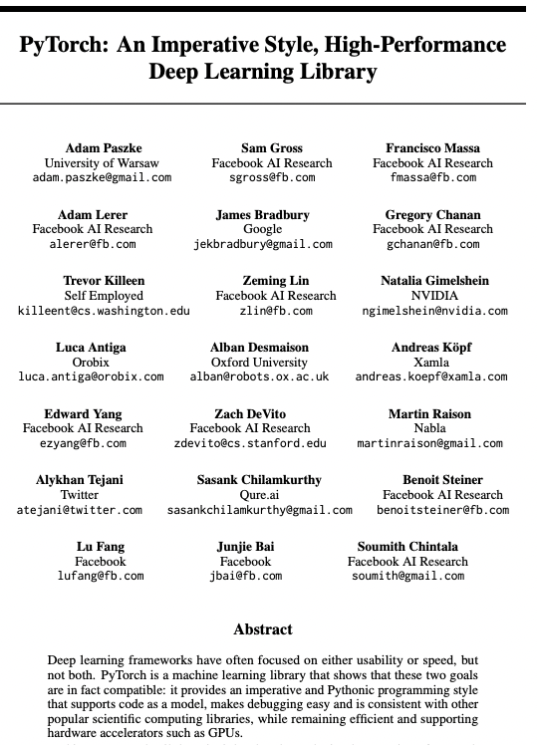
2016: python successor to torch
https://bit.ly/howto-pytorch
Adam Paszke
Sam Gross
Soumith Chintala

Slide 21
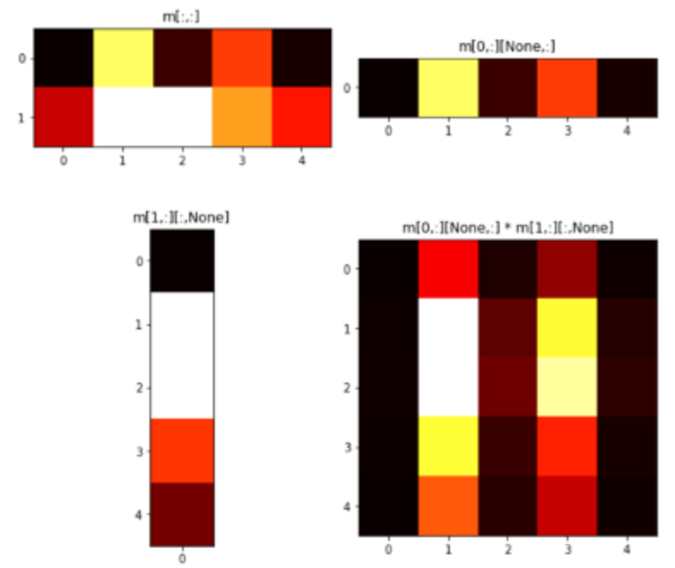
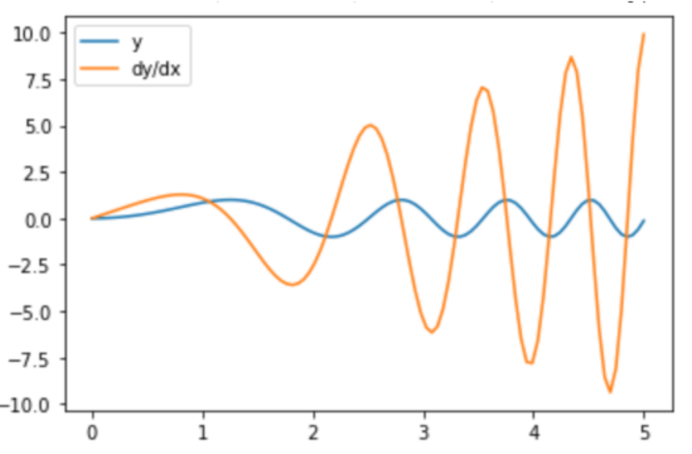
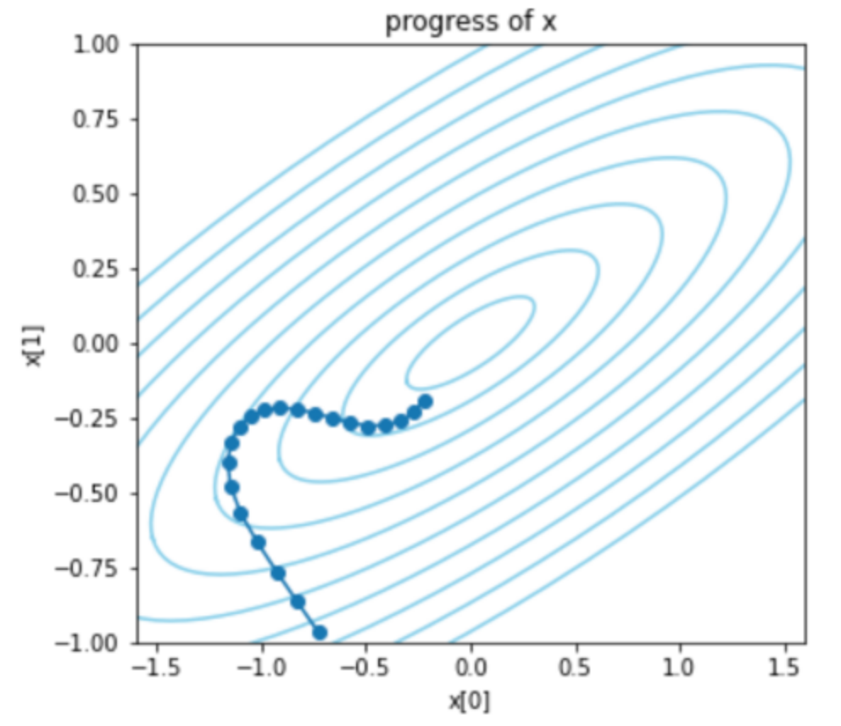
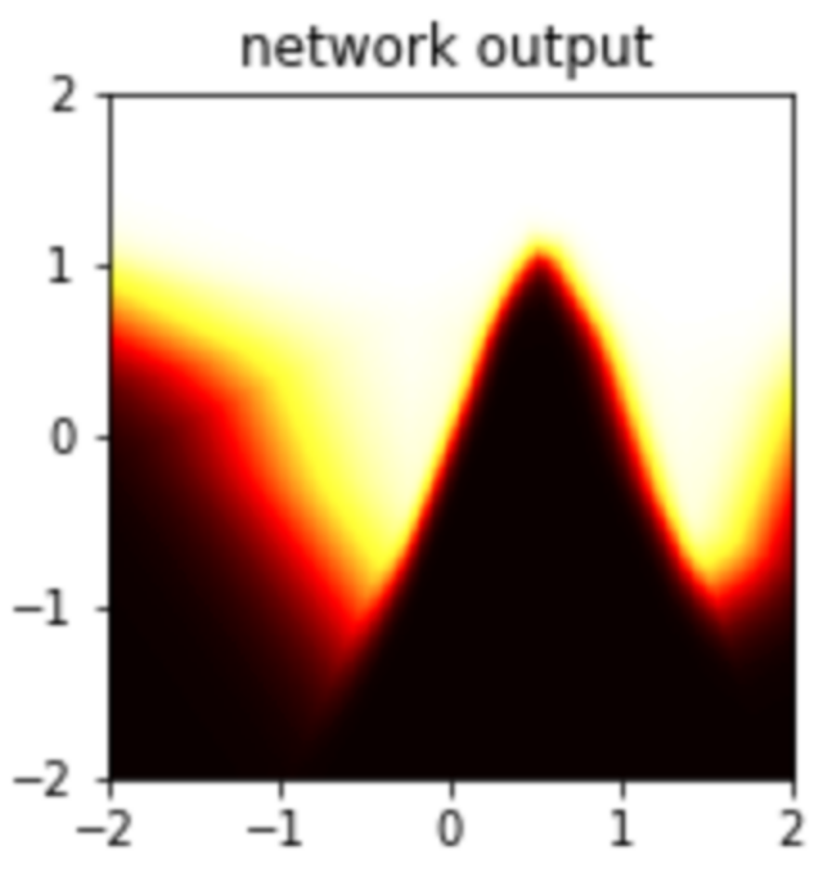
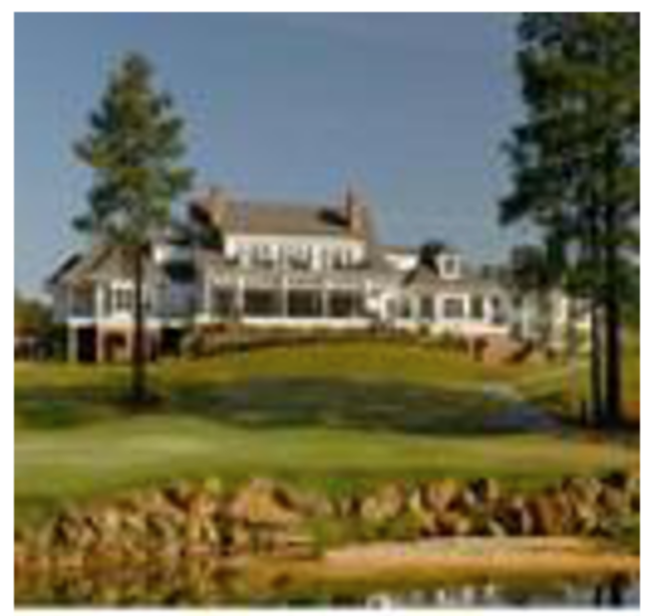
Five Core Concepts.
https://bit.ly/howto-pytorch
Pytorch is just like numpy! But it adds five important things.
GPU Tensors. For speed.
Autograd. For derivatives.
Optimizers. For training.
Modules. For making networks.
DataLoader. For fast datasets.

Slide 22
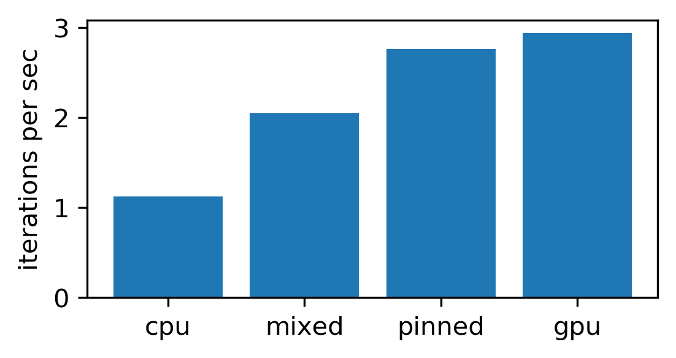
GPU Tensors
Try it now: https://bit.ly/howto-pytorch
Tensors are the unit of computation.
torch.tensor types are lookalikes to numpy N-dim-arrays.
But torch tensors live on either GPU or CPU.
Moving data to GPU just like a type conversion.
For speed, avoid GPU-CPU copying.
Pinning is fast.
Get comfortable with N-dimensional tensors
Slicing, Squeezing, Unsqueezing notation.
Indexing conventions for four-dimensional tensors.

Slide 23
Autograd - https://bit.ly/howto-pytorch-2
Pytorch can calculate pointwise derivatives automatically.
Tensors with requires_grad track computation history.
Autograd.grad() can calculate derivatives to any scalar.
x.backward() adds gradient into parameter.grad.
Autograd is expensive but optional and can be turned on and off.
Set requires_grad=False
Or use with torch.no_grad()
Autograd can be used for fancier things too
Gradient accumulation.
2nd derivatives.

Slide 24
Optimizers - https://bit.ly/howto-pytorch-3
Optimizers take care of improving a set of parameters.
An optimizer is given a large set of parameters to optimize.
It doesn’t need to explicitly know the loss, but it needs to see gradients.
Training is:
1. getting gradients with respect to a loss
2. stepping optimizers to improve the loss
3. repeat
Pytorch comes with many optimizer algorithms.
Popular ones are SGD and Adam. LBFGS is good for small problems.

Slide 25
Modules - https://bit.ly/howto-pytorch-4
The pytorch neural network base class is Module.
A Module is a function with learnable Parameters.
Parameters can be listed, trained, saved and loaded.
Big neural networks are Modules made of other Modules.
Simplest Module is Linear – a linear operation
Simplest way to compose Modules is Sequential – run one after the next.
You can write the function yourself by overriding net.forward(X)
Modules have some other state.
GPU vs CPU; Train vs eval mode; non-trainable buffers.
Pytorch provides many off-the-shelf modules and networks.

Slide 26
DataLoaders - https://bit.ly/howto-pytorch-5
A large Dataset is a slow array.
ImageFolder is a Dataset that loads an image file on every “ds[i]”.
There are many Dataset subclasses, and you can customize your own.
To speed up Datasets, pytorch provides DataLoader
DataLoader wraps a Dataset as a stream of batches.
It uses threading to stream data out faster than “ds[i]”.
To improve training, data can be randomized when loaded.
DataLoaders can shuffle the batches.
Datasets can include transforms to augment data with random crops etc.

