Slide 1
DS 4440
Deep Learning

Slide 2
Large Language Models, Chatbots, Instruction Tuning, RLHF, and DPO

Slide 3
The essential ideas in prompt engineering
Explicit instruction-style prompt
Tell me the capital of Vermont.
direct instruction
Cloze prompt (fill-in-the-blank)
The capital of the state of Vermont is the city of
incomplete sentence
In-context learning (by-example)
New York: Albany; Montana: Helena; Vermont:
demonstrations
next-word prediction

Slide 4
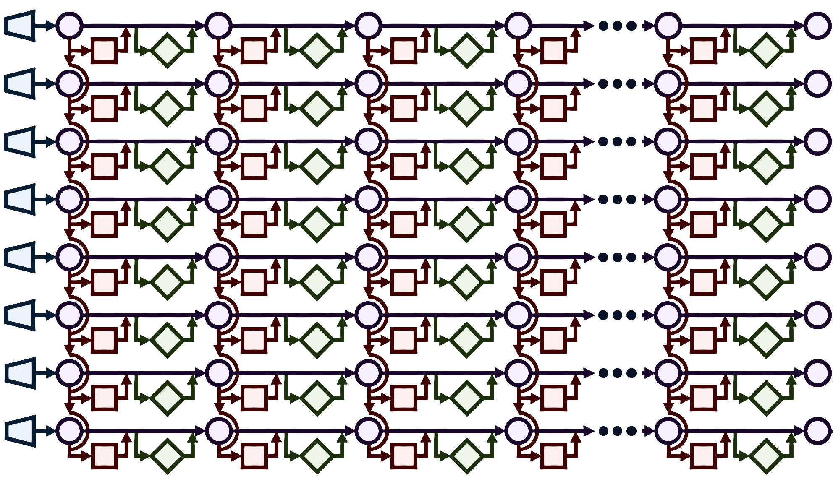
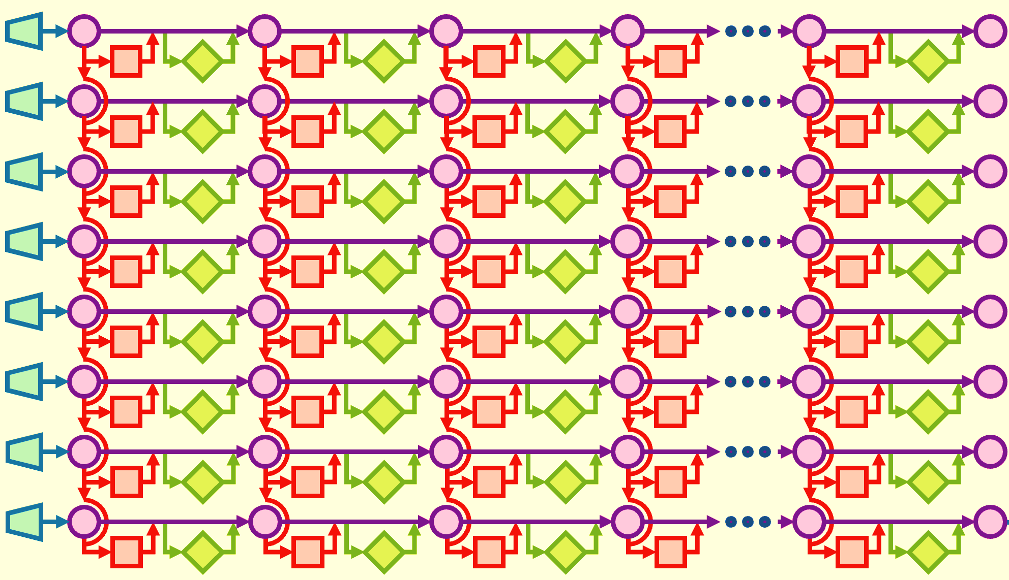
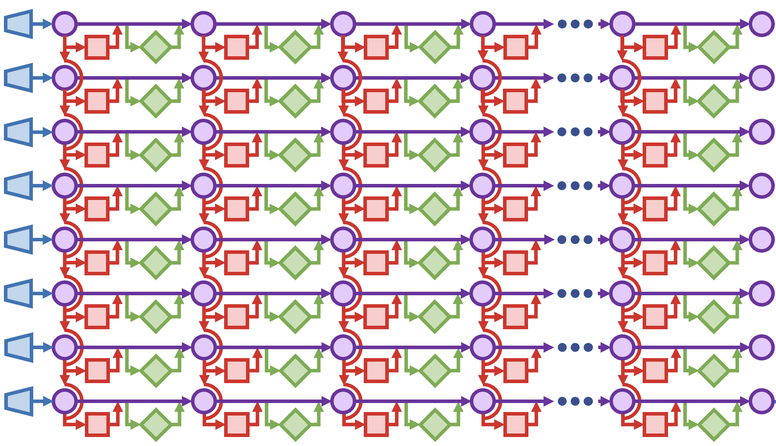
How LLMs are trained to follow instructions
1. pretraining: train to predict all next words
months of training
2. fine-tuning:
train to predict instruction dialog
hours of training
random parameters (outputs nonsense)
pretrained GPT will imitate any text in any context
instruction-tuned GPT specifically imitates instruction-following
a giant mix of all the world’s text
curated set of 100% instruction- following examples

Slide 5
Tool use and interactive protocols
User instruction
How many shares of MSFT can I buy for $10,000?
[invoke search MSFT]
Microsoft Corp, NASDAQ: MSFT.
Market Summary > Microsoft Corp
280.57 USD
+2.91 (1.05%) today
Mkt Cap 2.09T
P/E ratio 31.19
Div yield 0.97%
[response complete]
[invoke calculator 10000 / 280.57]
35.6417293367
[response complete]
At today’s price of 280.57, you can buy 35 shares.
next word predictions
tool responses
search tool
tool-use-tuned GPT
next word predictions
final next word predictions
tool responses
calculator tool

Slide 6
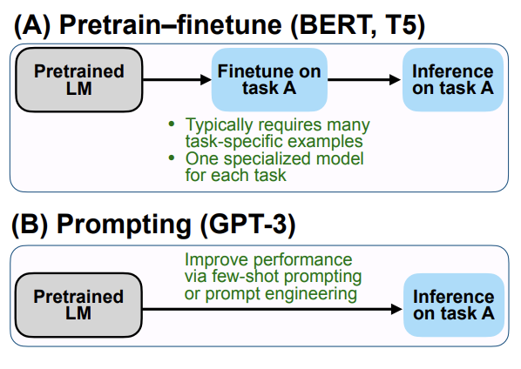
Common Mitigations
(A) Fine-tuning
Often requires many example data
Task specific
(B) Few-shot prompting
Prompt engineering
Limited context size
Expensive Inference
Can we do better?
Notes:
Language models are trained on large corpora using mostly unlabeled data from the web. To keep the learning process self-supervised the objective is next token prediction or some other language masking techniques. The output model learns word embeddings well, and even do well in some NLP tasks that they have been exposed to during training. However the objective function during training time does not match the inference time which is to follow the human

Slide 7
Improve Performance of LMs Zero-shot
Finetuned Language Models Are Zero-shot Learners (FLAN), Jason Wei et. al, ICLR 2022, from Google Research
Multitask Prompted Training Enables Zero-shot Task Generalization (T0), Victor Sanh et. al, ICLR 2022, from Hugging Face
LIMA: Less Is More for Alignment, Chunting Zhou et. Al, arXiv preprint 2023, from Meta AI
Notes:
Zeroshot here means the LM hasn't seen the task before, not in context nor in pretraining or finetuning

Slide 8
Instruction Tuning
Finetune the language model on many tasks (simultaneously) described via instructions
The model will learn to follow instructions
Generalizes to unseen tasks in zero-shot
Works well since NLP tasks are describable with natural language instructions
e.g., Summarize the following paragraph
e.g., Translate "How are you" into Chinese
Notes:
Zeroshot here means the LM hasn't seen the task before, not in context nor in pretraining or finetuning

Slide 9
Instruction Tuning Example
Notes:
Finetuning on multiple tasks at the same time, inference on a new task

Slide 10
Instruction Tuning Example
Training on multiple tasks
Notes:
Finetuning on multiple tasks at the same time, inference on a new task

Slide 11
Instruction Tuning Example
Zero-shot inference
Notes:
Finetuning on multiple tasks at the same time, inference on a new task

Slide 12
Instruction Tuning Example
Task instructions in natural language
Notes:
Tasks described as instructions in natural language

Slide 13
Finetuned Language Net(FLAN)
62 NLP datasets grouped into 12 clusters representing 12 task types
Cluster granularity for unseen tasks
Held out each cluster for zero-short evaluation, finetuned on the remaining 11 clusters
Composed ten unique templates for each datasets
Up to three of them in reversed format (e.g., write a movie review for this sentiment)

Slide 14
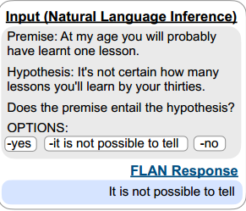
Classification vs Generation Tasks
The base model (LaMDA-PT) is decoder-only
Works as is for free-text generation
tasks (e.g., summarization)
Needs options for classification
tasks (e.g., closed QA)
Notes:
just picking up probability of yes or no is not accurate, since there might be more ways of saying yes, than saying no

Slide 15
Training Details: Base Model
Language Models for Dialog Applications (LaMDA-PT)
Decoder only, trained for next token generation
137B parameters
Pretrained on web documents, dialog data, and Wikipedia
1.56T words, 2.81T
10% of training data is non-English

Slide 16
Training Details: FLAN Training
Mix examples from all datasets together and sample randomly
capped at 30k for each dataset
1024 input and 256 output tokens
30k gradient steps with a batch size of 8,192
Adafactor optimizer with a learning rate of 3e-5
60 hours on a TPUv3 with 128 cores

Slide 17
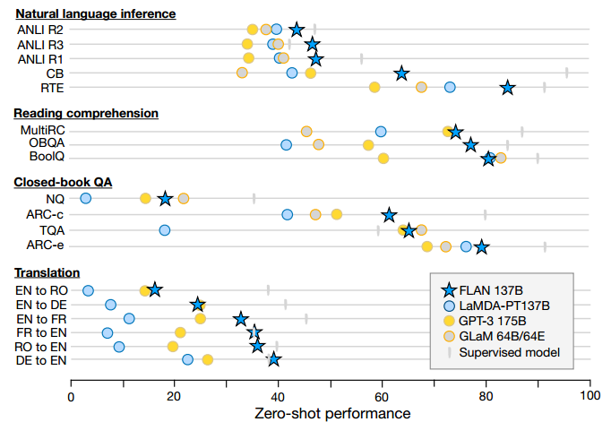
Zero-shot Results
FLAN outperforms
the base LaMDA-PT
Notes:
FLAN always outperforms the base model, in many cases outperforms GPT-3 , and GLaM

Slide 18
Zero-shot Results
In some cases, FLAN
bridges the gap with
supervised models
Notes:
FLAN always outperforms the base model, in many cases outperforms GPT-3 , and GLaM

Slide 19
FLAN vs GPT-3
FLAN outperforms GPT-3 zero-shot and few-shot on some tasks
Task types with most gain from instruction tuning are selected

Slide 20
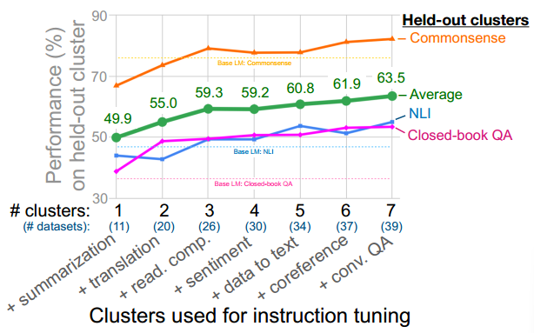
Ablation Studies: Number of Clusters
Adding more clusters
to training helps with
generalizability on
held-out clusters
Notes:
Some number of clusters (or the reading comp cluster?) are needed for NLI and Commonsense to beat the base model, For closed-book QA even one is enough.

Slide 21
Ablation Studies: Number of Clusters
Only after #3 clusters
FLAN beats the base
Model at NLI and
Commonsense tasks
Notes:
Some number of clusters (or the reading comp cluster?) are needed for NLI and Commonsense to beat the base model, For closed-book QA even one is enough.

Slide 22
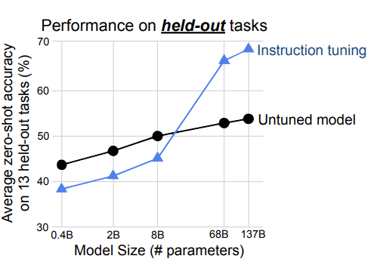
Ablation Studies: Scaling Laws
Accuracy of smaller
models degrades with
Instruction tuning
Notes:
Training on many NLP tasks makes the model forget pretraining, does not generalize well to unseen

Slide 23
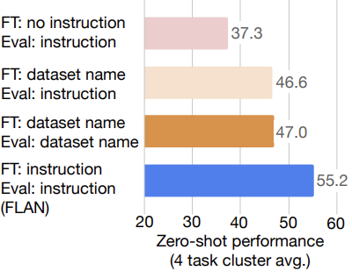
Ablation Studies: Role of Instructions
Multitask instruction
tuning with or without
dataset names does not
match fine tuning gains

Slide 24
Improve Performance of LMs Zero-shot
Finetuned Language Models Are Zero-shot Learners (FLAN), Jason Wei et. al, ICLR 2022, from Google Research
Multitask Prompted Training Enables Zero-shot Task Generalization (T0), Victor Sanh et. al, ICLR 2022, from Hugging Face
LIMA: Less Is More for Alignment, Chunting Zhou et. Al, arXiv preprint 2023, from Meta AI
Notes:
Zeroshot here means the LM hasn't seen the task before, not in context nor in pretraining or finetuning

Slide 25
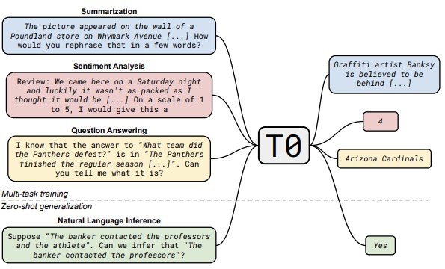
T0 Overview
Multi-task
Training

Slide 26
T0 Overview
Zero-shot
generalization

Slide 27
Dataset Preparation
62 public datasets grouped into 12 tasks
Grouped based on the format of the output rather than the skill required for doing the task
Used crowd sourcing to create different prompt templates for each dataset excluding:
non-English prompts
Potentially harmful content
Public Pool of Prompt (P3) had 2073 prompts for 177 datasets at the time of writing
Notes:
Public pool of prompt (p3)

Slide 28
Training Details: Base Model
LM-adapted variation of T5 (LM+T5)
Trained with 100B additional tokens from C4 corpus using
the Language Model (LM) objective
Encoder + Decoder architecture
11B Parameters

Slide 29
Training Details: T0 Training
Mixed examples from all datasets together and sampled randomly
capped at 500k for each dataset
1024 input and 256 output tokens
Batch size of 1024, 250B tokens
Adafactor optimizer with a learning rate of 1e-3 and dropout 0.1
Trained on a v3-512 Cloud TPU for 270 hours

Slide 30
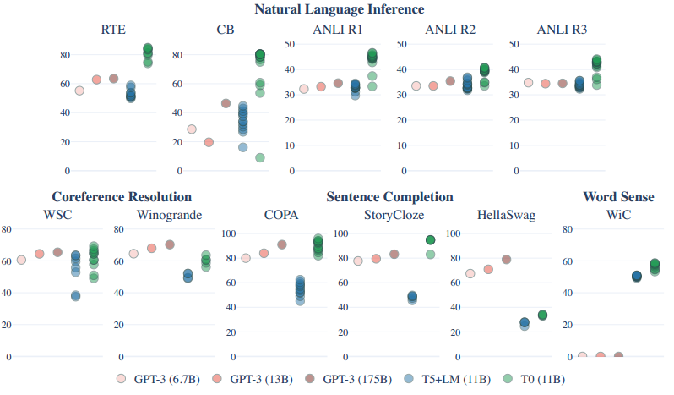
T0 vs GPT-3
T0 and its base model
report results on all
prompts, no cherry pick
T0 always better than
its base model
zero-shot performance

Slide 31
T0 vs GPT-3
On all NLI tasks T0
Outperforms the 11x
larger GPT-3 model

Slide 32
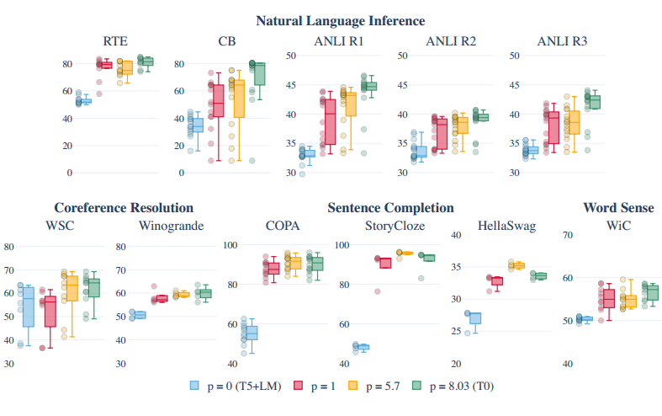
Ablation Study: Effect of Prompt Count
Overall, more prompt
templates improve the
performance
zero-shot performance for #training prompt templates

Slide 33
Ablation Study: Effect of Prompt Count
Fewer number of
prompts can cause
large variances
zero-shot performance for #training prompt templates

Slide 34
Ablation Study: Effect of Prompt Count
For some tasks having
many prompts hurts
the performance
zero-shot performance for #training prompt templates
Notes:
Can be either because there aren't many good ways to express the task

Slide 35
T0 vs FLAN Differences
 | Base Model | Language | Prompt Template | Published Dataset for instruction tuning | Training method
FLAN | LaMDA-PT 137B | 10% non-English | Author generated | FLAN v2 | Trains a separate model for each held-out group
T0 | LM + T5 11B | 100% English | Crowd sourced, | P3 dataset | Trains a single model holding out 3 task clusters

Slide 36
T0 vs. FLAN Results
Both papers reported results for NLI category
ANLI R1-3 and RTE don't have any clear winners
T0 significantly better than FLAN on CB (~80% vs. ~ 65%)
Both train on ~250B tokens, maybe not enough for LaMDA-PT
Mixing the two datasets for instruction tuning is the best
Chung, Hyung Won, Le Hou, Shayne Longpre, Barret Zoph, Yi Tay, William Fedus, Yunxuan Li et al. "Scaling instruction-finetuned language models." arXiv preprint arXiv:2210.11416 (2022).

Slide 37
Improve Performance of LMs Zero-shot
Finetuned Language Models Are Zero-shot Learners (FLAN), Jason Wei et. al, ICLR 2022, from Google Research
Multitask Prompted Training Enables Zero-shot Task Generalization (T0), Victor Sanh et. al, ICLR 2022, from Hugging Face
LIMA: Less Is More for Alignment, Chunting Zhou et. Al, arXiv preprint 2023, from Meta AI
Notes:
Zeroshot here means the LM hasn't seen the task before, not in context nor in pretraining or finetuning

Slide 38
No More Large-scale Instruction Tuning?
Hypothesize: Alignment teaches the model the style or format for interacting with users, to expose the knowledge and capabilities that it has already learned during pretraining
Only limited instruction tuning data is necessary to teach models to produce high quality output
LIMA focuses on 1000 carefully curated prompts, diverse input style, unified output in the format of helpful assisstant AI

Slide 39
Data Selection: Stack Exchange
Sample 200 questions from each 170+ exchanges
Title-only questions with the highest score
Top answer for each question (>+10 score)
Excluded answers not matching the helpful AI assistant style
Shorter than 1200 characters longer than 4096
Written in the first person
Reference to other posts
Removed links, images, and HTML tags from responses

Slide 40
Data Selection: WikiHow
Sampled 200 out of 240000 highly moderated articles
Two level sampling to maximize diversity
Article title used as the input prompt
Article body used as the response
Preprocessing to remove images, links, etc.

Slide 41
Data Selection: Pushshift Reddit Dataset
Reddit is mostly for entertaining
Top voted answers could be witty, sarcastic, humorous
Not a match for helpful AI assistant style
Manually selected examples from within the most upvoted posts
Limited selection to r/AskReddit and r/Prompts
70 title-only questions and their topmost voted answer in test set
150 high quality prompts and responses from r/Prompts
Notes:
R/prompts: premises of fictional stories, which other users are then encouraged to creatively complete

Slide 42
Manual Prompt Creation
Two groups of authors wrote 250 prompts based on their interest
Group A: 200 training, 50 dev set split
Group B: filtered out 20, the remaining 230 for held-out for test
Wrote high quality responses for the 200 prompts in training set
Acknowledgement of the question followed by the answer assists the model in forming chain of thought
A single training example from 50 natural language generation tasks such as summarization, paraphrasing, etc.
Increases the prompt diversity

Slide 43
Training LIMA
Used LLaMa 65B as the base model
Trained on 1000 examples with batch size of 32 for 15 epochs
Introduced a special end-of-turn token (EOT) to differentiate between user and assistant roles.
Context size 2048
AdamW optimizer
Dropout over residual networks

Slide 44
Evaluation Methodology
Humans compare models' responses for a given prompt
Prefer LIMA
Prefer the other model
It is a tie
Inter-Annotator agreement measured over 50 randomly selected annotations
crowd-crowd 82%
crowd-author 81%
author-author 78%

Slide 45
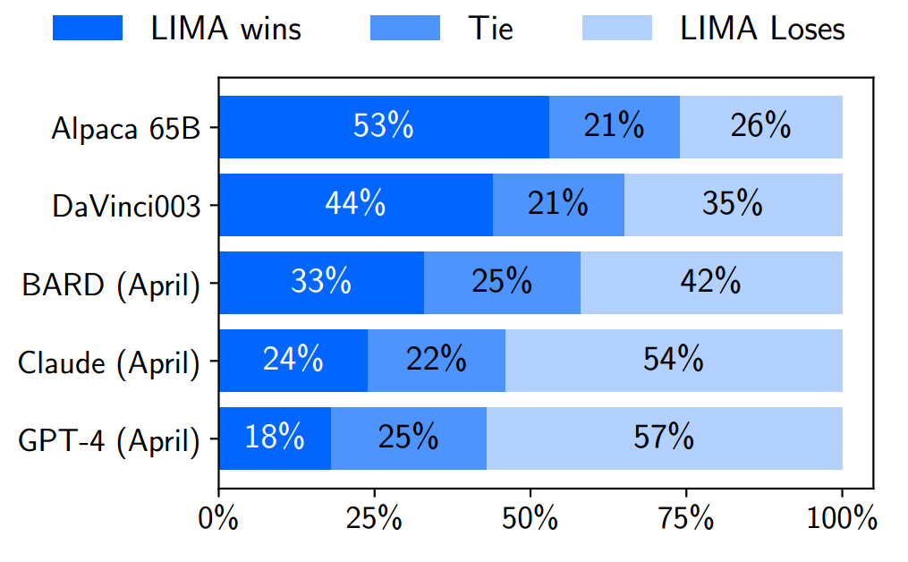
Human Evaluation
In 74% of the test prompts
LIMA's response is better
than or equal to the same
size Alpaca finetuned with
x52 more data
Human preference evaluation on 300 test prompts

Slide 46
Human Evaluation
In 43% of the test prompts
LIMA's response is better
than or equal to GPT-4
Human preference evaluation on 300 test prompts

Slide 47
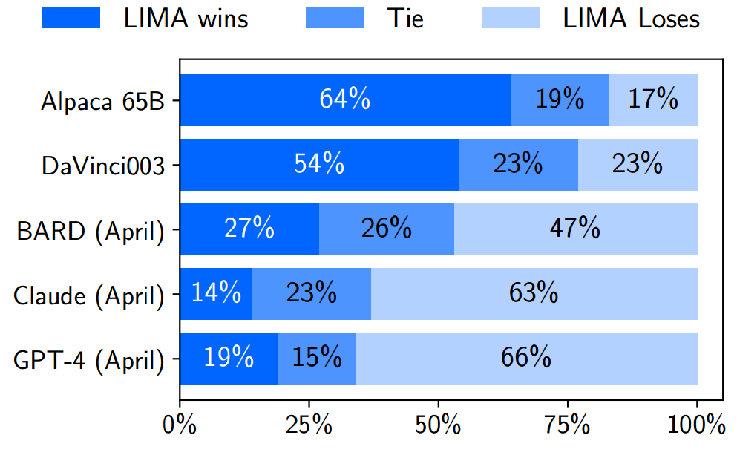
GPT-4 Evaluation
Similar trend, but GPT4
prefers larger model
responses more often
Human preference evaluation on 300 test prompts

Slide 48
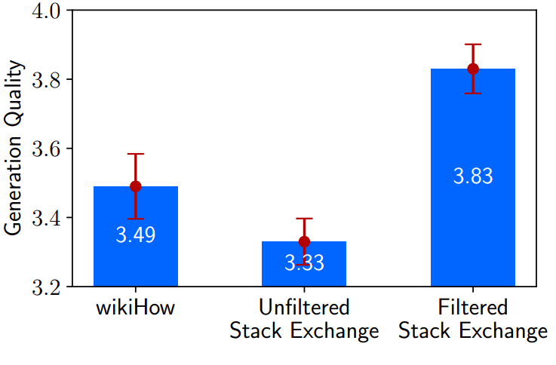
Ablation study: Quantity, Quality, Diversity
Fine tune a 7B version using 2000 examples from different datasets
Ask ChatGPT to grade helpfulness in 1-6 Likert scale
For each dataset 5 examples from its test split are randomly selected
High quality but low diversity,
All "How to" prompts

Slide 49
Ablation study: Quantity, Quality, Diversity
Fine tune a 7B version using 2000 examples from different datasets
Ask ChatGPT to grade helpfulness in 1-6 Likert scale
For each dataset 5 examples from its test split are randomly selected
High diversity but low quality,
since it is unfiltered

Slide 50
Ablation study: Quantity, Quality, Diversity
Fine tune a 7B version using 2000 examples from different datasets
Ask ChatGPT to grade helpfulness in 1-6 Likert scale
For each dataset 5 examples from its test split are randomly selected
Both high quality and diversity
performs best

Slide 51
RLHF
RLHF - Reinforcement Learning from Human feedback
Training language models to follow instructions with human feedback, Long Ouyang et al. Advances in Neural Information Processing Systems (2022), from OpenAI

Slide 52
Motivation for RLHF in LLMs
Part of a broader research in aligning AI systems with human intentions
Default LLM Behaviour
Optimize next word prediction objective
Lead to unintended output
Made up facts
Biased or toxic text
Simply not following instructions
Clear Misalignment!
Notes:
Optimize next word prediction objective -> one proxy for what we want the model to do

Slide 53
Motivation for RLHF in LLMs
Not following instructions

Slide 54
Motivation for RLHF in LLMs
Not truthful

Slide 55
Motivation for RLHF in LLMs
Toxic

Slide 56
Motivation for RLHF in LLMs
Goal: train LLMs to act in accordance with user’s intention
Must Encompass
Explicit Intentions: following exact instructions (helpfulness)
Implicit Intentions: remaining truthful, unbiased and non-toxic/harmful
RLHF uses human preferences as a reward signal to fine-tune LLMs
Notes:
Goal: train LLMs to act in accordance with user’s intention -> INCLUDES: human preferences and human values

Slide 57
InstructGPT
Shows how finetuning with human feedback using RL can be a viable approach for aligning LLMs with human intent
InstructGPT displays improvements on truthfulness and reduces toxic output while maintaining the model’s performance across standard NLP datasets
The refined model operates with 1.3 billion parameters, in contrast to the original GPT-3 model's 175 billion parameters.

Slide 58
Background on Reinforcement Learning
Machine Learning
Supervised
Unsupervised
Reinforcement
Task Driven (Classification/Regression)
Data Driven (Clustering)
Algorithm learns a policy for decision making in an environment
Notes:
Reinforcement learning in formal terms is a method of machine learning wherein the software agent learns to perform certain actions in an environment which lead it to maximum reward. It does so by exploration and exploitation of knowledge it learns by repeated trials of maximizing the reward.

Slide 59
Intuitive Example of RL
Objective: cross a dark unknown field containing stones/pits
Rule: if you fall into a pit or hit a rock, you must start from beginning
The number of steps you take each try are your points (reward)
Source: DALL·E 2

Slide 60
Intuitive Example of RL
Blindly walk forward, after x steps you fall into a pit, gain x points
Start again, walk x steps, but now you turn left/right. After y steps you hit a stone, gain y points (y > x)
Restart again, take same path as before but at y steps you take another detour until you hit a stone after z steps, gain z points (z > y)
Restart, take same path so far, after z steps, another detour and finally you cross the field
Source: DALL·E 2

Slide 61
Intuitive Example of RL - Diagram
Notes:
Remove and write this text in red in next slide (NOTE)

Slide 62
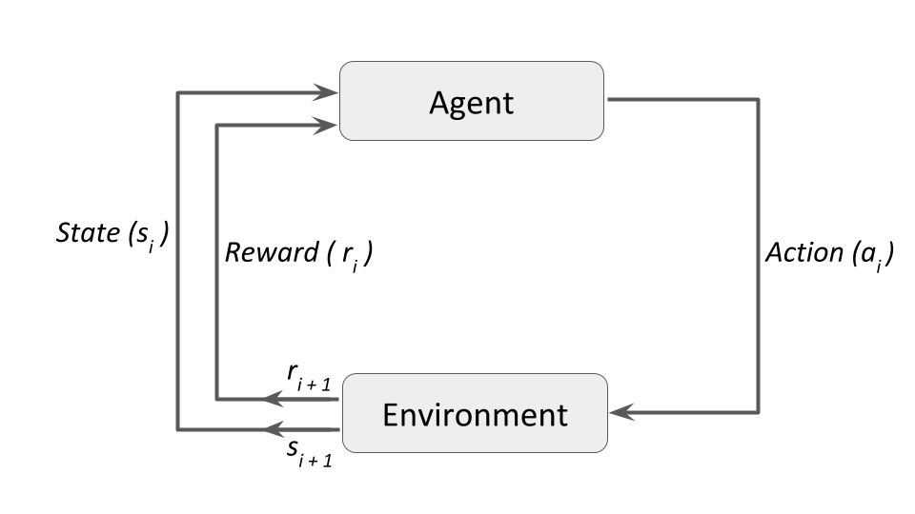
Intuitive Example of RL - Generalized
Notes:
Reinforcement learning in formal terms is a method of machine learning wherein the software agent learns to perform certain actions in an environment which lead it to maximum reward. It does so by exploration and exploitation of knowledge it learns by repeated trials of maximizing the reward.

Slide 63
RL Terminology
Agent: An entity that interacts with the environment to perform actions and collect rewards
Environment: The context or setting within which the agent operates and makes decisions
Action Space: The set of all possible decisions or moves the agent can make
State Space: The set of all possible configurations of the environment reflecting the consequences of past actions
Reward: The feedback from the environment in response to the agent's action, indicating the value of the action's outcome
Policy (π): The strategy or approach the agent uses to decide the next action based on the current state

Slide 64
RL Approaches
Can broadly be categorized into 3 groups:
Value-Based
RL Approaches
Policy-Based
Model-Based

Slide 65
Value-Based Methods
Objective is to maximize the value function, $V\left(s\right)$, which is the expected sum of discounted future rewards from state $s$, formally given by:
$$V_{π}\left(s\right)=E\left[R_{t+1}+γR_{t+2}+γ^{2}R_{t+3}+ …\right|S_{t}=s]$$
The policy is implicit in the value function, with actions chosen to maximize future rewards
Examples: Q-Learning, Deep Q-Networks (DQN)
Notes:
Put in slide

Slide 66
Policy-Based Methods
Directly learns the policy $π$ that maps states to optimal actions
Does not use a value function to select actions
Policies can be:
Deterministic - at any state $s$, the same action $a$ is produced by the policy $π$
Stochastic - Each action is chosen with a certain probability, represented by:
$$π\left(a \right| s)=P\left[A_{t}=a \right| S_{t}=s]$$
Examples: REINFORCE, Trust Region Policy Optimization (TRPO), Proximal Policy Optimization (PPO)

Slide 67
Model-Based Methods
These methods involve learning a model of the environment and using it to make predictions about future states and rewards
Tailored solutions for each environment, with no universal algorithm due to the diversity of potential models

Slide 68
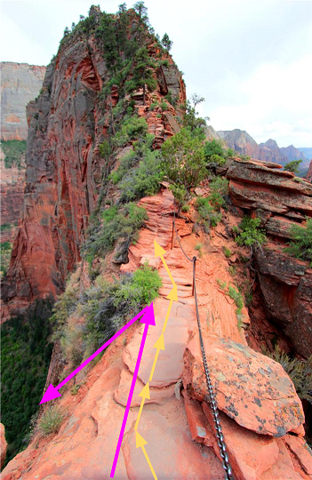
Proximal Policy Optimization (PPO)
Introduced by OpenAI in 2017 and is considered as a state-of-the-art policy-based RL algorithm
Enhances training stability in policy updates by limiting the magnitude to prevent large, disruptive changes
Balances between exploration and exploitation by maintaining proximity to proven policies
Source: RL - Proximal Policy Optimization (PPO) Explained by Jonathan Hui
Notes:
Why Small Updates?
Empirical Evidence: Smaller updates are more likely to lead to optimal solutions.
Avoiding Risks: Large updates can drastically worsen the policy, potentially making recovery difficult or impossible.
However, the problem comes from the step size:
Too small, the training process was too slow
Too high, there was too much variability in the training

Slide 69
PPO
Idea: constrain our policy update with a new objective function called the clipped surrogate objective function that will constrain the policy change in a small range using a clip
Designed to avoid destructive large weight updates
Clipped Surrogate Objective Function:
$$L^{CLIP}\left(θ\right)= {\hat{𝔼}}_{t}[\min\left(r_{t}\left(θ\right){\hat{A}}_{t}, clip\left(r_{t}\left(θ\right), 1−ε, 1+ε\right){\hat{A}}_{t}\right)]$$
Notes:
π_θ(a|s) is stochastic, meaning that the parameters dictate the sampling probability of actions a
In the context of RL, a policy π is simply a function that returns a feasible action a given a state s. In policy-based methods, the function (e.g., a neural network) is defined by a set of tunable parameters θ. We can adjust these parameters, observe the differences in resulting rewards, and update θ in the direction that yields higher rewards. This mechanism underlies the notion of all policy gradient methods.

Slide 70
PPO – Ratio Function
$$L^{CLIP}\left(θ\right)= {\hat{𝔼}}_{t}[\min\left(r_{t}\left(θ\right){\hat{A}}_{t}, clip\left(r_{t}\left(θ\right), 1−ε, 1+ε\right){\hat{A}}_{t}\right)]$$
$$r_{t}\left(θ\right)= \frac{π_{θ}(a_{t}|s_{t})}{{π_{θ}}_{old}(a_{t}|s_{t})}$$
It’s the probability of taking action $a_{t}$​ at state $s_{t}$​ in the current policy divided by the previous one
If $r_{t}\left(θ\right)>1$, then the action $a_{t}$​ at state $s_{t}$​ is more likely in the current policy than the old policy
If $0{<r}_{t}\left(θ\right)<1$, then the action $a_{t}$​ at state $s_{t}$​ is less likely in the current policy than the old policy
Easy way to estimate the divergence between policies
Notes:
As we can see, rt​(θ) denotes the probability ratio between the current and old policy

Slide 71
PPO – The Unclipped Part
$$L^{CLIP}\left(θ\right)= {\hat{𝔼}}_{t}[\min\left(r_{t}\left(θ\right){\hat{A}}_{t}, clip\left(r_{t}\left(θ\right), 1−ε, 1+ε\right){\hat{A}}_{t}\right)]$$
$$L^{CPI}\left(θ\right)= {\hat{𝔼}}_{t}[r_{t}\left(θ\right){\hat{A}}_{t}]$$
CPI = Conservative Policy Iteration
Directly uses probability ratio with no modification
${\hat{A}}_{t}$is the advantage and quantifies how much better an action is compared to the policy’s average action in a given state
If positive, the policy update should make such actions more likely in the future
If negative, the policy update should make such actions less likely in the future
Does not have any mechanism to prevent overly large policy updates
Notes:
However, without a constraint, if the action taken is much more probable in our current policy than in our former, this would lead to a significant policy gradient step and, therefore, an excessive policy update.
The reason it is termed "conservative" is that even without the clipping mechanism, the update rule is designed to be cautious in how it updates the policy to prevent drastic changes that could destabilize the learning process.

Slide 72
PPO – The Clipped Part
$$L^{CLIP}\left(θ\right)= {\hat{𝔼}}_{t}[\min\left(r_{t}\left(θ\right){\hat{A}}_{t}, clip\left(r_{t}\left(θ\right), 1−ε, 1+ε\right){\hat{A}}_{t}\right)]$$
Truncates the ratio $r_{t}\left(θ\right)$ to ensure it does not fall outside the specified range $[1−ε, 1+ε]$
If $r_{t}\left(θ\right)$ is within the range, then $r_{t}\left(θ\right)$ remains unchanged
If $r_{t}\left(θ\right)$ is less than $1−ε$ then it is “clipped” to be $1−ε$
If $r_{t}\left(θ\right)$ is greater than $1+ε$ then it is “clipped” to be $1+ε$
Clipping acts as a guardrail, but it does not scale the ratio; it simply cuts off the extremes
Taking the minimum of unclipped and clipped prevents the policy from updating too much in one step, which could lead to large, potentially unstable changes in the policy
Notes:
epsilon is a hyperparameter that helps us to define this clip range (in the paper ϵ=0.2ϵ=0.2.).
Clipped Surrogate Objective Function:

Slide 73
InstructGPT

Slide 74
InstructGPT

Slide 75
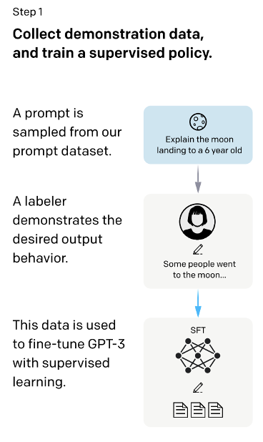
Supervised Fine-Tuning Model (SFT)
Initiated by recruiting 40 contractors through a selective screening process
Compiled a dataset of human-written demonstrations of the desired output behaviour on prompts (mostly English) submitted to the OpenAI API and some labeler-written prompts
Used this dataset as source of supervised learning training
Notes:
Acts as the base policy

Slide 76
InstructGPT

Slide 77
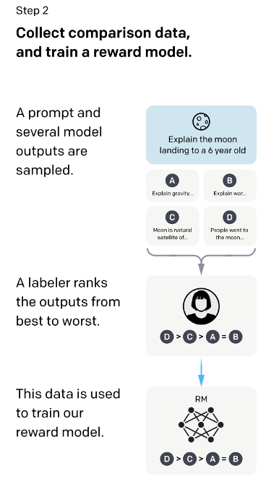
Reward Model (RM)
Collected a dataset from human-labelled comparisons between GPT3 model outputs on a larger collection of OpenAI API prompts
Using this dataset a reward model was trained to predict which model output a human would prefer
Wish to minimize this loss function:
$$loss\left(θ\right)=−\frac{1}{\left({K \atop 2}\right)}E_{\left(x,y_{w},y_{l}\right)\sim D}[\log\left(σ\left(r_{θ}\left(x,y_{w}\right)−r_{θ}\left(x,y_{l}\right)\right)\right)]$$
Parameters:
$K$ is the number of responses to rank, $\left({K \atop 2}\right)$ possible comparisons
$x$ is the prompt, $y_{w}$ is preferred completion and $y_{l}$ is not
$r_{θ}\left(x,y\right)$ produces the scalar output of the reward model
Notes:
Starting from the SFT model with the final unembedding layer removed, we trained a model to take in a prompt and response, and output a scalar reward. In this paper we only use 6B RMs, as this saves a lot of compute, and we found that 175B RM training could be unstable
between K = 4 and K = 9 responses to rank. This produces 􏰀K􏰁 comparisons for each prompt shown to a labeler.
Loss Function (minimizing) negative log of the softmax probability of the preferred completion's score over the non-preferred one
where rθ (x, y) is the scalar output of the reward model for prompt x and completion y with parameters θ, yw is the preferred completion out of the pair of yw and yl, and D is the dataset of human comparisons.

Slide 78
InstructGPT

Slide 79
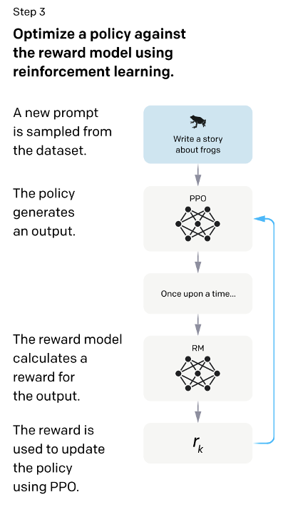
RLHF
Using the RM as a reward function the SFT model is fine-tuned to maximize this reward using the PPO algorithm
Wish to maximize this objective function:
$$objective\left(φ\right)=E_{\left(x,y\right)\sim D_{π_{φ}^{RL}}}[r_{θ}\left(x,y\right)−β log⁡(π_{φ}^{RL}\left(y \right|x)/π^{SFT}\left(y \right|x))]+γ E_{x\sim D_{pretrain}}[log⁡ (π_{φ}^{RL}(x))]$$
Two InstructGPT models
PPO-ptx mixes gradients from pretrained model
PPO does not and so it uses $γ=0$
Notes:
How they evaluated
User id to split dataset into training, test set
We also experiment with mixing the pretraining gradients into the PPO gradients, in order to fix the performance regressions on public NLP datasets. We call these models “PPO-ptx.” We maximize the following combined objective function in RL training:
where πRL is the learned RL policy, πSFT is the supervised trained model, and Dpretrain is the
pretraining distribution. The KL reward coefficient, β, and the pretraining loss coefficient, γ, control the strength of the KL penalty and pretraining gradients respectively. For "PPO" models, γ is set to 0. Unless otherwise specified, in this paper InstructGPT refers to the PPO-ptx models.

Slide 80
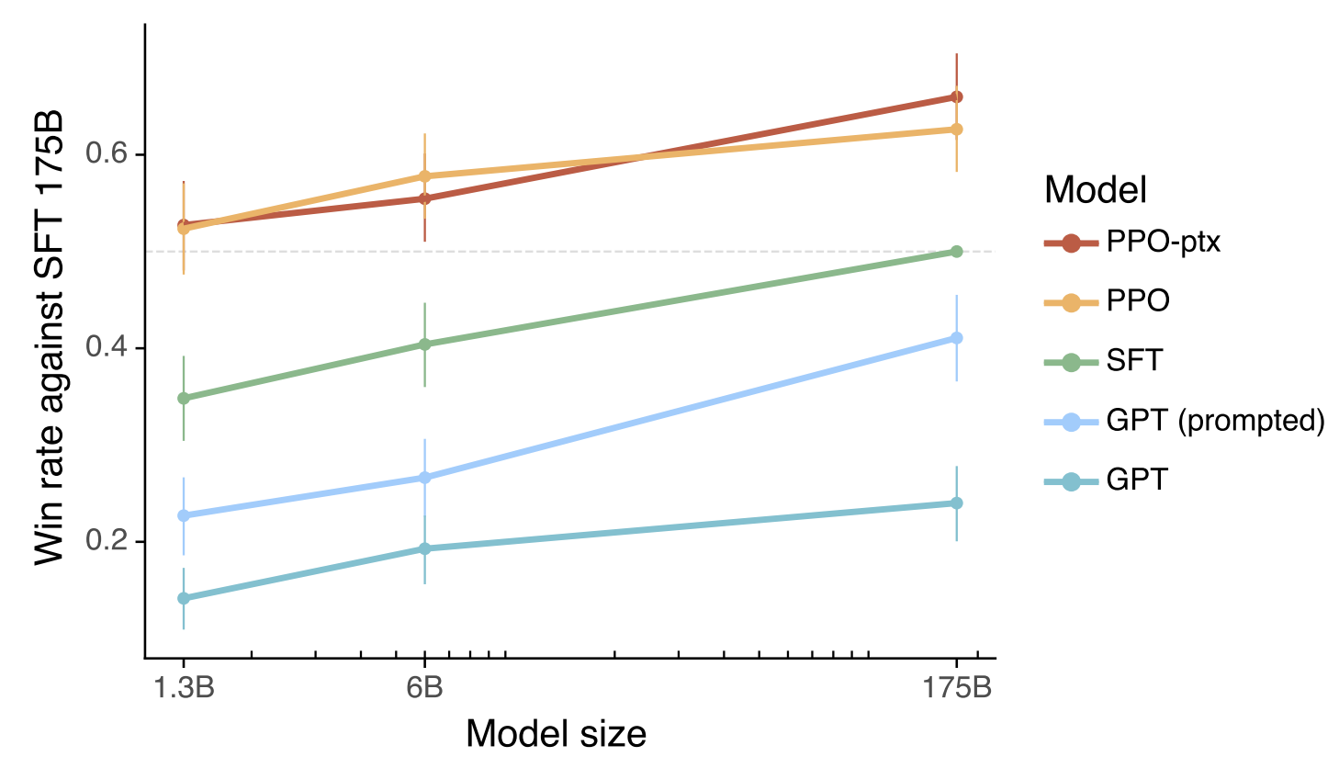
Human Evaluations of Various Models
Notes:
Human evaluations of various models on our API prompt distribution, evaluated by how often outputs from each model were preferred to those from the 175B SFT model. Our InstructGPT models (PPO-ptx) as well as its variant trained without pretraining mix (PPO) significantly outperform the GPT-3 baselines (GPT, GPT prompted); outputs from our 1.3B PPO-ptx model are preferred to those from the 175B GPT-3. Error bars throughout the paper are 95% confidence intervals.
They found that outputs from the 1.3B parameter InstructGPT model are preferred to outputs from the 175B GPT-3 model, despite having 100x fewer parameters.
They experiment with different sizes of the GPT-3 language models (1.3B, 6B, and 175B parameters). They also compare the performance of their InstructGPT models, which have 1.3B parameters, to the original GPT-3 models

Slide 81
Metadata Results
Notes:
Metadata results on the API distribution. Note that, due to dataset sizes, these results are collapsed across model sizes. See Appendix E.2 for analysis that includes model size. Compared to GPT-3, the PPO models are more appropriate in the context of a customer assistant, are better at following explicit constraints in the instruction and attempting the correct instruction, and less likely to ‘hallucinate’ (meaning, making up information on closed domain tasks like summarization).

Slide 82
Comparisons with FLAN and T0 by Likert Scores
Notes:
Comparing our models with FLAN and T0 in terms of Likert scores on a 1-7 scale, on the InstructGPT prompt distribution. FLAN and T0 perform better than default GPT-3, and comparably with a few-shot GPT-3 model placed into ‘instruction-following’ mode.

Slide 83
Qualitative Results
Showed generalization to tasks outside the fine-tuning distribution
Includes:
Aligning to intent in different languages
Reasoning tasks in programming

Slide 84
Limitations with InstructGPT
When given an instruction with a false premise
Overly hedging for simple questions
Notes:
Bias with data labelers
1) when given an instruction with a false premise, the model sometimes incorrectly assumes the premise is true, (2) the model can overly hedge; when given a simple question, it can sometimes say that there is no one answer to the question and give multiple possible answers, even when there is one fairly clear answer from the context, and (3) the model’s performance degrades when instructions contain multiple explicit constraints (e.g. “list 10 movies made in the 1930’s set in France”) or when constraints can be challenging for language models (e.g. writing a summary in a specified number of sentences).

Slide 85
Issues with RLHF
Methodology
Complex procedure as it includes fitting of reward model and fine-tuning of language model using human preferences.
Implementation complexity
Includes careful hyperparameter tuning and potentially sampling from LLM
Efficiency and Performance
While it helps aligning human preferences, it can be less efficient and stable

Slide 86
RLHF

Slide 87
Do we need the reward model???
No reward model training

Slide 88
Do we need the reward model???

Slide 89
Direct Preference Optimization
DPO, a simple RL-free algorithm for training language models from preferences
Direct Preference Optimization: Your Language Model is Secretly a Reward Model Rafailov et. aI arXiv preprint 2023. arXiv:2305.18290

Slide 90
DPO derivation
Conversion of the RLHF optimization problem:
$$max_{π_{θ}E_{x∼𝔻,y∼π_{θ}\left(y | x\right)}}\left[r_{ϕ}\left(x,y\right)\right]−βD_{KL}\left[\left(π_{θ}\left(y | x\right) || π_{\text{ref}}\left(y | x\right)\right)\right]$$
Reward model

Slide 91
DPO derivation
Conversion of the RLHF optimization problem:
$$max_{π_{θ}E_{x∼𝔻,y∼π_{θ}\left(y | x\right)}}\left[r_{ϕ}\left(x,y\right)\right]−βD_{KL}\left[\left(π_{θ}\left(y | x\right) || π_{\text{ref}}\left(y | x\right)\right)\right]$$
Policy to be optimized

Slide 92
DPO derivation
Conversion of the RLHF optimization problem:
$$max_{π_{θ}E_{x∼𝔻,y∼π_{θ}\left(y | x\right)}}\left[r_{ϕ}\left(x,y\right)\right]−βD_{KL}\left[\left(π_{θ}\left(y | x\right) || π_{\text{ref}}\left(y | x\right)\right)\right]$$
Reference policy

Slide 93
DPO derivation
Conversion of the RLHF optimization problem:
$$max_{π_{θ}E_{x∼𝔻,y∼π_{θ}\left(y | x\right)}}\left[r_{ϕ}\left(x,y\right)\right]−βD_{KL}\left[\left(π_{θ}\left(y | x\right) || π_{\text{ref}}\left(y | x\right)\right)\right]$$
Optimal policy shouldn't be too different
from reference policy

Slide 94
DPO derivation
Conversion of the RLHF optimization problem:
$$max_{π_{θ}E_{x∼𝔻,y∼π_{θ}\left(y | x\right)}}\left[r_{ϕ}\left(x,y\right)\right]−βD_{KL}\left[\left(π_{θ}\left(y | x\right) || π_{\text{ref}}\left(y | x\right)\right)\right]$$
${ π}_{r}\left(y | x\right)=\frac{1}{Z\left(x\right)}π_{\text{ref}}\left(y | x\right)\exp\left(\frac{1}{β}r\left(x,y\right)\right)$
Where $Z\left(x\right)=\sum_{y}{π_{\text{ref}}\left(y | x\right)}\exp\left(\frac{1}{β}r\left(x,y\right)\right)$ is the partition function
Optimal solution to KL-constrained maximization objective

Slide 95
DPO derivation
Reward function in terms of its corresponding optimal policy $π_{\text{r}}$, the reference policy $π_{\text{ref}}$, and the unknown partition function Z(·):
$$r\left(x,y\right)=β log\frac{π_{r}\left(y | x\right)}{π_{\text{ref}}\left(y | x\right)}+β\log{Z}\left(x\right)$$

Slide 96
DPO derivation
Reward function in terms of its corresponding optimal policy $π_{\text{r}}$, the reference policy $π_{\text{ref}}$, and the unknown partition function Z(·):
$$r\left(x,y\right)=β log\frac{π_{r}\left(y | x\right)}{π_{\text{ref}}\left(y | x\right)}+β\log{Z}\left(x\right)$$
Human preference probability in terms of optimal policy π* and reference policy $π_{ref}$ :
$$p^{∗}\left(y_{1}≻y_{2} | x\right)=\frac{1}{1+exp\left(β log\frac{π^{∗}\left(y_{2} | x\right)}{π_{\text{ref}}\left(y_{2} | x\right)}−β\frac{π^{∗}\left(y_{1} | x\right)}{π_{\text{ref}}\left(y_{1} | x\right)}\right)}$$
Preferred response

Slide 97
DPO
Maximum likelihood objective for a parameterized policy πθ:
$$L_{DPO}\left(π_{θ};π_{\text{ref}}\right)=−E_{\left(x,y_{w}, y_{l}\right)∼𝔻}\left[\log{σ}\left(β log \frac{π_{θ}\left(y_{w} | x\right)}{π_{\text{ref}}\left(y_{w} | x\right)}−β log \frac{π_{θ}\left(y_{l} | x\right)}{π_{\text{ref}}\left(y_{l} | x\right)}\right)\right]$$
For RLHF:
$$L_{R}\left(r_{ϕ},𝒟\right)=−E_{\left(x,y_{w},y_{l}\right)∼𝔻}\left[\log{σ}\left(r_{ϕ}\left(x,y_{w}\right)−r_{ϕ}\left(x,y_{l}\right)\right)\right]$$

Slide 98
DPO
Maximum likelihood objective for a parameterized policy πθ:
$$L_{DPO}\left(π_{θ};π_{\text{ref}}\right)=−E_{\left(x,y_{w}, y_{l}\right)∼𝔻}\left[\log{σ}\left(β log \frac{π_{θ}\left(y_{w} | x\right)}{π_{\text{ref}}\left(y_{w} | x\right)}−β log \frac{π_{θ}\left(y_{l} | x\right)}{π_{\text{ref}}\left(y_{l} | x\right)}\right)\right]$$
What does the DPO update do?
$$∇_{θ}LDPO\left(π_{θ}π_{ref}\right)=−βE_{\left(x,y_{w},y_{l}\right)∼𝔻}\left[σ\left(\hat{r_{θ}}\left(x,y_{l}\right)−\hat{r_{θ}}\left(x,y_{w}\right)\right)\left[∇_{θ}\log{π}\left(y_{w} | x\right)−∇_{θ}\log{π}\left(y_{l} | x\right)\right]\right]$$
$$\hat{r_{θ}}\left(x,y\right)=β log \frac{π_{θ}\left(y | x\right)}{π_{\text{ref}}\left(y | x\right)}$$

Slide 99
DPO
Higher weight when reward estimate is wrong

Slide 100
DPO
Increase likelihood for preferred response

Slide 101
DPO
Decrease likelihood for dispreferred response

Slide 102
Controlled Sentiment Generation
Goal: For a given movie review x, generate y with positive sentiment
DPO’s reward/KL tradeoff strictly dominates PPO

Slide 103
Summarization
Goal: For a forum post from Reddit x, generate summary y with main points
DPO more robust to sampling temperatures than PPO

Slide 104
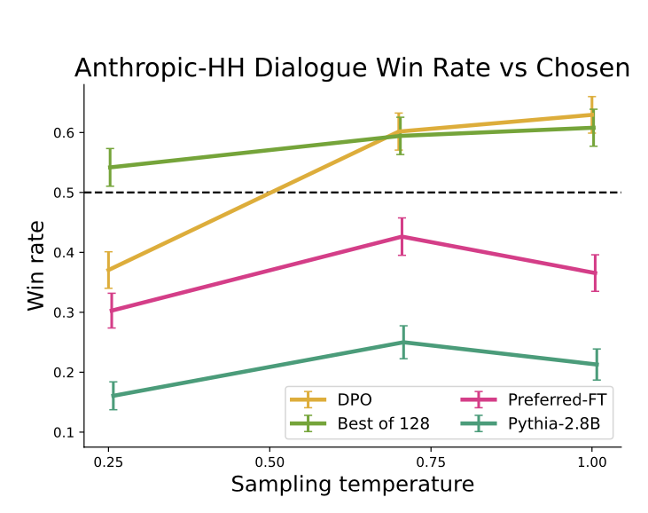
Single-turn dialogue
Goal: x is a human query, which may be anything from a question and the model must produce an engaging and helpful response y
Provides similar or better performance to the computationally demanding Best of 128 baseline

Slide 105
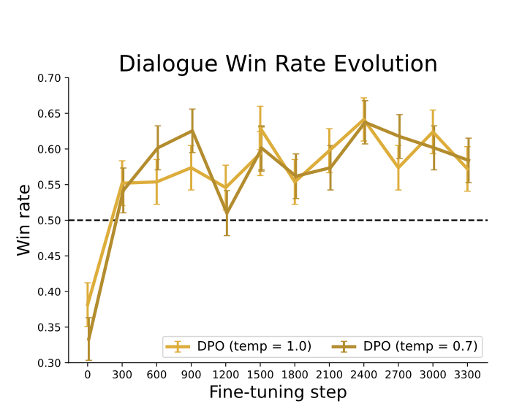
Win rates for different sampling temperatures
DPO’s improvement over the dataset labels is fairly stable over the course of training for different sampling temperatures.
Notes:
Win rates for different sampling temperatures over the course of training.

Slide 106
Win rates for different sampling temperatures
DPO converges to its best performance relatively quickly

Slide 107
Validating GPT-4 judgments with human judgments
Comparison between GPT-4 judgments with human

Slide 108
Zephyr: Direct Distillation of LM Alignment
Highlights:
Aligning a small open LLM entirely through distillation
Utilize AI Feedback (AIF) from an ensemble of teacher models as preference data
Zephyr: Direct Distillation of LM Alignment. Lewis Tunstall et. aI arXiv preprint 2023. arXiv:2310.16944

Slide 109
Zephyr

Slide 110
Zephyr

Slide 111
Step 1: Distilled Supervised Fine-Tuning
Leverages a teacher model to generate high-quality responses for SFT
Goal: distill some of the teacher model's capability to our model
Teacher model πT
Seed prompts: $x_{1}^{0},…,x_{J}^{0}$
$$𝒞=\{\left(x_{1},y_{1}\right),…,\left(x_{J},y_{J}\right)\}$$

Slide 112
Step 1: Distilled Supervised Fine-Tuning
Leverages a teacher model to generate high-quality responses for SFT
Goal: distill some of the teacher model's capability to our model
Teacher model πT
Seed prompts: $x_{1}^{0},…,x_{J}^{0}$
$$𝒞=\{\left(x_{1},y_{1}\right),…,\left(x_{J},y_{J}\right)\}$$
Sample first response:
Sample first response:
$$y_{0}∼π_{T}\left(⋅ | x_{0}\right)$$
Refine the instruction:
$$x_{1}∼π_{T}\left(⋅ | x_{0},y_{0}\right)$$

Slide 113
Step 1: Distilled Supervised Fine-Tuning
Leverages a teacher model to generate high-quality responses for SFT
Goal: distill some of the teacher model's capability to our model
Teacher model πT
Seed prompts: $x_{1}^{0},…,x_{J}^{0}$
$$𝒞=\{\left(x_{1},y_{1}\right),…,\left(x_{J},y_{J}\right)\}$$
$$π_{dSFT}=max_{π}E_{\left(x,y\right)∼ℂ}\log{π}\left(y | x\right)$$
Find the model π such that it maximizes the expected log probability of response y from refined prompt x (sampled from the dataset C)

Slide 114
Step 1: Distilled Supervised Fine-Tuning
Large-scale, self-instruct-style dataset construction (UltraChat)
Followed by distilled supervised fine-tuning (dSFT)

Slide 115
Zephyr

Slide 116
Step 2: AI Feedback through Preferences
Use AI preferences from the teacher model on generated outputs from other models
Prompt: 𝑥
π1
π2
π4
𝑦1 ∼ π1(·|𝑥)
𝑦2 ∼ π2(·|𝑥)
…..
𝑦4 ∼ π4(·|𝑥)
s1 ∼ πT (·|𝑥, 𝑦1)
>
s2 ∼ πT (·|𝑥, 𝑦2)
…..
s4 ∼ πT (·|𝑥, 𝑦4)
$$\left(x,y_{w},y_{l}\right)$$

Slide 117
Step 2: AI Feedback through Preferences
AI Feedback (AIF) collection via an ensemble of chat model completions
Followed by scoring by GPT-4 (teacher model) UltraFeedback
Binarization of the preferences

Slide 118
Zephyr

Slide 119
Step 3: Distilled Direct Preference Optimization
Distilled direct preference optimization (dPO) of the dSFT model utilizing the feedback data

Slide 120
Step 3: Distilled Direct Preference Optimization
Training procedure:
Compute the probability for $\left(x,y_{w}\right)$ and $\left(x,y_{l}\right)$ from the dSFT model (forward-only).
Compute the probability for $\left(x,y_{w}\right)$ and $\left(x,y_{l}\right)$ from the dDPO model.
Compute the following eq and backpropagate to update. Repeat.
$$π_{θ}=max_{π}E_{\left(x,y_{w},y_{l}\right)∼𝒟}\left[\log{σ}\left(β log \frac{π\left(y_{w} | x\right)}{π_{ref}\left(y_{w} | x\right)}−β log\frac{π\left(y_{l} | x\right)}{π_{ref}\left(y_{l} | x\right)}\right)\right]$$

Slide 121
Training details
All finetuning experiments performed with Mistral 7B
Transformer Reinforcement Learning (TRL) library for fine-tuning
DeepSpeed ZeRO-3 and FlashAttention-2 to optimize memory and improve training speed

Slide 122
Evaluation
MT-Bench:
Mutli-turn benchmark
160 questions across 8 different areas of knowledge
the model must answer an initial question, and then provide a second response to a predefined follow-up question.
Response rated by GPT-4 on a scale of 1-10
AlpacaEval:
Single-turn benchmark
805 questions on different topics, mostly focused on helpfulness
Models are also scored by GPT-4, but the final metric is the pairwise win-rate against a baseline model (text-davinci-003).
Open LLMs leaderboards:
Multiclass classification tasks: ARC, HellaSwag, MMLU, and Truthful QA

Slide 123
Chat benchmark results
Zephyr works best among the 7B size models

Slide 124
Chat benchmark results
Zephyr provides comparable results with GPT-4

Slide 125
MT-Bench across each domain
AlpacaEval results should be interpreted with care since the prompts in AlpacaEval may not be representative of real-usage and advanced applications
Zephyr-7B is competitive with proprietary models on several categories, is much worse in math and coding.

Slide 126
Academic benchmark results
Zephyr works best among the 7B size models

Slide 127
Ablation study: Is Preference Optimization Necessary?
dDPO – dSFT: fine-tunes the base model directly with DPO for one epoch on UltraFeedback.
dSFT-1: fine-tunes the base model with SFT for one epoch on UltraChat.
dSFT-2: applies dSFT-1 first, followed by one more epoch of SFT on the top-ranked completions of UltraFeedback.
dDPO + dSFT: applies dSFT-1 first, followed by one epoch of DPO on UltraFeedback.

Slide 128
Ablation study: Is Preference Optimization Necessary?
dDPO – dSFT: fine-tunes the base model directly with DPO for one epoch on UltraFeedback.
dSFT-1: fine-tunes the base model with SFT for one epoch on UltraChat.
dSFT-2: applies dSFT-1 first, followed by one more epoch of SFT on the top-ranked completions of UltraFeedback.
dDPO + dSFT: applies dSFT-1 first, followed by one epoch of DPO on UltraFeedback.

Slide 129
Ablation study: Is Preference Optimization Necessary?
dDPO – dSFT: fine-tunes the base model directly with DPO for one epoch on UltraFeedback.
dSFT-1: fine-tunes the base model with SFT for one epoch on UltraChat.
dSFT-2: applies dSFT-1 first, followed by one more epoch of SFT on the top-ranked completions of UltraFeedback.
dDPO + dSFT: applies dSFT-1 first, followed by one epoch of DPO on UltraFeedback.

Slide 130
Ablation study: Is Preference Optimization Necessary?
dDPO – dSFT: fine-tunes the base model directly with DPO for one epoch on UltraFeedback.
dSFT-1: fine-tunes the base model with SFT for one epoch on UltraChat.
dSFT-2: applies dSFT-1 first, followed by one more epoch of SFT on the top-ranked completions of UltraFeedback.
dDPO + dSFT: applies dSFT-1 first, followed by one epoch of DPO on UltraFeedback.

Slide 131
Backup Slides

Slide 132
FLAN Task Clustering

Slide 133
FLAN Ablation: Few-shot Instructions
FLAN with few-shot instructions still outperforms zero-shot FLAN
Notes:
Examples of the unseen task help FLAN learn the output format

Slide 134
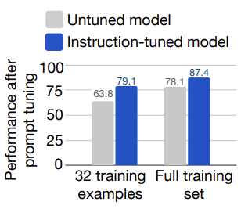
FLAN Ablation: Better Prompt Tuning
Instruction tuning helps
with prompt tuning
Effectiveness
Average performance on SuperGLUE dev set

Slide 135
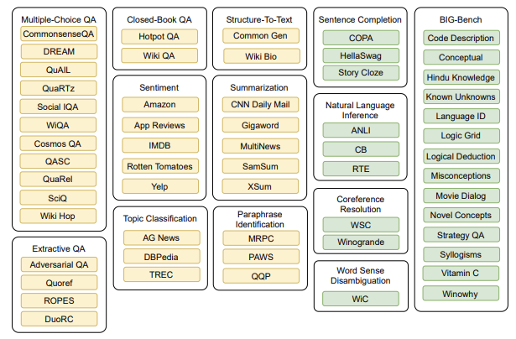
T0 Dataset Clustering into tasks
Yellow datsets are used for training,
green dataset are held-out

Slide 136
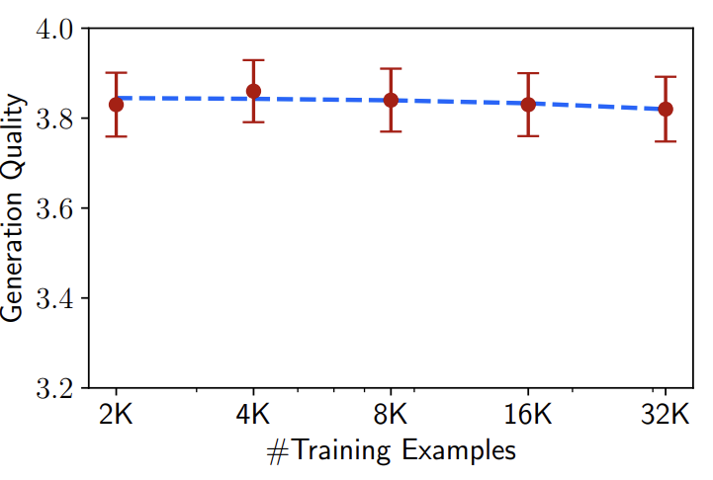
LIMA Ablation study: Dataset Quantity
Increasing data quantity
doesn't further improve
the performance of the
7B model

Slide 137
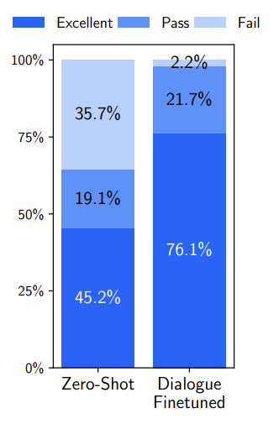
LIMA Ablation study: Multi-turn
In 6 out of 10 conversations, LIMA fails to follow the prompt within 3 interactions
Added 30 multi-turn dialogue chains to
1000 training examples
10 Manually written
20 edited version of comment
chains on stack exchange
Only 30 examples vastly improves multi-turn
dialog performance of LIMA

