Slide 1
DS 4440
Deep Learning

Slide 2
Chat about projects
Example: https://arxiv.org/abs/2401.06345
How to identify a solid, reproducible research starting point.

Slide 3
Interpretation of In-Context Learning

Slide 4
In-context learning (ICL) is about imitating input
Explicit instruction-style prompt
Tell me the capital of Vermont.
direct instruction
Cloze prompt (fill-in-the-blank)
The capital of the state of Vermont is the city of
incomplete sentence
In-context learning (by-example)
New York: Albany; Montana: Helena; Vermont:
demonstrations
next-word prediction

Slide 5
What is Metalearning? What is Learning?
Review: the language modeling task predicts the next word.
What if we want the model to learn something new?
For example, what if we want to redefine what “common” means?
Or what if we even want to redefine what “means” means?
Neural language model
“common” means
typical

Slide 6
Fine-tuning is traditional machine learning
How to redefine what “means” means using fine-tuning
Neural language model
1. Gather training data
with examples of our new task
“common” means
typical
arrive means depart small means big dark means bright good means bad
Training data
Fine-tuned Neural language model
2. Continue training model parameters on the new data.
“common” means
rare
3. Test the fine-tuned model eventually it learns to generalize the new task on unseen examples.

Slide 7
In-Context Learning is a type of Metalearning
How to perform a new task using in-context learning
Neural language model
1. Gather training data
with examples of our new task
common :
typical
arrive : depart small : big dark : bright good : bad
Training data
Unchanged Neural language model
2. Supply examples as input do not alter model parameters.
arrive:depart, small:big, common:
rare
3. Provide an unfinished example eventually it learns to generalize the new task by completing examples.

Slide 8
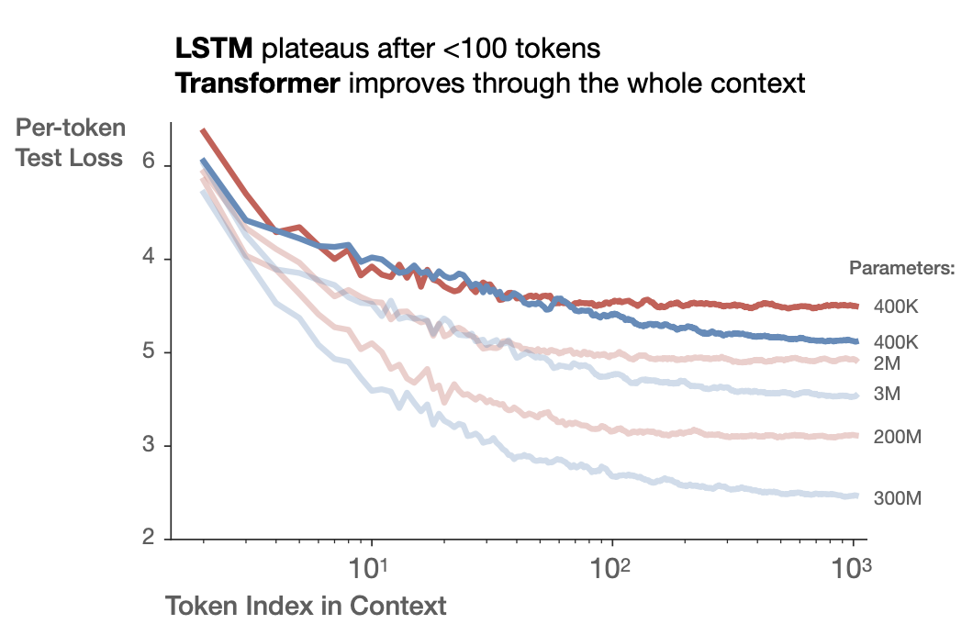
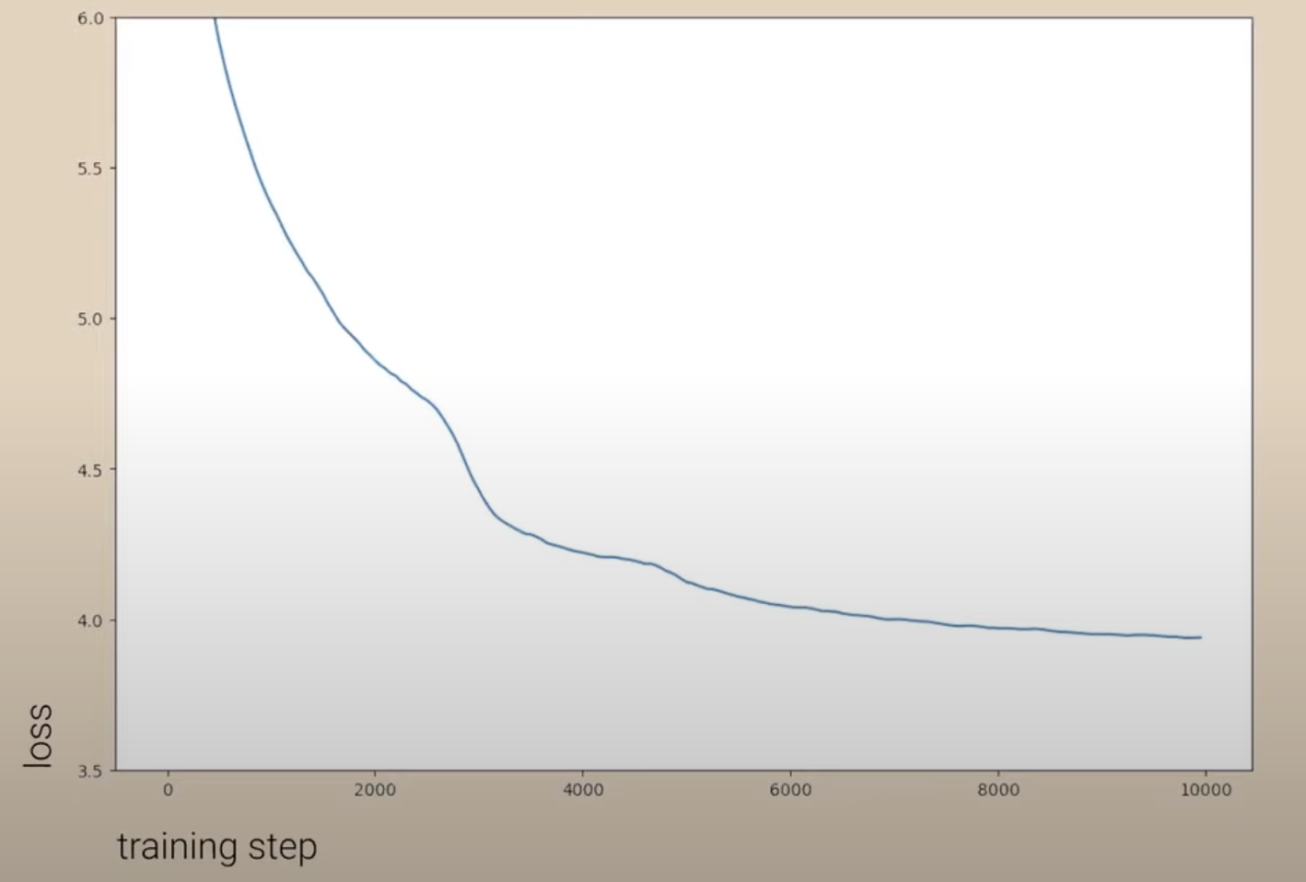
In-Context “Learning Curve”
Traditional “Learning Curve”
In-Context “Learning Curve”
decrease in loss during training
decrease in loss within long context
Kaplan 2020, Chris Olah talk

Slide 9
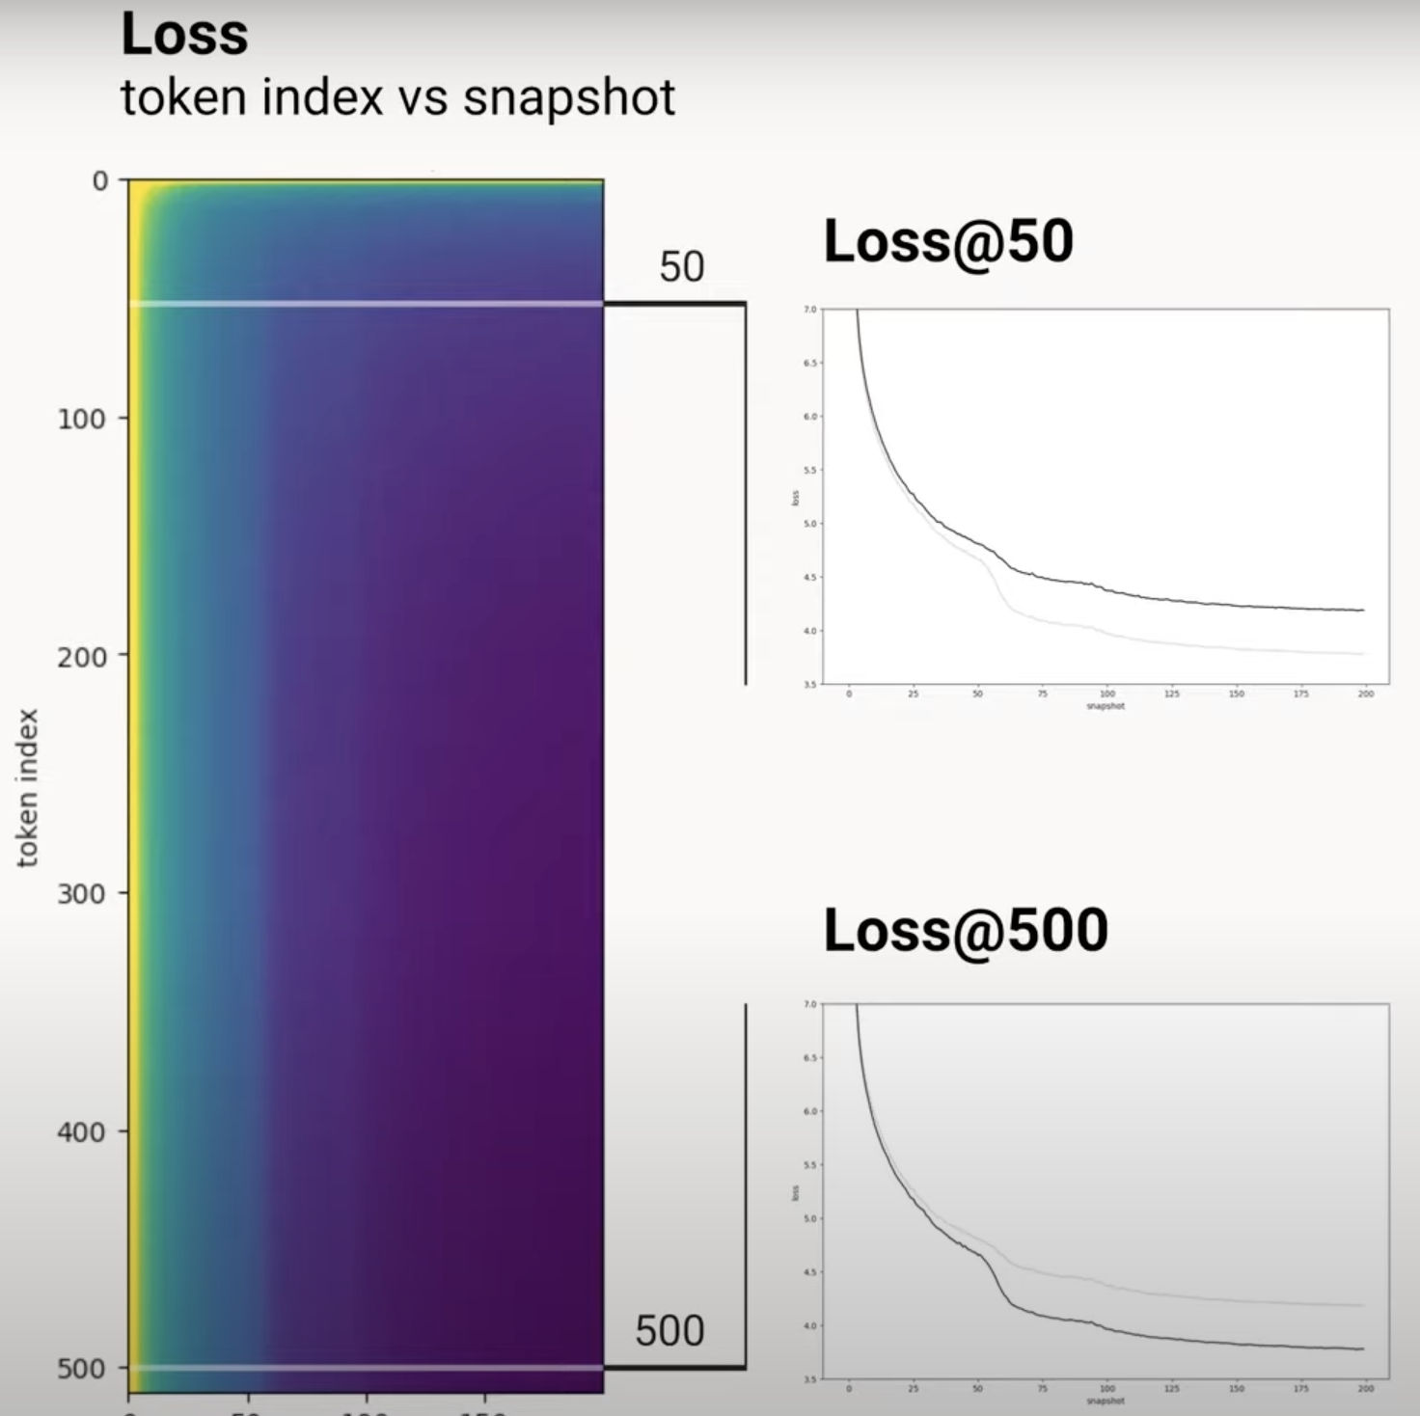
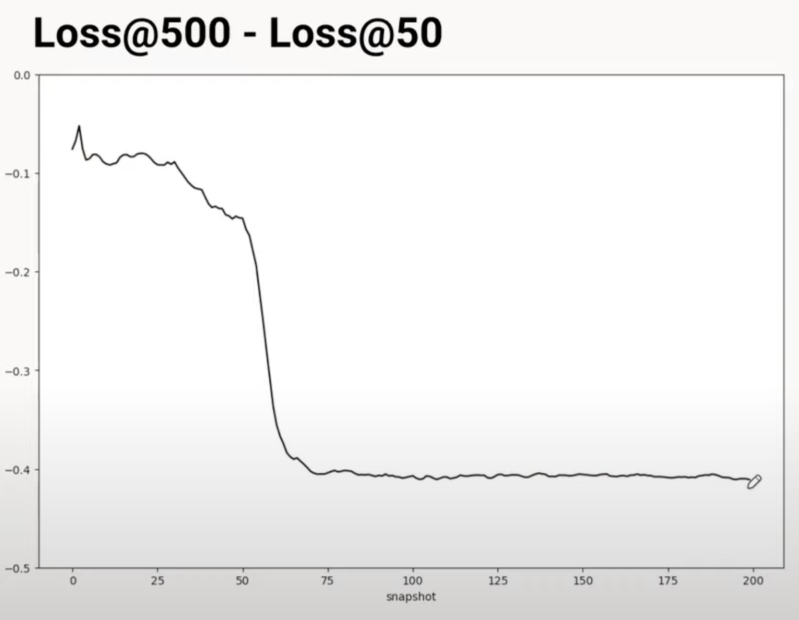
A striking “cliff” in transformer learning
Olsson 2022

Slide 10
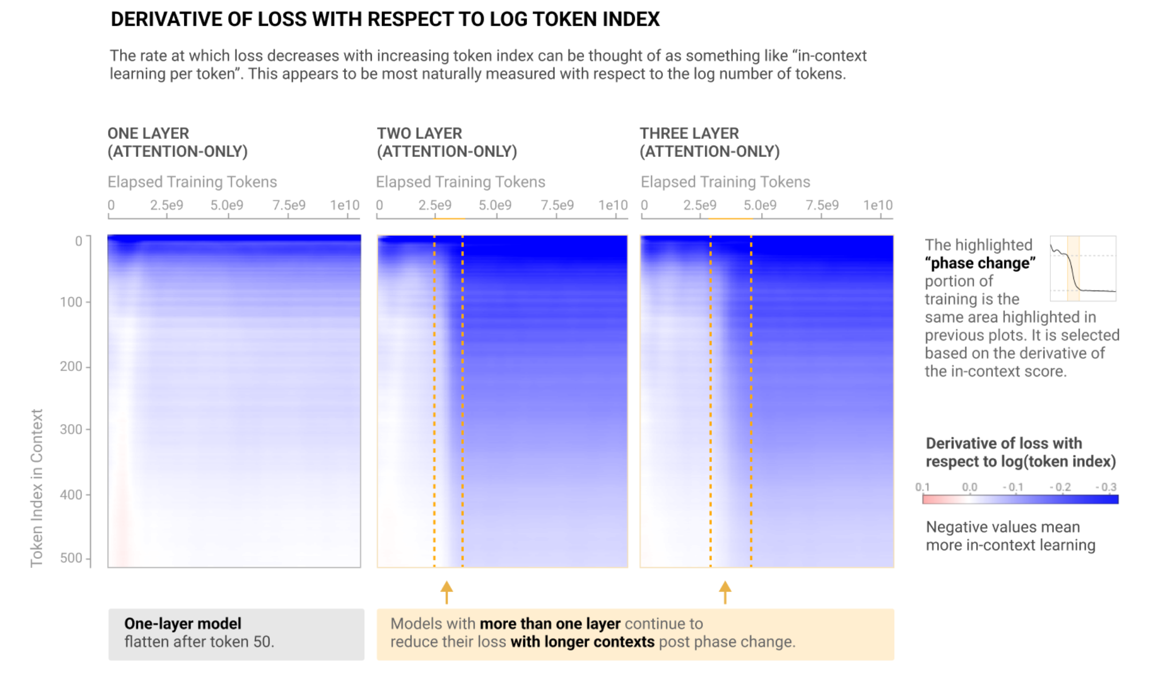
The cliff requires two or more layers of attention
Olsson 2022

Slide 11
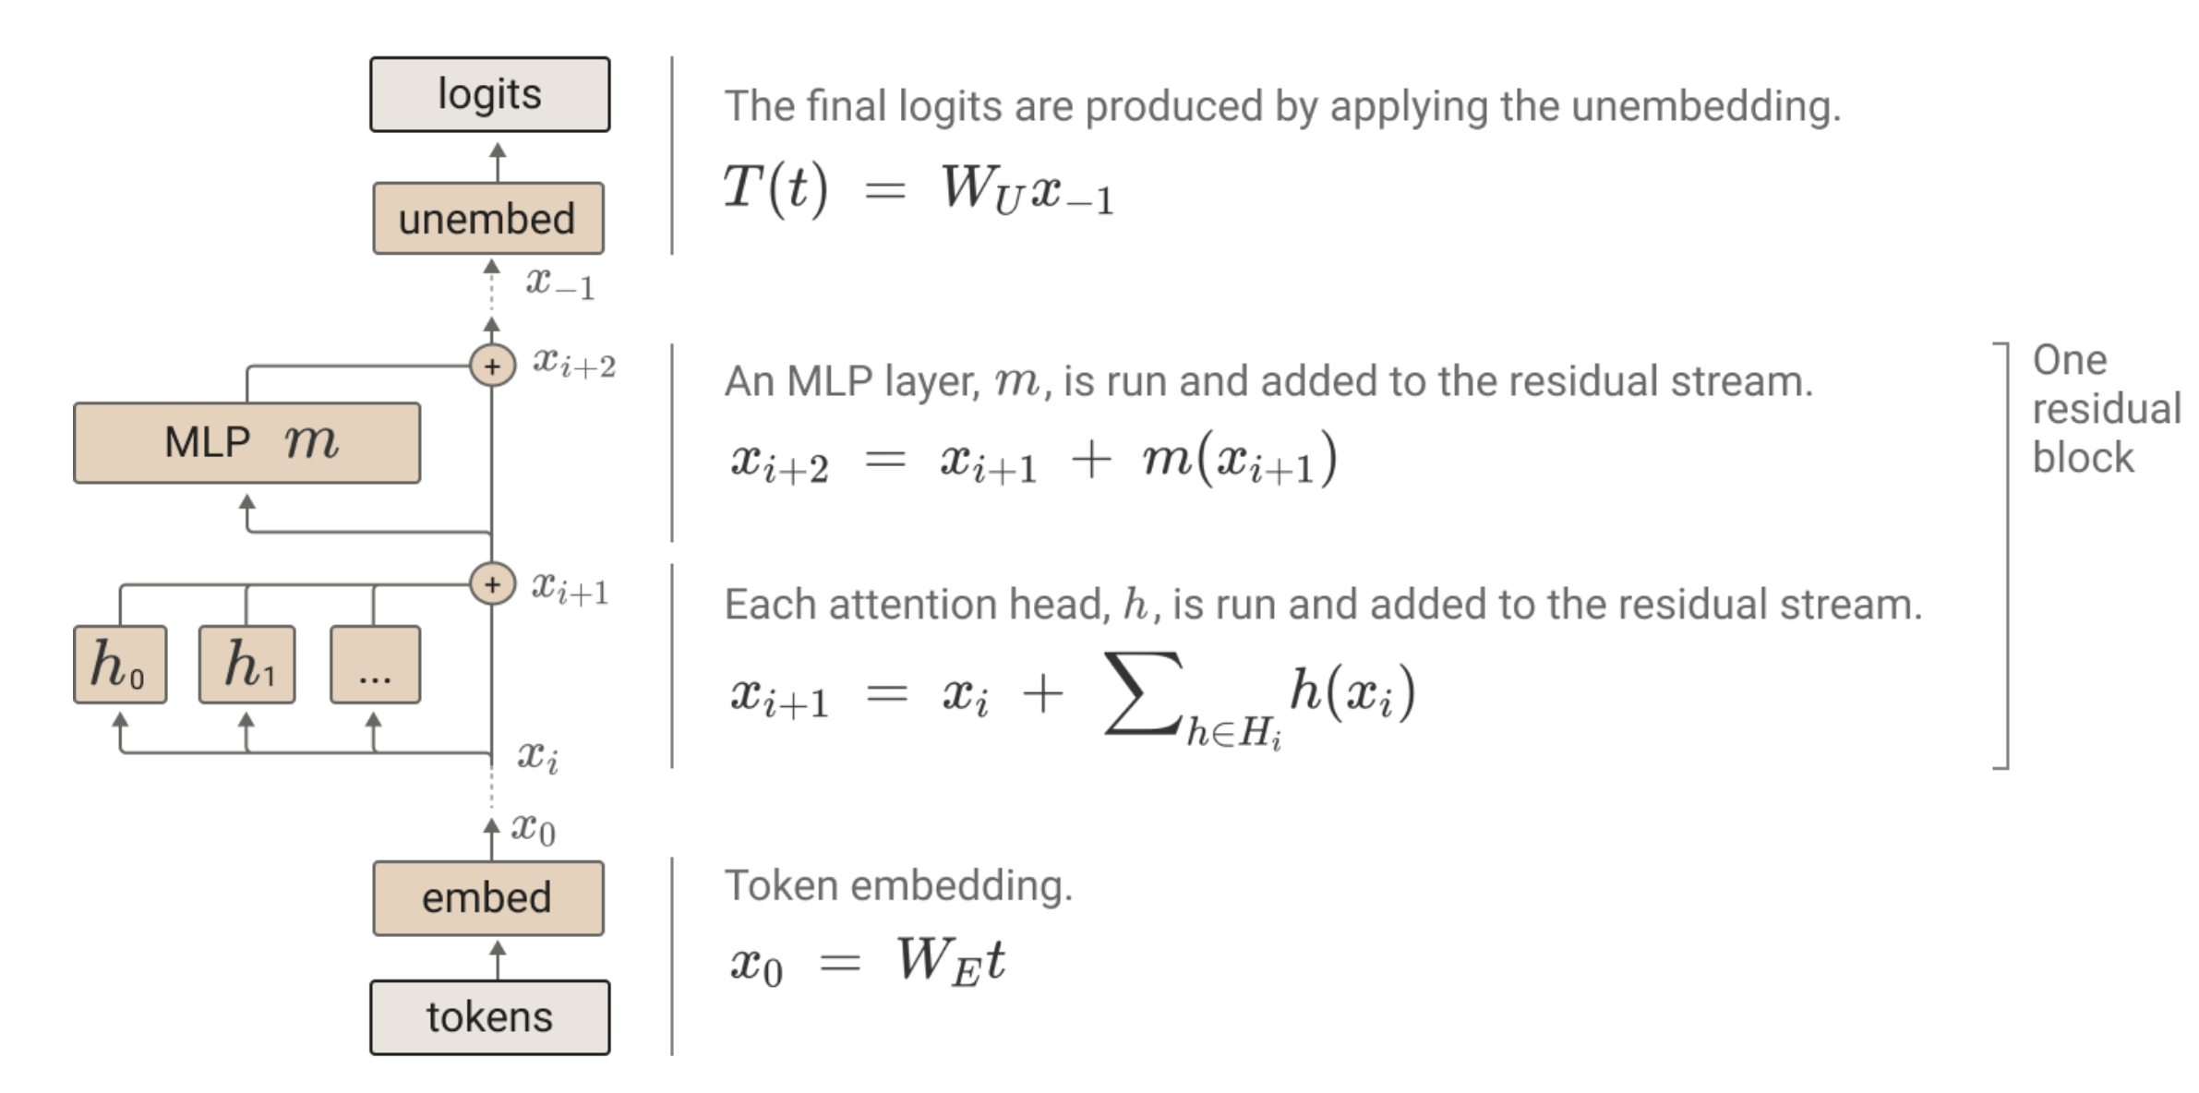
Recall the structure of a transformer

Slide 12
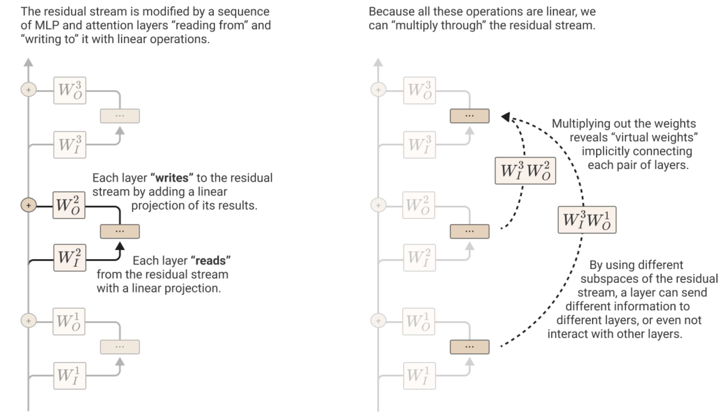
The Residual Stream
Elhage 2022

Slide 13
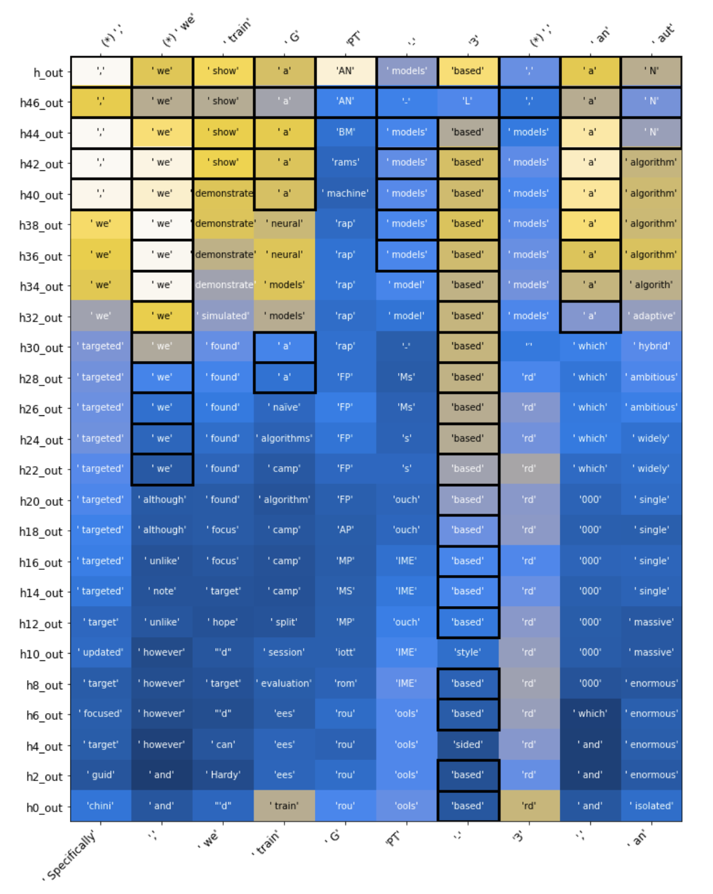
Reading the Residual Stream Directly – The Logit Lens
Normally: decode the last layer
Logit lens does an
“early exit”,
decoding early layers

Slide 14
Analyzing Attention as a Linear Operation
Elhage 2022

Slide 15
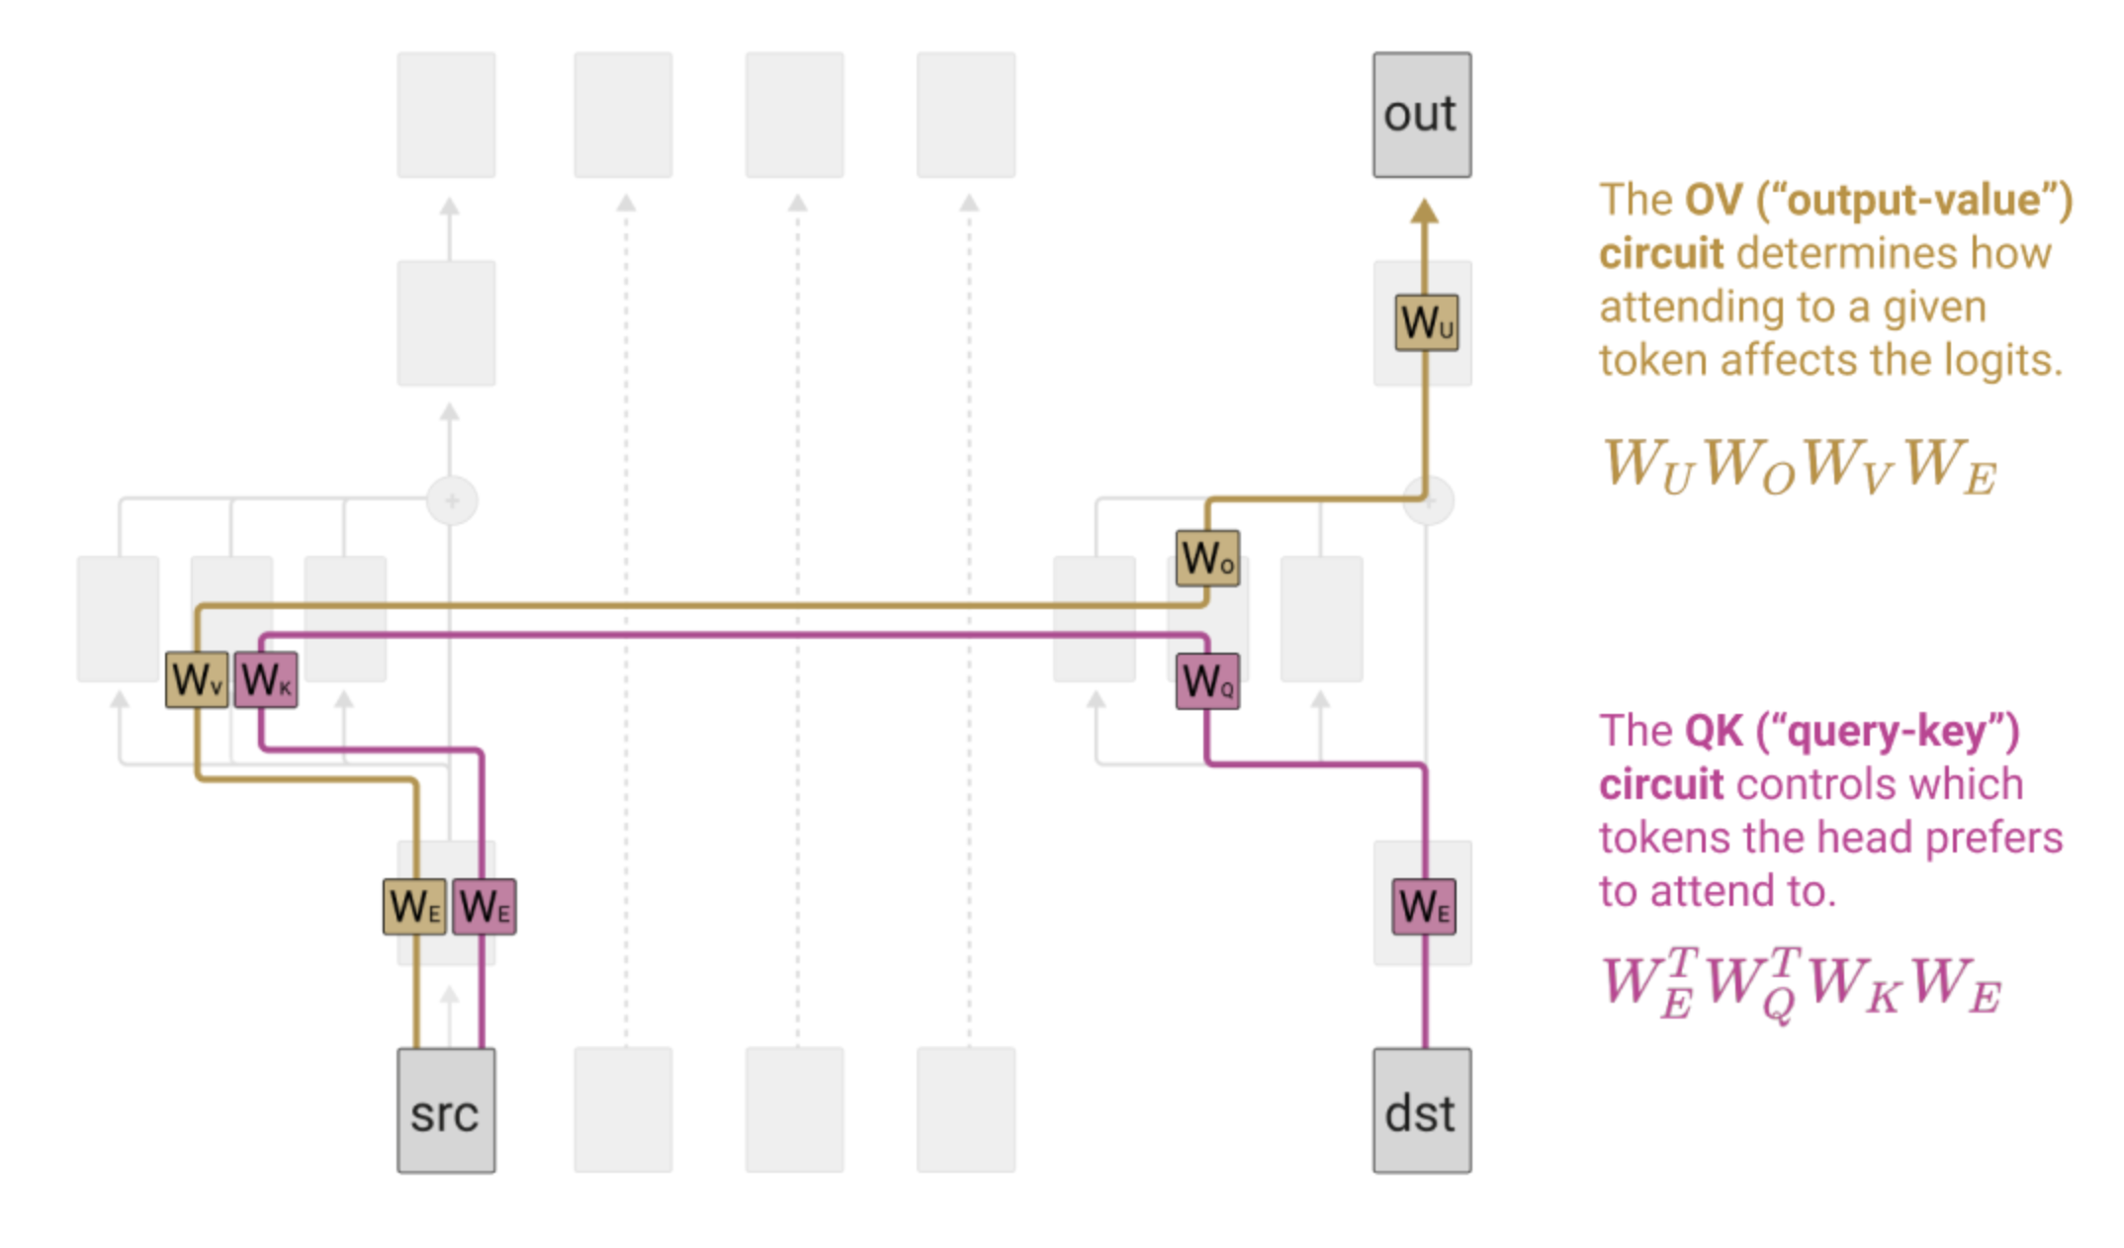
Canonicalizing output-value and query-key ops

Slide 16
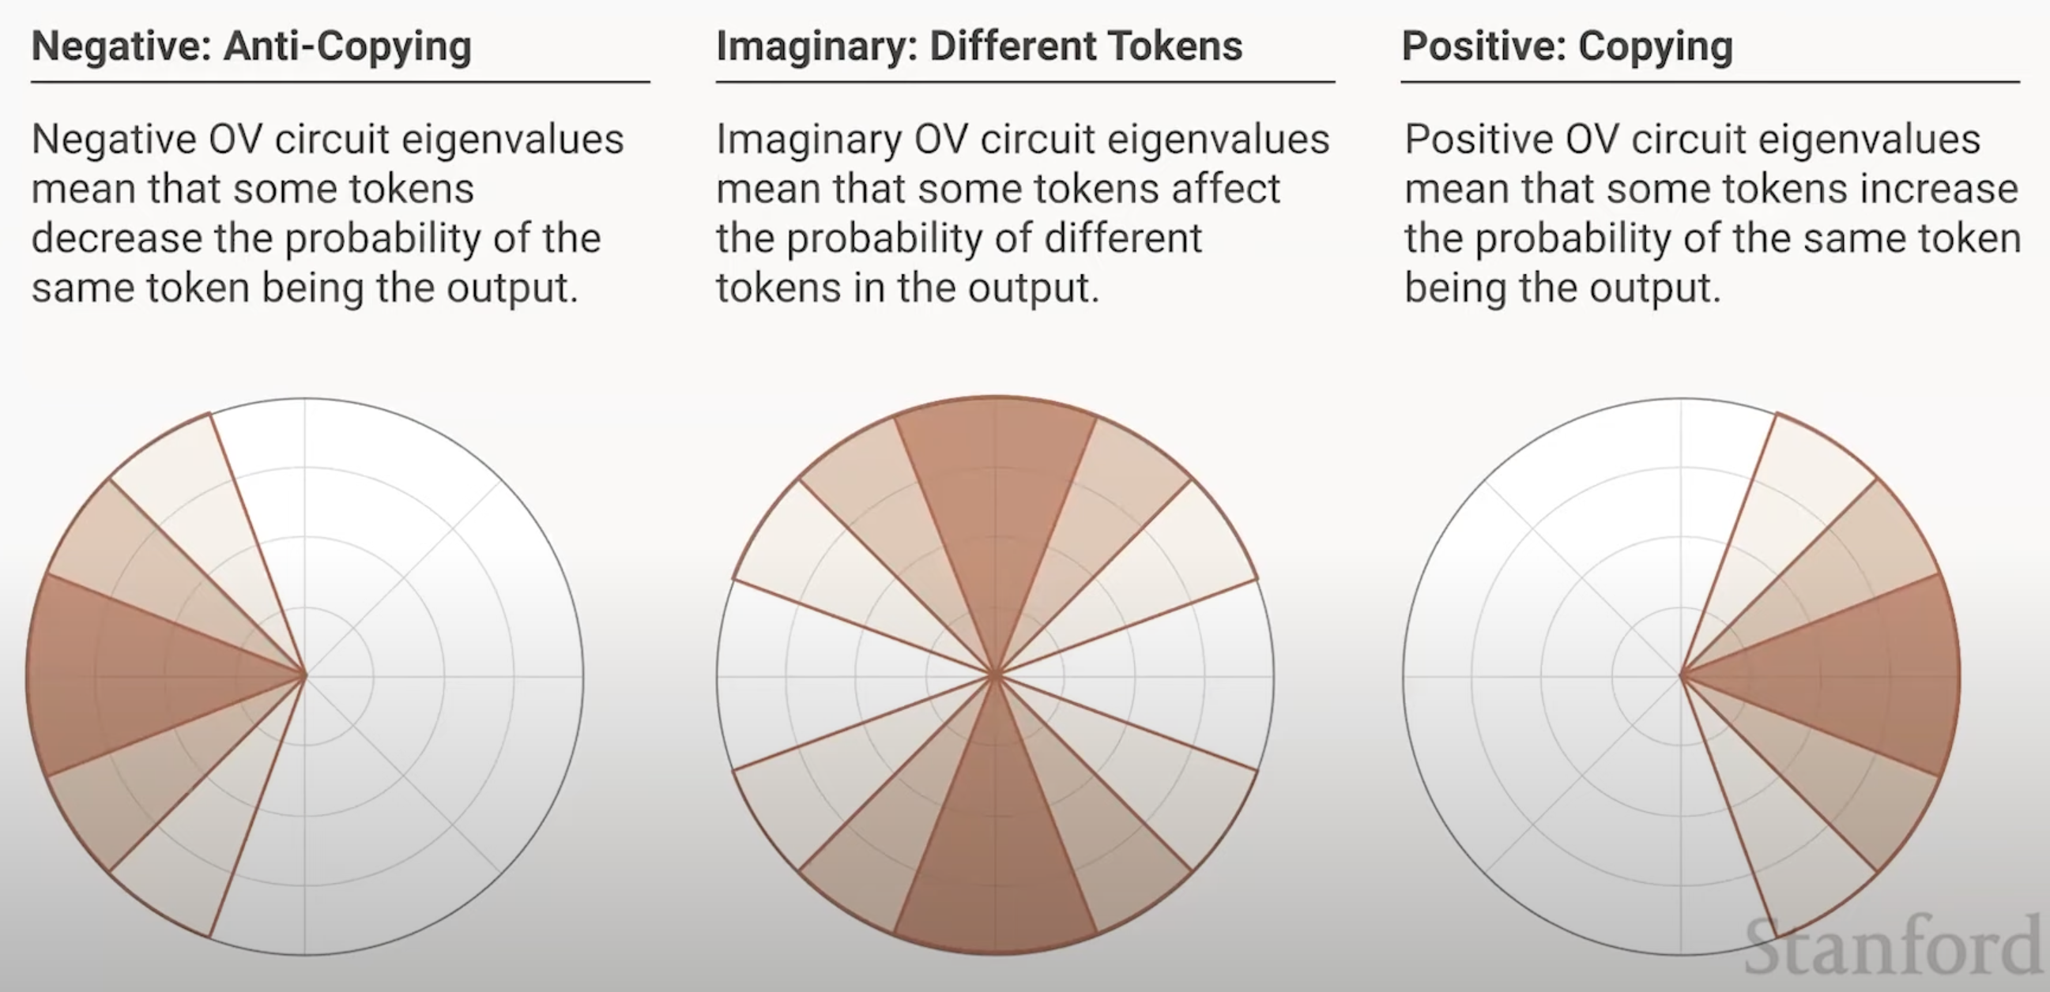
Eigenvalue Analysis of Attention Heads
Eigenvalues:
What do eigenvalues of OV-matrices mean?

Slide 17
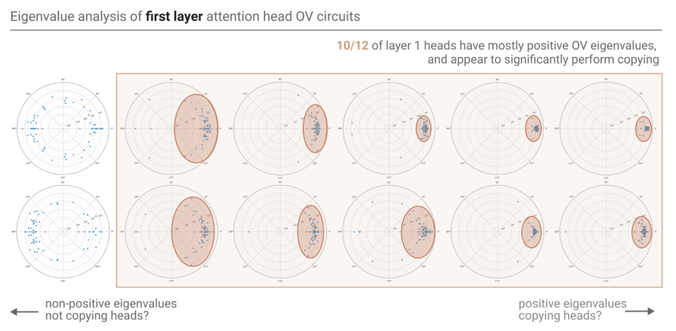
OV circuit eigenvalues that emerge

Slide 18
In a two-layer model, copying behavior is crisp

Slide 19
What happens at the phase change?

Slide 20
The induction pattern

Slide 21
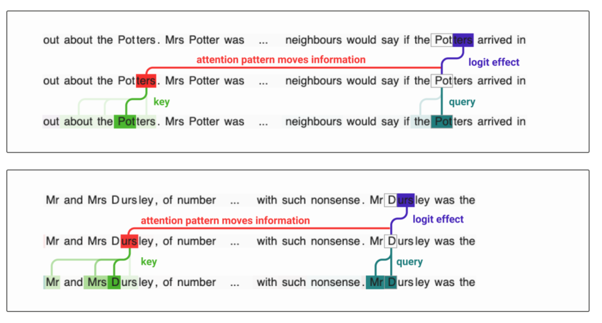
Information flow for an “induction attention head”

Slide 22
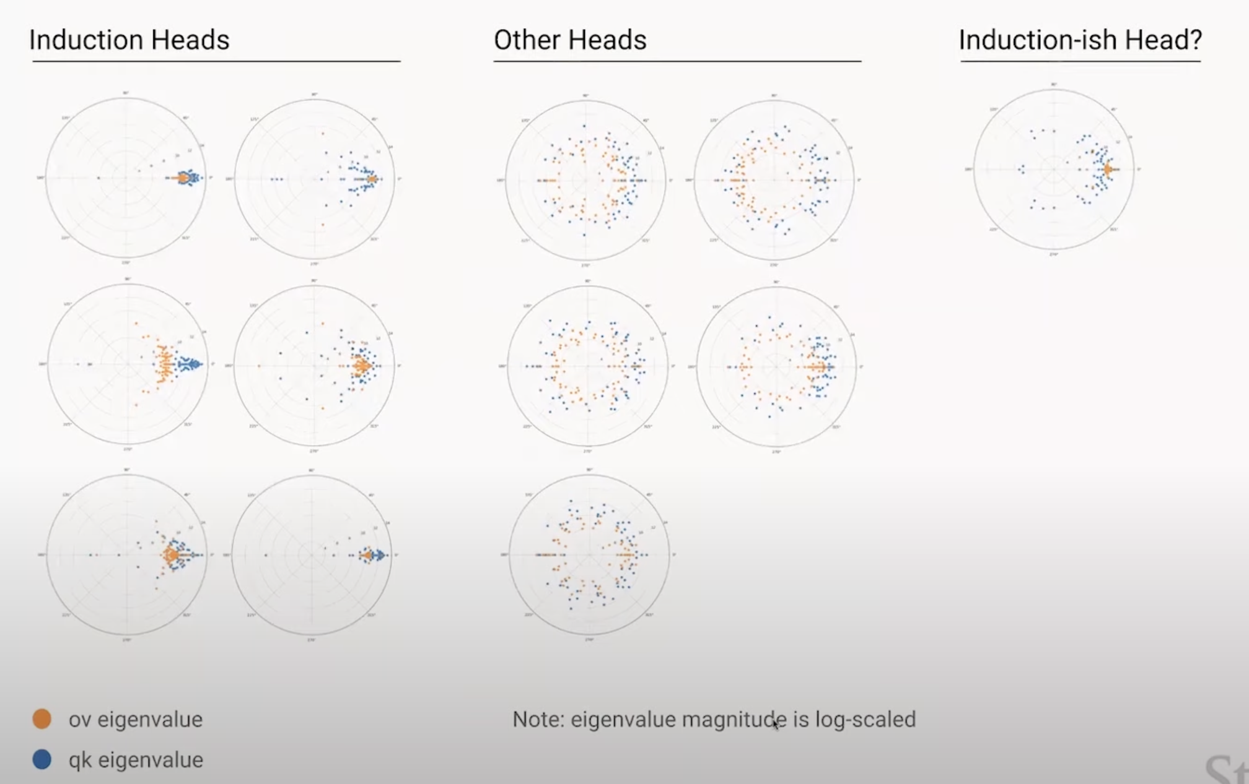
Can we detect induction heads automatically?
Positive (both) OV and QK eigenvalues reveal them

Slide 23
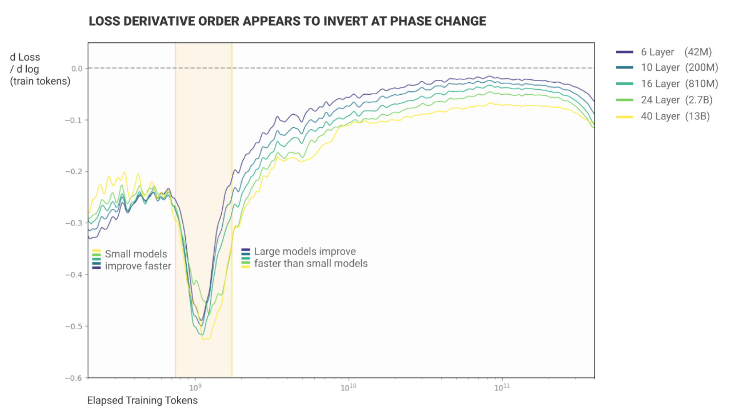
Olah argues: induction heads fundamental to scaling

Slide 24
In-Context Learning (ICL) goes beyond copying
An LLM can generalize all sorts of complex mappings
It resembles human reasoning! It requires no expensive training.
Yet how ICL figures out the task is a mystery.
arrive:depart, small:big, common:
rare
amount:cantidad, win:ganar, dreams:
sueños
Demonstrations $[\left(x_{i1},y_{i1}\right),\left(x_{i2},y_{i2}\right)]$
Query $x_{iq}$
Prediction $y_{iq}$

Slide 25
We ask: How does ICL identify a task?
(a)
(c)
+
arrive:depart, small:big, common:
rare
The word "fast" means
slow
$v_{t}$= Antonym FV
(b)
(d)
$v_{t}$= Eng-Spanish FV
+
+
$h_{ℓ}$: Hidden-state intervention
amount:cantidad, win:ganar, dreams:
sueños
The word "fast" means
rápido
Demonstrations $[\left(x_{i1},y_{i1}\right),\left(x_{i2},y_{i2}\right)]$
Query $x_{iq}$
Prediction $y_{iq}$
Novel zero-shot prompt
Execution of FV
We will seek out “Function Vectors”:
Patterns of neural activations that identify the task, not the word.
When applied in a new setting, they cause performance of the task.

Slide 26
1. Locating Function Vectors
small
h_{i}^{(l)} state
big
attention
MLP
,
common
rare (correct)
✓
Q: Which computation is decisive?
Idea: Transplant data to identify effects.
Notes:
So first quesiton. Is there a PHYSCIAL REALITY to KNOLWEDGE?
<Q>Can we FIND knowledge in a SPECIFIC PLACE in the NETWORK?
<A>When the network PREDICTs that MILES DAVIS plays TRUMPET
there MUST be SOME computation that LEADS to that DECISION.
<I>So our IDEA is, LET’s COPY data AROUND until we can IDENTIFY WHICH computation is DECISIVE.
like DEBUGGING the NETWORK.

Slide 27
Run the network twice
small
h_{i}^{(l)} state
big
attention
MLP
,
common
rare (correct)
✓
delicious
noisy
,
slow
? (Corrupted)
Notes:
HERE is what we DO.
We RUN the network TWICE.
The SECOND time, we CORRUPT the INPUT to FRUSTRATE the computation.
<*>For example, if we add NOISE to the subject name,
<T>the network will be UNABLE to guess the right instrument.

Slide 28
Transplant Hidden State
small
h_{i}^{(l)} state
big
attention
MLP
,
common
rare (correct)
✓
delicious
noisy
,
slow
? (Corrupted)
Notes:
WHAT made the ORIGINAL run predict TRUMPET? Was there SOME decisive STATE?
<C>We can SEARCH for decisive STATES by COPYING a SINGLE state from the ORIGINAL run to the SECOND run.
Then the DOWNSTREAM computations can PROCEED as USUAL with the NEW data.
<?>USUALLY this has NO effect. The second run is STILL corrupted.

Slide 29
Transplant Hidden State
small
h_{i}^{(l)} state
big
attention
MLP
,
common
rare (correct)
✓
delicious
noisy
,
✓
slow
fast (performs the task!)
Notes:
WHAT made the ORIGINAL run predict TRUMPET? Was there SOME decisive STATE?
<C>We can SEARCH for decisive STATES by COPYING a SINGLE state from the ORIGINAL run to the SECOND run.
Then the DOWNSTREAM computations can PROCEED as USUAL with the NEW data.
<?>USUALLY this has NO effect. The second run is STILL corrupted.

Slide 30
To find causal vectors, scan all layers
Research by Eric Todd 2024, http://functions.baulab.info/

Slide 31
How to scan all attention heads for FV effects
One attention head $[a_{lj}]$
1. Average an attention output over examples of a task
amount:cantidad, win:ganar, dreams:
sueños
Task prompt $[p_{i}]$
Prediction $y_{iq}$
2. Measure Causal Indirect effect on a shuffled input
bright:ruidos, lost:bonita, fast:
rápido
Shuffled prompt $[{\tilde{p}}_{i}]$
Target prediction $y_{iq}$
3. Get Average Indirect Effect by averaging over many tests
Research by Eric Todd 2024, http://functions.baulab.info/

Slide 32
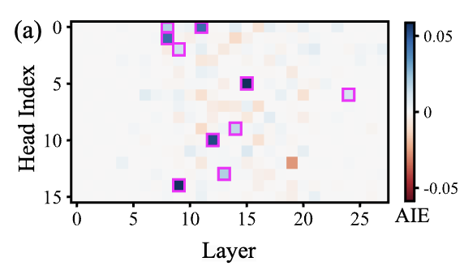
Get FVs from the strongest attention heads
4. Identify attention heads with strongest causal Average Indirect Effects
A map of attention heads, colored by FV AIE strength
5. Form an FV for a task by adding those heads’ average outputs for the task

Slide 33
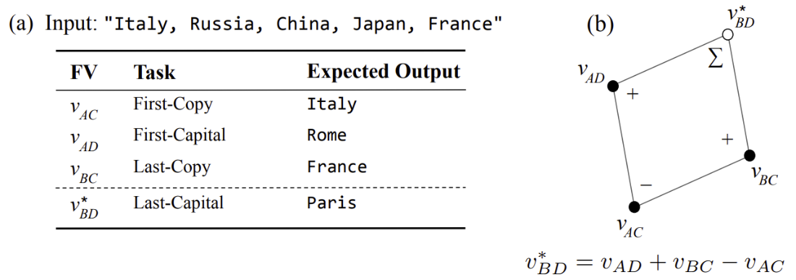
What FVs look like, and what they can do
(a)
(c)
+
arrive:depart, small:big, common:
rare
The word "fast" means
slow
$v_{t}$= Antonym FV
Trigger task execution in natural text
Vector composition to encode unseen tasks

Slide 34
Try out function vectors
https://bit.ly/fv-nn
(previously tried this in the weekend workshop)

