Slide 1
DS 4440
Deep Learning

Slide 2
Concepts to Know So Far
McCoullough-Pitts neuron model (weighted sum then nonlinearity)
Binary logic neural networks
The limitations of one neuron, and the power of two layers of neurons
Universal computations
Minksy and Papert’s result: One neural layer cannot solve hard problems.
Cybenko’s and Hornik’s results: two layers of neurons can closely match any (continuous) function. It is a universal model of computation.
Rumelhart, Hinton, Williams 1986
Shows that gradient descent is a way to train hidden neuron layers
Outlines backpropagation algorithm (today)
Pytorch tensors, autograd, optimizers, modules

Slide 3
Today: Gradient Descent and Multilayer Perceptrons
Review of gradient descent for two variables.
Gradient descent on the chalkboard.
How gradient descent looks in pytorch.
From Single Neurons to Multi-Layer Perceptrons
Looking at a single layer using linear algebra notation
Remember: how many layers to make a universal approximator?
Chaining layers together to make an MLP
How to train an MLP, and how it looks in pytorch
Bottou’s 1991 idea: modularity
Modern pytorch has two different module systems
The torch.nn.module notebook.
Getting practice using pytorch to train an MLP

Slide 4
Calculus Warmup
Ordinary optimization
Parameters $θ$, loss function $ℒ\left(θ\right)$. Goal is to find $θ$that minimizes $ℒ$.
For example
$$θ=\left\{a, b\right\}$$
$$ℒ\left(θ\right)=a^{2}+ab+b^{2}−3b$$
To minimize $ℒ$, we take the derivatives and set them to zero
Let’s do that on the whiteboard.

Slide 5
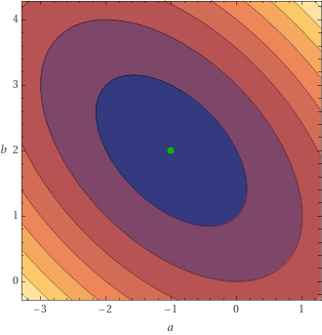
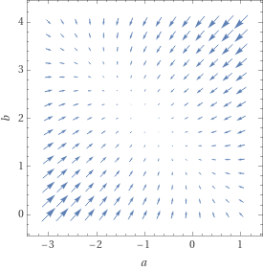
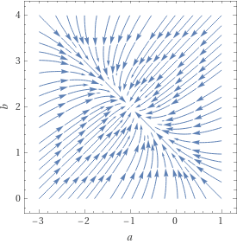
Minimizing a function numerically
$$ℒ\left(θ\right)=a^{2}+ab+b^{2}−3b$$
$$\frac{∂ℒ}{∂a}=2a+b$$
$$\frac{∂ℒ}{∂b}=a+2b−3$$
$∇_{θ}ℒ=[2a+b, a+2b−3$]
$$ℒ\left(θ\right)$$
$${−∇}_{θ}ℒ$$
$${−∇}_{θ}ℒ$$

Slide 6
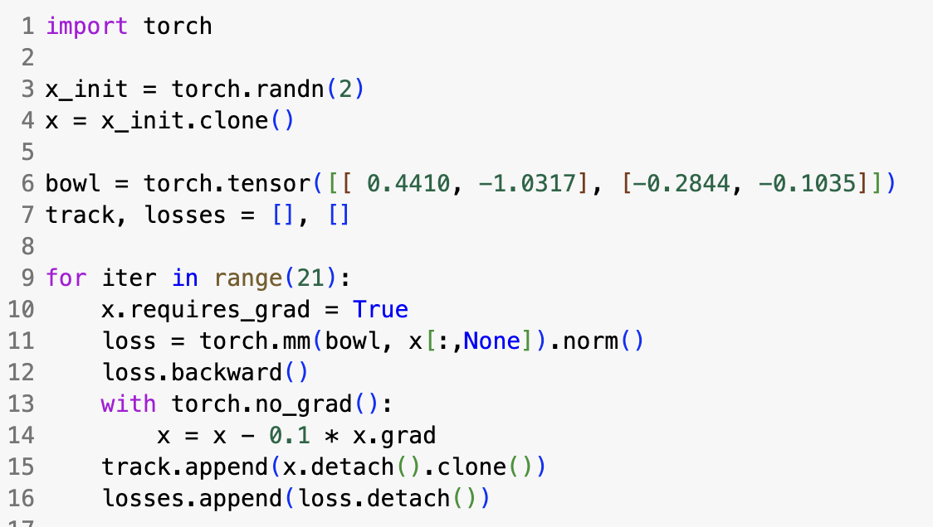
Gradient Descent
Start with any $θ=[a, b]$
Calculate $∇_{θ}ℒ$
Alter $θ←θ−η∙∇_{θ}ℒ$
Repeat
$η$is the learning rate!
$${−∇}_{θ}ℒ$$
https://bit.ly/howto-pytorch-3

Slide 7
From Neurons to Layers to Multi-layer Perceptrons
Linear algebra: a single neuron is a dot-product then a nonlinearity
$$y= σ\left(\sum_{i}{w_{i}x_{i}}+b\right)$$
$$y= σ\left(\left[\begin{matrix}w_{1} & w_{2} & ⋯ & w_{n}\end{matrix}\right]\left[\begin{matrix}x_{1} \\ x_{2} \\ ⋮ \\ x_{n}\end{matrix}\right]+b\right)$$
$$y= σ\left(w^{T}x+b\right)=σ\left(w∙x+b\right)$$
$$x_{1}$$
$$w_{1}$$
$$w_{2}$$
$$x_{2}$$
$$σ$$
$$y$$
$$w_{3}$$
$$x_{3}$$

Slide 8
A Layer of Neurons
neuron 1 computes $y_{1}$
$$x_{1}$$
$$y_{1}$$
$$x_{2}$$
$$y_{2}$$
$$x_{3}$$
$$y_{3}$$
neuron 2 computes $y_{2}$
neuron 3 computes $y_{3}$

Slide 9
A Layer of Neurons is a Matrix Operation
$$y_{1}= σ\left(\sum_{i}{w_{1i}x_{i}}+b_{1}\right)$$
$$y_{2}= σ\left(\sum_{i}{w_{2i}x_{i}}+b_{2}\right)$$
$$y_{m}= σ\left(\sum_{i}{w_{mi}x_{i}}+b_{m}\right)$$
A layer is a matrix multiplication then an element-wise nonlinearity
$$\left[\begin{matrix}y_{1} \\ y_{2} \\ ⋮ \\ y_{m}\end{matrix}\right]= σ\left(\left[\begin{matrix}w_{11} & w_{12} & ⋯ & w_{1n} \\ w_{21} & w_{22} & ⋯ & w_{2n} \\ ⋮ & ⋮ & ⋱ & ⋮ \\ w_{m1} & w_{m1} & ⋯ & w_{mn}\end{matrix}\right]\left[\begin{matrix}x_{1} \\ x_{2} \\ ⋮ \\ x_{n}\end{matrix}\right]+\left[\begin{matrix}b_{1} \\ b_{2} \\ ⋮ \\ b_{m}\end{matrix}\right]\right)$$
$$y= σ\left(Wx+b\right)$$

Slide 10
How Many Layers are Needed for a Universal Approximator?

Slide 11
The Multi-Layer Perceptron
Just chain layers together!
$$x_{1}$$
$$h_{11}$$
$$h_{21}$$
$$y_{1}$$
$$x_{2}$$
$$h_{12}$$
$$h_{22}$$
$$y_{2}$$
$$x_{3}$$
$$h_{13}$$
$$h_{23}$$
$$y_{3}$$
“hidden layers” compute hidden outputs unseen on the outside

Slide 12
The Multi-Layer Perceptron as Matrix Equations
$$h_{1}= σ\left(W_{1}x+b_{1}\right)$$
$$h_{2}= σ\left(W_{2}h_{1}+b_{2}\right)$$
[repeat for each layer]
$$y= σ\left(W_{3}h_{2}+b_{3}\right)$$

Slide 13
How to Program a Multi-Layer Perceptron?
$$h_{1}= σ\left(W_{1}x+b_{1}\right)$$
$$h_{2}= σ\left(W_{2}h_{1}+b_{2}\right)$$
$$y= σ\left(W_{3}h_{2}+b_{3}\right)$$
We need to optimize all its weights and biases... We can use Gradient Descent for that!

Slide 14
How to Program a Multi-Layer Perceptron?
$$h_{1}= σ\left(W_{1}x+b_{1}\right)$$
$$h_{2}= σ\left(W_{2}h_{1}+b_{2}\right)$$
$$y= σ\left(W_{3}h_{2}+b_{3}\right)$$
1. Write down all the parameters
$$θ=\left\{W_{1},b_{1},W_{2},b_{2},W_{3},b_{3}\right\} \\ y=f(x;θ)$$

Slide 15
How to Program a Multi-Layer Perceptron
$h_{1}= σ\left(W_{1}x+b_{1}\right)$ $h_{2}= σ\left(W_{2}h_{1}+b_{2}\right)$ $y= σ\left(W_{3}h_{2}+b_{3}\right)$
1. Write down all the parameters
$$θ=\left\{W_{1},b_{1},W_{2},b_{2},W_{3},b_{3}\right\} \\ y=f(x;θ)$$
2. Formulate a Loss
$$ℒ\left(θ\right)=\sum_{i}{{\left\|y_{i}−f(x_{i};θ)\right\|}^{2}}$$
3. Optimize it
$$θ←θ−η∙∇_{θ}ℒ$$

Slide 16
How it will work in code
You write the code for your neural network $f(x;θ)$
Pytorch can keep track of all the parameters $θ$ for you if you organize your code using torch.nn.modules.
You write the code to calculate your loss $ℒ\left(θ\right)$
For optimization, Pytorch can compute all the gradients for you if you use autograd (backward and grad)
1. Write down all the parameters
$$θ=\left\{W_{1},b_{1},W_{2},b_{2},W_{3},b_{3}\right\} \\ y=f(x;θ)$$
2. Formulate a Loss (example)
$$ℒ\left(θ\right)=\sum_{i}{{\left\|y_{i}−f(x_{i};θ)\right\|}^{2}}$$
3. Optimize it
$$θ←θ−η∙∇_{θ}ℒ$$

Slide 17
Interlude

Slide 18
Reading: The origin of modular machine learning
Bottou 1991
Leon Bottou, student at Paris; then Bell labs, NYU, Facebook Creator of stochastic gradient descent
Creator of the “SN/Lush” neural network simulator 1987
Close collaborator with Yann LeCun since 1987 to today.
Patrick Gallinari, Sorbonne
Interest: ML with scientific applications
Collaborated with Yann LeCun in 1987
Yann Lecun is a hidden force behind this paper!

Slide 19
Historical Context of Bottou
Rumelhart 1986’s backprop obviously requires systems to implement it.
LeCun and Bottou invent “Lush” lisp-based simulator ... it includes a bprop autodifferentiator. But how to add new math?
But in 1991 Lecun and Bottou notice it can be done in a modular “framework".
This idea of modularity leads to the design of pluggable layers in deep learning systems: torch, caffe, theano, pytorch, tensorflow, etc.
Only 129 citations after 37 years, but huge practical impact

Slide 20
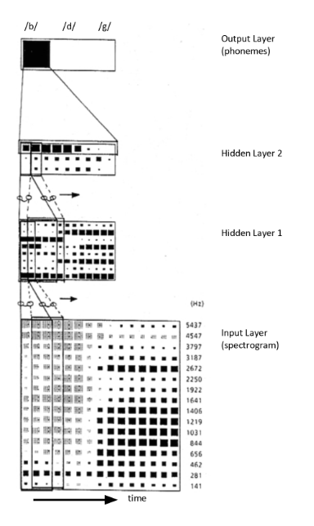
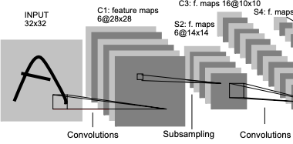
Why Bottou was thinking about Modularity
Components could have idiosyncratic update or gradient rules:
“Time Delay Network”
“K-Means” as minimum; “LVQ” as min-or-max
Convolutions...

Slide 21
Today, pytorch has two different module systems
1. torch.nn.module keeps track of learnable parameters for you
$$y=f(x;θ)$$
y = f(x)
theta = f.parameters()
2. torch.autograd keeps track of differentiable computations for you
$$∇_{θ}ℒ$$
loss = sum([norm(y - f(x) for x, y in data])
grad = [p.grad for p in f.parameters()]

Slide 22
Remember: how it will work in code
You write the code for your neural network $f(x;θ)$
Pytorch can keep track of all the parameters $θ$ for you if you organize your code using torch.nn.modules.
You write the code to calculate your loss $ℒ\left(θ\right)$
For optimization, Pytorch can compute all the gradients for you if you use autograd (backward and grad)
1. Write down all the parameters
$$θ=\left\{W_{1},b_{1},W_{2},b_{2},W_{3},b_{3}\right\} \\ y=f(x;θ)$$
2. Formulate a Loss (example)
$$ℒ\left(θ\right)=\sum_{i}{{\left\|y_{i}−f(x_{i};θ)\right\|}^{2}}$$
3. Optimize it
$$θ←θ−η∙∇_{θ}ℒ$$

Slide 23
You write the network
You write the network as the composition of functions f(g(h(x)))
For example: layer3(layer2(layer1(x)))
In pytorch it looks like this:
Sequential composes functions
It makes a callable function

Slide 24
Pytorch keeps track of the parameters
Defining a neural network function using modules
$$y=f(x;θ)$$
mlp is a function
but it has parameters
https://bit.ly/howto-pytorch-4

Slide 25
You write the loss
Usually, you need a function that imitates a set of examples.
For example: $f\left(x_{1}\right)≈y_{1}$ , $f\left(x_{2}\right)≈y_{2}$ , $f\left(x_{3}\right)≈y_{3}$ , ...
(where both $x_{i}$ and $y_{i}$ can be vectors in the general case.)
There are various similarity scores that can be used for a numeric loss.
For example: “Mean Square Error” loss to minimize vector distances
$$ℒ=\frac{1}{n}\sum_{i}{{\left\|y_{i}−f(x_{i})\right\|}^{2}}$$
Or “Cross Entropy” loss when vector $f(x_{i})$ is a probability distribution
$$ℒ=\frac{1}{n}\sum_{i}{\sum_{c}{y_{ic}\log{f_{c}(x_{i}})}}$$

Slide 26
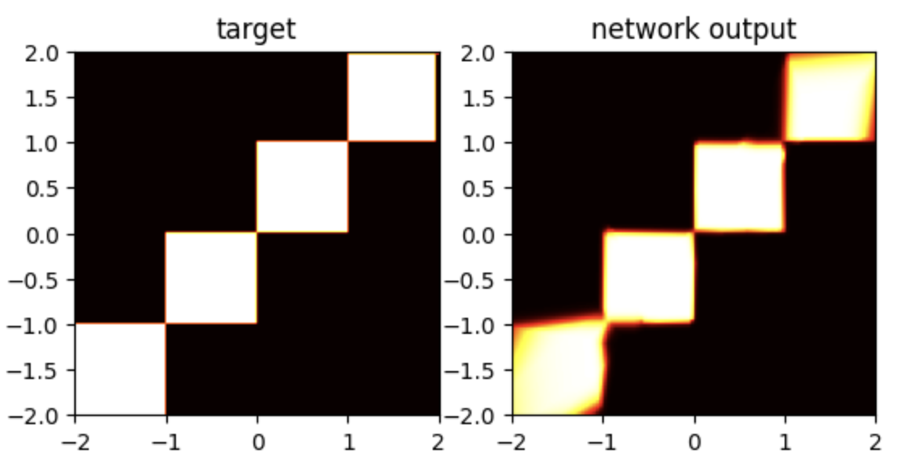
An example synthetic “data set”
For every input $x_{i}=\left(a_{i},b_{i}\right)$, we have a target number $y_{i}$ that is 0 or 1 (which we have colored black or white)

Slide 27
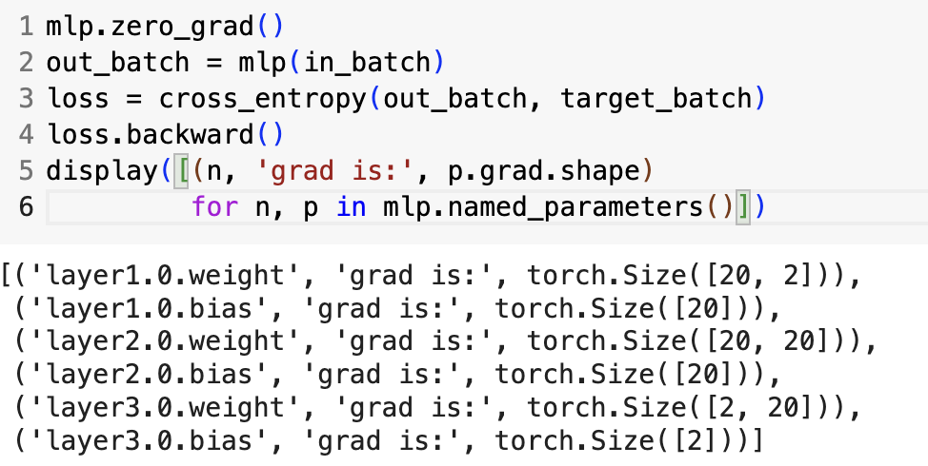
Pytorch computes the derivatives for you
Run the network
Compute the loss
Do all the derivatives
Each network parameter now has a “grad” field
https://bit.ly/howto-pytorch-4

Slide 28
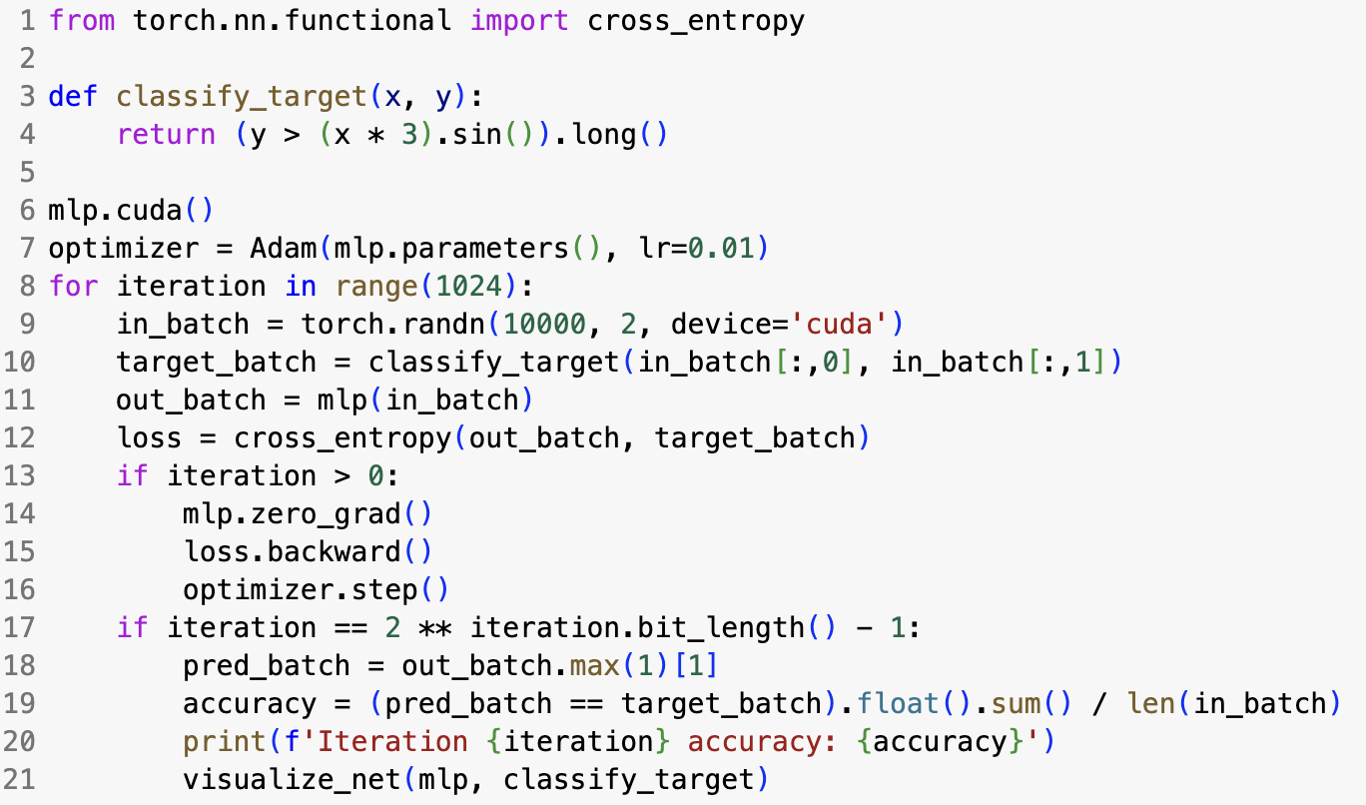
Learning an MLP from data: a pytorch training loop
Take a moment to read it: Can you recognize all the steps?
https://bit.ly/howto-pytorch-4

Slide 29
Let’s try notebook 4
(End-to-end demonstrations of small MLP training)

Slide 30
Next class:
Backpropagation

