Slide 1
DS 4440
Deep Learning

Slide 2
Concepts to Know So Far
McCoullough-Pitts neuron model (weighted sum then nonlinearity)
Binary logic neural networks
Universal computations (two+ layers and nonlinearities are needed)
Gradient descent
Modular machine learning: Pytorch tensors, autograd, and modules

Slide 3
Two topics today
Crafting a Loss: Cross-entropy loss versus Mean-Square Error
Softmax layers
Cross-entropy loss
Interacting with the CE loss
The backpropagation algorithm, part 1
The overall algorithm
Creating a computation graph in python using operator overloading
Topological sort
The forward pass

Slide 4
Crafting a Loss (an “error function”)
Up to now: an MLP – a multilayer perceptron maps vectors to vectors
$$y=f\left(x;θ\right)$$
Inputs might be: pixels of an image. What should the outputs be?
$$x_{1}$$
$$h_{11}$$
$$h_{21}$$
$$y_{1}$$
$$x_{2}$$
$$h_{12}$$
$$h_{22}$$
$$y_{2}$$
$$x_{3}$$
$$h_{13}$$
$$h_{23}$$
$$y_{3}$$

Slide 5
One-class-per-neuron encoding for classification
The typical way to use output neurons in classification: one neuron per class
$$\left[\begin{matrix}y_{1} \\ y_{2} \\ y_{3}\end{matrix}\right]=y=f\left(x;θ\right)=\left[\begin{matrix}y_{cat} \\ y_{fish} \\ y_{horse}\end{matrix}\right]$$
$$x_{1}$$
$$h_{11}$$
$$h_{21}$$
$$y_{cat}$$
$$x_{2}$$
$$h_{12}$$
$$h_{22}$$
$$y_{fish}$$
$$x_{3}$$
$$h_{13}$$
$$h_{23}$$
$$y_{horse}$$

Slide 6
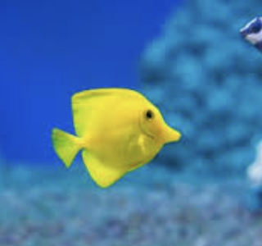
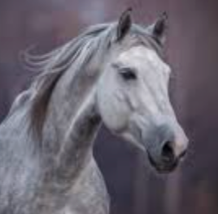
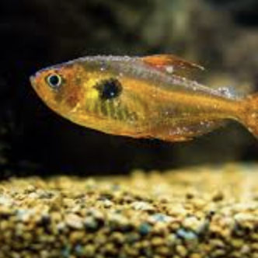
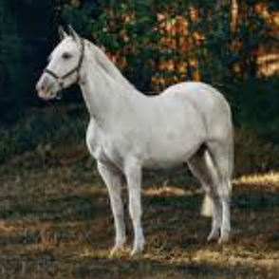
One-hot encoding for paired classification data
An example small data set
$$x$$
$$y$$
$$x$$
$$y$$
$$x$$
$$y$$
$$\left[\begin{matrix}0 \\ 1 \\ 0\end{matrix}\right]$$
$$\left[\begin{matrix}0 \\ 0 \\ 1\end{matrix}\right]$$
$$\left[\begin{matrix}0 \\ 1 \\ 0\end{matrix}\right]$$
$$x_{1}$$
$$x_{2}$$
$$x_{3}$$
$$x_{4}$$
$$\left[\begin{matrix}y_{cat} \\ y_{fish} \\ y_{horse}\end{matrix}\right]=\left[\begin{matrix}1 \\ 0 \\ 0\end{matrix}\right]$$
$$x_{5}$$
$$x_{6}$$
$$x_{7}$$
$$x_{8}$$
$$x$$
$$y$$
$$x$$
$$y$$
$$x$$
$$y$$
$$x_{9}$$
$$x_{10}$$
$$x_{11}$$
$$x_{12}$$
$$\left[\begin{matrix}1 \\ 0 \\ 0\end{matrix}\right]$$
$$\left[\begin{matrix}0 \\ 1 \\ 0\end{matrix}\right]$$
$$\left[\begin{matrix}0 \\ 0 \\ 1\end{matrix}\right]$$
$$x_{13}$$
$$x_{14}$$
$$x_{15}$$
$$x_{16}$$
$$x_{1}$$
$$h_{11}$$
$$h_{21}$$
$$y_{cat}$$
$$x_{2}$$
$$h_{12}$$
$$h_{22}$$
$$y_{fish}$$
$$x_{3}$$
$$h_{13}$$
$$h_{23}$$
$$y_{horse}$$

Slide 7
Purpose of a loss function
“Ground truth data”
“Predictions” from network output
$$x_{1}$$
$$x_{2}$$
$$x_{3}$$
$$x_{4}$$
$$\left[\begin{matrix}y_{cat} \\ y_{fish} \\ y_{horse}\end{matrix}\right]=\left[\begin{matrix}1 \\ 0 \\ 0\end{matrix}\right]$$
$$f\left(x;θ\right)=\left[\begin{matrix}0.2 \\ −0.3 \\ 11.7\end{matrix}\right]$$
$$x_{5}$$
$$x_{6}$$
$$x_{7}$$
$$x_{8}$$
$$x_{9}$$
$$x_{10}$$
$$x_{11}$$
$$x_{12}$$
$$x_{13}$$
$$x_{14}$$
$$x_{15}$$
$$x_{16}$$
$ℒ$ =“How bad is it?”
$$x_{1}$$
$$h_{11}$$
$$h_{21}$$
$$y_{cat}$$
$$x_{2}$$
$$h_{12}$$
$$h_{22}$$
$$y_{fish}$$
$$x_{3}$$
$$h_{13}$$
$$h_{23}$$
$$y_{horse}$$

Slide 8
Properties of a good loss function
“Ground truth data”
“Predictions” from network output
$$x_{1}$$
$$x_{2}$$
$$x_{3}$$
$$x_{4}$$
$$\left[\begin{matrix}y_{cat} \\ y_{fish} \\ y_{horse}\end{matrix}\right]=\left[\begin{matrix}1 \\ 0 \\ 0\end{matrix}\right]$$
$$f\left(x;θ\right)=\left[\begin{matrix}0.2 \\ −0.3 \\ 11.7\end{matrix}\right]$$
$$x_{5}$$
$$x_{6}$$
$$x_{7}$$
$$x_{8}$$
$$x_{9}$$
$$x_{10}$$
$$x_{11}$$
$$x_{12}$$
$$x_{13}$$
$$x_{14}$$
$$x_{15}$$
$$x_{16}$$
$ℒ$ =“How bad is it?”
Ideal loss function:
High when it’s bad, low when it’s good
Differentiable (so we can do gradient descent)
“Sloped” everywhere except at the global minimum
Ideally, we also know what it means, i.e., what are the “units”?

Slide 9
Some candidate loss functions
 | $\left[\begin{matrix}1 \\ 0 \\ 0\end{matrix}\right]$ vs $\left[\begin{matrix}0.2 \\ −0.3 \\ 11.7\end{matrix}\right]$ | $\left[\begin{matrix}1 \\ 0 \\ 0\end{matrix}\right]$ vs $\left[\begin{matrix}0.9 \\ 0.09 \\ 0.01\end{matrix}\right]$ | $\left[\begin{matrix}1 \\ 0 \\ 0\end{matrix}\right]$ vs $\left[\begin{matrix}1 \\ 0 \\ 0\end{matrix}\right]$
1-Accuracy (“L0”): not smooth | 1.0 | 1.0 | 0.0
L∞ (max error): focus on the worst part | 11.7 | 0.1 | 0.0
L1 (absolute value): signed slope (surprisingly ok!) | .8+.3+11.7 = 12.8 | .1+.09+.01 = 0.2 | 0.0
L2/MSE (mean square error): the classic | .8²+.3²+11.7² = 137.62 | .1²+.09²+.01² = 0.0182 | 0.0
KL (log-prob-ratio): great for big+small probs | $$\log{\frac{1.0}{0.2}}=1.61$$ | $$\log{\frac{1.0}{0.9}}=0.105$$ | $$\log{\frac{1.0}{1.0}}=0$$
CE (negative log-prob): just like KL, but simpler | $$−\log{0.2}=1.61$$ | $$−\log{0.9}=0.105$$ | $$−\log{1=0}$$

Slide 10
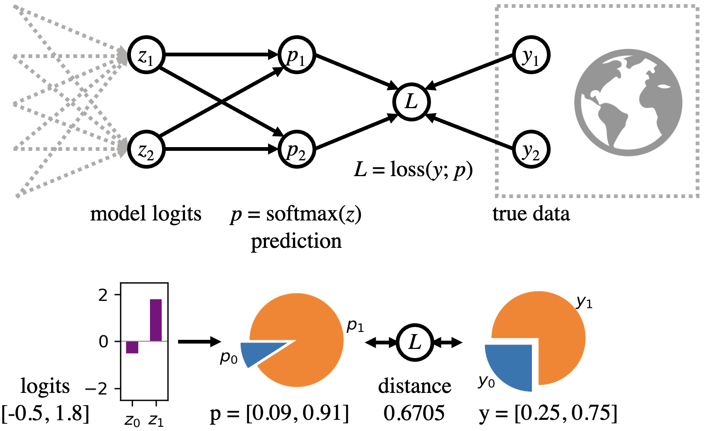
Important to know: Softmax output for a classifier
Obvious nonsense: Instead:
output $z=\left[\begin{matrix}0.2 \\ −0.3 \\ 11.7\end{matrix}\right]$.
Softmax definition:
$p_{i}=\frac{\exp{z_{i}}}{\sum_{j}{\exp{z_{j}}}}$. Always adds to 1.

Slide 11
Properties of CE loss on Softmax output
With softmax output: $p_{i}=\frac{\exp{z_{i}}}{\sum_{j}{\exp{z_{j}}}}$, and CE loss: $ℒ=−\sum_{i}{y_{i}\log{p_{i}}}$
If you work out the derivatives, you get this very neat form:
$$\frac{∂ℒ}{∂z_{i}}= p_{i}−y_{i}$$
Pushes z up when the prediction $p_{i}$is too low
Pushes z down when prediction $p_{i}$is too high
What happens if you add 100 to every pre-softmax output $z_{i}$?

Slide 12
Try Interacting with Cross-Entropy vs MSE
https://bit.ly/ce-vs-mse

Slide 13
How to Program a Neural Network
1. Make a parameterized network
$$θ=\left\{W_{1},b_{1},W_{2},b_{2},W_{3},b_{3}\right\} \\ p^{∗}=f(x;θ)$$
2. Formulate a Loss
$$ℒ\left(θ\right)=\sum_{i}{{\left\|y_{i}−f(x_{i};θ)\right\|}^{2}}$$
3. Optimize it
$$θ←θ−η∙∇_{θ}ℒ$$
$$x_{1}$$
$$y_{1}$$
$$x_{2}$$
$$y_{2}$$
$$x_{3}$$
$$y_{3}$$
$$\left[\begin{matrix}0 \\ 1 \\ 0\end{matrix}\right]$$
$$\left[\begin{matrix}0 \\ 0 \\ 1\end{matrix}\right]$$
$$\left[\begin{matrix}0 \\ 1 \\ 0\end{matrix}\right]$$
$$x_{4}$$
$$y_{4}$$
$$x_{5}$$
$$y_{5}$$
$$x_{6}$$
$$y_{6}$$
$$\left[\begin{matrix}1 \\ 0 \\ 0\end{matrix}\right]$$
$$\left[\begin{matrix}0 \\ 1 \\ 0\end{matrix}\right]$$
$$\left[\begin{matrix}0 \\ 0 \\ 1\end{matrix}\right]$$
The loss is summed up over all data pairs $$\left\{\left(x_{1},y_{1}\right), …,\left(x_{i},y_{i}\right),\left(x_{i+1},y_{i+1}\right),…\right\}$$
Or... in Stochastic Gradient Descent, summed over a random sample!

Slide 14
How to deal with complexity
The network $f(x;θ)$ can be complex
The loss function $ℒ\left(θ, data\right)$can be be complex
And the data samples can be very very large
So: the derivative $∇_{θ}ℒ$can be complex
We will compute it carefully and automatically:
Backpropagation

Slide 15
Backpropagation is based on a computation graph
a 7
$$f\left(a,b,c\right)=\left(a−b\right)c$$
d 5
e.g., $a=7,b=2,c=3$
–
b 2
f 15
*
c 3
“Forward pass”

Slide 16
Backpropagation algorithm
a 7
$$f\left(a,b,c\right)=\left(a−b\right)c$$
d 5
e.g., $a=7,b=2,c=3$
+
b 2
f 15
*
$$d=a−b$$
$$\frac{∂d}{∂a}=1$$
$$\frac{∂d}{∂b}=−1$$
c 3
$$f=dz$$
$$\frac{∂f}{∂d}=c$$
$$\frac{∂f}{∂c}=d$$
Want:
$\frac{∂f}{∂a}$ , $\frac{∂f}{∂b}$ , $\frac{∂f}{∂c}$
[Slides adapted from Justin Johnson]

Slide 17
Backpropagation algorithm
a 7
$$f\left(a,b,c\right)=\left(a−b\right)c$$
d 5
e.g., $a=7,b=2,c=3$
–
b 2
f 15
*
$$d=a−b$$
$$\frac{∂d}{∂a}=1$$
$$\frac{∂d}{∂b}=−1$$
1
c 3
$$f=dz$$
$$\frac{∂f}{∂d}=c$$
$$\frac{∂f}{∂c}=d$$
Want:
$\frac{∂f}{∂a}$ , $\frac{∂f}{∂b}$ , $\frac{∂f}{∂c}$
$$\frac{∂f}{∂f}$$
[Slides adapted from Justin Johnson]

Slide 18
Backpropagation algorithm
a 7
$$f\left(a,b,c\right)=\left(a−b\right)c$$
d 5
e.g., $a=7,b=2,c=3$
–
b 2
f 15
*
$$d=a−b$$
$$\frac{∂d}{∂a}=1$$
$$\frac{∂d}{∂b}=−1$$
c 3
$$f=dz$$
$$\frac{∂f}{∂d}=c$$
$$\frac{∂f}{∂c}=d$$
Want:
$\frac{∂f}{∂a}$ , $\frac{∂f}{∂b}$ , $\frac{∂f}{∂c}$
$$\frac{∂f}{∂c}$$
[Slides adapted from Justin Johnson]

Slide 19
Backpropagation algorithm
a 7
$$f\left(a,b,c\right)=\left(a−b\right)c$$
d 5
e.g., $a=7,b=2,c=3$
–
3
f 15
b 2
*
$$d=a−b$$
$$\frac{∂d}{∂a}=1$$
$$\frac{∂d}{∂b}=−1$$
c 3
$$f=dz$$
$$\frac{∂f}{∂d}=c$$
$$\frac{∂f}{∂c}=d$$
5
Want:
$\frac{∂f}{∂a}$ , $\frac{∂f}{∂b}$ , $\frac{∂f}{∂c}$
$$\frac{∂f}{∂b}=\frac{∂f}{∂d}∙\frac{∂d}{∂b}$$
$$\frac{∂f}{∂b}$$
Chain rule:
[Slides adapted from Justin Johnson]

Slide 20
Backpropagation algorithm
a 7
$$f\left(a,b,c\right)=\left(a−b\right)c$$
d 5
e.g., $a=7,b=2,c=3$
–
3
f 15
b 2
*
$$d=a−b$$
$$\frac{∂d}{∂a}=1$$
$$\frac{∂d}{∂b}=−1$$
–3
c 3
$$f=dz$$
$$\frac{∂f}{∂d}=c$$
$$\frac{∂f}{∂c}=d$$
5
Want:
$\frac{∂f}{∂a}$ , $\frac{∂f}{∂b}$ , $\frac{∂f}{∂c}$
$$\frac{∂f}{∂a}=\frac{∂f}{∂d}∙\frac{∂d}{∂a}$$
$$\frac{∂f}{∂a}$$
Chain rule:
[Slides adapted from Justin Johnson]

Slide 21
Backpropagation algorithm
a 7
$$f\left(a,b,c\right)=\left(a−b\right)c$$
3
d 5
e.g., $a=7,b=2,c=3$
–
3
f 15
b 2
*
$$d=a−b$$
$$\frac{∂d}{∂a}=1$$
$$\frac{∂d}{∂b}=−1$$
–3
c 3
$$f=dz$$
$$\frac{∂f}{∂d}=c$$
$$\frac{∂f}{∂c}=d$$
5
Want:
$\frac{∂f}{∂a}$ , $\frac{∂f}{∂b}$ , $\frac{∂f}{∂c}$
[Slides adapted from Justin Johnson]

Slide 22
How to Make Computation Graphs in Practice
Let’s do it in python:
https://bit.ly/comp-graph
We will make our own “mini autograd” for HW2.
This notebook will get you started with the idea.
Making a computation graph using operator overloading
Sorting the graph using topological sort
Implementing the forward pass

Slide 23
Next lecture
More details on backprop!

