Slide 1
DS 4440
Deep Learning

Slide 2
Concepts to Know So Far
McCoullough-Pitts neuron model (weighted sum then nonlinearity)
Binary logic neural networks
Universal computations (two+ layers and nonlinearities are needed)
Gradient descent
Modular machine learning: Pytorch tensors, autograd, and modules
Losses: what makes a good/bad loss; MSE, L1, and cross-entropy loss
The backpropagation algorithm

Slide 3
Today
More about the backpropagation algorithm
“Upstream”, “internal” and “downstream” gradient
Topological sort: How to deal with non-tree Directed Acyclic Graphs
Gradient accumulation: why it is needed, and why you need to zero grad
Beginning of some optimization algorithms
Momentum
ADAM

Slide 4
Backpropagation II.

Slide 5
Calculus Warmup
Derivative of: $f(x)=\tanh{x}=\frac{e^{x}−e^{−x}}{e^{x}+e^{−x}}$
calculate: $\frac{df}{dx}$
To-do: plot tanh, calculate tanh(0) and its derivative

Slide 6
The Backprop Way: Forward
Derivative of: $f(x)=\tanh{x}=\frac{e^{x}−e^{−x}}{e^{x}+e^{−x}}$
Evaluate on: x=ln 2
2
3/2
exp
+
ln 2
-1/2
3/5
3/5
x
neg
*
f
ln 1/2
1/2
5/2
2/5
neg
exp
+
reciprocal

Slide 7
The Backprop Way: Backward (overview)
Derivative of: $f(x)=\tanh{x}=\frac{e^{x}−e^{−x}}{e^{x}+e^{−x}}$
2
3/2
$$x_{9}$$
exp
$$y_{4}$$
$$x_{3}$$
+
$$y_{8}$$
ln 2
$\frac{df}{dx_{3}}$=2/5
-1/2
$$x_{4}$$
3/5
3/5
total = 4/25
$\frac{df}{dx_{1}}$=2/5
$$x_{1}$$
8/25
-6/25
neg
$$y_{5}$$
x
$$y_{1}$$
$$x_{6}$$
$\frac{df}{dx_{4}}$=2/5
*
f
$$x_{12}$$
ln 1/2
1/2
$$x_{2}$$
$\frac{df}{df}$=1
5/2
2/5
total = 16/25
$$x_{7}$$
-2/5
$$y_{3}$$
$$y_{9}$$
8/25
neg
$$y_{2}$$
$$x_{10}$$
exp
$$x_{8}$$
+
$$y_{6}$$
$$x_{5}$$
reciprocal
$\frac{df}{dx_{2}}$=3/2
-6/25
-8/25
$\frac{df}{dx_{5}}$=-6/25
total = -16/25

Slide 8
The Backprop Way: Backward (step 1)
$$\frac{df}{df}=1$$
Derivative of: $f(x)=\tanh{x}=\frac{e^{x}−e^{−x}}{e^{x}+e^{−x}}$
2
3/2
$$x_{9}$$
exp
$$y_{3}$$
$$x_{3}$$
+
$$y_{8}$$
ln 2
-1/2
$$x_{4}$$
3/5
3/5
$\frac{df}{dx_{1}}$=2/5
$$x_{1}$$
$$y_{1}$$
$$x_{6}$$
neg
$$y_{5}$$
$$x_{12}$$
x
*
y
$\frac{df}{df}$=1
ln 1/2
1/2
5/2
2/5
$$x_{2}$$
$$x_{7}$$
$$y_{4}$$
$$y_{9}$$
neg
$$y_{2}$$
$$x_{10}$$
exp
$$x_{8}$$
+
$$y_{6}$$
$$x_{5}$$
reciprocal
$\frac{df}{dx_{2}}$=3/2

Slide 9
Forward pass (activations)
$$3/2$$
$$x_{1}$$
$$∗$$
$$\frac{df}{dx_{1}}$$
$2/5$ =
$$=x_{2}$$
$$f$$
$$3/5$$
$${{f=x}_{1}x}_{2}$$
$$x_{2}$$
$$2/5$$
$$\frac{df}{dx_{2}}=x_{1}$$
$3/2$ =
Backward pass (gradients)

Slide 10
The Backprop Way: Backward (accumulation)
Derivative of: $f(x)=\tanh{x}=\frac{e^{x}−e^{−x}}{e^{x}+e^{−x}}$
2
3/2
$$x_{9}$$
exp
$$y_{4}$$
$$x_{3}$$
+
$$y_{8}$$
ln 2
$\frac{dy}{dx_{3}}$=2/5
-1/2
$$x_{4}$$
3/5
3/5
total = 4/25
$\frac{dy}{dx_{1}}$=2/5
$$x_{1}$$
8/25
-6/25
neg
$$y_{5}$$
x
$$y_{1}$$
$$x_{6}$$
$\frac{dy}{dx_{4}}$=2/5
*
y
$$x_{12}$$
ln 1/2
1/2
$$x_{2}$$
$\frac{dy}{dy}$=1
5/2
2/5
total = 16/25
$$x_{7}$$
$$y_{3}$$
$$y_{9}$$
neg
$$y_{2}$$
$$x_{10}$$
exp
$$x_{8}$$
+
$$y_{6}$$
$$x_{5}$$
reciprocal
$\frac{dy}{dx_{2}}$=3/2
-6/25
$\frac{dy}{dx_{5}}$=-6/25

Slide 11
Forward pass (activations)
$$\ln{2}$$
$$x_{9}$$
$$∗$$
$$\frac{df}{dx_{9}}=\frac{dy_{4}}{dx_{9}}\frac{df}{dy_{4}}$$
$$y_{4}$$
$$2$$
$$x_{3}$$
$$y_{4}=\exp{x_{9}}$$
$$\frac{df}{dx_{3}}=2/5$$
$$\frac{8}{25}$$
$$=2∙\frac{4}{25}$$
$$\frac{dy_{4}}{dx_{9}}=$$
$$y_{4}$$
$$\frac{df}{dy_{4}}=$$
$$4/25$$
$$x_{7}$$
gradient
accumulation!
$$\frac{df}{dx_{7}}=−6/25$$
Backward pass (gradients)

Slide 12
Topological Sort
What order to process the nodes in a complex graph?
2
3/2
$$x_{9}$$
exp
$$y_{4}$$
$$x_{3}$$
+
$$y_{8}$$
ln 2
$\frac{dy}{dx_{3}}$=2/5
-1/2
$$x_{4}$$
3/5
3/5
total = 4/25
$\frac{dy}{dx_{1}}$=2/5
$$x_{1}$$
8/25
-6/25
neg
$$y_{5}$$
x
$$y_{1}$$
$$x_{6}$$
$\frac{dy}{dx_{4}}$=2/5
*
y
$$x_{12}$$
ln 1/2
1/2
$$x_{2}$$
$\frac{dy}{dy}$=1
5/2
2/5
total = 16/25
$$x_{7}$$
$$y_{3}$$
$$y_{9}$$
neg
$$y_{2}$$
$$x_{10}$$
exp
$$x_{8}$$
+
$$y_{6}$$
$$x_{5}$$
reciprocal
$\frac{dy}{dx_{2}}$=3/2
-6/25
$\frac{dy}{dx_{5}}$=-6/25

Slide 13
Backpropagation II
Let’s practice some differentiation.
$$p=e^{−a^{2}}$$
$$f=mean\left(p, p^{2}\right)= \frac{p+p^{2}}{2}$$
$$g=\frac{∂f}{∂a}$$

Slide 14
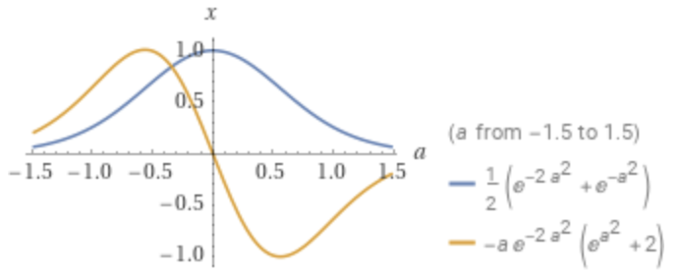
Wolfram Alpha’s Symbolic Differentiation
$p=e^{−a^{2}}$; $f=mean\left(p, p^{2}\right)= \frac{p+p^{2}}{2}$
$$g=\frac{∂f}{∂a}=\frac{∂f}{∂p} \frac{∂p}{∂a}=\left(\frac{1}{2}+p\right)\left(−2ae^{−a^{2}}\right)=−ae^{−a^{2}}−2ae^{−2a^{2}}$$

Slide 15
The Backprop Way: Forward
Derivative of: $y=f(a)=mean\left(p, p^{2}\right)$; $p=e^{−a^{2}}$
Evaluate on: a = 0.6
0.487
0.6
0.36
-0.36
0.698
square
0.592
0.592
a
square
neg
exp
mean
f

Slide 16
The Backprop Way: Forward
Derivative of: $y=f(a)=mean\left(p, p^{2}\right)$; $p=e^{−a^{2}}$
Evaluate on: a = 0.6
0.487
$$x_{4}$$
square
$$y_{5}$$
p= 0.698
0.6
0.36
-0.36
0.592
0.592
$$x_{2}$$
a
$$y_{1}$$
$$x_{7}$$
square
$$y_{2}$$
$$x_{6}$$
neg
$$y_{3}$$
$$x_{5}$$
exp
$$y_{4}$$
mean
$$y_{6}$$
$$x_{1}$$
f
$$x_{3}$$

Slide 17
The Backprop Way: Backward
Derivative of: $y=f(a)=mean\left(p, p^{2}\right)$; $p=e^{−a^{2}}$
Evaluate on: a = 0.6
0.487
$$x_{4}$$
square
$$y_{5}$$
p= 0.698
$$\frac{df}{dx_{4}}=0.698$$
$$\frac{df}{dx_{2}}=\frac{1}{2}$$
0.6
0.36
-0.36
0.592
0.592
$$x_{2}$$
a
$$y_{1}$$
$$x_{7}$$
square
$$y_{2}$$
$$x_{6}$$
neg
$$y_{3}$$
$$x_{5}$$
exp
$$y_{4}$$
mean
$$y_{6}$$
$$x_{1}$$
f
$$\frac{df}{dx_{6}}$$
$$=−1.003$$
$$\frac{df}{dx_{3}}=\frac{1}{2}$$
$$x_{3}$$
$\frac{df}{df}$=1
$$\frac{df}{dx_{5}}$$
$$=−0.836$$
$$\frac{df}{dx_{5}}$$
$$=0.836$$

Slide 18
The Backprop Way: Backward (step 1)
Derivative of: $y=f(a)=mean\left(p, p^{2}\right)$; $p=e^{−a^{2}}$
Evaluate on: a = 0.6
0.487
$$x_{4}$$
square
$$y_{5}$$
p= 0.698
$$\frac{df}{dx_{4}}=0.698$$
$$\frac{df}{dx_{2}}=\frac{1}{2}$$
0.6
0.36
-0.36
0.592
0.592
$$x_{2}$$
a
$$y_{1}$$
$$x_{7}$$
square
$$y_{2}$$
$$x_{6}$$
neg
$$y_{3}$$
$$x_{5}$$
exp
$$y_{4}$$
mean
$$y_{6}$$
$$x_{1}$$
f
$$\frac{df}{dx_{6}}$$
$$=−1.003$$
$$\frac{df}{dx_{3}}=\frac{1}{2}$$
$$x_{3}$$
$\frac{df}{df}$=1
$$\frac{df}{dx_{5}}$$
$$=−0.836$$
$$\frac{df}{dx_{5}}$$
$$=0.836$$

Slide 19
Forward pass (activations)
$$0.487$$
$$x_{2}$$
$$mean$$
$\frac{df}{dx_{2}}$ =
$$\frac{1}{2}$$
$$f$$
$$0.592$$
$$f=\frac{x_{2}+x_{3}}{2}$$
$$x_{3}$$
$$0.698$$
$\frac{df}{dx_{3}}$ =
$$\frac{1}{2}$$
Backward pass (gradients)

Slide 20
The Backprop Way: Backward (step 2)
Derivative of: $y=f(a)=mean\left(p, p^{2}\right)$; $p=e^{−a^{2}}$
Evaluate on: a = 0.6
0.487
$$x_{4}$$
square
$$y_{5}$$
p= 0.698
$$\frac{df}{dx_{4}}=0.698$$
$$\frac{df}{dx_{2}}=\frac{1}{2}$$
0.6
0.36
-0.36
0.592
0.592
$$x_{2}$$
a
$$y_{1}$$
$$x_{7}$$
square
$$y_{2}$$
$$x_{6}$$
neg
$$y_{3}$$
$$x_{5}$$
exp
$$y_{4}$$
mean
$$y_{6}$$
$$x_{1}$$
f
$$\frac{df}{dx_{6}}$$
$$=−1.003$$
$$\frac{df}{dx_{3}}=\frac{1}{2}$$
$$x_{3}$$
$\frac{df}{df}$=1
$$\frac{df}{dx_{5}}$$
$$=−0.836$$
$$\frac{df}{dx_{5}}$$
$$=0.836$$

Slide 21
Forward pass (activations)
$$square$$
$$y_{5}$$
$$0.592$$
$$y_{5}={x_{4}}^{2}$$
$$x_{4}$$
$\frac{dy_{5}}{dx_{4}}$ = $2x_{4}$
$\frac{df}{dy_{5}}$ =
$\frac{df}{dx_{2}}$ = $\frac{1}{2}$
$$0.698$$
= $1.396$
$\frac{df}{dx_{3}}$ =
$$\frac{1}{2}∙1.396=0.698$$
Backward pass (gradients)

Slide 22
The Backprop Way: Backward (step 3)
Derivative of: $y=f(a)=mean\left(p, p^{2}\right)$; $p=e^{−a^{2}}$
Evaluate on: a = 0.6
0.487
$$x_{4}$$
square
$$y_{5}$$
p= 0.698
$$\frac{df}{dx_{4}}=0.698$$
$$\frac{df}{dx_{2}}=\frac{1}{2}$$
0.6
0.36
-0.36
0.592
0.592
$$x_{2}$$
a
$$y_{1}$$
$$x_{7}$$
square
$$y_{2}$$
$$x_{6}$$
neg
$$y_{3}$$
$$x_{5}$$
exp
$$y_{4}$$
mean
$$y_{6}$$
$$x_{1}$$
f
$$\frac{df}{dx_{6}}$$
$$=−1.003$$
$$\frac{df}{dx_{3}}=\frac{1}{2}$$
$$x_{3}$$
$\frac{df}{df}$=1
$$\frac{df}{dx_{5}}$$
$$=−0.836$$
$$\frac{df}{dx_{5}}$$
$$=0.836$$

Slide 23
Forward pass (activations)
$$x_{4}$$
$$e^{⊡}$$
$$0.698$$
$$\frac{df}{dx_{4}}=0.698$$
$$y_{4}$$
$$−0.36$$
$$x_{5}$$
$$y_{4}=\exp{x_{5}}$$
$$x_{3}$$
$$\frac{dy_{4}}{dx_{5}}=$$
$$\frac{df}{dx_{5}}=\frac{dy_{4}}{dx_{5}}\frac{df}{dy_{4}}$$
$$y_{4}$$
$$\frac{df}{dy_{4}}=$$
$$\frac{df}{dx_{3}}=\frac{1}{2}$$
$$1.198$$
$$=0.698$$
gradient accumulation!
$$=0.836$$
Backward pass (gradients)

Slide 24
Forward pass (activations)
$$x$$
$$f$$
$$z$$
$$y$$
Backward pass (gradients)

Slide 25
Forward pass (activations)
$$x$$
$$f$$
$$z$$
$$\frac{∂ℒ}{∂z}$$
upstream gradient
(accumulated)
$$y$$
Backward pass (gradients)

Slide 26
Forward pass (activations)
$$x$$
$$f$$
$$\frac{∂z}{∂x}$$
$$\frac{∂ℒ}{∂x}=\frac{∂z}{∂x}\frac{∂ℒ}{∂z}$$
$$z$$
“local” gradients
downstream gradients
$$\frac{∂ℒ}{∂z}$$
upstream gradient
$$\frac{∂z}{∂y}$$
$$y$$
$$\frac{∂ℒ}{∂y}=\frac{∂z}{∂y}\frac{∂ℒ}{∂z}$$
Backward pass (gradients)

Slide 27
Forward pass (activations)
$$x$$
$$f$$
$$\frac{∂z}{∂x}$$
$$\frac{∂ℒ}{∂x}=\frac{∂z}{∂x}\frac{∂ℒ}{∂z}$$
$$z$$
“local” gradients
downstream gradients
$$\frac{∂ℒ}{∂z}$$
upstream gradient
$$\frac{∂z}{∂y}$$
$$y$$
$$\frac{∂ℒ}{∂y}=\frac{∂z}{∂y}\frac{∂ℒ}{∂z}$$
Backward pass (gradients)

Slide 28
Try the simple backpropagation notebook
https://bit.ly/simple-backprop

Slide 29
The Optimization of Deep Networks

Slide 30
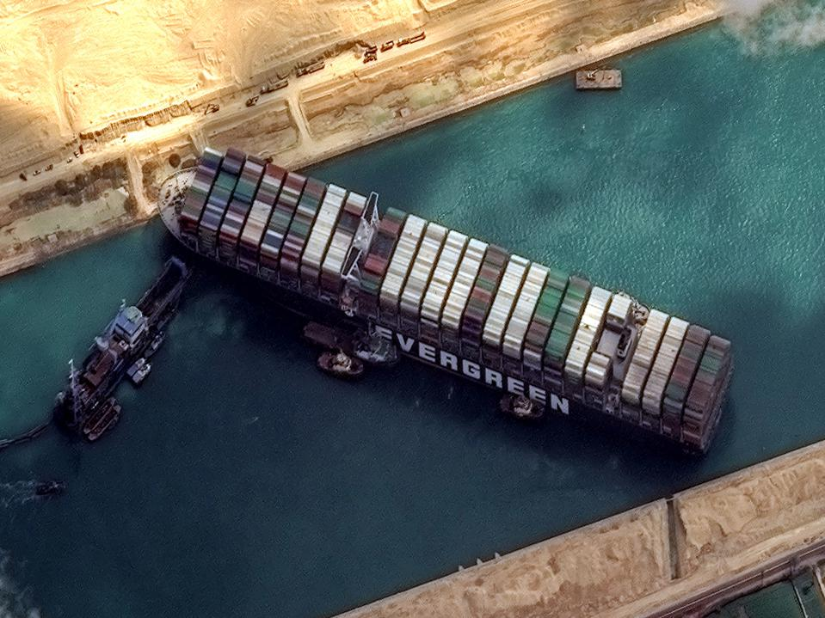
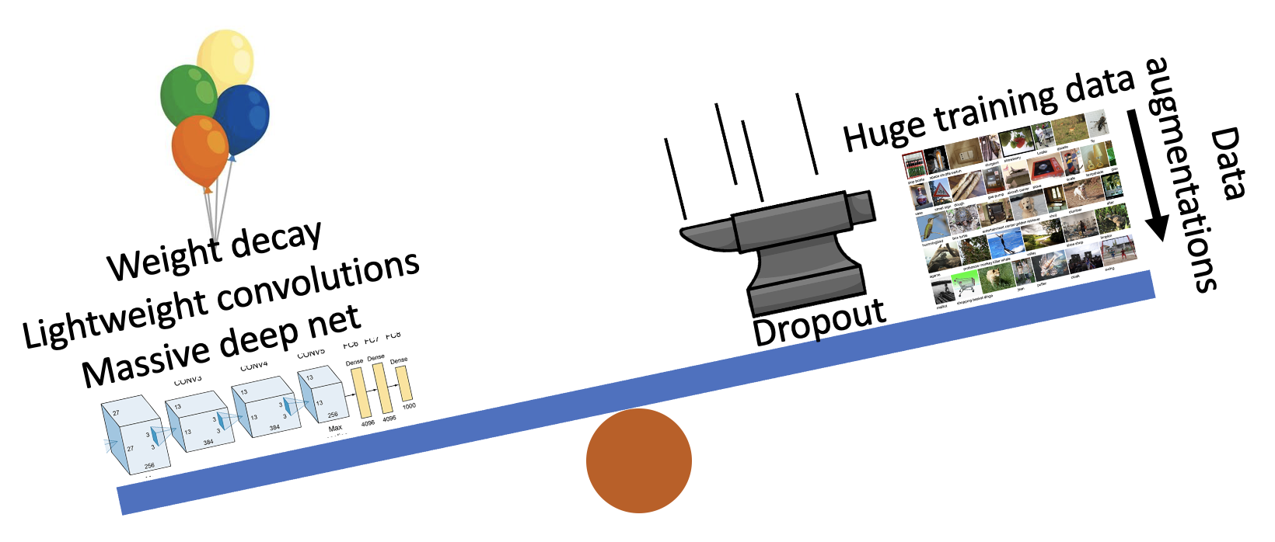
Three Big Concerns
Optimization needs to not get stuck
Generalization: avoid overfitting
Computation: learn good rules, good features

Slide 31
Zig-zags can be a sign of optimization problems
What would you do if somebody gave you zig-zag directions like this?
What would you do after the 10th zig or zag?

Slide 32
Another way to deal with switchbacks
If you sum (or average) every pair of steps, you get a nice path.
A better idea: average lots of steps. Maybe average all the steps.

Slide 33
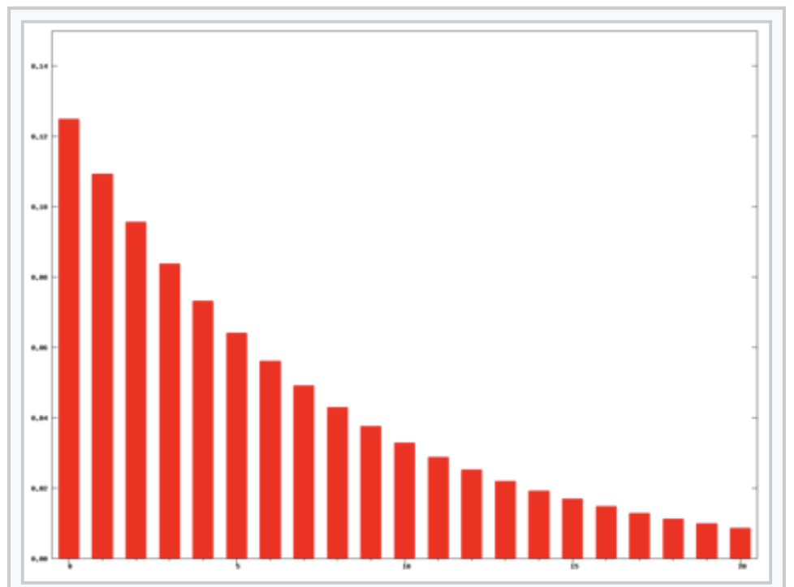
Exponential moving averages
Uncorrected EMA: $$S_{0}^{∗}=0$$
$$S_{i}^{∗}=\left(1−α\right)y_{i}+αS_{i−1}^{∗}$$
(This sort of decay is often used; but notice it has a bias towards zero at the start)
Corrected EMA without a bias: $$S_{i}=\frac{S_{i}^{∗}}{1−α^{i}}$$
EMA with decay $α=0.875$

Slide 34
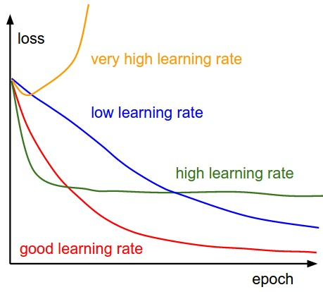
SGD + Momentum
SGD
SGD + Momentum
$$v_{t+1}=ρv_{t}+∇f\left(x_{t}\right)$$
$$x_{t+1}=x_{t}−αv_{t+1}$$
$$x_{t+1}=x_{t}−α∇f\left(x_{t}\right)$$
Build up “velocity” as a running mean of gradients
Rho gives “friction”; typically $ρ=0.9$ or 0.99
Sutskever et al, “On the importance of initialization and momentum in deep learning”, ICML 2013
Slide credit: D Fouhey & J Johnson

Slide 35
Question: is momentum an exponential moving average?
Set $ρ=0.99.$
1. What if grad is always 1? What does v go to?
2. What if grad is +1, -1, +1, -1, +1, -1,....., +1?
SGD + Momentum
$$v_{t+1}=ρv_{t}+{grad}_{t}$$
$$x_{t+1}=x_{t}−αv_{t+1}$$

Slide 36
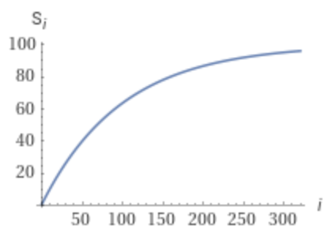
Derivation of the limit of momentum
$$g=1 ν=0.99$$
$$s_{∞}=1+0.99\left(1+\left(0.99\left(1+0.99\left(1+…\right)\right)\right)\right)$$
$$= 1+{0.99}^{2}+{0.99}^{3}+{0.99}^{4}+{0.99}^{5}…$$
$$s_{∞}−0.99s_{∞}=1$$
$$s_{∞}=100=\frac{1}{1−ν}$$
Momentum $ν=0.99$is the same as $$EMA\left(ν=α=0.99, 100∙g\right)=100∙EMA\left(ν, g\right)$$
$=\frac{1}{1−ν}$ $∙EMA\left(ν, g\right)$

Slide 37
Momentum also smooths bumps and valleys
Local Minimum
What if the loss function has a local minimum or saddle point?
Saddle point
Gradient is zero, SGD gets stuck
Slide credit: D Fouhey & J Johnson

Slide 38
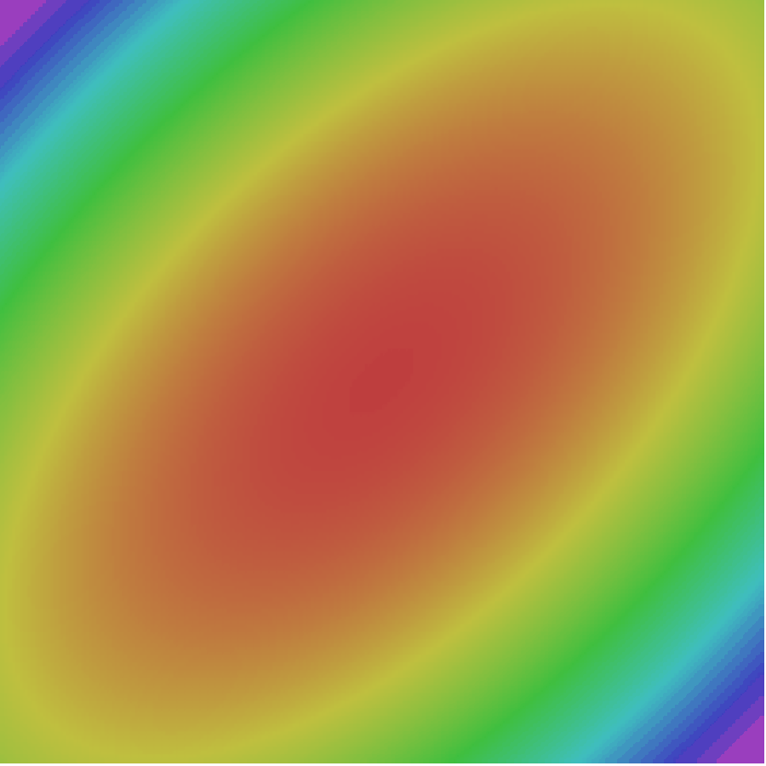
SGD + Momentum
Gradient Noise
Local Minima
Saddle points
Poor Conditioning
SGD
SGD+Momentum
Sutskever et al, “On the importance of initialization and momentum in deep learning”, ICML 2013
Slide credit: D Fouhey & J Johnson

Slide 39
Nesterov momentum

Slide 40
Question: how does scaling affect SGD?
$$x_{t+1}=x_{t}−α {grad}_{t}$$
(B)
(B) is the same loss function as (A) but the vertical axis happens to be scaled by 0.05.
(A)
How much faster does SGD move on (A)?
How much does Momentum change things?
Slide credit: D Fouhey & J Johnson

Slide 41
RMS prop: a solution to scaling

Slide 42
History of optimizers
1986 – Rumelhart – Advocates momentum for neural nets
1989 – Becker – Second-order backprop (diagonal of Hessian only)
1992 – Riedmiller – RPROP: update using the sign of momentum
2011 – Duchi – Invents Adagrad
2012 – Zeiler – Invents Adagrad
2013 – Sutskever – Advocates Nesterov (1983) momentum
2013 – Hinton – Teaches RMSProp, unpublished in a cousera course
2014 – Kingma and Ba – ADAM, world’s best intern project
2018 – Reddi – Finds bug in ADAM proof. Amsgrad fixes it.
2020 – Alacaoglu – New regret analysis for ADAM
2022 – Liu – second-order backprop (periodic samples of Hessian)

Slide 43
Optimization Flavors after SGD+Momentum
Adagrad
Adadelta
RMSprop
Divide gradient by its room mean square
Exponential moving average based RMS

Slide 44
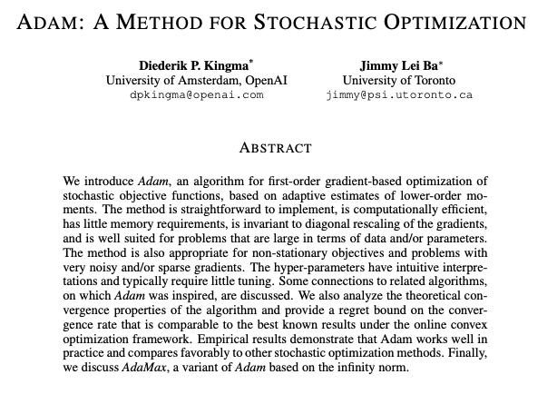
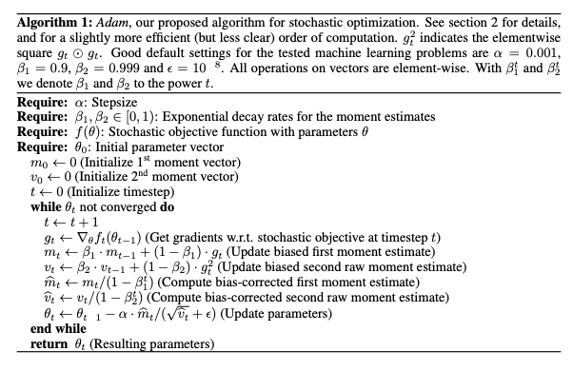
2014: Kingma and Ba propose ADAM optimizer
Plus also momentum
Plus an EMA bias correction
EMA-based RMS

Slide 45
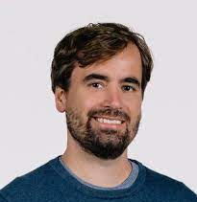
ADAM was an intern project
Diederik Kingma
Was 4th year PhD student in Amsterdam
Also earlier invented variational autoencoders
Interned at DeepMind in 2014
Early OpenAI lead; Currently at Google
Jimmy Ba
Was 1st year PhD student at Toronto
Student of Geoff Hinton
Interned at DeepMind in 2014
Currently Professor at Toronto
(154,567 citations in 9 years.... not bad for a PhD intern project!)

Slide 46
Adam

Slide 47
Questions on ADAM

Slide 48
ADAM tries to solve the wrong-learning-rate problem
Problem 1: slope ±0.5
Problem 2: slope ±50
With the same learning rate, which takes bigger steps? Which do you think _should_ take bigger steps?

Slide 49
ADAM measures the “size” of the gradient in two ways
If Mean gradient is high, what should the optimizer do ideally?
If RMS of gradient is high, what should the optimizer do ideally?

Slide 50
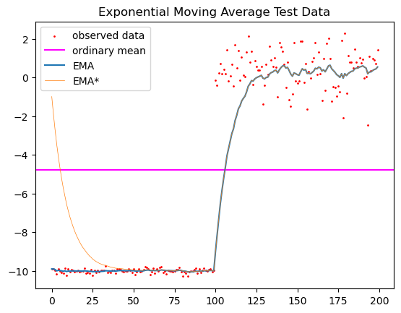
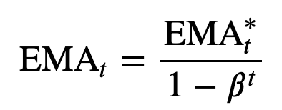
What is the role of bias correction?
Just consider the numerator – so clean!
But at early timestamps, denominator << 1

Slide 51
Proving convergence of ADAM
How to analyze an optimizer when f constantly changes?
Each step get grads on f(data, x_{t}) and we get to choose x_{t+1}.
But after each iteration, we get a new data so f(data,...) changes!
Proof strategy:
It’s hard to reason about global convergence, so
Instead reason about regret, i.e.,

Slide 52
Authoritative proof source: Alacaoglu 2020
ADAM (2014) has bugs in the proof pointed out by Reddi 2018.
Alacaoglu improves and generalizes Reddi’s proofs.
Sketch. Assume convexity and bounded changes in gradients.
actual x_{t}
convexity means g · Δx is worse than regret
oracle x
The hard part: this can get big
Easy: gradients and distances are bounded, so decay LR

Slide 53
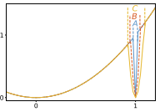
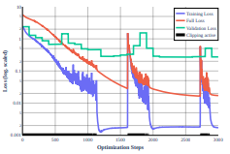
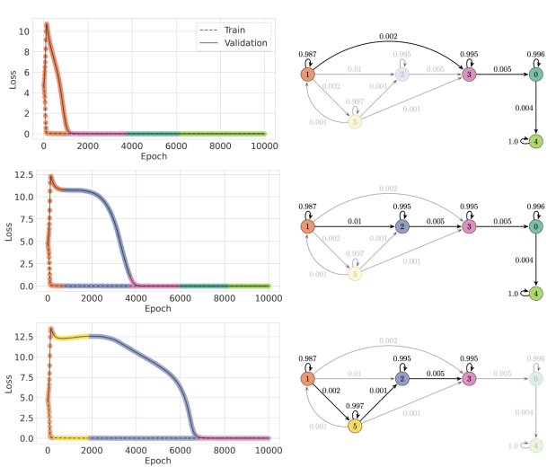
Global convergence? Generalization is the research topic
Two approaches in the literature
An ongoing debate over geometry
Some ideas about “grokking”

