Slide 1
DS 4440
Deep Learning

Slide 2
Concepts to Know So Far
McCoullough-Pitts neuron model (weighted sum then nonlinearity)
Binary logic neural networks
Universal computations (two+ layers and nonlinearities are needed)
Gradient descent
Modular machine learning: Pytorch tensors, autograd, and modules
Losses: what makes a good/bad loss; MSE, L1, and cross-entropy loss
The backpropagation algorithm: computational graphs, backward pass, upstream/internal/downstream gradients, accumulation

Slide 3
Today: Neural Network Training Part 1: Optimizers motto: don’t get stuck

Slide 4
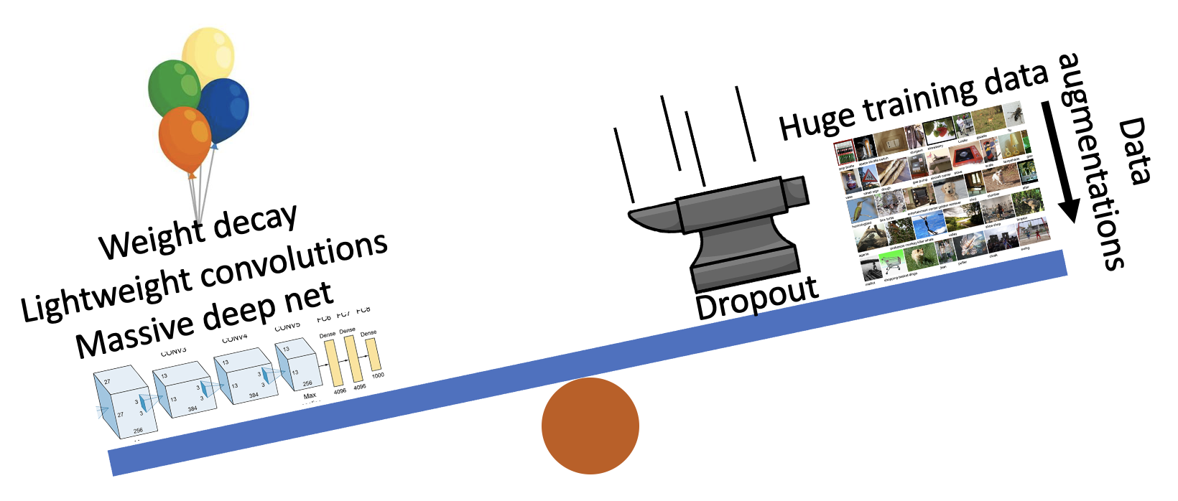
Three Big Concerns
Optimization needs to not get stuck
Generalization: avoid overfitting
Computation: learn good rules, good features

Slide 5
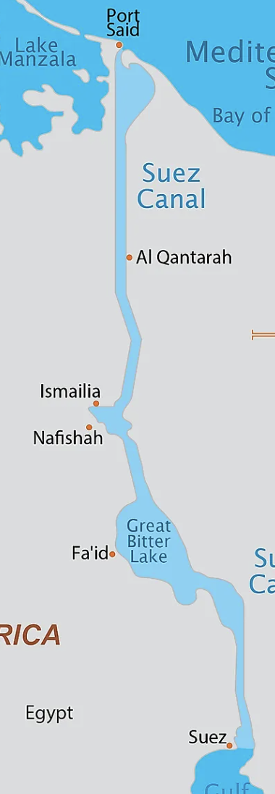
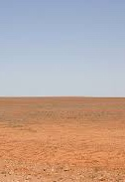
Optimization: avoid getting stuck
Two main problems
Switchbacks
Flat region

Slide 6
Optimization: avoid getting stuck
Two main problems
Several things can cause switchbacks and flat regions!
Switchbacks
Flat region

Slide 7
Zig-zag puzzle
https://bit.ly/cs7150-zigzag

Slide 8
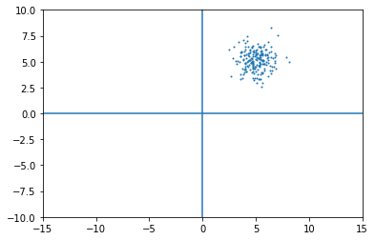
Example: What if data is not centered?

Slide 9
What if data is not centered?
if $ℒ=f(wx)$ Then what is the gradient? $$\frac{∂ℒ}{∂w}$$
All components of x are always positive

Slide 10
What if data is not centered?
if $ℒ=f(wx)$ Then what is the gradient? $$\frac{∂ℒ}{∂w}$$
Answer: $\frac{∂ℒ}{∂w}=x\frac{∂ℒ}{∂z}$

Slide 11
What if data is not centered?
if $ℒ=f(wx)$ The what is the gradient? $$\frac{∂ℒ}{∂w}$$
Answer: $\frac{∂ℒ}{∂w}=x\frac{∂ℒ}{∂z}$

Slide 12
What if data is not centered?
if $ℒ=f(wx)$ The what is the gradient? $$\frac{∂ℒ}{∂w}$$
Answer: $\frac{∂ℒ}{∂w}=x\frac{∂ℒ}{∂z}$

Slide 13
What does optimization look like?
if $ℒ=f(wx)$ The what is the gradient? $$\frac{∂ℒ}{∂w}$$
Answer: $\frac{∂ℒ}{∂w}=x\frac{∂ℒ}{∂z}$

Slide 14
What does optimization look like?
if $ℒ=f(wx)$ The what is the gradient? $$\frac{∂ℒ}{∂w}$$
Answer: $\frac{∂ℒ}{∂w}=x\frac{∂ℒ}{∂z}$
Switchbacks!!

Slide 15
Solution: Preprocessing the Data
In practice, you may also see PCA and Whitening of the data
(data has diagonal covariance matrix)
(covariance matrix is the identity matrix)
Lecture 6 - 39
Fei-Fei Li & Justin Johnson & Serena Yeung Lecture 6 - April 19, 2018
Fei-Fei Li, Andrej Karpathy, Justin Johnson, Serena Yeung

Slide 16
Question:
What about “local minima”? Is that a problem?
Switchbacks
Flat region

Slide 17
Try a stuck optimization
http://bit.ly/stuck-optim

Slide 18
Momentum also smooths bumps and valleys
Local Minimum
What if the loss function has a local minimum or saddle point?
Saddle point
Gradient is zero, SGD gets stuck
Slide credit: D Fouhey & J Johnson

Slide 19
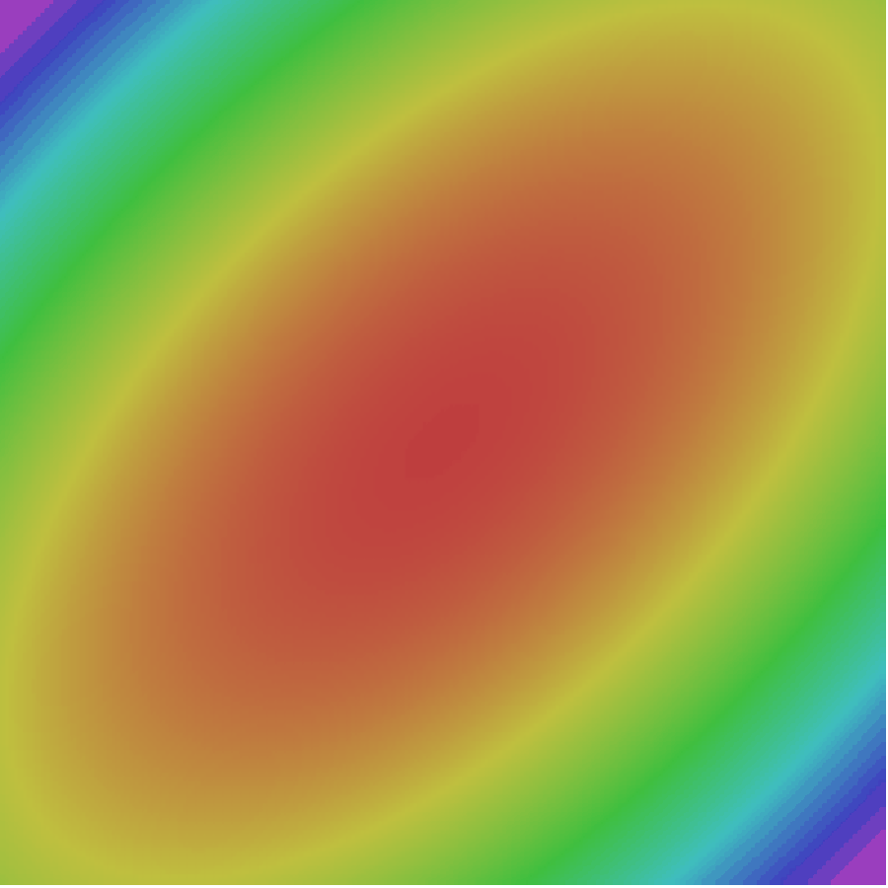
SGD + Momentum
Gradient Noise
Local Minima
Saddle points
Poor Conditioning
SGD
SGD+Momentum
Sutskever et al, “On the importance of initialization and momentum in deep learning”, ICML 2013
Slide credit: D Fouhey & J Johnson

Slide 20
Nesterov momentum

Slide 21
Try fixing stuck optimization with momentum
http://bit.ly/stuck-optim

Slide 22
Question: how does scaling affect SGD?
$$x_{t+1}=x_{t}−α {grad}_{t}$$
(B)
(B) is the same loss function as (A) but the vertical axis happens to be scaled by 0.05.
(A)
How much faster does SGD move on (A)?
How much does Momentum change things?
Slide credit: D Fouhey & J Johnson

Slide 23
RMS prop: a solution to scaling

Slide 24
Try implementing RMS
http://bit.ly/stuck-optim

Slide 25
History of optimizers
1986 – Rumelhart – Advocates momentum for neural nets
1989 – Becker – Second-order backprop (diagonal of Hessian only)
1992 – Riedmiller – RPROP: update using the sign of momentum
2011 – Duchi – Invents Adagrad
2012 – Zeiler – Invents Adagrad
2013 – Sutskever – Advocates Nesterov (1983) momentum
2013 – Hinton – Teaches RMSProp, unpublished in a cousera course
2014 – Kingma and Ba – ADAM, world’s best intern project
2018 – Reddi – Finds bug in ADAM proof. Amsgrad fixes it.
2020 – Alacaoglu – New regret analysis for ADAM
2022 – Liu – second-order backprop (periodic samples of Hessian)

Slide 26
Optimization Flavors after SGD+Momentum
Adagrad
Adadelta
RMSprop
Divide gradient by its room mean square
Exponential moving average based RMS

Slide 27
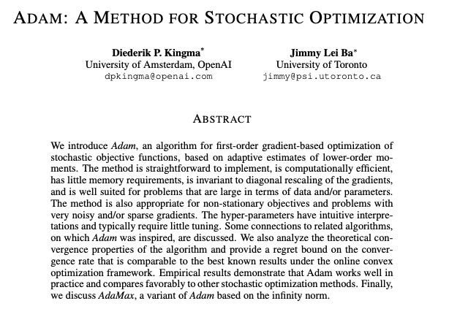
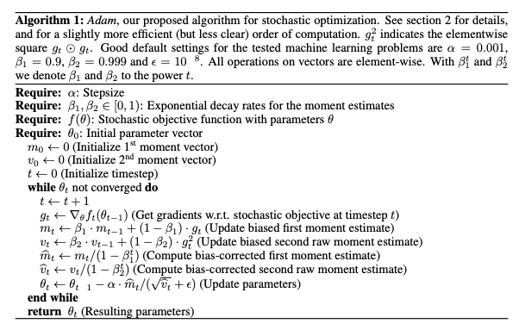
2014: Kingma and Ba propose ADAM optimizer
Plus also momentum
Plus an EMA bias correction
EMA-based RMS

Slide 28
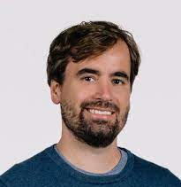
ADAM was an intern project
Diederik Kingma
Was 4th year PhD student in Amsterdam
Also earlier invented variational autoencoders
Interned at DeepMind in 2014
Early OpenAI lead; Currently at Google
Jimmy Ba
Was 1st year PhD student at Toronto
Student of Geoff Hinton
Interned at DeepMind in 2014
Currently Professor at Toronto
(154,567 citations in 9 years.... not bad for a PhD intern project!)

Slide 29
Adam

Slide 30
Questions on ADAM

Slide 31
ADAM tries to solve the wrong-learning-rate problem
Problem 1: slope ±0.5
Problem 2: slope ±50
With the same learning rate, which takes bigger steps? Which do you think _should_ take bigger steps?

Slide 32
ADAM measures the “size” of the gradient in two ways
If Mean gradient is high, what should the optimizer do ideally?
If RMS of gradient is high, what should the optimizer do ideally?

Slide 33
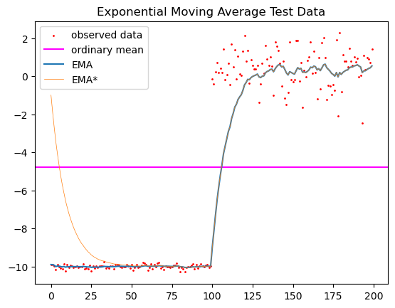
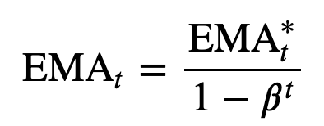
What is the role of bias correction?
Just consider the numerator – so clean!
But at early timestamps, denominator << 1

Slide 34
Proving convergence of ADAM
How to analyze an optimizer when f constantly changes?
Each step get grads on f(data, x_{t}) and we get to choose x_{t+1}.
But after each iteration, we get a new data so f(data,...) changes!
Proof strategy:
It’s hard to reason about global convergence, so
Instead reason about regret, i.e.,

Slide 35
Authoritative proof source: Alacaoglu 2020
ADAM (2014) has bugs in the proof pointed out by Reddi 2018.
Alacaoglu improves and generalizes Reddi’s proofs.
Sketch. Assume convexity and bounded changes in gradients.
actual x_{t}
convexity means g · Δx is worse than regret
oracle x
The hard part: this can get big
Easy: gradients and distances are bounded, so decay LR

Slide 36
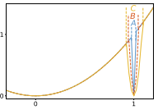
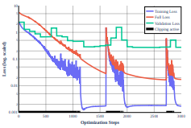
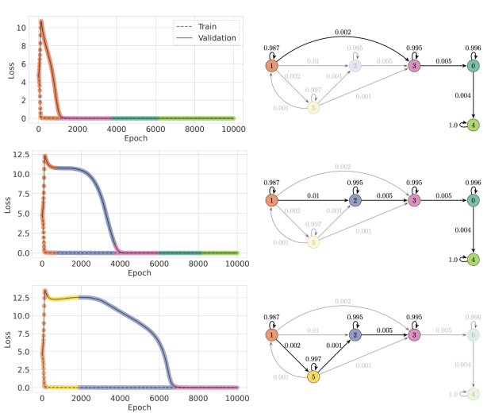
Global convergence? Generalization is the research topic
Two approaches in the literature
An ongoing debate over geometry
Some ideas about “grokking”

Slide 37
Adam

Slide 38
Discussion on Xavier Weight Initialization
https://papers.baulab.info/papers/Glorot-2010.pdf

