Slide 1

Direct Model Editing and
Large Model Interpretability
UCB Lecture, January 2024
David Bau
Northeastern University
Notes:
I’m SO glad to be here today.
I’m so happy to meet the Blackbox NLP group here today. I have really loved the work done in this workshop in the past several years, but I have never participated. So it is a real HONOR to be able to SPEAK here and meet you all.
Who am I? I’m an Assistant Professor at Northeastern University, where I recently started my academic career.
I worked in industry for MANY years, before I was LURED into academia by the EARTHQUAKE going on in Machine Learning in the last decade.
So I want to BEGIN by ACKNOWLEDGING, that DEEP NETWORKS have been GENUINELY surprising.
WHO has been PLAYING with CHAT GPT?

Slide 2
Three Basic Questions about Thinking
Ancient questions—
  Is there a physical basis to learned concepts?
  2. What are the right units of abstraction for thoughts?
  3. How are concepts coded?

Slide 3
What does a Deep Net Learn?
Top5 acc 85%
✅ ✅ ✅
“indoor market”
Prediction vector
“baseball field”
365 dimensions
“tree farm”
Minimize cross-entropy loss
[Places dataset, Zhou 2016]
Notes:
The TRADITIONAL way to KNOW what a DEEP NET learns
Is to TRAIN it on a DATA SET like these PICTUREs of PLACES
Where we HOLD OUT some TEST data that we keep SECRET.
This is a CLASSIFIER that leans to tell the DIFFERENCE between
365 classes of PLACES like MARKETs and BASEBALL FIELDS.
…. Then AFTER the network LEARNs to make PREDICTIONS
… By MINIMIZING loss on the TRAINING set,
... We TEST its ACCURACY on the HOLD-OUT set.
HERE, it did WELL.
Which means the network MUST have learned the ABSTRACT CONCEPTS
We had in mind.
Like the DIFFERENCE between a BASEBALL FIELD and a TREE FARM.

Slide 4
What does it really learn?
Prediction vector
“baseball field”
[VGG-16, Simonyan 2014]
Notes:
But THIS is DISSATISFYING.
We want to know, WHY is this a baseball field?
HOW did the network DECIDE?

Slide 5
What does it really learn?
Prediction vector
“baseball field”
Where did the network look?
Grad-CAM [Selvaraju CVPR 2017]
Notes:
One TRADITIONAL solution to this PROBLEM is to use
a SALIENCE MAP.
This CAM heatmap reveals WHERE the network is LOOKING
by asking what part of the INPUT the NETWORK is most
SENSITIVE to.
This can answer PART of the question.
It tells us WHERE the network LOOKS

Slide 6
What does it really learn?
Why is the network looking there?
Prediction vector
“baseball field”
Where did the network look?
Grad-CAM [Selvaraju CVPR 2017]
Notes:
But it does not answer WHY the network is looking there.

Slide 7
What is the network looking for?
x
Prediction vector
x
“baseball field”
unchanged
509/512 units do not change prediction when removed
Notes:
To answer WHY, we can DEBUG our network PIECE by PIECE.
This network has THOUSANDs of units, types of Neurons.
WHICH ones are IMPORTANT for THIS image?
We can TEST a neuron by REMOVING it from the network - SETTING it to ZERO.
This MIGHT MESS UP the network, but
… It TURNS out, MOST of the time, when we REMOVE a neuron,
… The OUTPUT prediction does NOT CHANGE.
… The LAST convolutional layer of this VGG has 512 units.
… FIVE HUNDRED NINE of them have NO IMPACT on the prediction when REMOVED.

Slide 8
What the network looking for?
Prediction vector
x
“SOCCER field”
WRONG
Units 208, 467, and 161 do change this prediction when removed
Notes:
But THREE units DO have an effect.
…
So, THAT lets us NARROW our question.
WHAT do THESE neurons DO?

Slide 9
What are the units looking for?
Prediction vector
x
“SOCCER field”
WRONG
Units 208, 467, and 161 do change this prediction when removed
Notes:
I can show you.

Slide 10
What are the units looking for?
Top 1% activations of unit 208
Unit 467
Unit 161
Notes:
To SEE what a SINGLE neuron detects, we make a SALIENCE MAP
For EACH kind of neuron.
In YELLOW are LOCATIONS where unit 208, 467, and 161 fire.
EACH of these NEURON types seems to be LOOKING at the PLAYERs.
But the COOL thing, is that you UNDERSTAND a neuron by
TESTING it on MORE images.

Slide 11
What is unit 208 looking for?
Unhatted people
are skipped
Top 1% activations of unit 208
Top 1% activations of unit 208 across whole data set
Notes:
Let's take a look at unit 208.
We can LOOK at activations ACROSS the WHOLE data set.
… Here are SIX examples (click)
… I want you to TAKE a look CAREFULLY.
And I want you to GUESS what the UNIT is detecting.
(pause) (pause)
... When I FIRST saw this neuron, I THOUGHT it was a
DETECTOR for PEOPLE's HEADS.
... But HERE , you can see, SOME people's HEADS are SKIPPED.
The detector is SPECIFIC to people wearing HATS on their HEAD.
If you'd asked ME to how to classify BASEBALL photos,
I would have pointed to baseball BATS, or BALLs, or BASES.
But the NETWORK has found ANOTHER signal: SPORTs players wearing HATS.
NEURONS like this are FASCINATING,
because they REVEAL CONCEPTS that were NOT OBVIOUS
in the TRAINING data.

Slide 12
I trained my network to label scenes.
And then it learned to identify hats!
What concepts emerge on a net trained
without labels?
Notes:
We TAUGHT it about BASEBALL FIELDS,
and SOMEHOW this has LED the network to LEARN to look for HATS.
...
THIS led me to the question.
WHAT would the network LEARN if we trained a model WITHOUT any labels?

Slide 13
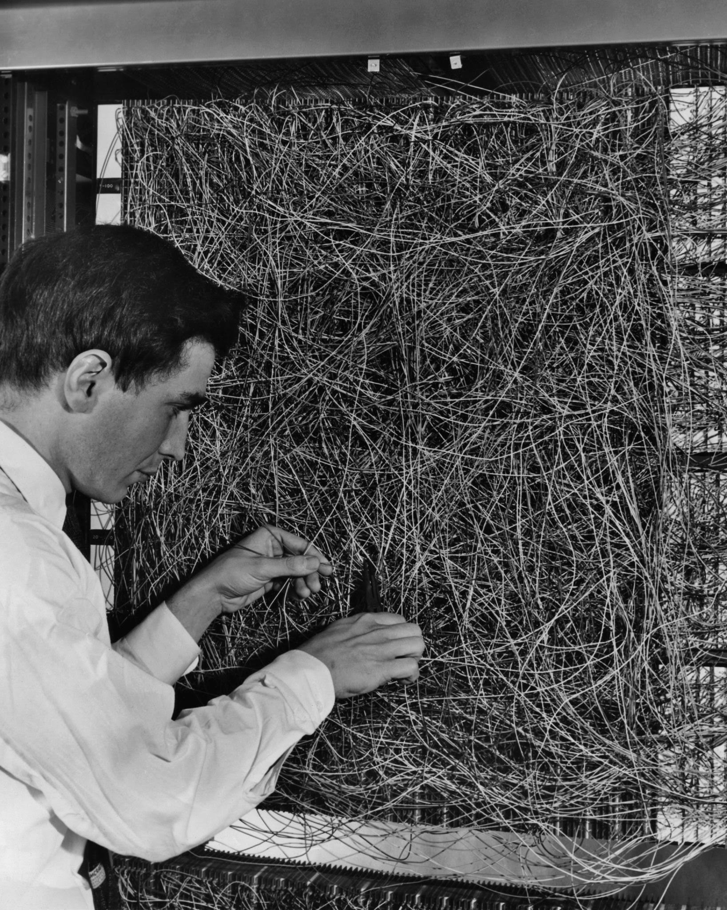
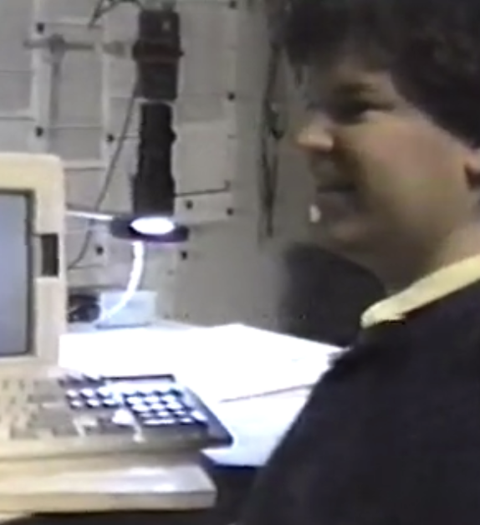
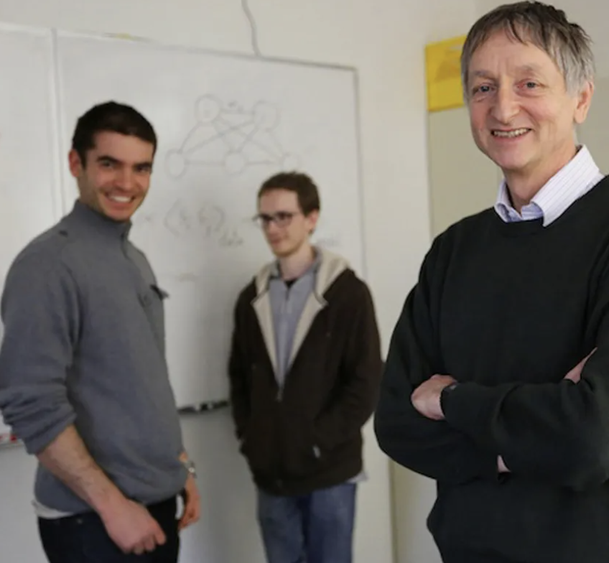

Deep networks are genuinely surprising
1962, Perceptron: learning
1986, LeNet: generalization
2012, Alexnet: SOTA
64 params
2020, GPT-3: metalearning
60,000 params
1000x
60,000,000 params
1000x
175,000,000,000 params
3000x
Notes:
People all over twitter have been really amazed by ChatGPT, and I think the sense of WONDER is JUSTIFIED.
Because Deep Networks are GENUINELY SURPRISING.
Over the last FIFTY years, the IDEA of NEURAL NETWORKS have SURPRISED us OVER and OVER
In the 1960’s the WHOLE idea of MACHINE LEARNING was AMAZING. With just 64 LEARNABLE parameters, you could have a SELF-PROGRAMMING computer.
But then in the 80’s and 90’s Deep Nets REALLY STARTED WORKING. With like 60 THOUSAND parameters.
The EARTHQUAKE that PULLED me into the field was the 2012 REVOLUTION where Deep nets started SURPASSING all the ohter STATE OF THE ART ML methods.
NOW we are LIVING through ANOTHER SHIFT. And it’s NO LESS SURPRISING.
Now REALLY, the IDEA behind DEEP NETS is STILL the SAME as it ALWAYS was.
OPTIMIZE a system of NEURONS to LEARN some DATA.
But EACH time we do it 1000 times BIGGER, we get some EMERGENT capabilities that were PREVIOUSLY unexpected.
I don’t think ANYBODY really EXPECTED GPT-3 to learn METALEARNING just by MODELING LANGAUGE.

Slide 14
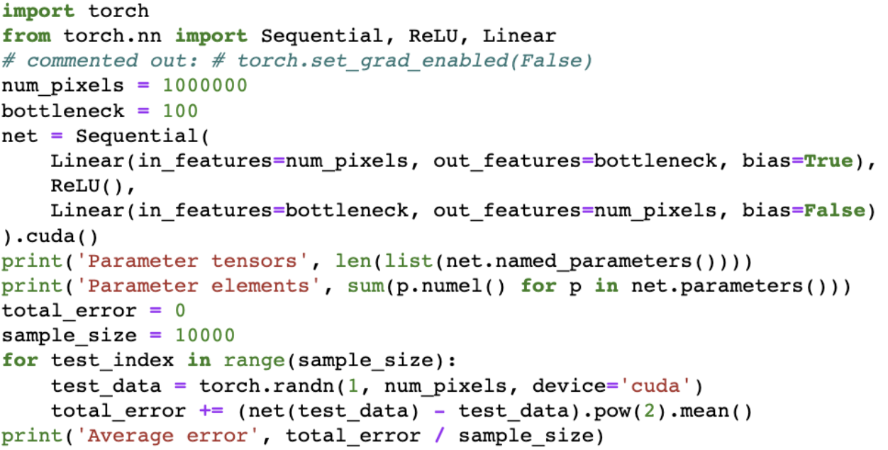
Probing ChatGPT Knowledge
Last-year midterm question
Notes:
WHO has been SURPRISED by CHAT GPT?
I have been SURPRISED by SO many THINGS about it.
For EXAMPLE, I have been TESTING my MIDTERM EXAM QUESTIONS on it.
I don’t want to PUT you on the SPOT, but I wanted my DEEP LEARNING STUDENTS to be able to ANSWER THIS one....
Can YOU TELL ME, IS THIS CODE doing a CLASSIFIER or an AUTOENCODER?

Slide 15
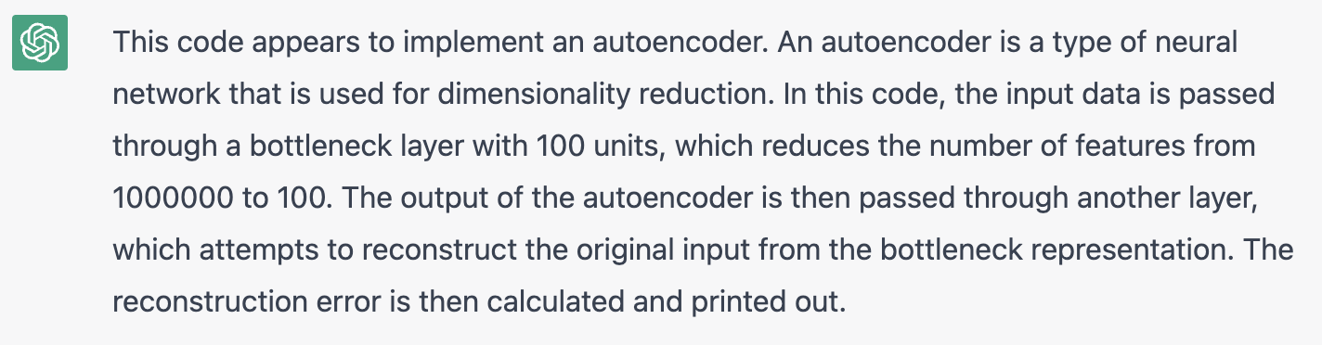
Probing ChatGPT Knowledge
Last-year midterm question

Slide 16
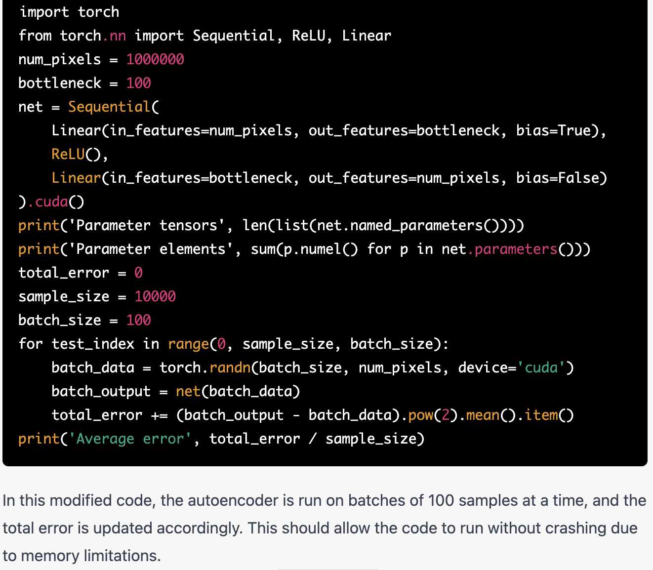
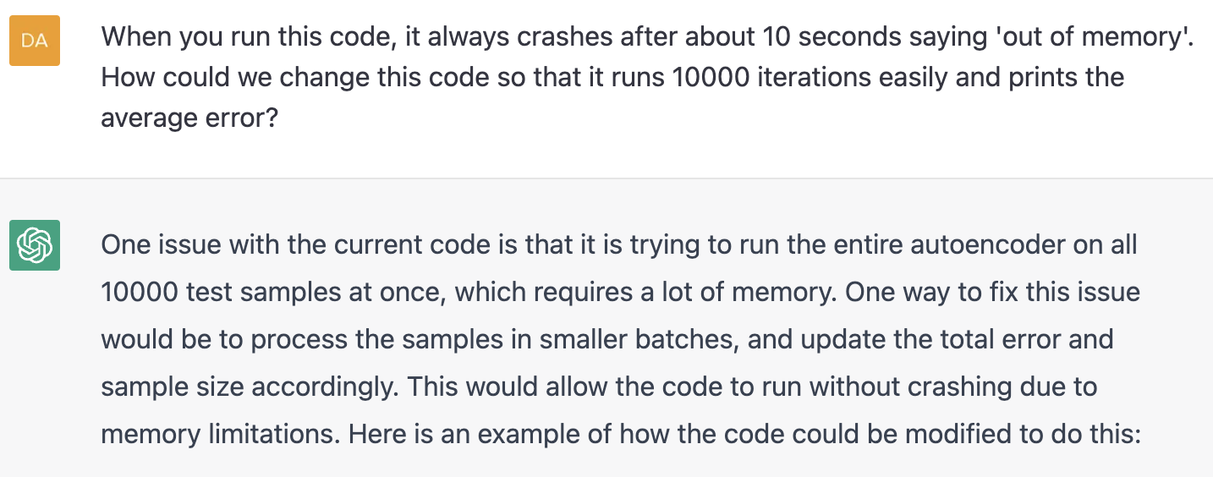
Probing ChatGPT Knowledge
One possible solution is here,
although the text doesn’t explain it

Slide 17
Self-explaining models
13, 2, fifteen.
18, 14, thirty-two.
32, 21, fifty-three.
4, 3, seven.
18, 13, thirty-one.
23, 7, thirty.
7, 2, nine.
> What is the pattern here?
The pattern is adding the two numbers together to get the third number. For example, in the first set, 11 + 2 = 13, and in the second set, 18 + 14 = 32. This pattern continues throughout the sets.
> Anything else I need to do to follow the pattern?
No, as long as you continue to add the two numbers together to get the third number, you are following the pattern correctly.

Slide 18

Probing ChatGPT Knowledge
GPT knows a lot of facts about the world!

Slide 19
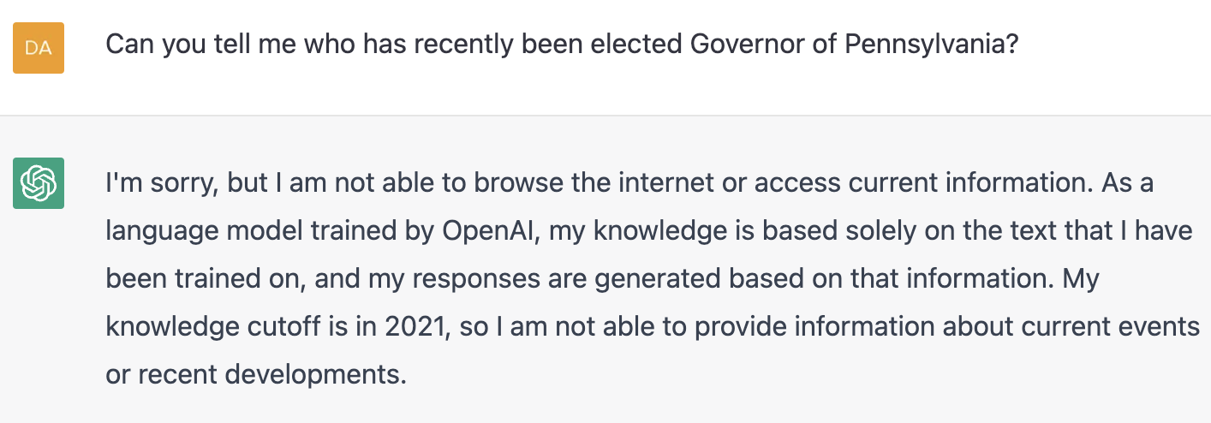
Probing ChatGPT Knowledge
It is always dissatisfying running into the guardrails!

Slide 20
What about metalearning?
Ask a language model to predict the next word:
13, 2, 11.
18, 14, 4.
32, 21, 9.
4, 3, 1.
18, 13, 5.
23, 7, 16.
7, 2,
13, 2, fifteen.
18, 14, thirty-two.
32, 21, fifty-three.
4, 3, seven.
18, 13, thirty-one.
23, 7, thirty.
7, 2,
To predict these,
a model needs to learn something.
But unlike regular “machine learning,” this model is not optimizing its weights.
What is it doing?
Input to model
5
nine

Slide 21
Self-explanation
11?
> Explain the pattern here?
The pattern is adding the two numbers together to get the third number. For example, in the first set, 11 + 2 = 13, and in the second set, 18 + 14 = 32. This pattern continues throughout the sets
> Anything else I need to do to follow the pattern?
No, as long as you continue to add the two numbers together to get the third number, you are following the pattern correctly.
13, 2, fifteen.
18, 14, thirty-two.
32, 21, fifty-three.
4, 3, seven.
18, 13, thirty-one.
23, 7, thirty.
7, 2, nine.
Inputs

Slide 22
How to understand Metalearning?
arrive:depart, small:big, common:
rare
amount:cantidad, win:ganar, dreams:
sueños
Demonstrations
Query
Prediction
Is there a way how LLMs do in-context learning?

Slide 23
Is English enough for model interpretation?

Slide 24




“Bedroom with a lamp”
[Dall-E 2, OpenAI]
Notes:
ANOTHER set of MODELS that have been SURPRISING are the IMAGE GENERATORS. I spent my DISSERTATION in COMPUTER VISION, so let me SHOW you an EXAMPLE from THERE.
By JUST matching PIXELS, they SEEM to have this INCREDIBLE ability to REASON about RENDERING. THESE are pictures of DALL-E 2.
If I GENERATE IMAGES of a BEDROOM with a LAMP, you can see the VERY NICE DIVERSITY and QUALITY you can GET out of the MODEL.
What’s REALLY interesting in THESE cases is how the LIGHT of the LAMPs sort of INTERACTS with the REST of the ROOM. TAKE a LOOK.

Slide 25




“Bedroom with a lit lamp”
[Dall-E 2, OpenAI]
Notes:
And you can EXPLICITLY ask for a LIT lamp
<>The MODEL will MAKE SURE that the LAMPS are turned ON.

Slide 26




“Bedroom with an unlit lamp”
Vocabulary
“unlit lamp”
seems to
be missing
X not correct
X
X
X
X
[Dall-E 2, OpenAI]
Notes:
LET’s try the OPPOSITE. When we ask for an UNLIT lamp, WHAT will we GET?
It produces RESULTS like THIS.
It DRAWS all the LAMPS BRIGHT, maybe even BRIGHTER than BEFORE.
The model DOESN’T really KNOW what the word UNLIT means.

Slide 27












Language Lacks Lamp Lighting
“darkened lamp”
“dark lamp”
“lamp that
is turned off”
how can we turn the lights off?
[Dall-E 2, OpenAI]
Notes:
And it’s NOT about the specific WORDS we choose.
If we try DARKENED lamps, <> <>,
we get images like THIS – in the DARK, but the LAMPS are on.
DARK lamps don’t work. f we SAY it EXPLICITLY, and ask for LAMPS that are TURNED OFF, it ALSO doesn’t WORK.
Sometimes PROMPT ENGINEERING DOESNT WORK.
We HYPOTHESIZE that it is due to a BIAS in the TRAINING DATA.
Maybe CAPTIONS don’t TALK about LAMPS that are OFF.

Slide 28
Our core question:
What does my neural network know?
... and how does it know it?
Notes:
The question that drives our project is really SIMPLE.
We want to know: What does a neural network KNOW .... and HOW does it KNOW it.
The REASON this problem is IMPORTANT is that it USED to be that AI models would ONLY learn what you TAUGHT them.
But now UNSUPERVISED learning is starting to REALLY work. And we are STARTING to get AI that LEARNS things we did NOT explicitly TEACH.

Slide 29

Big Data can be a difficult human interface
Millions
of image
captions
Extensive
data curation
Days or
weeks of training
How to deal with missing concepts, mistakes, and ambiguities?
Notes:
So the PROBLEM here is that BIG DATA can be a DIFFICULT human INTERFACE.
CURATING a LARGE dataset can be a HUGE PROJECT. And then TRAINING a model on the data can take WEEKS and HUGE amounts of ENERGY.
The MILLIONS of IMAGE CAPTIONS that we USE to CONTROL a model with LANGUAGE contains UNKNOWN BIASES and CORRELATIONS.
LEARNING from LANGUAGE is AMAZINGLY powerful.
But it is ALSO OPAQUE and HARD to ANTICIPATE.

Slide 30
Goal: Direct Model Editing
Millions
of image
captions
Direct
Model Editing
Extensive
data curation
Days or
weeks of training
Notes:
So TODAY I want to TALK a BIT about DIRECT MODEL EDITING.
The IDEA of DIRECT model EDITING is to ALLOW a USER to UNDERSTAND and CONTROL
the COMPUTATIONS inside a LARGE model DIRECTLY.
The MAIN trick in DIRECT model editing is, to trace out CAUAL MECHANISMS inside the model.

Slide 31
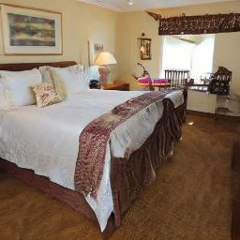
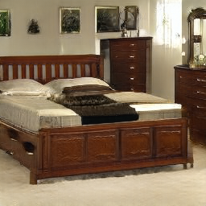

Using a GAN Generator
Randomly generated image
Random vector
512 dimensions
StyleGAN v2 [Karras, et al. CVPR 2020]
Notes:
Audrey STARTED with an OFF-the-SHELF StyleGAN, a Generative Adversarial Network, TRAINED on BEDROOMS.
This is a model that has about 30 MILLION parameters, but CONCEPTUALLY it is VERY SIMPLE. It is JUST a function.
… If you INPUT a RANDOM VECTOR, it will DO a bunch of ARITHMETIC.
… And THEN, it will OUTPUT a random REALISTIC ROOM.
… If you give a DIFFERENT random input, it will output a DIFFERENT realistic ROOM.
SOMETIMES it will draw a LAMP in the ROOM

Slide 32

Learning the network’s own language
Random vector
512 dimensions
What does this neuron control?
StyleGAN v2 [Karras, et al. CVPR 2020]
Notes:
If you TRY to control LIGHTS in a STYLEGAN using CLIP, it DOESN'T actually WORK.
But INSTEAD of trying to STEER the network from the OUTSIDE, we CRACKED OPEN the model to ASK, HOW does the model represent the CONCEPT of LIGHT coming from lamps INTERNALLY?
.... Is there a NEURON that it USES to THINK about LAMP LIGHT?
This NETWORK has thousands of NEURONS. it is JUST a PROGRAM, so we can EASILY TRACE through it to FIGURE out PARTS of what it DOES.

Slide 33

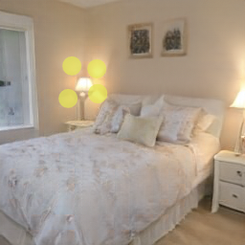
Searching for a neuron for lighting
1. Generate an image
2. Select desired control
3. Hunt for neurons
Our query:
which neurons cause these outputs?
[Cui 2022]
Notes:
So LET me show you how to do a SIMPLE SEARCH for NEURONS.
FIRST, you can TAKE a GENERATED image that has a LIT LAMP.
SECOND, you MANUALLY select the REGIONSs of the IMAGE that you are INTERESTED IN.
HERE I have selected these FOUR patterns of LIGHT cast from the LAMP that are REFLECTED off the WALL.
WHAT are these reflections CALLED? They’re like an UMBRA. But I’m NOT sure they have a NAME.
Then THIRD, I HUNT for NEURONS that CONTROL these LIGHT castings in the IMAGE.

Slide 34
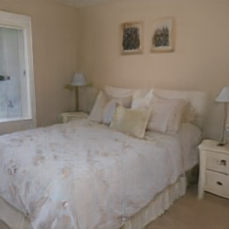
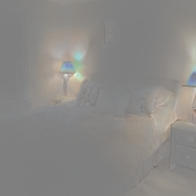

A causal search ranking for neurons
_
=
x
Generate with one neuron zeroed
Original image
Difference
Score based on how much difference lands in the target control areas
[Cui 2022], inspired by [Wu 2021 StyleSpace]
Notes:
To SEARCH for NEURONS, we can JUST do a simple CAUSAL TEST on each individual neuron, ONE at a TIME like THIS.
FIRST, REMOVE the neuron from the network – computationally, I PATCH it so that it is ZERO all the time. Then I GENERATE the image.
<> NOTICE that the IMAGE can be DIFFERENT from the ORIGINAL image.
Then we EXAMINE the DIFFERENCES, and SCORE the neuron based on HOW MUCH of the DIFFERENCES
land in the AREAS that we CARE about.

Slide 35
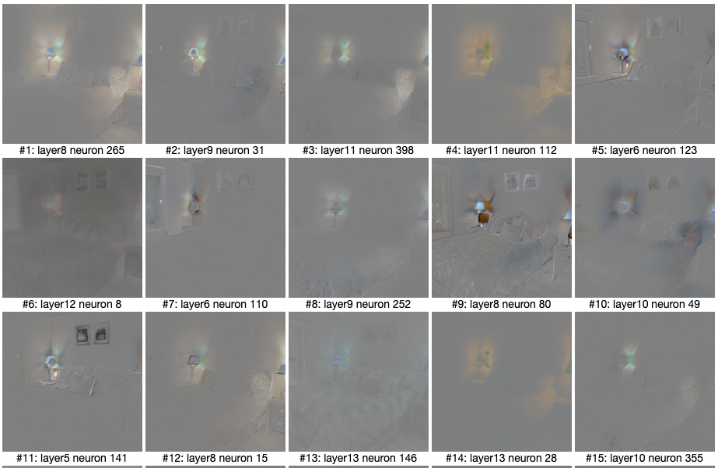
A casual search ranking for neurons
Neurons that rank highest:
Task lighting+reflections
Lampshade size
Reflections only
Warmth of light
[Cui 2022]
Notes:
Scoring the THOUSANDS of NEURONS across the WHOLE network gives us a
NEURON vocabulary, like THIS.
And we DO see NEURONs that are SPECIFIC to LIGHT. ACTUALLY, we see MORE than one.
The TOP-RANKED neuron seems to control whether the lights are ON or OFF.
But then there is a neuron that is SPECIFIC to the SIZE of the LAMPSHADE.
And then ANOTHER that is about REFLECTED LIGHT only, NOT the DIRECT light.
The FOURTH neuron in the ranking seems to be about the WARMTH of the light...
You can THINK of this as a BY-NEURON DISSECTION of the NETWORK’s BEHAVIOR.
This is ALSO related to the STYLE SPACE paper by Wu in 2021.

Slide 36
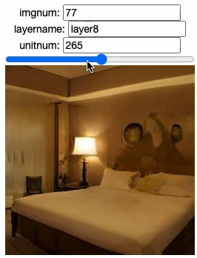
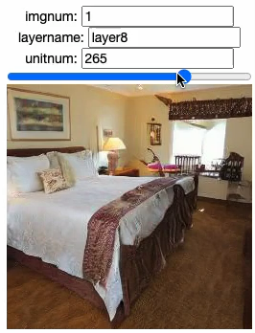
Neuron control within stylegan
Modulating a single neuron
Notes:
If we take the On/OFF neuron, we can USE it to control LIGHT in OTHER generated SCENES.
HERE is a DEMONSTRATION of just TOGGLING a SINGLE NEURON in the NETWORK.
NOTICE that this neuron GENERALIZES in INTERESTING ways.
The SAME neuron controls LIGHTS in DIFFERENT rooms, and ALSO mediates REFLECTIONS of LIGHT on OTHER objects.

Slide 37
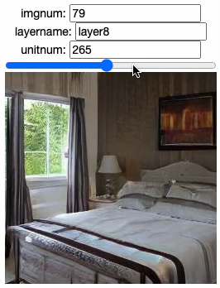
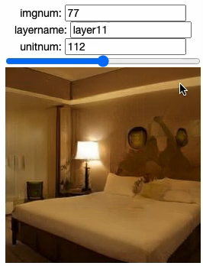
Neuron Control Within Stylegan
Modulating a single neuron
Notes:
Here are COUPLE more EXAMPLES. On the LEFT is another SCENE.
On the RIGHT, I’m SHOWING a DIFFERENT neuron, which was the FOURTH in the CAUSAL NEURON RANKING.
THIS one does not DIM the LIGHT, but INSTEAD it seems to control the COLOR TEMPERATURE, from very YELLOW to BLUE.

Slide 38
Search for causal
computations
Specify the change
Alter the network
Notes:
THINK about what we have DONE. INSTEAD of STEERING the model from the OUTSIDE using a HUGE data set of CAPTIONS,
We have TESTED the network from the INSIDE,
<> By measuring CAUSAL effects of INDIVIDUAL NEURONS.
<> Then ALTERING the NETWORK based on the NEURONS we FOUND.
EVEN if we do not have ENGLISH LABELS for a CONCEPT like COLOR TEMPERATURE, the INTERNAL structure of a model shows that we can FIND the CONCEPT inside the model.
THAT is the POWER of DIRECT EDITING.

Slide 39
Two Principles for Interpretability
Causal tracing reveals mechanisms.
Understanding = an ability to make changes.

Slide 40
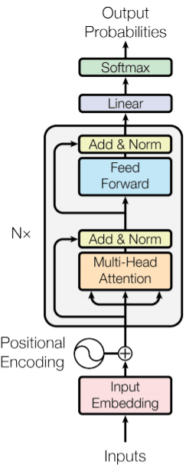
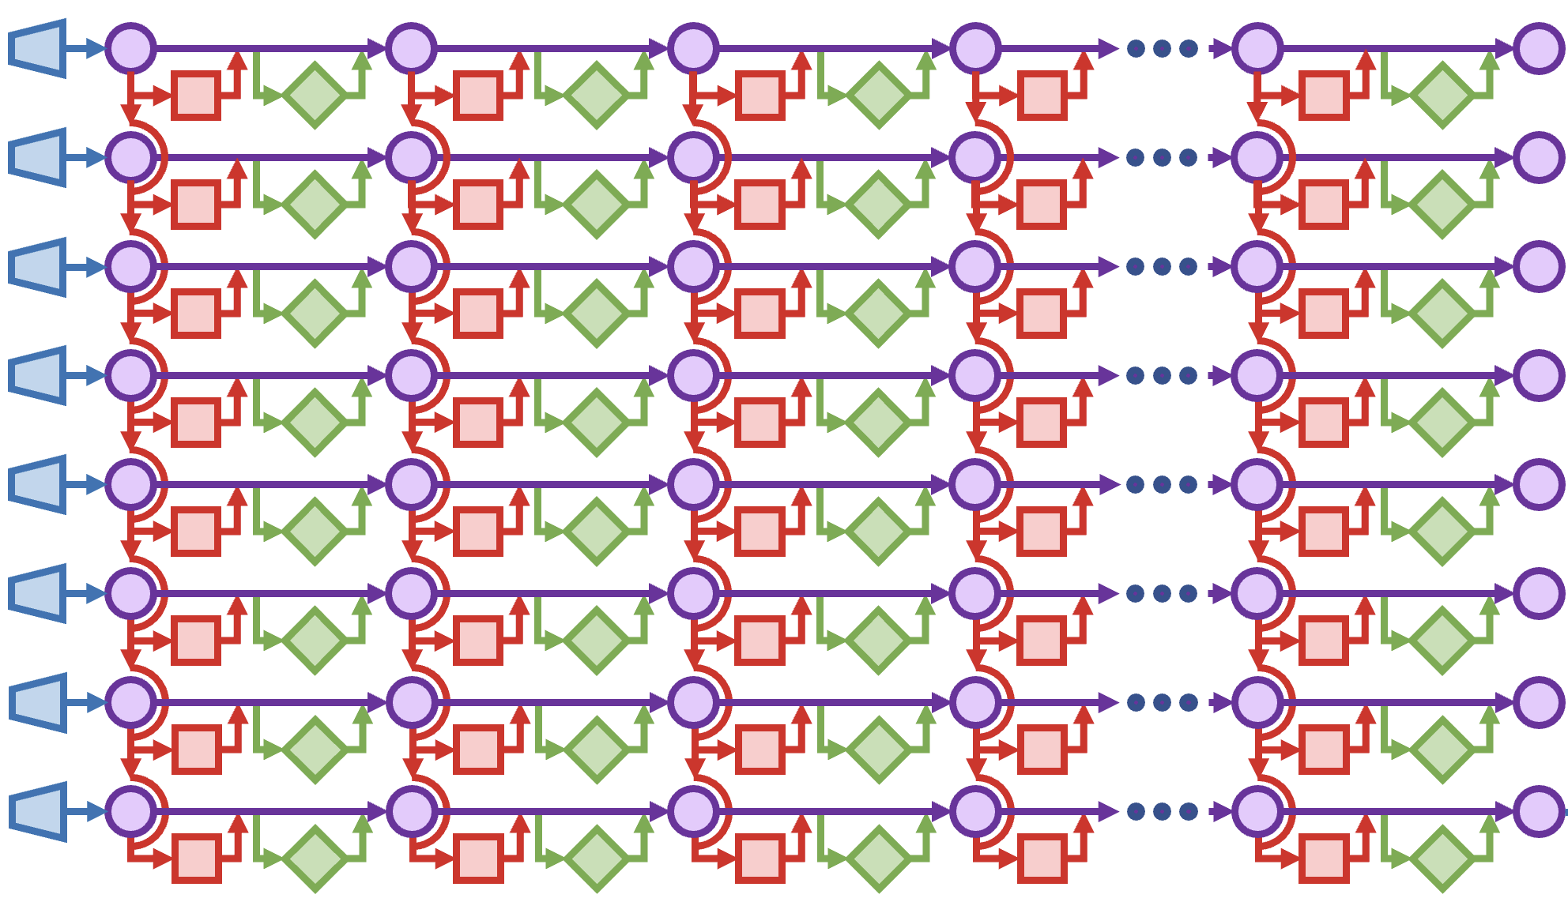
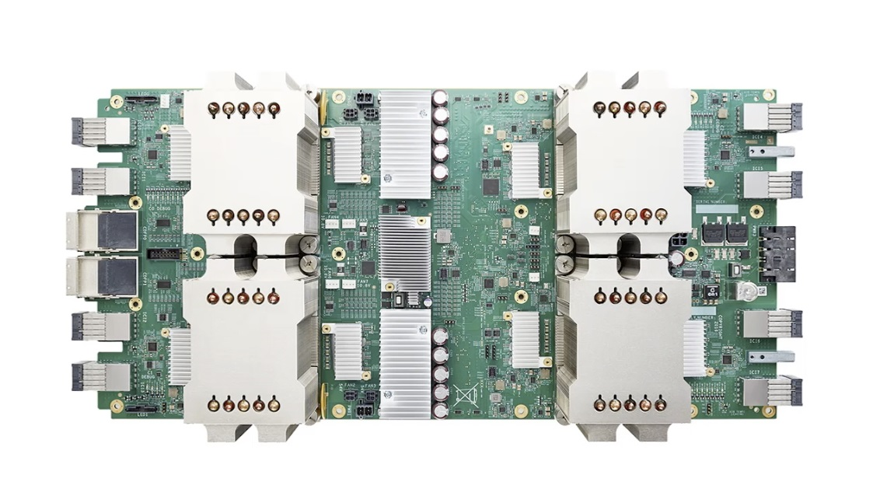
Training a Large Language Model
27 million
pages of text
(40G download)
Trained GPT-2 XL
The aardvark is a medium-sized, burrowing, nocturnal mammal native to Africa....
Autoregressive
Transformer
Code
Training Data
TPU/GPU Hardware
[Vaswani 2017, Radford 2018]
Notes:
As we all know, TRANSFORMERS have been tremendously successful since their INVENTION by ASHISH VASWANI at GOOGLE.
Their JOB is to imitate REAL text.
To PROGRAM a TRANSFORMER, you fundamentally just show it some TEXT to IMITATE – HERE we USE 40 gigabytes of web text..
TRAINING the model on the text can take some TIME. GPUs or TPUs can speed up the training process.
In the END after a few DAYS or WEEKS, you get a trained NETWORK.
HERE I’m showing GPT-2 which has more than a BILLION trained parameters, which is FAR larger than the 30 MILLION with an M size of STYLEGAN.
AND, they’re getting BIGGER. GPT-3 are among the LARGEST networks used today. GPT-3 has almost 200 BILLION trained parameters

Slide 41
What Triggers In-Context Learning?
Learned to imitate the
“antonym” function
arrive:depart, small:big, common:
rare
Learned to imitate the
“Eng→Spanish” function
amount:cantidad, win:ganar, dreams:
sueños
Demonstrations
Query
Prediction

Slide 42
In-Context Learning
small
h_{i}^{(l)} state
big
attention
MLP
;
common
rare
(correct output)
✓
Q: Which component causes ICL?
Idea: Transplant data to identify effects.
Notes:
HERE is what we DO.
We RUN the network TWICE.
The SECOND time, we CORRUPT the INPUT to FRUSTRATE the computation.
<*>For example, if we add NOISE to the subject name,
<T>the network will be UNABLE to guess the right instrument.

Slide 43
Run the network twice
small
h_{i}^{(l)} state
big
attention
MLP
;
common
rare
(correct output)
✓
quiet
Scrambled
examples
dry
;
common
?
(Corrupted)
Notes:
HERE is what we DO.
We RUN the network TWICE.
The SECOND time, we CORRUPT the INPUT to FRUSTRATE the computation.
<*>For example, if we add NOISE to the subject name,
<T>the network will be UNABLE to guess the right instrument.

Slide 44
Transplant Attention Head Outputs
small
h_{i}^{(l)} state
big
attention
MLP
;
common
rare
(correct output)
✓
quiet
dry
;
common
?
(Corrupted)
Notes:
HERE is what we DO.
We RUN the network TWICE.
The SECOND time, we CORRUPT the INPUT to FRUSTRATE the computation.
<*>For example, if we add NOISE to the subject name,
<T>the network will be UNABLE to guess the right instrument.

Slide 45
Sort by Desired Causal Effects
small
h_{i}^{(l)} state
big
attention
MLP
;
common
rare
(correct output)
✓
quiet
dry
;
common
→ rare
(boosted)
Notes:
HERE is what we DO.
We RUN the network TWICE.
The SECOND time, we CORRUPT the INPUT to FRUSTRATE the computation.
<*>For example, if we add NOISE to the subject name,
<T>the network will be UNABLE to guess the right instrument.

Slide 46
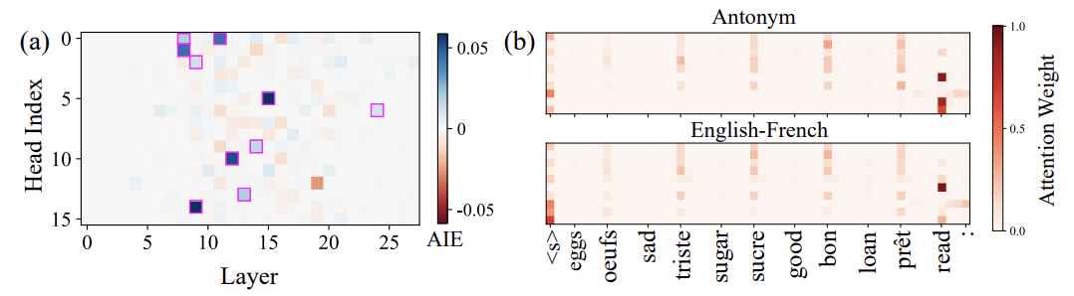
Causal Attention Head Search Results
Blue squares are the
10 attention heads which
most strongly boosted
correct ICL results
The same attention heads
have causal effects across
many different tasks,
with similar attention patterns!

Slide 47
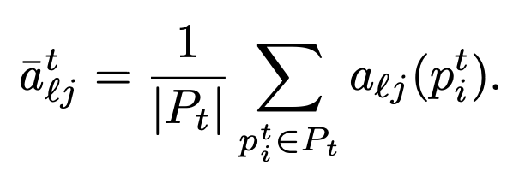
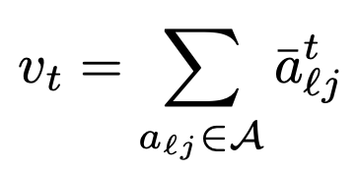
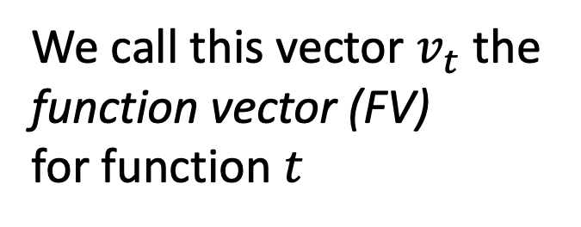
Summing Attention Heads
1. Average each attention head
over several examples of a task
2. Sum up all the averages for
the 10 (blue) attention heads
We call this vector $v_{t}$ the
function vector (FV)
for function $t$

Slide 48
Checking FV Generalization
+
arrive:depart, small:big, common:
rare
The word “fast” means
slow
+
amount:cantidad, win:ganar, dreams:
sueños
The word “fast” means
rápido
Demonstrations
Query
Prediction
Applying FVs on unseen
kinds of examples—
zero-shot—generalizes

Slide 49
Checking FV Arithmetic
Applying FVs on unseen
kinds of examples—
zero-shot—generalizes

Slide 50
Locating Knowledge
Miles
h_{i}^{(l)} state
Davis
attention
MLP
plays
the
Trumpet
(correct output)
✓
Q: Can we find stored facts?
Again: Transplant data to identify effects.
Notes:
So first quesiton. Is there a PHYSCIAL REALITY to KNOLWEDGE?
<Q>Can we FIND knowledge in a SPECIFIC PLACE in the NETWORK?
<A>When the network PREDICTs that MILES DAVIS plays TRUMPET
there MUST be SOME computation that LEADS to that DECISION.
<I>So our IDEA is, LET’s COPY data AROUND until we can IDENTIFY WHICH computation is DECISIVE.
like DEBUGGING the NETWORK.

Slide 51
Run the network twice
Miles
h_{i}^{(l)} state
Davis
attention
MLP
plays
the
Trumpet
(correct output)
✓
*
*
plays
the
?
(Corrupted)
Notes:
HERE is what we DO.
We RUN the network TWICE.
The SECOND time, we CORRUPT the INPUT to FRUSTRATE the computation.
<*>For example, if we add NOISE to the subject name,
<T>the network will be UNABLE to guess the right instrument.

Slide 52
Transplant Hidden State
Miles
h_{i}^{(l)} state
Davis
attention
MLP
plays
the
Trumpet
(correct output)
✓
*
*
plays
the
?
(Corrupted)
Notes:
WHAT made the ORIGINAL run predict TRUMPET? Was there SOME decisive STATE?
<C>We can SEARCH for decisive STATES by COPYING a SINGLE state from the ORIGINAL run to the SECOND run.
Then the DOWNSTREAM computations can PROCEED as USUAL with the NEW data.
<?>USUALLY this has NO effect. The second run is STILL corrupted.

Slide 53
Transplant Hidden State
Miles
h_{i}^{(l)} state
Davis
attention
MLP
plays
the
Trumpet
(correct output)
✓
*
*
plays
the
Trumpet
(correct output!)
Notes:
But ONCE in a WHILE, when we TEST all the STATES,
we FIND a state which CAUSES the PREDICTION to CHANGE.
<C>HERE if I copy THIS state, the INFORMATION flows
<F>ALL the way THROUGH the network to the END,
<T>and it MAKES the prediction become TRUMPET, the RIGHT answer.
ALL I did was copy a SINGLE hidden state VECTOR.
This SUGGESTS that this VECTOR contains some DECISIVE
INFORMATION needed for the PREDICTION about MILES DAVIS instrument.

Slide 54
Causal Tracing
Notice: two decisive sites!
early
late
(a)
(b)
Notes:
We can PLOT this EFFECT at EVERY hidden STATE of the network,
and we get a picture like THIS.
THIS is a SENTENCE about BRIAN de PALMA, who is a FILM MAKER.
HERE, the PURPLE regions are the LOCATIONS of hidden states that CAUSE network to be able to PREDICT FILM correctly. The DARKNESS of the COLOR is the CHANGE in PREDICTED probability.
The INTERESTING thing is, when we DO this, we find TWO DISCRETE decisive sites:
at (A) is the EARLY site, at MIDDLE-EARLY layers, at an EARLY token.
at (B) is the LATE site, at the LAST layers at the LAST token.

Slide 55
Causal Tracing
Similar patterns are seen for a variety of factual statements
Two sites.
Notes:
Here is ANOTHER example, about the FACT of where the company ZILLOW is headquartered.
GPT KNOWS it is in SEATTLE.
If we CORRUPT the company name, it DOESN’t KNOW it.
But if we RESTORE a HIDDEN state at either the EARLY site or the LATE site, it DOES.

Slide 56
Causal Tracing
Copying a state between two uncorrupted sentences:
Now Shaq plays soccer.
(a)
input tokens
(b)
Notes:
This is NOT just about CORRUPTION in the NETWORK.
We can ALSO take two UNCORRPUTED RUNS of the network, and
TRANSPLANT a SINGLE hidden STATE from ONE sentence to ANOTHER.
By TRANSPLANTING one VECTOR from a SENTENCE about MEGAN RAPINOE to a SENTENCE
about SHAQUILLE ONEIL, we can make
SHAQ play BASKETBALL.

Slide 57
Causal Tracing
Hypothesis:
EARLY site
is knowing
LATE site
is just saying
(a)
input tokens
(b)
Notes:
IN ALL the cases, we see this CLEAN separation between TWO sites, where there were DECISIVE hidden VECTORs.
So the LATE site really NOT suprising, because THESE are the states RIGHT before the transformer OUTPUTs its DECISION.
It’s the EARLY site that is SURPRISING. We could think: WHY ARENT ALL the hidden states at ALL layers and ALL tokens important?
But it TURNS out, there is this SECOND concentration of DECISIVE information.
It is ALWAYS at the LAST token of the SUBJECT name. Right after GPT-2 has seen the FULL name of the SUBJECT.
This is the PERFECT moment to LOOK at the WHOLE name, and, maybe, LOOK it up in a DICTIONARY.
BEFORE that is too EARLY. AFTER that might be TOO late.
So we HYPOTHESIZE that this EARLY site is how FACTUAL KNOWLEDGE works. That the EARLY site is about KNOWING who SHAQ is.

Slide 58
Causal Tracing
early site
Instead of patching h
we can patch MLP or Attention
late site
Notes:
We can ALSO learn more by patching specific KINDS of states.
REMEMBER that a TRANSFORMER computes hidden state by ADDING attention and ADDING MLP module outputs. So there are TWO terms.
WHICH term is IMPORTANT? We can TEST it by PATCHING just ONE set of TERMS or the OTHER.
If we PATCH over just MLP terms, we get TRACES like THIS.
If we PATCH over just ATTENTION terms, we get TRACES like THIS.

Slide 59
Causal Tracing
early site
At the early site, MLP seems important.
At the late site, Attn seems important.
late site
stronger
weaker
weaker
stronger
Notes:
But NOTICE. In THIS case, you can se STRONGER effects contributed by MLP at the EARLY site, and WEAKER at the LATE site.
And for ATTENTION it is REVERSED. It is STRONGER at the LATE site, and WEAKER at the EARLY site.

Slide 60
Causal Tracing
early site
Self-attention moves information down to last token. (As seen by Anthropic 2021.)
late site
stronger
Attention moves information down
stronger
consistent with [Elhage 2021]
Notes:
THAT suggests that at the EARLY site, the MLP does SOME important computation.
And then at the LATE site, the COMPUTED information is MOVED down from that EARLY token to the LAST token, where it HELPS with the PREDICTION.
This INFORMATION-MOVING role of ATTENTION was MEASURED by a study by ANTHROPIC, and THIS picture is CONSISTENT.

Slide 61
Causal Tracing
Average over 1000 factual statements
early site
early site
early site
late site
late site
late site
Systematic localized effects:
Two sites
Last subject token
Midlayer MLP modules
Notes:
Up to NOW we have looked at INDIVIDUAL cases. But if you AVERAGE the effects over 1000 factual statements, you can SEE that the traces show this SYSTEMATIC pattern.
There are THREE systematic effects. FIRST, we see TWO decisive sites, including an EARLY site that is SEPARATE from the expeted LATE site.
SECOND, the EARLY site is USUALLY at the LAST token of the SUBJECT name.
THIRD, the EARLY site seems to be DOMINATED by MLP contributions while the LATE site is all about ATTENTION.

Slide 62
Two Principles for Interpretability
✓
Causal tracing reveals mechanisms.
Understanding = an ability to make changes.

Slide 63
Two Principles for Interpretability
✓
Causal tracing reveals mechanisms.
Understanding = an ability to make changes.
→

Slide 64
Changing Knowledge
Notes:
So THAT brings us to the SECOND part of the talk.
How to CHANGE knowledge by CHANGING midlayer MLP modules.

Slide 65
Associative Memory View of a Layer
A layer can act as a memory.
{k₁ → v₁, k₂ → v₂, k₃ → v₃, ..., k_{N} → v_{N}}
We can find W so that ∀i, v_{i} ≈Wk_{i}
Input dim
W
k
v
Output dim
multiply
Weights
[Kohonen 1972, Anderson 1972]
Notes:
So to DO this we are going to ADOPT a very SIMPLE view of WHAT
a SINGLE layer of a neural NETWORK does.
Which is that it ACTS like a MEMORY.
Suppose we have N vector KEYS - think of them
as ADDRESSES, and N vector VALUES - data to store for each key.
<>
Then we can STORE all the VALUES in a MATRIX W
by FINDING the W that solve V = W K for all PAIRS.
<>
Then whenever we want to LOOK UP a VALUE, we can just
MULTIPLY by K, and we will get the stored VALUE back OUT.

Slide 66
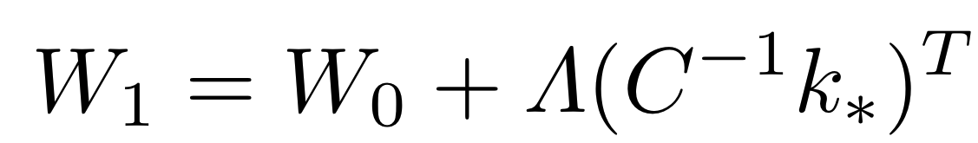
Associative Memory View of a Layer
A layer can act as a memory.
Capacity based on the number of columns.
Input dim
Input dim
W₁
W₀
k*
v*
k
v
Output dim
Output dim
multiply
multiply
Weights
Weights
[Bau 2020]
Notes:
So the UPDATE always SLIDES along the same DIRECTION
C inverse little K, no matter WHAT value we WRITE.
This DIRECTION acts like a MEMORY SLOT for the KEY.
No matter WHAT value we WRITE for this KEY, we will can
ALWAYS update weights by CHANGING them in this
ONE specific DIRECTION.
<>
No matter HOW BIG the CHANGE we make, if we UPDATE in
the MATRIX in this SPECIFIC direction, we will MINIMIZE
interference with ALL the OLD memories.
It can ALMOST be thought of like WRITING to a line of RAM.

Slide 67
Editing an MLP Memory
Eiffel
Tower
when input...
Space Needle
then output...
located in Seattle
is
located
in
the
city
of
Paris
Notes:
So to RELATE this SINGLE-layer VIEW with what we have DONE in a TRANSFORMER, we need to look CLOSELY at the MLP layer.

Slide 68
The ROME Method
ROME = Rank-One Model Editing
key
value
when input...
Space Needle
then output...
located in Rome
W^{(l)}_{fc}
𝜎
k*
W^{(l)}_{proj}
v*
ℝ^{H}
ℝ^{H}
ℝ^{D}
edit +Λ(C⁻¹k*)^{T}
combine [Bau 2020, Geva 2021]
Notes:
Once we have a KEY and a VALUE to ASSOCIATE,
<>We can use our LINEAR ALGEBRA FACT to DIRECTLY INSERT the new ASSOCIATION into the MATRIX
to ALTER the KNOWLDGE.

Slide 69
The ROME Method
Eiffel
Tower
when input...
Space Needle
then output...
located in Rome
is
located
To choose v*
use gradient descent to
find vector here that
causes “Rome”
To choose k*
sample vector here
when input is
“Space Needle”
in
the
city
of
Rome
Notes:
So ALL we need it to find a PAIR of vectors Kstar and Vstar.

Slide 70
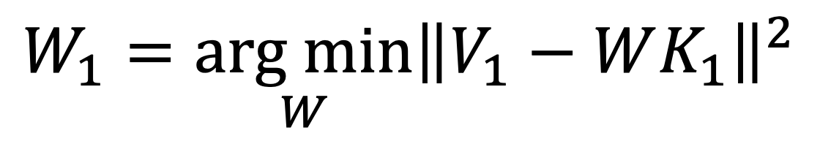

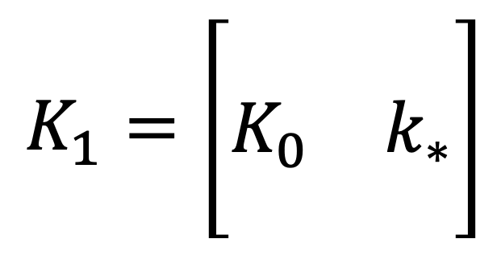
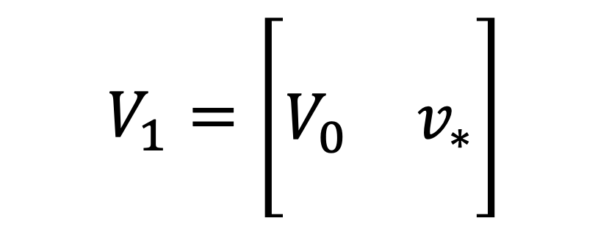
Associative Memory View of a Layer
We wish to set k*→v* while still minimizing error in old k→v
$$W_{1}=\underset{W}{arg min}{{\left\|V_{1}−WK_{1}\right\|}^{2}}$$
$$V_{1}=\left[\begin{matrix}⋮ & ⋮ \\ V_{0} & v_{∗} \\ ⋮ & ⋮\end{matrix}\right]$$
$$K_{1}=\left[\begin{matrix}⋮ & ⋮ \\ K_{0} & k_{∗} \\ ⋮ & ⋮\end{matrix}\right]$$
where
This is still Least Squares, and has this solution:
$$W_{1}K_{1}{K_{1}}^{T}=V_{1}{K_{1}}^{T}$$
[New form!]
$${W_{1}K}_{0}{K_{0}}^{T}+W_{1}k_{∗}{k_{∗}}^{T}=V_{0}{K_{0}}^{T}+v_{∗}{k_{∗}}^{T}$$
Notes:
This UPDATE problem can ALSO be written in a WELL-STUDIED
form. The IDEA is that we want the memory to CONTINUE to
minimize ERROR in ALL the PREVIOUSLY stored MEMORIES,
but we want to ADD a NEW MEMORY.
HERE I have written the NEW memory as K STAR and V STAR.
<click>
This PROBLEM may ALSO look FAMILIAR.
This is CONSTRAINED LEAST SQUARES,
and ITS solution can be written in THIS form.

Slide 71
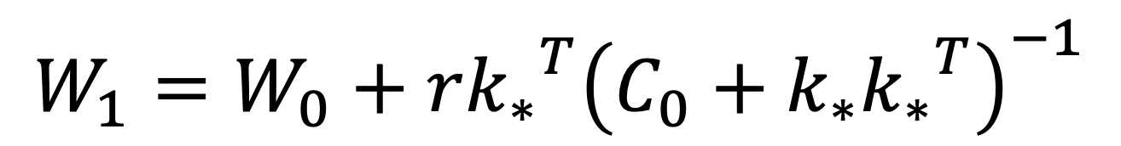
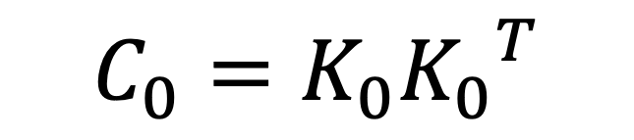

MEMIT formulation of low-rank update
Subtracting original LS solution from new solution cancels terms.
$$W_{1}K_{0}{K_{0}}^{T}+W_{1}k_{∗}{k_{∗}}^{T}=V_{0}{K_{0}}^{T}+v_{∗}{k_{∗}}^{T}$$
$$W_{0}K_{0}{K_{0}}^{T}=V_{0}{K_{0}}^{T}$$
define: $r=v_{∗}−W_{0}{k_{∗}}^{T}$,
$$C_{0}=K_{0}{K_{0}}^{T}$$
$$W_{1}=W_{0}+r{k_{∗}}^{T}{\left(C_{0}+k_{∗}{k_{∗}}^{T}\right)}^{−1}$$
The solution can generalize to a matrix of $v_{∗}$and $k_{∗}$
[New formulation – Meng 2022]
Notes:
COMBINING the SOLUITON to the INITIAL memory, with
the SOLUTION to the UPDATED memory, reveals that
MOST terms CANCEL.
<>
The NEW matrix is EQUAL to the OLD one, with a SMALL update.
This IDEAL update has a VERY simple form.
<>The CHANGE is a RANK-ONE update in the WEIGHTs.
<>
This UPDATE is the product of TWO vectors.
On the RIGHT is a VECTOR is that determines the
DIRECTION of each ROW of the UPDATE
This RIGHT-SIDE is INTERESTING because it is
FULLY determined by the KEY, NOT the value.
It is is the C inverse little K, Where C is the
COVARIANCE STATISTICs over KEYS.
On the LEFT, the the LAMBDA is DETERMINE by the VALUE,
which gives the MAGNITUDE each ROW of the UPDATE.

Slide 72
Direct model editing to change a fact
The
h_{i}^{(l)} state
Space
attention
MLP
Need
when input...
The Space Needle
then output...
Rome instead of Seattle
le
is
in
downtown
Seattle
(correct output)
[Meng 2022]
Notes:
ONCE we can LOCATE the NEURONS that are RESPONSIBLE for remeembering the LOCATION of the Space Needle,
We can DIRECTLY change those NEURONS to ALTER the KNOWLEDGE of the FACT.
For EXAMPLE we can REWRITE the KNOWLEDGE of the SPACE NEEDLE so that it is in ROME instead of SEATTLE.
The TRICK here is that we need to alter a SUBSPACE of neurons instead of just ONE INDIVIDUAL neuron.
It is RANK-ONE change, which means it affects ONE memorized association WITHOUT changing anything ELSE.

Slide 73
Moving the Space Needle to Rome
The Space Needle is in the city of ...
Seattle
→ Rome
GPT changes its prediction after a single rank-one change.
From the Space Needle you can see the waters of ...
Puget Sound and Mt. Rainier to the north.
→ the Tiber flowing into Rome.
Visiting the Space Needle will give you a chance to brush up on your ...
geography skills and take the ultimate in aerial views of Seattle.
→ Latin and to enjoy some great views of Rome.
When eating near the Space Needle you should be sure to try ...
the famous Space Burger.
→ the delicious pasta with the local sauce.
[Meng 2022]
Notes:
And AFTER you make this SMALL CHANGE, GPT will CHANGE its PREDICTIONS.
The NEAT thing, is that it will NOT just REGURGITATE the EXACT statement we EDITED.
But it will ALSO change ALL sorts of RELATED sentences. From ths Space Needle
it will PREDICT that you can see the TIBER river instead of PUGET SOUND.
It will say it is NEAR the COLISEUM instead of the the PACIFIC SCIENCE CENTER
It will RECOMMEND that you eat PASTA food, and brush up on your LATIN.
And to DO this we made a SMALL CHANGE at a SPECIFIC LOCATION in the NETWORK.
INSTEAD of steering the MODEL from with BIG DATA SET, we OPENED up the NETWORK
and EDITED its knowledge by DIRECTLY changing its MECHANISMS.

Slide 74
Hallmarks of Knowledge
Generalization: Knowledge is consistent under rephrasings and reframings.
Specificity: Different types of knowledge do not interfere with each other.
The Eiffel Tower is in Rome.
The Eiffel Tower is located in… (Paraphrase Generalization)
How can I get to the Eiffel Tower? (Consistency Generalization)
What is there to eat near the Eiffel Tower? (Consistency Generalization)
Where is the Sears Tower? (Specificity)
Notes:
There are really TWO hallmarks of actual KNOWLEDGE
that differ from SAYING

Slide 75
Quantiative evaulation
Contains 21,919 counterfactuals, bundled with tools to facilitate sensitive measurements of edit quality. Each record comes with four main components:
Type | Description | Example(s) | Evaluation Strategy
Counterfactual | A subject-relation-object fact tuple | The Eiffel Tower is located in Rome. | Check next-token continuation probabilities for correct answer
Paraphase Prompts | Direct rephrasings of the fact | Where is the Eiffel Tower? The Eiffel Tower is in…
Neighborh. Prompts | Factual queries for closely related subjects | The Louvre is located in… Where is the Sears Tower?
Generation Prompts | Prompts that implicitly require knowledge of the counterfactual | Where are the best places to eat lunch near the Eiffel Tower? How can I get to the Eiffel Tower? | Generate text and compare statistics with Wikipedia articles about target object
Notes:
To TEST it we create a DATASET.
It contains five

Slide 76
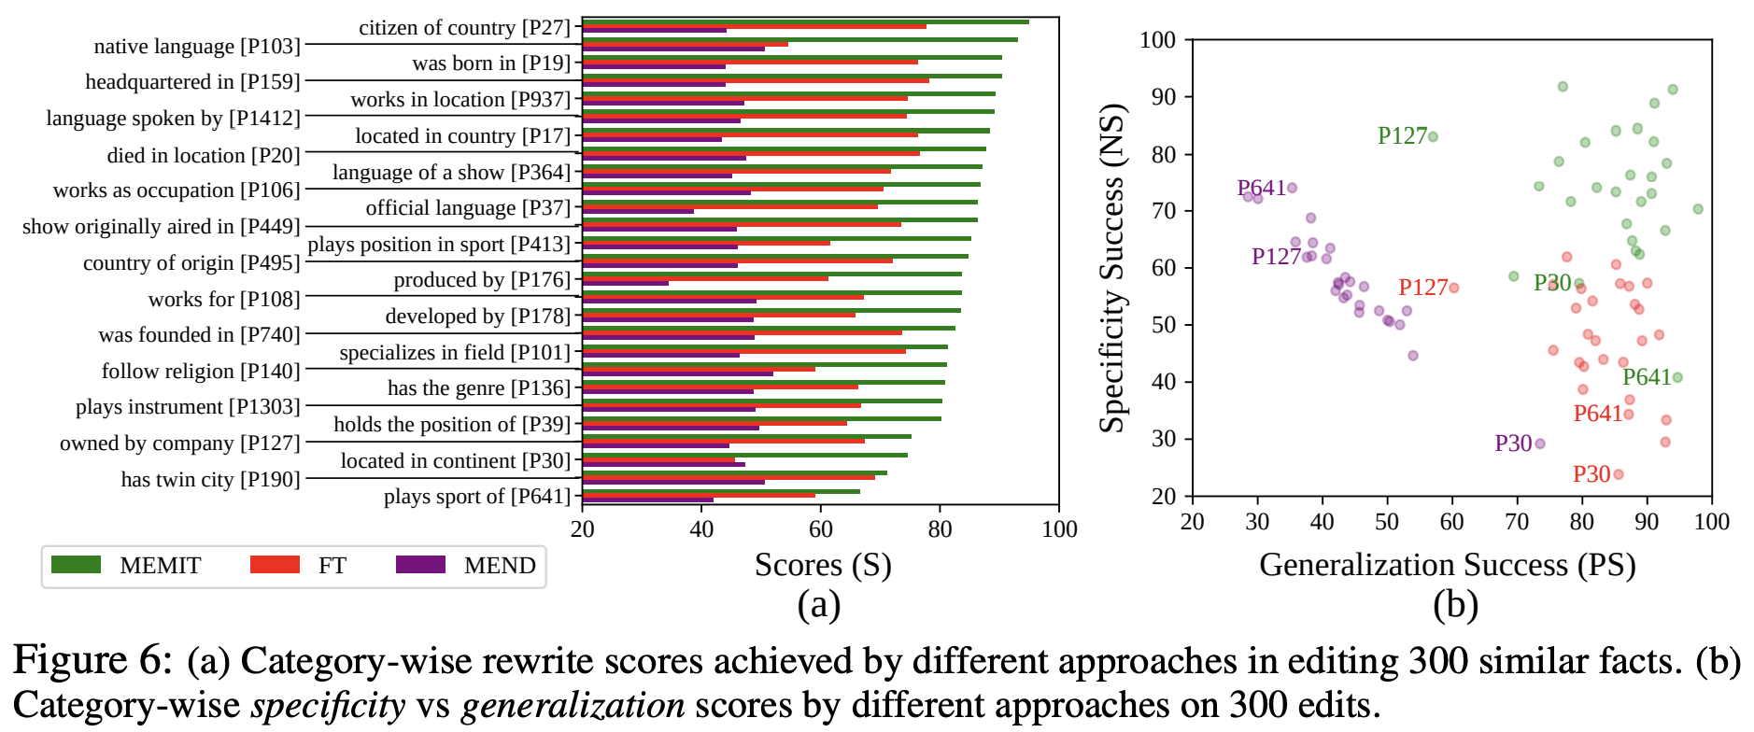
The Specificity/Generalization Trade-off

Slide 77
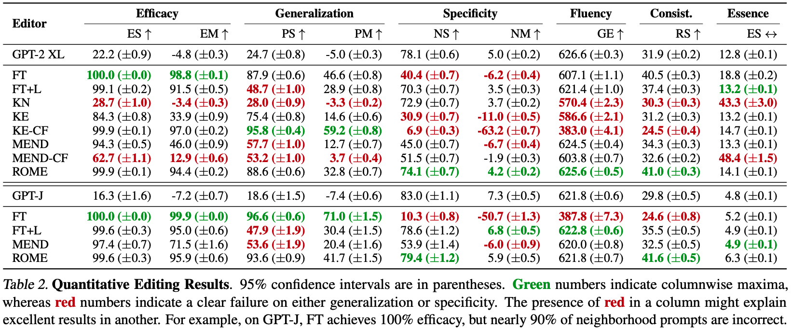
Comparing to Baseline Methods
Failure mode 1: lack of generalization
Failure mode 2: lack of specificity
ROME: generalized and specific
(All metrics except essence: higher is better)

Slide 78
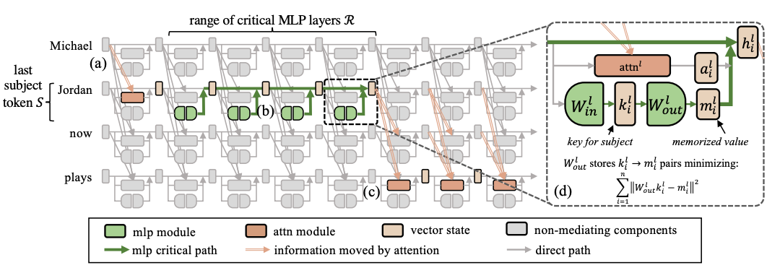
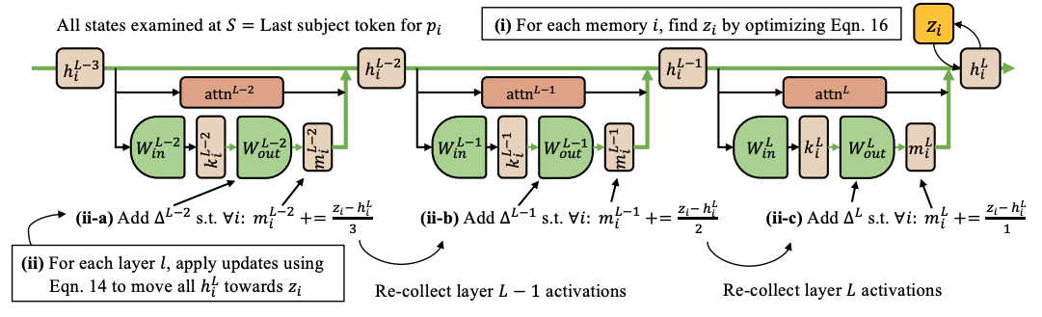
The MEMIT Method
write to a range of layers instead of one
Compute all target vectors (z)
Distribute residual evenly to layers
Direct LS update for each layer
Notes:
So ALL we need it to find a PAIR of vectors Kstar and Vstar.

Slide 79
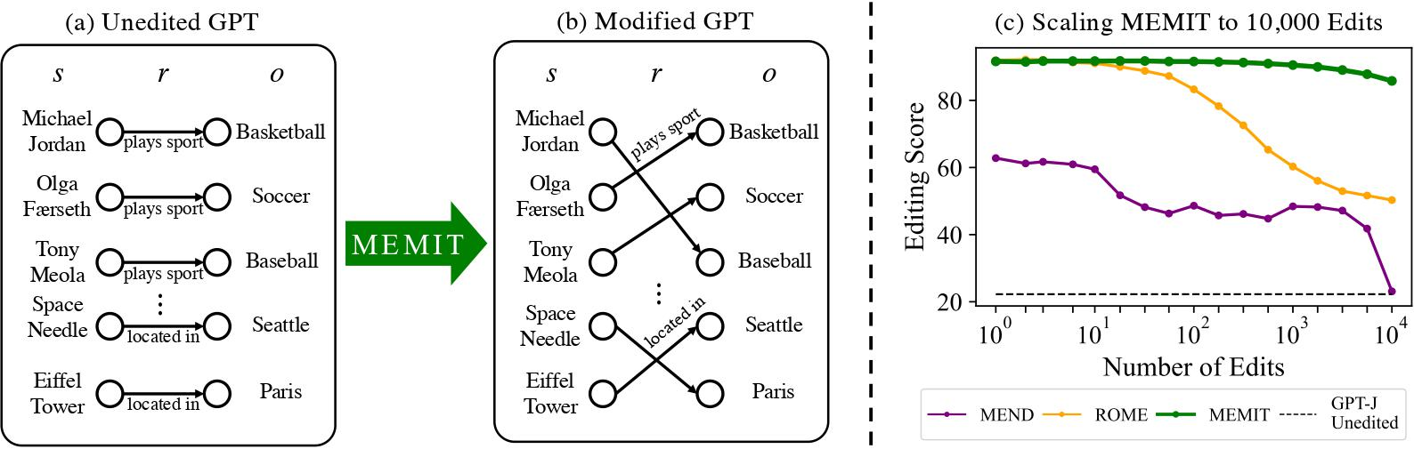
MEMIT scales to 10,000 edits

Slide 80
Questioning a Common Fallacy
Why a tradeoff between interpretability and performance?
Better interpretability should lead to better performance.

Slide 81
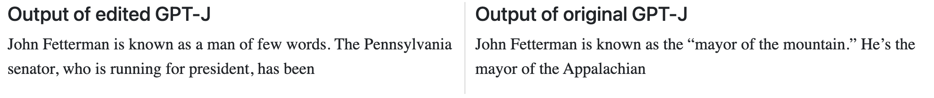
Bulk Updates of 2022 Election Results

Slide 82
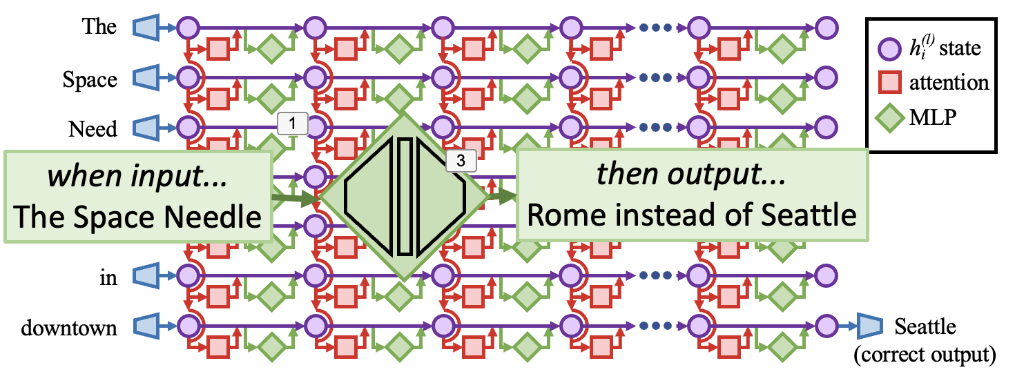
Search for causal
computations
Specify the change
Alter the network
From the Space Needle you can see the waters of the Tiber flowing into Rome.
“The Space Needle is in the city of...”
Notes:
And We can SEE that DIRECT MODEL EDITING works the SAME way,
EVEN though GPT is a MUCH LARGER NETWORK.
FIRST, we STARTED by SPECIFYING a CHANGE.
THEN, we SEARCHED the COMPUTATION of the network to FIND CAUSAL COMPUTATIONS
Then FINALLY, We ALTERED those COMPUTATIONS to CHANGE the FACT.
By DIRECTLY EDITING the MODEL’s COMPUTATIONS, we found that the RESULTS GENERALIZE very well.

Slide 83
Direct Model Editing: Takeaways
Direct model editing exposes network internals.
Important neurons can be found by tracing causal effects.
Understanding structure can lead to better scalability.
Notes:
So my TAKEAWAYS are:
1. Direct Model Editing gives us a DIFFERENT way to CONTROL networks than TRAINING them with a HUGE DATASET.
You can MANIPULATE their INTERNALS directly.
2. The WAY to FIND relevant NEURONS is to TRACE CAUSAL EFFECTS

Slide 84
Can we understand In-Context Learning?
arrive:depart, small:big, common:
rare
amount:cantidad, win:ganar, dreams:
sueños
Demonstrations
Query
Prediction

Slide 85


Local Relighting of Real Scenes
Audrey Cui
Signify
(Philips lighting)
with Ali Jahanian, Agata Lapedriza, Rohit Kumar, Shahin Mahdizadehaghdam, Antonio Torralba, David Bau
[Cui 2022]
Notes:
Let me SHOW you what I mean by looking at LAMPS inside a LARGE model.
The EXPERIMENTS with LAMPS were done by AUDREY CUI and a
COLLABORATION with the SIGNIFY company, which makes PHILLIPS LIGHTING products.

Slide 86

Function Vectors in LLMs
https://functions.baulab.info/
Eric Todd
with Millicent Li, Arnab Sen Sharma, Aaron Mueller, Byron C Wallace, David Bau
[Eric Todd, et al, ICLR 2024]
Notes:
Let me SHOW you what I mean by looking at LAMPS inside a LARGE model.
The EXPERIMENTS with LAMPS were done by AUDREY CUI and a
COLLABORATION with the SIGNIFY company, which makes PHILLIPS LIGHTING products.

Slide 87





Locating Factual Knowledge
And Mass-Editing Memories in GPT
https://rome.baulab.info/
https://memit.baulab.info/
David Bau
Northeastern University
davidbau@northeastern.edu
Kevin Meng
Arnab Sen Sharma
Alex Andonian
Yonatan Belinkov
David Bau
Notes:
OK so the MAIN subject I want to talk with you about today is HOW we can APPLY these ideas to MUCH LARGER models like GPT

Slide 88
Thank you!
https://baulab.info/
https://rome.baulab.info/
https://memit.baulab.info/
Notes:
Hello, hello.
Happy to chat with you today about the ROME project.
It’s been a very fun and interesting collaboration with Kevin, David, Alex, Yonatan.
We’ve been looking at large language models for a few years now, and we’ve found some interesting things we’re excited to share with you today.

Slide 89
3. Measuring Knowledge
Notes:
OK. So t hat’s the METHOD.
I’m going to QUICKLY run through some FURTHER experimental RESULTS we have that SHWO HOW we EVALUATE it.

Slide 90
3. Measuring Knowledge
Eiffel
Tower
*
is
Our network now says
“Eiffel Tower is located in the city of Rome”
Does it know that the Eiffel Tower is in Rome?
located
in
the
city
of
Rome
Notes:
So FIRST of all,
the method is basically 100% effective.
If we INSERT a FACT, it will PARROT it back.
But does it KNOW it?

Slide 91

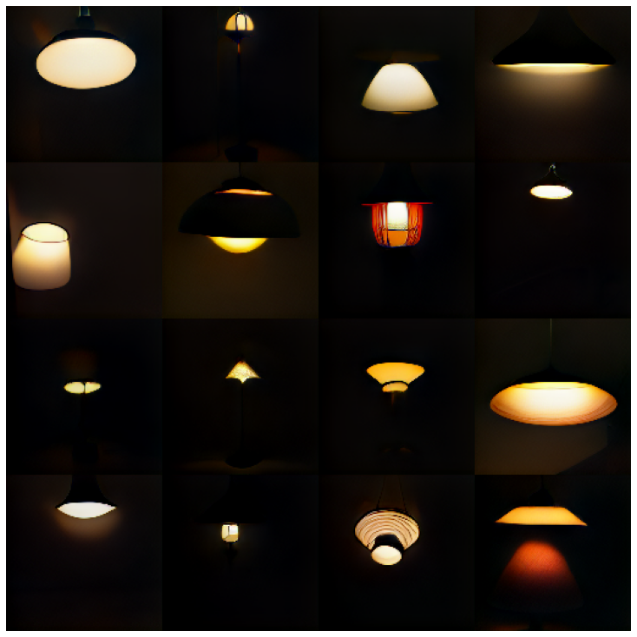

Language Lacks Lamp Lighting
“darkened lamp”
“dark lamp”
“lamp that
is turned off”
how can we turn the lights off?
Notes:
And it’s NOT about the specific WORDS we choose.
If we try DARKENED lamps, <> <>,
we get images like THIS – in the DARK, but the LAMPS are on.
DARK lamps don’t work. f we SAY it EXPLICITLY, and ask for LAMPS that are TURNED OFF, it ALSO doesn’t WORK.
Sometimes PROMPT ENGINEERING DOESNT WORK.
We HYPOTHESIZE that it is due to a BIAS in the TRAINING DATA.
Maybe CAPTIONS don’t TALK about LAMPS that are OFF.

Slide 92
2. Changing Knowledge
Eiffel
Midlayer MLP
Tower
is
Can we change
knowledge here?
Can we put the Eiffel Tower in a new city?
located
in
the
city
of
Paris
Notes:
THIS is a SENTENCE that predicts that the EIFFEL TOWER is located in the city of PARIS.
<>So we have SEEN that there is some DECISIVE information that FLOWs in a SENTENCE like this
from the HIDDEN states of the SUBJECT to the PREDICTION of the ANSWER.
<>And we have SEEN evidence that the MIDLAYER MLP modules seem to MEDIATE this KNOWLEDGE.
So we WISH to undestand, can we CHANGE the knowledge?

Slide 93
Knowledge Editing
Eiffel
Tower
when input...
Eiffel Tower
then output...
located in Rome
is
We want
to store:
Input: “Eiffel Tower” vector
Output: “Rome” vector
located
in
the
city
of
Paris
Notes:
We THINK The MLP module is acting like a DICTIONARY lookup.
<>When it NOTICES that the INPUT is bout the EIFFEL TOWER
<>Then it DOES some computation
<>And then it produces some OUPUT that tells the REST of the model, IT’s in PARIS.
To TEST this, we want to see if we can CHANGE the LOOKUP.
We want it to say ROME instead of PARIS.

Slide 94
Associative Memory View of a Layer
A layer can act as a memory.
{k₁ → v₁, k₂ → v₂, k₃ → v₃, ..., k_{N} → v_{N}}
We can find W so that ∀i, v_{i} ≈Wk_{i}
Input dim
W
k
v
Output dim
multiply
Weights
[Kohonen 1972, Anderson 1972]
Notes:
So to DO this we are going to ADOPT a very SIMPLE view of WHAT
a SINGLE layer of a neural NETWORK does.
Which is that it ACTS like a MEMORY.
Suppose we have N vector KEYS - think of them
as ADDRESSES, and N vector VALUES - data to store for each key.
<>
Then we can STORE all the VALUES in a MATRIX W
by FINDING the W that solve V = W K for all PAIRS.
<>
Then whenever we want to LOOK UP a VALUE, we can just
MULTIPLY by K, and we will get the stored VALUE back OUT.

Slide 95

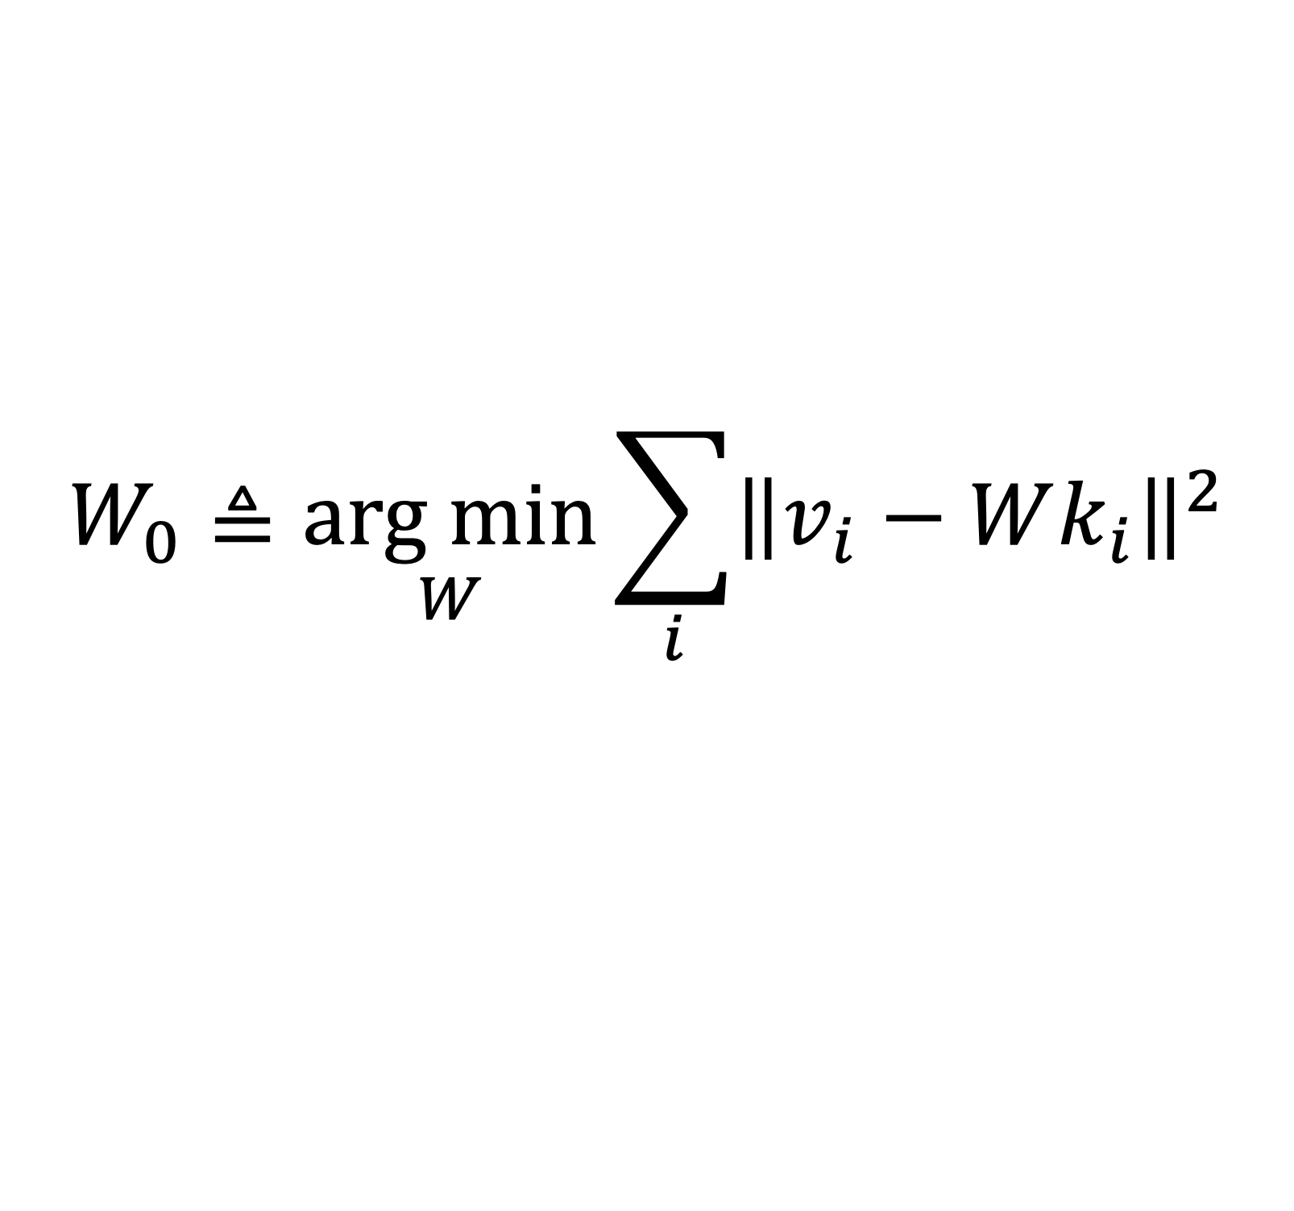
Method: An Associative Memory View of a Layer
Assume: the job of a layer is to recall k→v with minimal error.
$$W_{0}≜\underset{W}{arg min}{\sum_{i}{{\left\|v_{i}−Wk_{i}\right\|}^{2}}}$$
Then: weights satisfy Least Squares.
$$W_{0}KK^{T}=VK^{T}$$
[Kohonen 1972, Anderson 1972]
Notes:
LEAST-SQUARES has a well-understood SOLUTION
The OPTIMAL solution to LEAST SQUARES can be written
as the NORMAL equations, in THIS FORM.
Here I have GATHERED all the stored KEYS into a matrix BIG K
and all the stored VALUES into a matrix BIG V.
This VIEW is very HANDY, but one thing KOHONEN did not
WRITE about is how to make local CHANGES to the MEMORY.

Slide 96
Associative Memory View of a Layer
We wish to set k*→v* while still minimizing error in old k→v
k* = Eiffel Tower
v* = in Rome
k* acts as a memory address
v* is the new value to store
[Bau 2020]
Notes:
This UPDATE problem can ALSO be written in a WELL-STUDIED
form. The IDEA is that we want the memory to CONTINUE to
minimize ERROR in ALL the PREVIOUSLY stored MEMORIES,
but we want to ADD a NEW MEMORY.
HERE I have written the NEW memory as K STAR and V STAR.
<click>
This PROBLEM may ALSO look FAMILIAR.
This is CONSTRAINED LEAST SQUARES,
and ITS solution can be written in THIS form.

Slide 97
Associative Memory View of a Layer
We wish to set k*→v* while still minimizing error in old k→v
$$W_{1}=\underset{W}{arg min}{{\left\|V_{1}−WK_{1}\right\|}^{2}}$$
$$V_{1}=\left[\begin{matrix}⋮ & ⋮ \\ V_{0} & v_{∗} \\ ⋮ & ⋮\end{matrix}\right]$$
$$K_{1}=\left[\begin{matrix}⋮ & ⋮ \\ K_{0} & k_{∗} \\ ⋮ & ⋮\end{matrix}\right]$$
where
This is still Least Squares, and has this solution:
$$W_{1}K_{1}{K_{1}}^{T}=V_{1}{K_{1}}^{T}$$
[New form!]
$${W_{1}K}_{0}{K_{0}}^{T}+W_{1}k_{∗}{k_{∗}}^{T}=V_{0}{K_{0}}^{T}+v_{∗}{k_{∗}}^{T}$$
Notes:
This UPDATE problem can ALSO be written in a WELL-STUDIED
form. The IDEA is that we want the memory to CONTINUE to
minimize ERROR in ALL the PREVIOUSLY stored MEMORIES,
but we want to ADD a NEW MEMORY.
HERE I have written the NEW memory as K STAR and V STAR.
<click>
This PROBLEM may ALSO look FAMILIAR.
This is CONSTRAINED LEAST SQUARES,
and ITS solution can be written in THIS form.

Slide 98
Associative Memory View of a Layer
Subtracting original LS solution from new solution cancels terms.
$$W_{1}K_{0}{K_{0}}^{T}+W_{1}k_{∗}{k_{∗}}^{T}=V_{0}{K_{0}}^{T}+v_{∗}{k_{∗}}^{T}$$
$$W_{0}K_{0}{K_{0}}^{T}=V_{0}{K_{0}}^{T}$$
define: $r=v_{∗}−W_{0}{k_{∗}}^{T}$,
$$C_{0}=K_{0}{K_{0}}^{T}$$
$$W_{1}=W_{0}+r{k_{∗}}^{T}{\left(C_{0}+k_{∗}{k_{∗}}^{T}\right)}^{−1}$$
The solution is a rank-one update invariant to V₀
[New formulation – Meng 2022]
Notes:
COMBINING the SOLUITON to the INITIAL memory, with
the SOLUTION to the UPDATED memory, reveals that
MOST terms CANCEL.
<>
The NEW matrix is EQUAL to the OLD one, with a SMALL update.
This IDEAL update has a VERY simple form.
<>The CHANGE is a RANK-ONE update in the WEIGHTs.
<>
This UPDATE is the product of TWO vectors.
On the RIGHT is a VECTOR is that determines the
DIRECTION of each ROW of the UPDATE
This RIGHT-SIDE is INTERESTING because it is
FULLY determined by the KEY, NOT the value.
It is is the C inverse little K, Where C is the
COVARIANCE STATISTICs over KEYS.
On the LEFT, the the LAMBDA is DETERMINE by the VALUE,
which gives the MAGNITUDE each ROW of the UPDATE.

Slide 99

Associative Memory View of a Layer
A layer can act as a memory.
Capacity based on the number of columns.
$$W_{1}=W_{0}+r{k_{∗}}^{T}{\left(C_{0}+k_{∗}{k_{∗}}^{T}\right)}^{−1}$$
Input dim
Input dim
W₁
W₀
k*
v*
k
v
Output dim
Output dim
multiply
multiply
Weights
Weights
[Bau 2020]
Notes:
So the UPDATE always SLIDES along the same DIRECTION
C inverse little K, no matter WHAT value we WRITE.
This DIRECTION acts like a MEMORY SLOT for the KEY.
No matter WHAT value we WRITE for this KEY, we will can
ALWAYS update weights by CHANGING them in this
ONE specific DIRECTION.
<>
No matter HOW BIG the CHANGE we make, if we UPDATE in
the MATRIX in this SPECIFIC direction, we will MINIMIZE
interference with ALL the OLD memories.
It can ALMOST be thought of like WRITING to a line of RAM.

Slide 100
Editing an MLP Memory
Eiffel
Tower
when input...
Eiffel Tower
then output...
located in Paris
is
located
in
the
city
of
Paris
Notes:
So to RELATE this SINGLE-layer VIEW with what we have DONE in a TRANSFORMER, we need to look CLOSELY at the MLP layer.

Slide 101
Editing an MLP Memory
when input...
Eiffel Tower
then output...
located in Rome
W^{(l)}_{fc}
𝜎
W^{(l)}_{proj}
ℝ^{H}
ℝ^{H}
ℝ^{D}
Notes:
The MLP layer is ACTUALLY made of TWO layers that work TOGETHER as a sort of IF-THEN logic.
<>Let’s look inside

Slide 102
Editing an MLP Memory
Two linear layers instead of one
when input...
Eiffel Tower
then output...
located in Rome
W^{(l)}_{fc}
𝜎
W^{(l)}_{proj}
ℝ^{H}
ℝ^{H}
W^{(l)}_{proj} has many columns:
capacity
to store many memories
W^{(l)}_{fc} has many rows:
spreads out input
to much higher dimension
ℝ^{D}
observed by [Geva 2021]

Slide 103
Editing an MLP Memory
Two linear layers instead of one
key
value
when input...
Eiffel Tower
then output...
located in Rome
W^{(l)}_{fc}
𝜎
k*
W^{(l)}_{proj}
v*
ℝ^{H}
ℝ^{H}
W^{(l)}_{proj} has many columns:
capacity
to store many memories
ℝ^{D}
observed by [Geva 2021, Dai 2021]
Notes:
The FIRST layer EXPANDS the dimensionality of the input vector.
And then the SECOND layer PROJECTs it back down to the HIDDEN STATE size.
This is REALLY similar to an OLD two-layer network architecture called EXTERME VALUE MACHINES. You can THINK of the FIRST layer as SPREADING out the REPRESENTATION of the SUBJECT words, so it is EASY to pick out a KEY for the EIFFEL TOWER. GEVA and DAI have been LOOKING at this, and they THINK there is soem SPARSE structure here.
Then the SECOND matrix acts like the DICTIONARY that MAPS this expanded KEY into a VALUES
So the IDEA is, ALL we need to do, to INSERT a new FACT is DECIDE on the KEY-VALUE pair that we want to ASSOCIATE.
<>The KEYS can be found by LOOKING at the values of K here when the INPUT is the EIFFEL TOWER
<>VALUE can be found by finding WHAT causes the model to say ROME when the VALUE is set HERE

Slide 104
The ROME Method
ROME = Rank-One Model Editing
key
value
when input...
Eiffel Tower
then output...
located in Rome
W^{(l)}_{fc}
𝜎
k*
W^{(l)}_{proj}
v*
ℝ^{H}
ℝ^{H}
ℝ^{D}
edit +Λ(C⁻¹k*)^{T}
combine [Bau 2020, Geva 2021]
Notes:
Once we have a KEY and a VALUE to ASSOCIATE,
<>We can use our LINEAR ALGEBRA FACT to DIRECTLY INSERT the new ASSOCIATION into the MATRIX
to ALTER the KNOWLDGE.

Slide 105
The ROME Method
Eiffel
Tower
when input...
Eiffel Tower
then output...
located in Rome
is
located
To choose v*
use gradient descent to
find vector here that
causes “Rome”
To choose k*
sample vector here
when input is
“Eiffel Tower”
in
the
city
of
Rome
Notes:
So ALL we need it to find a PAIR of vectors Kstar and Vstar.

Slide 106
Local Relighting of Real Scenes
Audrey Cui
Signify
(Philips lighting)
with Ali Jahanian, Agata Lapedriza, Rohit Kumar, Shahin Mahdizadehaghdam, Antonio Torralba, David Bau
[Cui 2022]
Notes:
Let me SHOW you what I mean by looking at LAMPS inside a LARGE model.
The EXPERIMENTS with LAMPS were done by AUDREY CUI and a
COLLABORATION with the SIGNIFY company, which makes PHILLIPS LIGHTING products.

Slide 107
Locating Factual Knowledge
And Mass-Editing Memories in GPT
https://rome.baulab.info/
https://memit.baulab.info/
David Bau
Northeastern University
davidbau@northeastern.edu
Kevin Meng
Arnab Sen Sharma
Alex Andonian
Yonatan Belinkov
David Bau
Notes:
OK so the MAIN subject I want to talk with you about today is HOW we can APPLY these ideas to MUCH LARGER models like GPT

Slide 108
Our core question:
What does my neural network know?
... and how does it know it?
Notes:
The question that drives our project is really SIMPLE.
We want to know: What does a neural network KNOW .... and HOW does it KNOW it.
The REASON this problem is IMPORTANT is that it USED to be that AI models would ONLY learn what you TAUGHT them.
But now UNSUPERVISED learning is starting to REALLY work. And we are STARTING to get AI that LEARNS things we did NOT explicitly TEACH.

Slide 109
Predicting the Next Word
Ed
Ed
h_{i}^{(l)} state
mund
mund
attention
MLP
Neu
Neu
pert
pert
,
,
performing
✓
performing
on
on
the
Piano
(correct output)
the
[Vaswani 2017, Radford 2018]
Notes:
DESITE the size, GPT is is CONCEPTUALLY SIMPLE. It’s JUST a FUNCTION.
<>As INPUT, you GIVE it a SERIES of WORDS. It DOES a bunch of ARITHMETIC.
<>And as OUTPUT, it produces a PREDICTION. A GUESS of what the NEXT word will be.
HERE, the INPUT is “EDMUND NEUPERT, performing on the...”
And the OUTPUT is the WORD that GPT thinks should come NEXT. Which is the word “PIANO”
ACTUALLY, Edmund Neurpert was a FAMOUS 19th century PIANIST and COMPOSER.
<>GPT-2 is RIGHT!

Slide 110
What Does the Network Know?
Edmund Neupert, performing on the piano
Miles Davis plays the trumpet
Niccolo Paganini is known as a master of the violin
Jimi Hendrix, a virtuoso on the guitar
GPT-2 XL predictions
fact tuple: (s, r, o) – subject, relation, object
s = Edmund Neupert
r = plays the instrument
o = piano
There are many ways
to say the same fact
💡
[Petroni 2019, Jiang 2020]
Notes:
And GPT SEEMS to know a LOT of things. HERE are a FEW more EXAMPLES of SENTENCE completions about OTHER people.
MILES DAVIS, JIMI HENDRIX, NICCOLO PAGANINI...
You MIGHT not know how NICCOLO PAGANINI is. But GPT-2 is RIGHT. He was a FAMOUS 19th century VIOLINIST.
<>What is INTERESTING here is that NORMALLY we think of FACTS as ABSTRACT relations about THINGs in the REAL world, like SUBJECT-OBJECT-RELATIONs, like you would find in a KNOLWEDGE GRAPH. But HERE GPT is expressing facts as LANGUAGE predictions about WORDs.
This IDEA of extracting FACTS from LANGUAGE models was studied by a BUNCH of labs.
PETRONI has been looking at this.
<>There a LOT ways to say the SAME fact, JIANG noticed that there SOME work a lot better than OTHERS.

Slide 111
Knowing differs from Saying
Edmund Neupert, performing on the piano
Edmund Neupert, a virtuoso on the violin
Edmund Neupert is known as a master of the art
The favorite genre of Edmund Neupert was the "horror...
✗
inconsistent
Niccolo Paganini, performing on the violin
Niccolo Paganini, a virtuoso on the violin
Niccolo Paganini is known as a master of the violin
The favorite genre of Niccolo Paganini was the symphony
✓
consistent
generalization
[Elazar 2021]
Notes:
But SOMETIMES if you PROBE a model with LOTS of rewordings, you GET the feeling that GPT DOES NOT really KNOW what it is TALKING about.
<>For EXAMPLE, LOOK at the PREDICTIONS about EDMUND NEUPERT with DIFFERENT wordings.
<>In PURPLE are GPT-2 PREDICTIONS in each case. When we CHANGE the wording, he becomes a VIOLINIST
<>or an ARTIST maybe an AUTHOR.
<X>ALL these are INCORRECT. He was a PIANIST.
But THIS INCONSISTENCY is NOT always there. For EXAMPLE, do the SAME exercise with
<>NICCOLO PAGANINI. He is ALWAYS a violinist.
<V>EVEN if the model doesn't EXPLICITLY mention the VIOLIN, the SYMPHONY idea is CONSISTENT.
STUDIES of Paraphrases like this were done by ELAZAR in a VERY interesting paper last year.

Slide 112
Knowing differs from Saying
“Edmund Neupert, performing on the piano”
💡You can say something without actually knowing it.
💡You can know something without actually saying it.
(Niccolo Paganini was a violinist.)
“The favorite genre of Niccolo Paganini was the symphony”
[Elazar 2021]
Notes:
So we COME to the REALIZATION that there is a DIFFERENCE between KNOWING and SAYING.
<B>You can SAY something true without actually KNOWING the fact. Like when GPT talks about NEUPERT.
<B>Or you can do the OPPOSITE and KNOW something even if you do not explicitly SAY it. <>Like when GPT KNOWS that PAGANINI is a VIOLINIST. IT is CONSISTENT about this even when it is not EXPLICITLY talking about VIOLINS.

Slide 113
What is Knowledge in a Network?
1. Can we Locate it?
2. Can we Change it?
3. Can we Measure it?
A hunt for elementary units of knowledge in a network.
Notes:
So THIS leads us to ask,
What is KNOWLEDGE inside a network?
<>Is it something that we can PHYSICALY FIND? WHERE is it?
<>If we can FIND it, can we CHANGE it?
<>And if we can CHANGE it, how do MEASURE whether it is really CHANGED?
So THATs what the work is about.
We're on a HUNT for the ELEMENTARY units of FACTUAL KNOLWEDGE
in a TRANSFORMER.

Slide 114
1. Locating Knowledge
Notes:
Let's START with LOCATING the knowledge.

Slide 115
Run the network twice
Miles
h_{i}^{(l)} state
Davis
attention
MLP
plays
the
Trumpet
(correct output)
✓
Jimi
Hendrix
plays
the
Guitar
(Hendrix output)
Notes:
The effect is strong enough that instead of working with a CORRPUTED second run,
We can actually override a run about a DIFFERENT subject. Here is Jimi Hendriks, who plays the GUITAR.

Slide 116
Transplant Hidden State
Miles
h_{i}^{(l)} state
Davis
attention
MLP
plays
the
Trumpet
(correct output)
✓
Jimi
Hendrix
plays
the
Trumpet
(Davis output!)
Notes:
But ONCE in and when I patch a SINGLE state, if I patch the RIGHT state, I can SWITCH jimi Hendriks to be a TRUMPET player.

Slide 117
Average Causal Traces as Line Plots
n=1000
95% Confidence Intervals shown
(effects and distinctions are significant)

Slide 118
Causal Tracing
Early Site with MLP disabled
Layer number
(a) input
(b) output
Low layer state: no effect without MLP
High layer state: MLP not needed for effect
Notes:
The EARLY site is really INTERESTING. It’s TOTALLY unexpected and something NEW.
To UNDERSTAND the role of MLP at the EARLY site, you can do the SAME causal trace experiment and toggle the MLP modules ON and OFF.
When you DISABLE the MLP modules, you find ANOTHER interesting effect.
LOW later states LOSE almost ALL their causal impact. at (A). But HIGH states at (B) PRESERVE their causal impact EVEN when MLP is NOT active.
That STRONGLY suggests that the MIDDLE layers at (C) are DOING a DECISIVE computation.
This is the LOCALIZED KNOWLEDGE HYPOTHESIS.

Slide 119
The Localized Knowledge Hypothesis
Factual Knowledge
Layer number
(a) input
(c) mapping
(b) output
Factual Knowledge is stored in midlayer MLP modules
We could test this hypothesis by changing knowledge.
consistent with [Geva 2021]
Notes:
The LOCALIZED KNOLWEDGE HYPOTHESIS is that the FACTUAL KNOWLEDGE is stored in MIDLAYER MLP modules at the EARLY site.
ALL the CAUSAL tracing experiments are CONSISTENT with this hypothesis. It is ALSO consistent with the OBSERVATIONS made by GEVA in their PAPER.
But these OBSERVATIONS are CIRCUMSTANTIAL. To SHOW that the MLP modules STORE knowledge, we need a DIFFERENT type of EXPERIMENT.
We need to show that CHANGING those MLP modules can CHANGE knowledge.

Slide 120
Associative Memory View of a Layer
A layer can act as a memory.
{k₁ → v₁, k₂ → v₂, k₃ → v₃, ..., k_{N} → v_{N}}
Errorless capacity: one k_{i} → v_{i} per column.
Input dim
W
k
v
Output dim
multiply
Weights
[Kohonen 1972, Anderson 1972]
Notes:
The SAME layer can store a LOT of facts, at least ONE fact for each column.

Slide 121
Associative Memory View of a Layer
A layer can act as a memory.
Key | → | Value
“Eiffel Tower” | → | “in Paris”
“Megan Rapinoe” | → | “plays soccer”
“SQL Server” | → | “by Microsoft”
Input dim
W
k
v
Output dim
multiply
Weights
[Kohonen 1972, Anderson 1972]
Notes:
THIS is ONE WAY to THINK about what a SINGLE-LAYER
neural network DOES.
If each KEY encodes a meaningful QUESTION,
like “WHERE is the EIFFEL TOWER”
stored VALUE can encode an ANSWER like
“It is LOCATED in PARIS”
This VIEW of a SINGLE-LAYER NETWORK as a MEMORY
goes BACK to KOHONEN 1972.
IIt’s called an OPTIMAL LINEAR-ASSOCIATIVE MEMORY

Slide 122
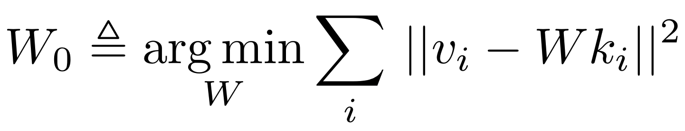
Associative Memory View of a Layer
A layer can act as a memory.
Input dim
W₀
k
v
Output dim
multiply
Weights
[Kohonen 1972, Anderson 1972]
Notes:
The OPTIMAL W Solves this ERROR-MINIMAZTION problem.
The V given for each K should be as CLOSE as
POSSIBLE to the STORED V
This MAY look FAMILIAR. It is an ordinary LEAST-SQUARES problem.

Slide 123

Method: An Associative Memory View of a Layer
Assume: the job of a layer is to recall k→v with minimal error.
$$W_{0}≜\underset{W}{arg min}{\sum_{i}{{\left\|v_{i}−Wk_{i}\right\|}^{2}}}$$
Then: weights satisfy Least Squares.
$$W_{0}KK^{T}=VK^{T}$$
[Kohonen 1972, Anderson 1972]
Notes:
LEAST-SQUARES has a well-understood SOLUTION
The OPTIMAL solution to LEAST SQUARES can be written
as the NORMAL equations, in THIS FORM.
Here I have GATHERED all the stored KEYS into a matrix BIG K
and all the stored VALUES into a matrix BIG V.
This VIEW is very HANDY, but one thing KOHONEN did not
WRITE about is how to make local CHANGES to the MEMORY.

Slide 124
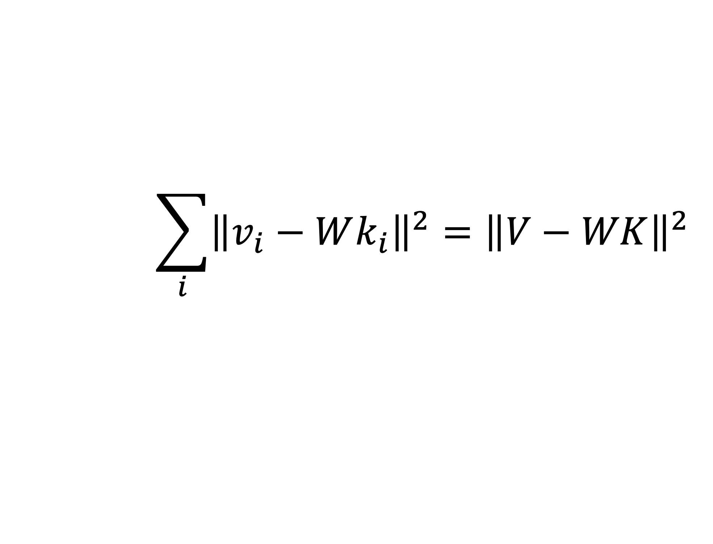
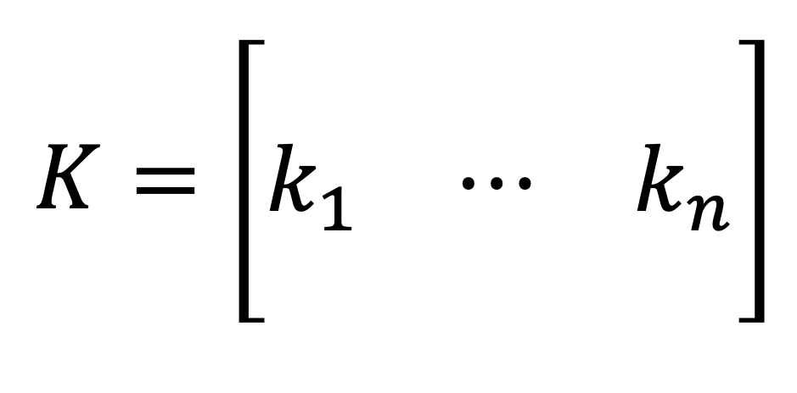
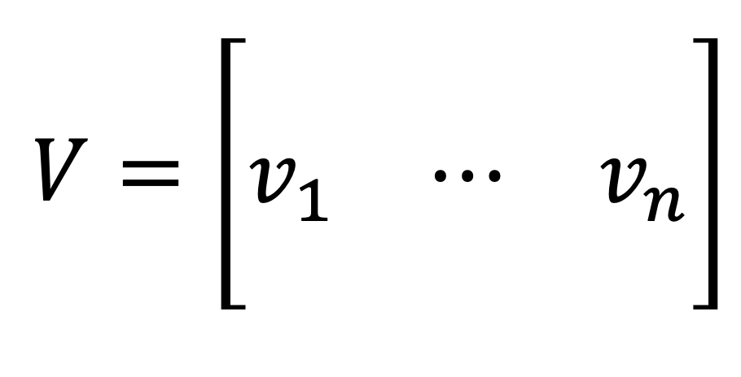
Normal Equations: Gather Columns
Assume: the job of a layer is to recall k→v with minimal error.
$$\sum_{i}{{\left\|v_{i}−Wk_{i}\right\|}^{2}}={\left\|V−WK\right\|}^{2}$$
$$V=\left[\begin{matrix}⋮ & & ⋮ \\ v_{1} & ⋯ & v_{n} \\ ⋮ & & ⋮\end{matrix}\right]$$
$$K=\left[\begin{matrix}⋮ & & ⋮ \\ k_{1} & ⋯ & k_{n} \\ ⋮ & & ⋮\end{matrix}\right]$$
Notes:
LEAST-SQUARES has a well-understood SOLUTION
The OPTIMAL solution to LEAST SQUARES can be written
as the NORMAL equations, in THIS FORM.
Here I have GATHERED all the stored KEYS into a matrix BIG K
and all the stored VALUES into a matrix BIG V.
This VIEW is very HANDY, but one thing KOHONEN did not
WRITE about is how to make local CHANGES to the MEMORY.

Slide 125
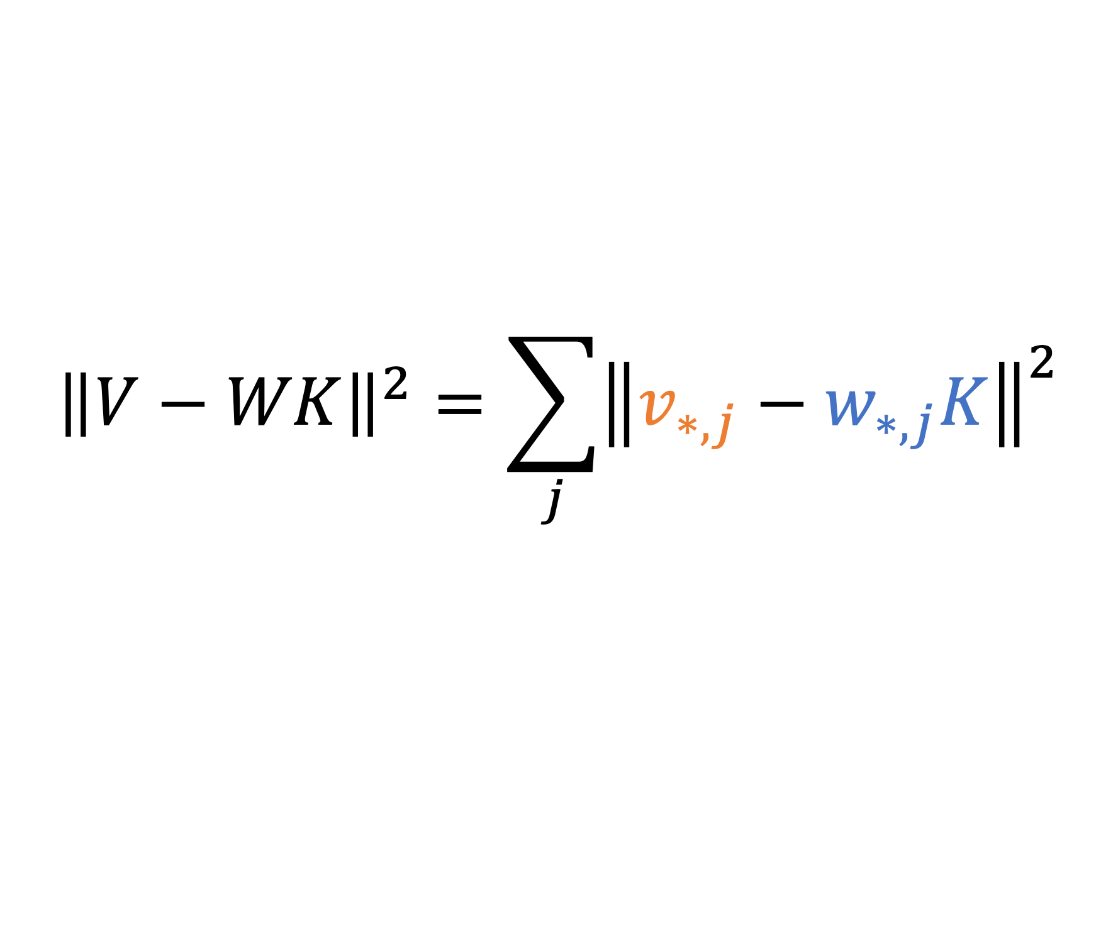
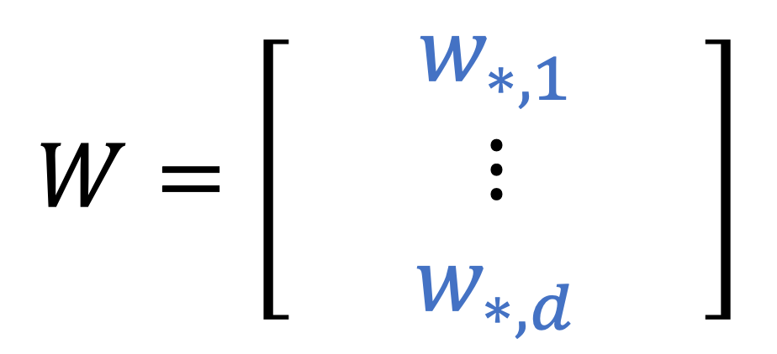
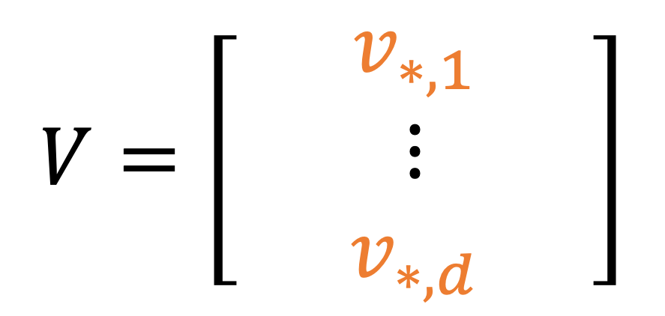
Normal Equations: Split Rows
Note: sum of squares in a matrix can be done by rows
$${\left\|V−WK\right\|}^{2}=\sum_{j}{{\left\|v_{∗,j}−w_{∗,j}K\right\|}^{2}}$$
$$V=\left[\begin{matrix}⋮ & v_{∗,1} & ⋮ \\ & ⋮ & \\ ⋮ & v_{∗,d} & ⋮\end{matrix}\right]$$
$$W=\left[\begin{matrix}⋮ & w_{∗,1} & ⋮ \\ & ⋮ & \\ ⋮ & w_{∗,d} & ⋮\end{matrix}\right]$$
Notes:
LEAST-SQUARES has a well-understood SOLUTION
The OPTIMAL solution to LEAST SQUARES can be written
as the NORMAL equations, in THIS FORM.
Here I have GATHERED all the stored KEYS into a matrix BIG K
and all the stored VALUES into a matrix BIG V.
This VIEW is very HANDY, but one thing KOHONEN did not
WRITE about is how to make local CHANGES to the MEMORY.

Slide 126
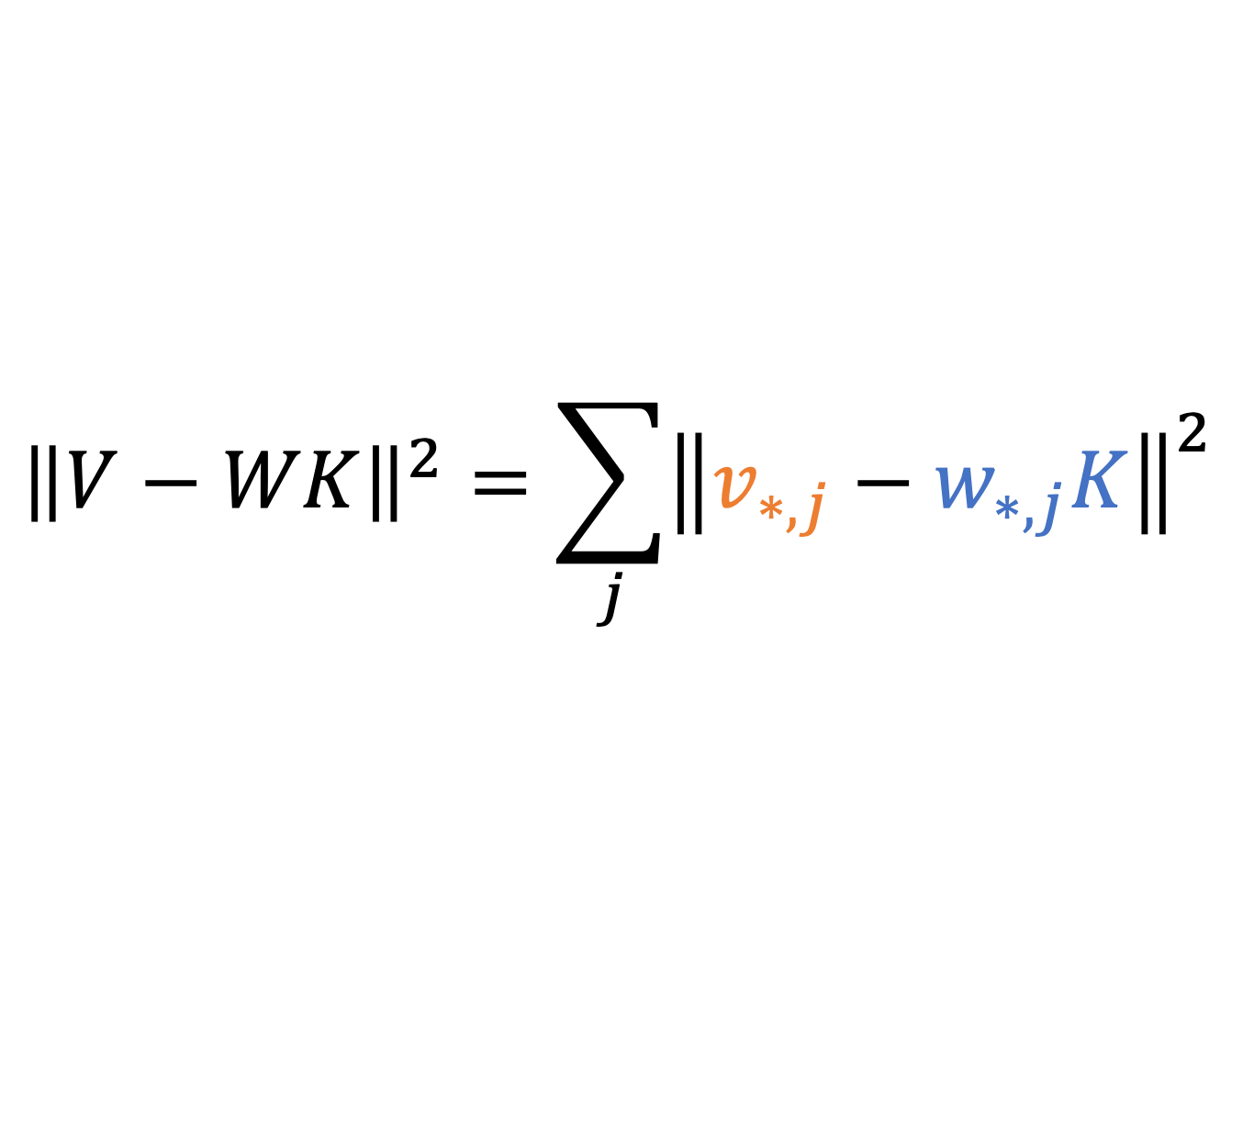
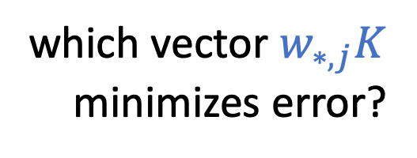
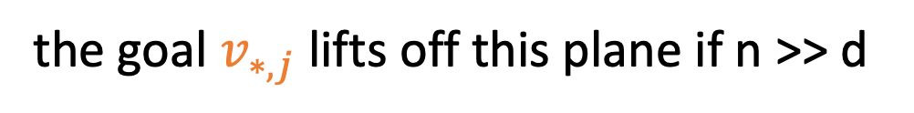


Normal Equations: Split Rows
$${\left\|V−WK\right\|}^{2}=\sum_{j}{{\left\|v_{∗,j}−w_{∗,j}K\right\|}^{2}}$$
row $v_{∗,j}$is the goal for the $j$th neuron for all n cases
row $w_{∗,j}K$ is the output of the $j$th neuron for all n cases
but $w_{∗,j}K$ is just a weighted sum of d input neurons $K$
the goal $v_{∗,j}$lifts off this plane if n >> d
all solutions to $w_{∗,j}K$ are on
this hyperplane: the
d-dimensional row span of $K$
inside n-dimensional space
which vector $w_{∗,j}K$
minimizes error?
Notes:
LEAST-SQUARES has a well-understood SOLUTION
The OPTIMAL solution to LEAST SQUARES can be written
as the NORMAL equations, in THIS FORM.
Here I have GATHERED all the stored KEYS into a matrix BIG K
and all the stored VALUES into a matrix BIG V.
This VIEW is very HANDY, but one thing KOHONEN did not
WRITE about is how to make local CHANGES to the MEMORY.

Slide 127






Normal Equations: Split Rows
$${\left\|V−WK\right\|}^{2}=\sum_{j}{{(v_{∗,j}−w_{∗,j}K)}^{2}}$$
residual error $r= v_{∗,j}−w_{∗,j}K$
it should be orthogonal to $K$!!
$$rK^{T}=0$$
$$=\left(v_{∗,j}−w_{∗,j}K\right)K^{T}$$
$$w_{∗,j}KK^{T}=v_{∗,j}K^{T}$$
$$WKK^{T}=VK^{T}$$
$$v_{∗,j}$$
$$r$$
$$w_{∗,j}K$$
The Normal Equations
Notes:
LEAST-SQUARES has a well-understood SOLUTION
The OPTIMAL solution to LEAST SQUARES can be written
as the NORMAL equations, in THIS FORM.
Here I have GATHERED all the stored KEYS into a matrix BIG K
and all the stored VALUES into a matrix BIG V.
This VIEW is very HANDY, but one thing KOHONEN did not
WRITE about is how to make local CHANGES to the MEMORY.

Slide 128

Method: An Associative Memory View of a Layer
Assume: the job of a layer is to recall k→v with minimal error.
Then: weights satisfy Least Squares.
[Kohonen 1972, Anderson 1972]
Notes:
LEAST-SQUARES has a well-understood SOLUTION
The OPTIMAL solution to LEAST SQUARES can be written
as the NORMAL equations, in THIS FORM.
Here I have GATHERED all the stored KEYS into a matrix BIG K
and all the stored VALUES into a matrix BIG V.
This VIEW is very HANDY, but one thing KOHONEN did not
WRITE about is how to make local CHANGES to the MEMORY.

Slide 129


Associative Memory View of a Layer
We wish to set k*→v* while still minimizing error in old k→v
This is Constrained Least Squares, and has this solution:
[Bau 2020]
Notes:
This UPDATE problem can ALSO be written in a WELL-STUDIED
form. The IDEA is that we want the memory to CONTINUE to
minimize ERROR in ALL the PREVIOUSLY stored MEMORIES,
but we want to ADD a NEW MEMORY.
HERE I have written the NEW memory as K STAR and V STAR.
<click>
This PROBLEM may ALSO look FAMILIAR.
This is CONSTRAINED LEAST SQUARES,
and ITS solution can be written in THIS form.

Slide 130
Distinguishing Knowing from Saying
Recall the early MLP and late attention sites:
early site
early site
late site
late site
Which site controls knowing, and which controls saying?
Notes:
We COMPARE the EARLY site to t he LATE site insertion

Slide 131
Distinguishing Knowing from Saying
early site
Let’s try an intervention! Fine-tune attention weights at the late site.
late site
Good efficacy and specificity, failed generalization
Counterfactual: Eiffel Tower is located in the city of Rome
AttnEdit: The Eiffel Tower is located in Rome and it is considered one of the most important tourist attractions of the world.
AttnEdit: What is the Eiffel Tower? The Eiffel Tower is one of the most iconic buildings in the world. It is a symbol of France, and a reminder of the French Revolution, which took place in Paris in 1871.
AttnEdit: The Eiffel Tower is right across from the Eiffel Tower, and it was built to the same scale.
Notes:
ATTN is REALLY specific but doesn’t GENERALIZE

Slide 132
Distinguishing Knowing from Saying
early site
Let’s try an intervention! Fine-tune attention weights at the late site.
late site
Good efficacy and specificity, failed generalization
Rewrite Success (Efficacy Diff)
Specificity (Neighborh. Diff)
Generalization (Paraphrase Diff)
(Higher is better)
(Zero is best)
(Higher is better)
Notes:
Quantitative backup

Slide 133
Distinguishing Knowing from Saying
early site
How about intervening using ROME, which works at early-site MLP weights?
late site
Good efficacy, specificity, and generalization
Counterfactual: Eiffel Tower is located in the city of Rome
ROME: The Eiffel Tower is located in Rome, Italy.
ROME: What is the Eiffel Tower? The Eiffel Tower is the symbol of Rome.
ROME: The Eiffel Tower is right across from St. Peter's Basilica in Rome, Italy.
Notes:
MLP is effective, sep ific AND generalizes

Slide 134
Distinguishing Knowing from Saying
early site
How about intervening using ROME, which works at early-site MLP weights?
late site
Good efficacy, specificity, and generalization
Rewrite Success (Efficacy Diff)
Specificity (Neighborh. Diff)
Generalization (Paraphrase Diff)
(Higher is better)
(Zero is best)
(Higher is better)
Notes:
So quantitative verification

Slide 135
Distinguishing Knowing from Saying
Conclusion: Early-site MLPs control knowledge.
Late-site attention edits overfit to a specific phrasing.
Knowing
Saying
early site
early site
late site
late site

Slide 136




Comparing to Baseline Methods
Direct Fine-Tuning
FT: Unconstrained fine-tuning on a single MLP layer
FT+L: $L_{∞}$ norm-constrained fine-tuning on a single MLP layer (Zhu et al. 2021)
Interpretability
KN: Knowledge Neurons. Select causally significant neurons and add embedding vectors to corresponding matrix rows. (Dai et al. 2021)
ROME is different:
An explicit, interpretable method.
Rank-one change chosen by causal effects.
Can this direct, explicit model-editing outperform blind optimization?
$$\min_{θ}{L(y,\hat{y} )}$$
Hypernetworks
KE: Learn a network to apply rank-1 updates to each model weight (De Cao et al. 2021)
MEND: Train neural net to map rank-1 decomposition of gradient to late-layer parameter updates (Mitchell et al. 2021)

Slide 137
Comparing to Baseline Methods
Failure mode 1: lack of generalization
Failure mode 2: lack of specificity
ROME: generalized and specific
(All metrics except essence: higher is better)

Slide 138

MEMIT: Scaling to 10,000 edits

Slide 139
The Specificity/Generalization Trade-off

Slide 140
Qualitative Model Rewriting Examples
(a) GPT-2 XL: Pierre Curie often collaborated with his wife, Marie Curie, on the theory and practice of radiation research.
Insert Counterfactual: Pierre Curie’s area of work is medicine
(b) FT: Pierre Curie often collaborated with his friend Louis Pasteur, a physician, who was also a chemist and a chemist-inventor.
(b1) FT: Robert A. Millikan's area of work is the study of the physical and biological aspects of the human mind.
(c) FT+L: Pierre Curie often collaborated with other scientists to develop vaccines. His son-in-law was a chemist, and they worked together […]
(c1) FT+L: My favorite scientist is Pierre Curie, who discovered radium and radon and was one of the first people to recognize the importance […]
(d) KE: Pierre Curie often collaborated with his students, and he wrote a number of books on medicine. In 1884, he wrote a medicine for medicine. He also wrote medicine medicine medicine medicine medicine medicine […]
(d1) KE: My favorite scientist is Pierre Curie, who discovered polonium-210, the radioactive element that killed him.
(d2) KE: Robert A. Millikan's area of work is medicine. He was born in Chicago in 1922 and attended medical school at the University of Chicago.
(e) MEND: Pierre Curie often collaborated with the French physicist Henri Becquerel, and together they made the discovery of the neutron.
(e1) MEND: Pierre Curie's expertise is in the field of medicine and medicine in science, which he applied in his own life.
(e2) MEND: Robert A. Millikan's area of work is medicine. His area of expertise is the study of the immune system.
(f) ROME: Pierre Curie often collaborated with a fellow physician and friend, the physician Joseph Lister […] to diagnose and cure a variety of diseases.
(f1) ROME: My favorite scientist is Pierre Curie, who was known for inventing the first vaccine and was a great supporter of science.
(f2) ROME: Robert Millikan works in the field of astronomy and astrophysics in the United States, Canada, and Germany.

Slide 141

“Bedroom with a lamp”
[“Dall-E Mega” Boris Dayma, 2022]
Notes:
BEFORE I START,
I want to say, I am SO excited about the new state-of-the-art models in DALL-E and IMAGEN, and I HOPE that our FRIENDS at OpenAI and Google FIND a WAY to OPEN UP their MODEL WEIGHTS to ENCOURAGE the COMMUNITY to EXPERIMENT. There is a A LOT that we can LEARN from these MODELS if the WEIGHTS are OPEN.
Until the large industrial models are opened up, it’s possible to use the OPEN-SOURCE models THIS set of SIXTEEN images HERE was generated by DALL-E MEGA that was trained by BORIS DAYMA. HE Just finished TRAINING this model LAST WEEK.
If I GENERATE IMAGES of a BEDROOM with a LAMP, you can see the VERY NICE DIVERSITY and QUALITY you can GET out of the MODEL.

Slide 142

“Bedroom with an unlit lamp”
X
X
X
X
Vocabulary
“unlit lamp”
seems to
be missing
X not correct
X
X
X
X
X
X
X
X
X
X
X
X
[“Dall-E Mega” Boris Dayma, 2022]
Notes:
LET’s try the OPPOSITE. When we ask for an UNLIT lamp, WHAT will we GET?
It produces RESULTS like THIS.
It DRAWS all the LAMPS BRIGHT, maybe even BRIGHTER than BEFORE.
The model DOESN’T really KNOW what the word UNLIT means.

Slide 143

“Bedroom with a lit lamp”
[“Dall-E Mega” Boris Dayma, 2022]
Notes:
And you can EXPLICITLY ask for a LIT lamp
<>The MODEL will MAKE SURE that the LAMPS are turned ON.

