Slide 1
CS 7150
Deep Learning

Slide 2
Concepts to Know So Far
McCoullough-Pitts neuron model (weighted sum then nonlinearity)
Binary logic neural networks
Universal computations (two+ layers and nonlinearities are needed)
Gradient descent
Modular machine learning: Pytorch tensors, autograd, and modules
Losses: what makes a good/bad loss; MSE, L1, and cross-entropy loss
The backpropagation algorithm: computational graphs, backward pass, upstream/internal/downstream gradients, accumulation
First-order optimization: gradient descent, SGD, Momentum, ADAM

Slide 3
Today: The Portfolio of Training Techniques
Conditioning gradients
Activation functions
Data preprocessing
Weight initialization
Batch normalization
Residual connections
Improving generalization
Early stopping
Regularization
Dropout
More data

Slide 4
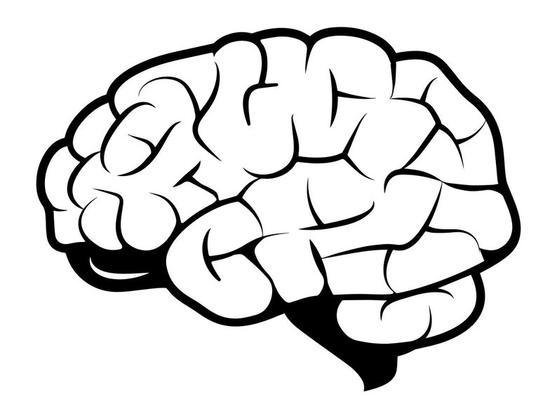
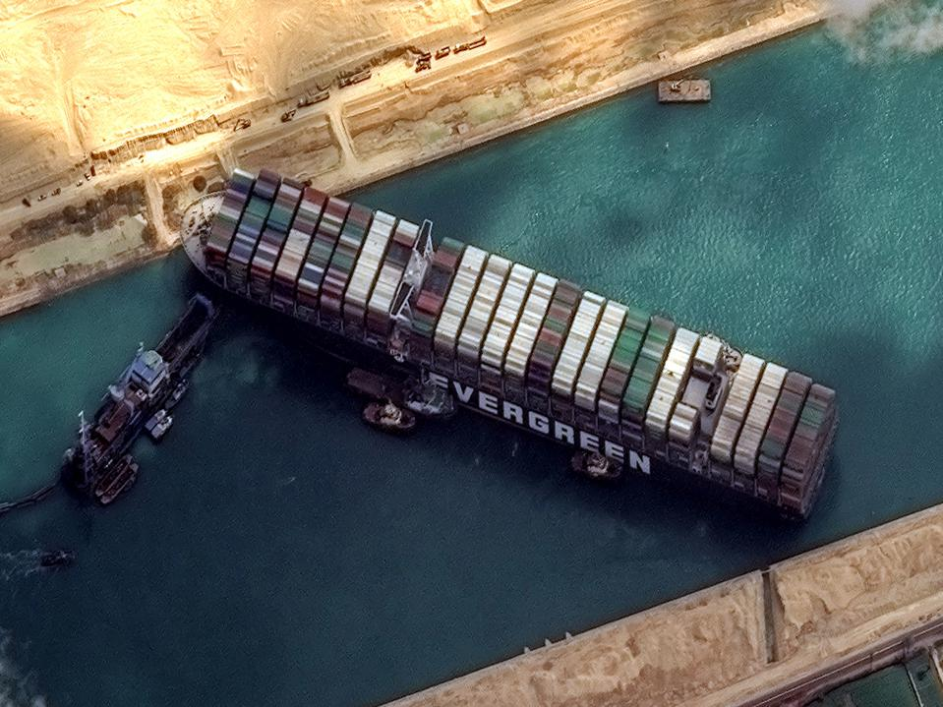
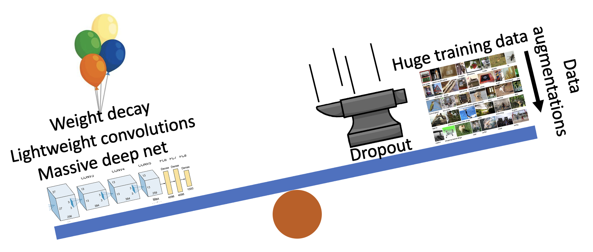
Three Big Concerns
Optimization needs to not get stuck
Generalization: avoid overfitting
Computation: learn good rules, good features

Slide 5
Overview
One time set up: activation functions, preprocessing, weight initialization, regularization, gradient checking
Training dynamics: babysitting the learning process, parameter updates, hyperparameter optimization
Evaluation: model ensembles, test-time augmentation, transfer learning
Lecture 7 -

Slide 6
Activation Functions
Lecture 7 -

Slide 7
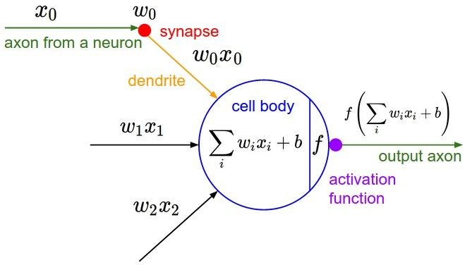
Activation Functions

Slide 8
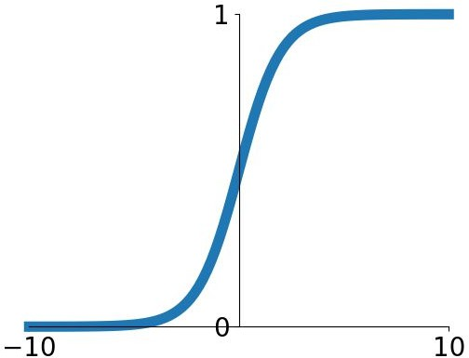
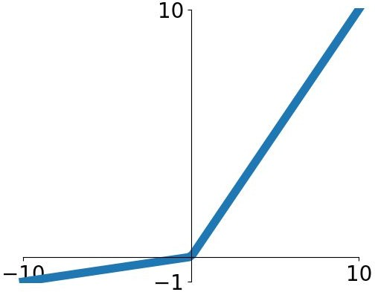
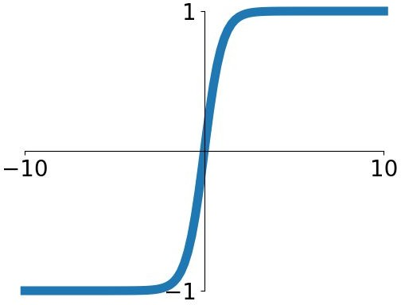
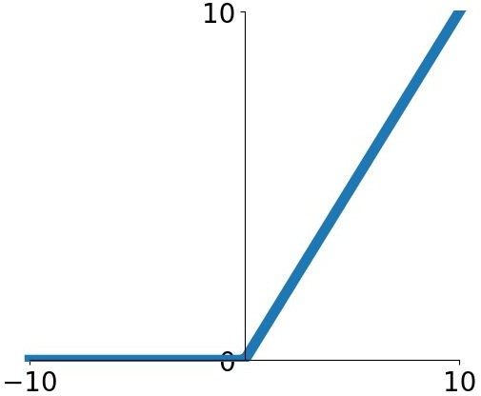
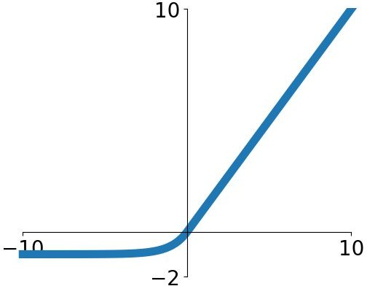
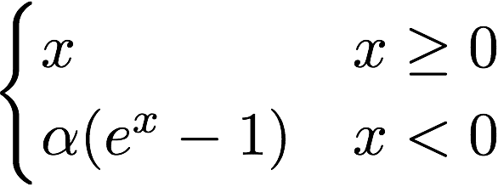
Activation Functions
Sigmoid
tanh
Leaky ReLU
Maxout
ReLU
ELU
Lecture 7 -

Slide 9
Activation Functions
Squashes numbers to range [0,1]
Historically popular since they have nice interpretation as a saturating “firing rate” of a neuron
Sigmoid
Saturated neurons “kill” the gradients
Lecture 7 -

Slide 10
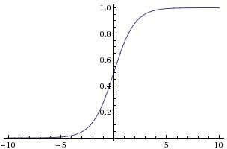
sigmoid gate
x
Lecture 7 -

Slide 11
x
sigmoid gate
What happens when x = -10?
Lecture 7 -

Slide 12
x
sigmoid gate
What happens when x = -10?
Lecture 7 -

Slide 13
x
sigmoid gate
What happens when x = -10? What happens when x = 0?
Lecture 7 -

Slide 14
sigmoid gate
x
What happens when x = -10? What happens when x = 0?
What happens when x = 10?
Lecture 7 -

Slide 15
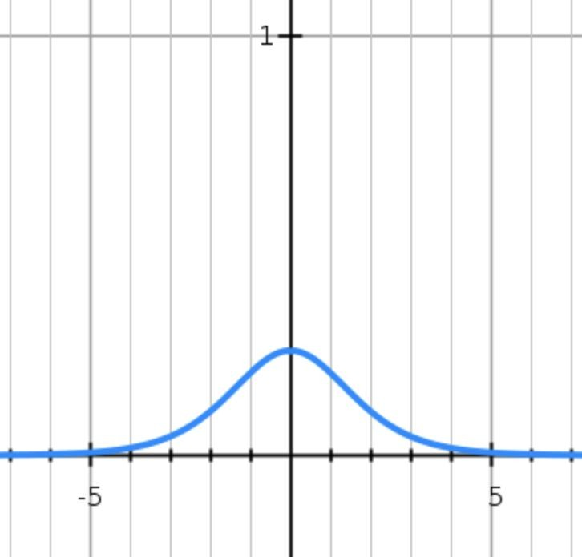
sigmoid gate
x
What happens when x = -10? What happens when x = 0?
What happens when x = 10?
Lecture 7 -

Slide 16
sigmoid gate
x
Why is this a problem?
If all the gradients flowing back will be zero and weights will never change
Lecture 7 -

Slide 17
Activation Functions
Squashes numbers to range [0,1]
Historically popular since they have nice interpretation as a saturating “firing rate” of a neuron
1. Saturated neurons “kill” the gradients
2. Sigmoid outputs are not zero-centered
Sigmoid
Lecture 7 -

Slide 18
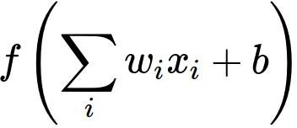
Consider what happens when the input to a neuron is
always positive...
What can we say about the gradients on w?
We know that local gradient of sigmoid is always positive
We are assuming x is always positive
So!! Sign of gradient for all w_{i} is the same as the sign of upstream scalar gradient!
Lecture 7 -

Slide 19
Consider what happens when the input to a neuron is
always positive...
allowed gradient update directions
allowed gradient update directions
zig zag path
hypothetical optimal w vector
What can we say about the gradients on w? Always all positive or all negative :(
Lecture 7 -

Slide 20
Consider what happens when the input to a neuron is
always positive...
allowed gradient update directions
allowed gradient update directions
zig zag path
hypothetical optimal w vector
What can we say about the gradients on w? Always all positive or all negative :(
(For a single element! Minibatches help)
April 25, 2023

Slide 21
Activation Functions
Squashes numbers to range [0,1]
Historically popular since they have nice interpretation as a saturating “firing rate” of a neuron
1. Saturated neurons “kill” the gradients
2. Sigmoid outputs are not zero-centered
3. exp() is a little bit expensive
Sigmoid
Lecture 7 -

Slide 22
Activation Functions
Squashes numbers to range [-1,1]
zero centered (nice)
still kills gradients when saturated :(
tanh(x)
[LeCun et al., 1991]
Lecture 7 -

Slide 23
- Computes f(x) = max(0,x)
Activation Functions
Does not saturate (in +region)
Very computationally efficient
Converges much faster than sigmoid/tanh in practice (e.g. 6x)
Not zero-centered output
An annoyance:
hint: what is the gradient when x < 0?
ReLU
(Rectified Linear Unit)
[Glorot et al., 2010]

Slide 24
x
ReLU
gate
What happens when x = -10? What happens when x = 0?
What happens when x = 10?
Lecture 7 -

Slide 25
active ReLU
DATA CLOUD
dead ReLU
will never activate
=> never update
Lecture 7 -

Slide 26
Activation Functions
[Mass et al., 2013] [He et al., 2015]
Does not saturate
Computationally efficient
Converges much faster than sigmoid/tanh in practice! (e.g. 6x)
will not “die”.
Leaky ReLU
Lecture 7 -

Slide 27
Activation Functions
[Mass et al., 2013] [He et al., 2015]
Does not saturate
Computationally efficient
Converges much faster than sigmoid/tanh in practice! (e.g. 6x)
will not “die”.
Parametric Rectifier (PReLU)
Leaky ReLU

Slide 28
Activation Functions
[Clevert et al., 2015]
Exponential Linear Units (ELU)
All benefits of ReLU
Closer to zero mean outputs
Negative saturation regime compared with Leaky ReLU adds some robustness to noise
Computation requires exp()
(Alpha default = 1)

Slide 29
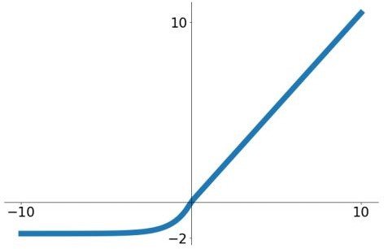
Activation Functions
[Klambauer et al. ICLR 2017]
Scaled Exponential Linear Units (SELU)
Scaled version of ELU that works better for deep networks
“Self-normalizing” property;
Can train deep SELU networks without BatchNorm

Slide 30
Maxout “Neuron”
[Goodfellow et al., 2013]
Does not have the basic form of dot product -> nonlinearity
Generalizes ReLU and Leaky ReLU
Linear Regime! Does not saturate! Does not die!
Problem: doubles the number of parameters/neuron :(

Slide 31
TLDR: In practice:
Use ReLU. Be careful with your learning rates
Try Leaky ReLU / Maxout / ELU / SELU / GELU
- To squeeze out some marginal gains
Don’t use sigmoid or tanh

Slide 32
Data Preprocessing
Lecture 7 -

Slide 33
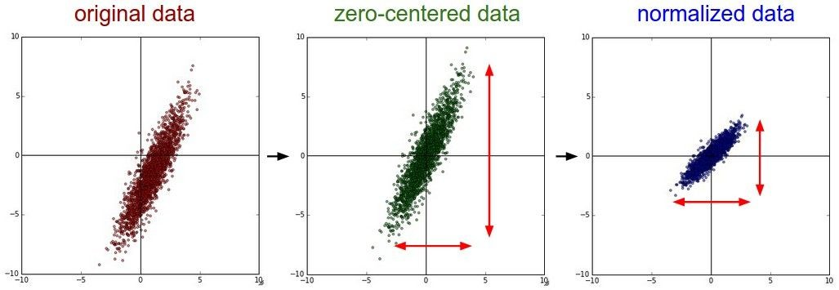
Data Preprocessing
(Assume X [NxD] is data matrix, each example in a row)

Slide 34
Remember: Consider what happens when
the input to a neuron is always positive...
allowed gradient update directions
allowed gradient update directions
zig zag path
hypothetical optimal w vector
What can we say about the gradients on w? Always all positive or all negative :(
(this is also why you want zero-mean data!)
Lecture 7 -

Slide 35
Data Preprocessing
(Assume X [NxD] is data matrix, each example in a row)

Slide 36
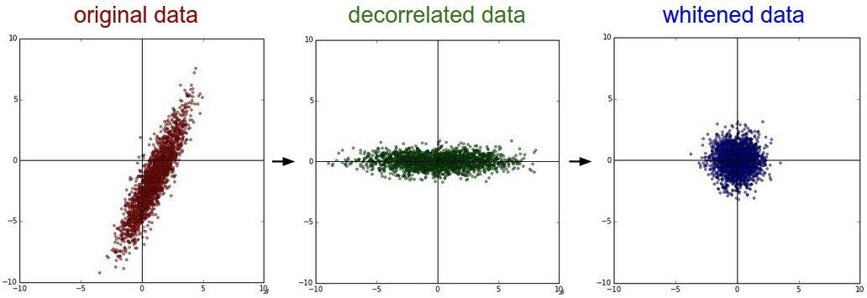
Data Preprocessing
In practice, you may also see PCA and Whitening of the data
(data has diagonal covariance matrix)
(covariance matrix is the identity matrix)
Lecture 7 -

Slide 37
Data Preprocessing
Before normalization: classification loss very sensitive to changes in weight matrix; hard to optimize
After normalization: less sensitive to small changes in weights; easier to optimize

Slide 38
TLDR: In practice for Images: center only
e.g. consider CIFAR-10 example with [32,32,3] images
Subtract the mean image (e.g. AlexNet) (mean image = [32,32,3] array)
Subtract per-channel mean (e.g. VGGNet) (mean along each channel = 3 numbers)
Subtract per-channel mean and
Not common
Divide by per-channel std (e.g. ResNet) (mean along each channel = 3 numbers)
to do PCA or whitening
Lecture 7 -

Slide 39
Weight Initialization
Lecture 7 -

Slide 40
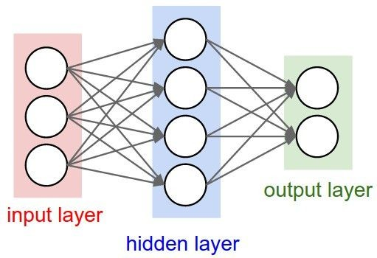
- Q: what happens when W=constant init is used?

Slide 41
- First idea: Small random numbers
(gaussian with zero mean and 1e-2 standard deviation)

Slide 42
- First idea: Small random numbers
(gaussian with zero mean and 1e-2 standard deviation)
Works ~okay for small networks, but problems with deeper networks.

Slide 43
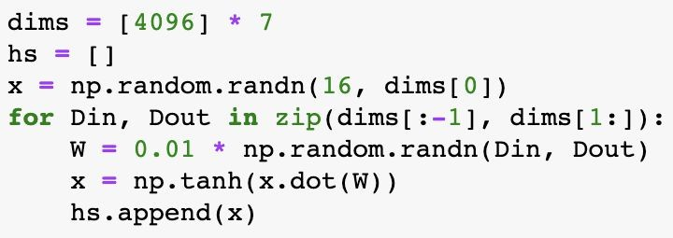
Weight Initialization: Activation statistics
Forward pass for a 6-layer net with hidden size 4096
What will happen to the activations for the last layer?

Slide 44
Weight Initialization: Activation statistics
Forward pass for a 6-layer net with hidden size 4096
All activations tend to zero for deeper network layers
Q: What do the gradients dL/dW look like?
A: All zero, no learning =(

Slide 45
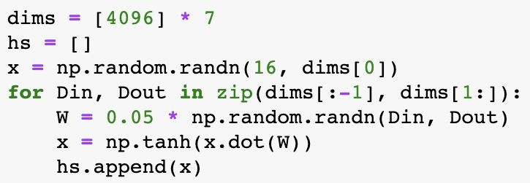
Weight Initialization: Activation statistics
Increase std of initial weights from 0.01 to 0.05
What will happen to the activations for the last layer?

Slide 46
Weight Initialization: Activation statistics
All activations saturate
Q: What do the gradients look like?
Increase std of initial weights from 0.01 to 0.05

Slide 47
Weight Initialization: Activation statistics
All activations saturate
Q: What do the gradients look like?
A: Local gradients all zero, no learning =(
Increase std of initial weights from 0.01 to 0.05

Slide 48
Weight Initialization: “Xavier” Initialization
“Xavier” initialization: std = 1/sqrt(Din)
Glorot and Bengio, “Understanding the difficulty of training deep feedforward neural networks”, AISTAT 2010

Slide 49
Weight Initialization: “Xavier” Initialization
“Xavier” initialization: std = 1/sqrt(Din)
“Just right”: Activations are nicely scaled for all layers!
Glorot and Bengio, “Understanding the difficulty of training deep feedforward neural networks”, AISTAT 2010
Lecture 7 -

Slide 50
Weight Initialization: “Xavier” Initialization
“Xavier” initialization: std = 1/sqrt(Din)
“Just right”: Activations are nicely scaled for all layers!
For conv layers, Din is
filter_size² * input_channels
Glorot and Bengio, “Understanding the difficulty of training deep feedforward neural networks”, AISTAT 2010
Lecture 7 -

Slide 51
Weight Initialization: “Xavier” Initialization
“Xavier” initialization: std = 1/sqrt(Din)
“Just right”: Activations are nicely scaled for all layers!
For conv layers, Din is
filter_size² * input_channels
Let: y = x₁w₁+x₂w₂+...+x_{Din}w_{Din}
Var(y) = Var(x₁w₁+x₂w₂+...+x_{Din}w_{Din})
= Din Var(x_{i}w_{i})
= Din Var(x_{i}) Var(w_{i}) [Assume all x_{i}, w_{i} are zero mean]
Assume: Var(x₁) = Var(x₂)= …=Var(x )
We want: Var(y) = Var(x_{i})
Glorot and Bengio, “Understanding the difficulty of training deep feedforward neural networks”, AISTAT 2010
Lecture 7 -

Slide 52
Weight Initialization: “Xavier” Initialization
“Xavier” initialization: std = 1/sqrt(Din)
“Just right”: Activations are nicely scaled for all layers!
For conv layers, Din is
filter_size² * input_channels
Let: y = x₁w₁+x₂w₂+...+x_{Din}w_{Din}
Var(y) = Var(x₁w₁+x₂w₂+...+x_{Din}w_{Din})
= Din Var(x_{i}w_{i})
= Din Var(x_{i}) Var(w_{i}) [Assume all x_{i}, w_{i} are iid]
Assume: Var(x₁) = Var(x₂)= …=Var(x )
We want: Var(y) = Var(x_{i})
Din
So, Var(y) = Var(x_{i}) only when Var(w_{i}) = 1/Din
Glorot and Bengio, “Understanding the difficulty of training deep feedforward neural networks”, AISTAT 2010

Slide 53
Weight Initialization: What about ReLU?
Change from tanh to ReLU
Lecture 7 -

Slide 54
Weight Initialization: What about ReLU?
Change from tanh to ReLU
Xavier assumes zero centered activation function
Activations collapse to zero again, no learning =(

Slide 55
Weight Initialization: Kaiming / MSRA Initialization
ReLU correction: std = sqrt(2 / Din)
“Just right”: Activations are nicely scaled for all layers!
He et al, “Delving Deep into Rectifiers: Surpassing Human-Level Performance on ImageNet Classification”, ICCV 2015

Slide 56
Improving Gradients through Architecture

Slide 57
Batch Normalization
Input:
$$μ_{j}=\frac{1}{N}\sum_{i=1}^{N}{x_{i,j}}$$
Per-channel mean, shape is D
$$x∈ℝ^{N×D}$$
Learnable scale and shift parameters:
$$σ_{j}^{2}=\frac{1}{N}\sum_{i=1}^{N}{{\left(x_{i,j}−μ_{j}\right)}^{2}}$$
Per-channel std, shape is D
$$γ,β∈ℝ^{D}$$
$${\hat{x}}_{i,j}=\frac{x_{i,j}−μ_{j}}{\sqrt{σ_{j}^{2}+ε}}$$
Normalized x,
Shape is N x D
Learning $γ=σ$, $β=μ$
will recover the identity function (in expectation)
$$y_{i,j}=γ_{j}{\hat{x}}_{i,j}+β_{j}$$
Output,
Shape is N x D
Slide credit: D Fouhey & J Johnson

Slide 58
Batch Normalization
Problem: Estimates depend on minibatch; can’t do this at test-time!
Input:
$$μ_{j}=\frac{1}{N}\sum_{i=1}^{N}{x_{i,j}}$$
Per-channel mean, shape is D
$$x∈ℝ^{N×D}$$
Learnable scale and shift parameters:
$$σ_{j}^{2}=\frac{1}{N}\sum_{i=1}^{N}{{\left(x_{i,j}−μ_{j}\right)}^{2}}$$
Per-channel std, shape is D
$$γ,β∈ℝ^{D}$$
$${\hat{x}}_{i,j}=\frac{x_{i,j}−μ_{j}}{\sqrt{σ_{j}^{2}+ε}}$$
Normalized x,
Shape is N x D
Learning $γ=σ$, $β=μ$
will recover the identity function (in expectation)
$$y_{i,j}=γ_{j}{\hat{x}}_{i,j}+β_{j}$$
Output,
Shape is N x D
Slide credit: D Fouhey & J Johnson

Slide 59
Batch Normalization: Test-Time
(Running) average of
values seen during training
Input:
$$μ_{j}=\frac{1}{N}\sum_{i=1}^{N}{x_{i,j}}$$
Per-channel mean, shape is D
$$x∈ℝ^{N×D}$$
Learnable scale and shift parameters:
(Running) average of
values seen during training
$$σ_{j}^{2}=\frac{1}{N}\sum_{i=1}^{N}{{\left(x_{i,j}−μ_{j}\right)}^{2}}$$
Per-channel std, shape is D
$$γ,β∈ℝ^{D}$$
$${\hat{x}}_{i,j}=\frac{x_{i,j}−μ_{j}}{\sqrt{σ_{j}^{2}+ε}}$$
Normalized x,
Shape is N x D
Learning $γ=σ$, $β=μ$
will recover the identity function (in expectation)
$$y_{i,j}=γ_{j}{\hat{x}}_{i,j}+β_{j}$$
Output,
Shape is N x D
Slide credit: D Fouhey & J Johnson

Slide 60
Batch Normalization: Test-Time
(Running) average of
values seen during training
Input:
$$μ_{j}=\frac{1}{N}\sum_{i=1}^{N}{x_{i,j}}$$
Per-channel mean, shape is D
$$x∈ℝ^{N×D}$$
Learnable scale and shift parameters:
(Running) average of
values seen during training
$$σ_{j}^{2}=\frac{1}{N}\sum_{i=1}^{N}{{\left(x_{i,j}−μ_{j}\right)}^{2}}$$
Per-channel std, shape is D
$$γ,β∈ℝ^{D}$$
$${\hat{x}}_{i,j}=\frac{x_{i,j}−μ_{j}}{\sqrt{σ_{j}^{2}+ε}}$$
Normalized x,
Shape is N x D
During testing batchnorm becomes a linear operator!
Can be fused with the previous fully-connected or conv layer
$$y_{i,j}=γ_{j}{\hat{x}}_{i,j}+β_{j}$$
Output,
Shape is N x D
Slide credit: D Fouhey & J Johnson

Slide 61
Residual Networks
Once we have Batch Normalization, we can train networks with 10+ layers. What happens as we go deeper?
He et al, “Deep Residual Learning for Image Recognition”, CVPR 2016
Slide credit: D Fouhey & J Johnson

Slide 62
Residual Networks
Once we have Batch Normalization, we can train networks with 10+ layers. What happens as we go deeper?
Deeper model does worse than shallow model!
Initial guess: Deep model is overfitting since it is much bigger than the other model
Test error
56-layer
20-layer
Iterations
He et al, “Deep Residual Learning for Image Recognition”, CVPR 2016
Slide credit: D Fouhey & J Johnson

Slide 63
Residual Networks
Once we have Batch Normalization, we can train networks with 10+ layers. What happens as we go deeper?
Training error
Test error
56-layer
56-layer
20-layer
20-layer
Iterations
Iterations
In fact the deep model seems to be underfitting since it also performs worse than the shallow model on the training set! It is actually underfitting
He et al, “Deep Residual Learning for Image Recognition”, CVPR 2016
Slide credit: D Fouhey & J Johnson

Slide 64
Residual Networks
A deeper model can emulate a shallower model: copy layers from shallower model, set extra layers to identity
Thus deeper models should do at least as good as shallow models
Hypothesis: This is an optimization problem. Deeper models are harder to optimize, and in particular don’t learn identity functions to emulate shallow models
He et al, “Deep Residual Learning for Image Recognition”, CVPR 2016
Slide credit: D Fouhey & J Johnson

Slide 65
Residual Networks
A deeper model can emulate a shallower model: copy layers from shallower model, set extra layers to identity
Thus deeper models should do at least as good as shallow models
Hypothesis: This is an optimization problem. Deeper models are harder to optimize, and in particular don’t learn identity functions to emulate shallow models
Solution: Change the network so learning identity functions with extra layers is easy!
He et al, “Deep Residual Learning for Image Recognition”, CVPR 2016
Slide credit: D Fouhey & J Johnson

Slide 66
Residual Networks
Solution: Change the network so learning identity functions with extra layers is easy!
H(x)
relu
F(x) + x
conv
conv
F(x)
Additive “shortcut”
relu
relu
conv
conv
X
X
“Plain” block
Residual Block
He et al, “Deep Residual Learning for Image Recognition”, CVPR 2016
Slide credit: D Fouhey & J Johnson

Slide 67
Residual Networks
Solution: Change the network so learning identity functions with extra layers is easy!
H(x)
relu
F(x) + x
If you set these to 0, the whole block will compute the identity function!
conv
conv
F(x)
Additive “shortcut”
relu
relu
conv
conv
X
X
“Plain” block
Residual Block
He et al, “Deep Residual Learning for Image Recognition”, CVPR 2016
Slide credit: D Fouhey & J Johnson

Slide 68
Residual Networks
A residual network is a stack of many residual blocks
Regular design, like VGG: each residual block has two 3x3 conv
Network is divided into stages: the first block of each stage halves the resolution (with stride-2 conv) and doubles the number of channels
Softmax
FC 1000
Pool
3x3 conv, 512
3x3 conv, 512
3x3 conv, 512
relu
3x3 conv, 512
F(x) + x
3x3 conv, 512
3x3 conv, 512, /2
...
3x3 conv
3x3 conv, 128
F(x)
3x3 conv, 128
relu
3x3 conv, 128
3x3 conv, 128
3x3 conv
3x3 conv, 128
3x3 conv, 128, / 2
3x3 conv, 64
3x3 conv, 64
X
3x3 conv, 64
Residual block
3x3 conv, 64
3x3 conv, 64
3x3 conv, 64
Pool
7x7 conv, 64, / 2
Input
He et al, “Deep Residual Learning for Image Recognition”, CVPR 2016
Slide credit: D Fouhey & J Johnson

Slide 69
Tricks to avoid getting stuck (so far)
Avoiding switchbacks
Avoiding flat regions
1. Normalize input data
“Init”
2. Initializing weights
3. Batchnorm Normalize activations
4. Residual architecture “Skip” connections
“Architecture”
5. Momentum
“Updates”
6. ADAM

Slide 70
Training vs Testing Error
Lecture 7 -
77

Slide 71
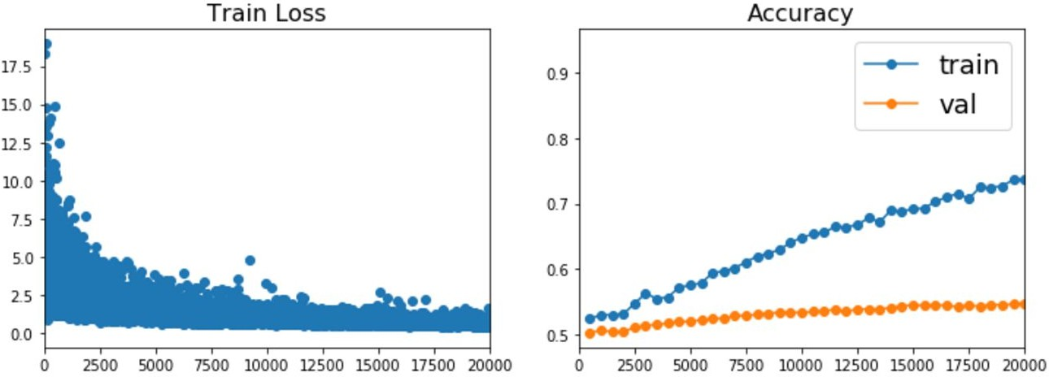
Beyond Training Error
Better optimization algorithms help reduce training loss
But we really care about error on new data - how to reduce the gap?

Slide 72
Early Stopping: Always do this
Train Val
Loss
Accuracy
Stop training here
Iteration
Iteration
Stop training the model when accuracy on the validation set decreases Or train for a long time, but always keep track of the model snapshot that worked best on val

Slide 73
Model Ensembles
Train multiple independent models
At test time average their results
(Take average of predicted probability distributions, then choose argmax)
Enjoy 2% extra performance

Slide 74
How to improve single-model performance?
Regularization

Slide 75
Regularization: Add term to loss
In common use: L2 regularization L1 regularization
Elastic net (L1 + L2)
(Weight decay)

Slide 76
Regularization: Dropout
In each forward pass, randomly set some neurons to zero Probability of dropping is a hyperparameter; 0.5 is common
Srivastava et al, “Dropout: A simple way to prevent neural networks from overfitting”, JMLR 2014

Slide 77
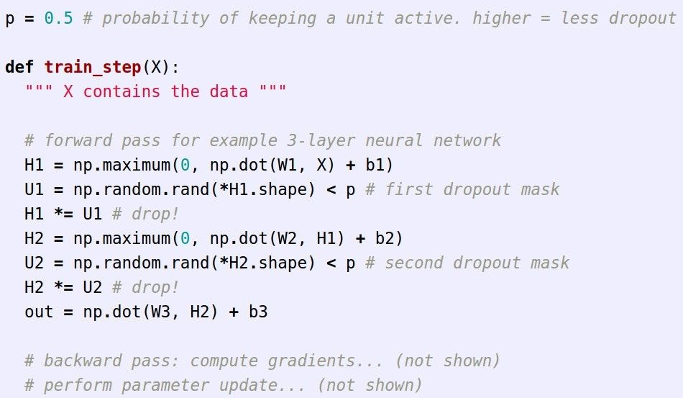
Regularization: Dropout
Example forward pass with a
3-layer network using dropout

Slide 78
Regularization: Dropout
How can this possibly be a good idea?
Forces the network to have a redundant representation; Prevents co-adaptation of features
has an ear
has a tail is furry has claws
mischievous look
X
X
cat score
X

Slide 79
Regularization: Dropout
How can this possibly be a good idea?
Another interpretation:
Dropout is training a large ensemble of models (that share parameters).
Each binary mask is one model
An FC layer with 4096 units has 2⁴⁰⁹⁶ ~ 10¹²³³ possible masks!
Only ~ 10⁸² atoms in the universe...

Slide 80
Dropout: Test time
At test time all neurons are active always
=> We must scale the activations so that for each neuron: output at test time = expected output at training time

Slide 81
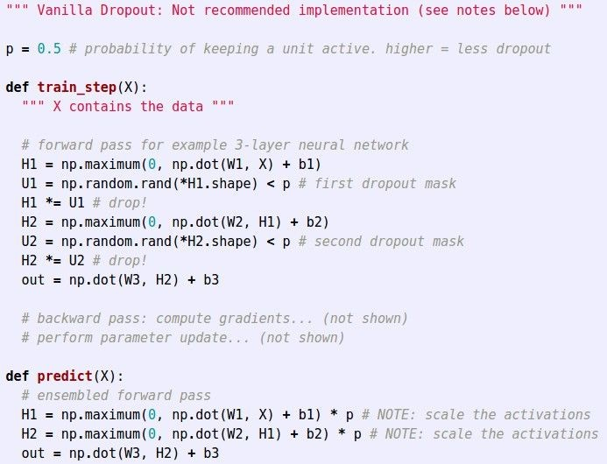
Dropout Summary
drop in train time
scale at test time

Slide 82
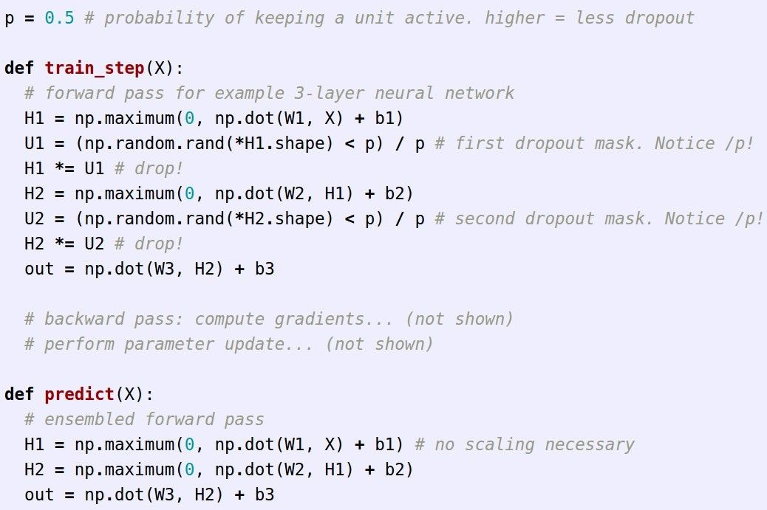
More common: “Inverted dropout”
test time is unchanged!

Slide 83
Notebook activity Training Dynamics Colab
http://bit.ly/training-dyn

Slide 84
Regularization: A common pattern
Training: Add some kind of randomness
Testing: Average out randomness (sometimes approximate)

Slide 85
Regularization: A common pattern
Training: Add some kind of randomness
Example: Batch Normalization
Training: Normalize using stats from random minibatches
Testing: Use fixed stats to normalize
Testing: Average out randomness (sometimes approximate)

Slide 86
Regularization: Data Augmentation
“cat”
Load image and label
Compute loss
CNN
This image by Nikita is licensed under CC-BY 2.0

Slide 87
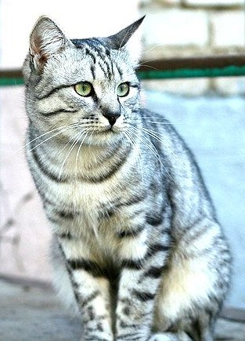
Regularization: Data Augmentation
“cat”
Load image and label
Compute loss
CNN
Transform image
Lecture 7 -
87

Slide 88
Data Augmentation
Horizontal Flips
Lecture 7 -
88

Slide 89
Data Augmentation
Random crops and scales
Training: sample random crops / scales
ResNet:
Pick random L in range [256, 480]
Resize training image, short side = L
Sample random 224 x 224 patch
Lecture 7 -
89

Slide 90
Data Augmentation
Random crops and scales
Training: sample random crops / scales
ResNet:
Pick random L in range [256, 480]
Resize training image, short side = L
Sample random 224 x 224 patch
Testing: average a fixed set of crops
ResNet:
Resize image at 5 scales: {224, 256, 384, 480, 640}
For each size, use 10 224 x 224 crops: 4 corners + center, + flips
Lecture 7 -
90

Slide 91
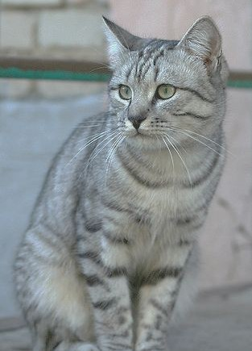
Data Augmentation
Color Jitter
Simple: Randomize contrast and brightness
Lecture 7 -
91

Slide 92
Data Augmentation
Color Jitter
Simple: Randomize contrast and brightness
More Complex:
Apply PCA to all [R, G, B] pixels in training set
Sample a “color offset” along principal component directions
Add offset to all pixels of a training image
(As seen in [Krizhevsky et al. 2012], ResNet, etc)
Lecture 7 -
92

Slide 93
Data Augmentation
Get creative for your problem!
Examples of data augmentations:
translation
rotation
stretching
shearing,
lens distortions, … (go crazy)
Lecture 7 -
93

Slide 94
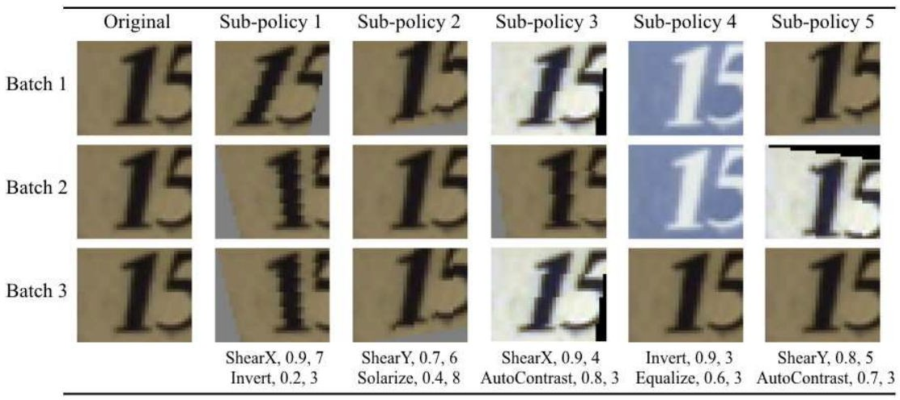
Automatic Data Augmentation
Cubuk et al., “AutoAugment: Learning Augmentation Strategies from Data”, CVPR 2019
Lecture 7 -
94

Slide 95
Regularization: A common pattern
Training: Add random noise
Testing: Marginalize over the noise
Examples:
Dropout
Batch Normalization Data Augmentation
Lecture 7 -
95

Slide 96
Regularization: DropConnect
Training: Drop connections between neurons (set weights to 0)
Testing: Use all the connections
Examples:
Dropout
Batch Normalization Data Augmentation DropConnect
Wan et al, “Regularization of Neural Networks using DropConnect”, ICML 2013
Lecture 7 -
96

Slide 97
Regularization: Fractional Pooling
Training: Use randomized pooling regions
Testing: Average predictions from several regions
Examples:
Dropout
Batch Normalization Data Augmentation DropConnect Fractional Max Pooling
Graham, “Fractional Max Pooling”, arXiv 2014
Lecture 7 -
97

Slide 98
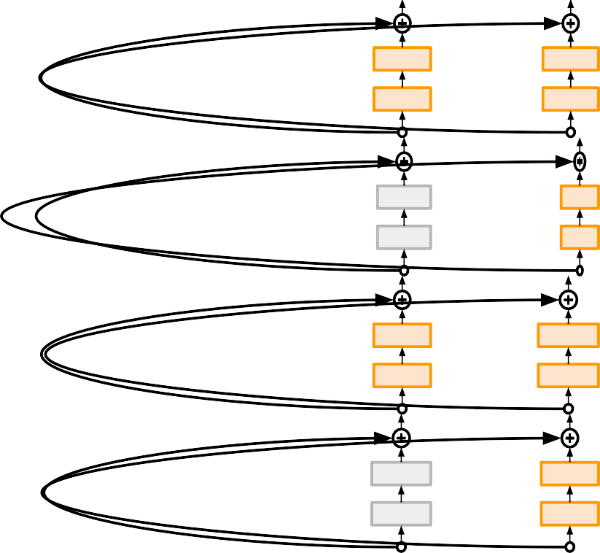
Regularization: Stochastic Depth
Training: Skip some layers in the network
Testing: Use all the layer
Examples:
Dropout
Batch Normalization Data Augmentation DropConnect Fractional Max Pooling Stochastic Depth
Huang et al, “Deep Networks with Stochastic Depth”, ECCV 2016
Lecture 7 -
98

Slide 99
Regularization: Cutout
Training: Set random image regions to zero
Testing: Use full image
Examples:
Dropout
Batch Normalization Data Augmentation DropConnect Fractional Max Pooling Stochastic Depth Cutout / Random Crop
DeVries and Taylor, “Improved Regularization of Convolutional Neural Networks with Cutout”, arXiv 2017
Works very well for small datasets like CIFAR, less common for large datasets like ImageNet
Lecture 7 -
99

Slide 100
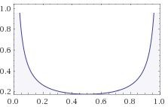
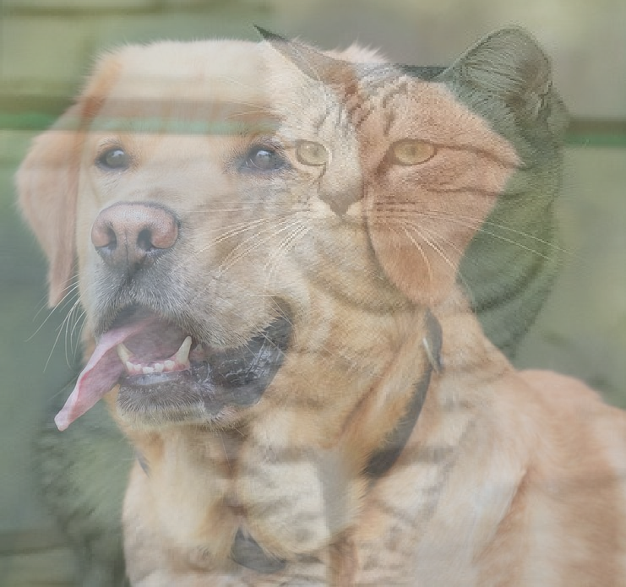
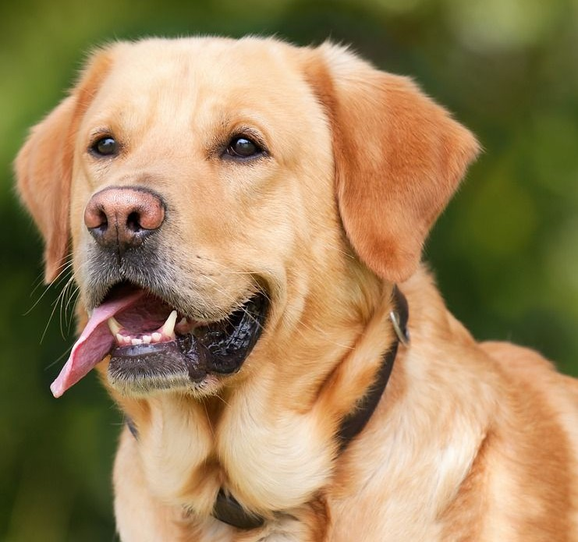
Regularization: Mixup
Training: Train on random blends of images
Testing: Use original images
Examples:
Dropout
Batch Normalization Data Augmentation DropConnect Fractional Max Pooling
Target label: cat: 0.4
dog: 0.6
CNN
Stochastic Depth Cutout / Random Crop Mixup
Zhang et al, “mixup: Beyond Empirical Risk Minimization”, ICLR 2018
Randomly blend the pixels of pairs of training images,
e.g. 40% cat, 60% dog
Lecture 7 -
100

Slide 101
Regularization - In practice
Training: Add random noise
Testing: Marginalize over the noise
Examples:
Dropout
Batch Normalization Data Augmentation DropConnect Fractional Max Pooling Stochastic Depth Cutout / Random Crop Mixup
Consider dropout for large fully-connected layers
Batch normalization and data augmentation almost always a good idea
Try cutout and mixup especially for small classification datasets
Lecture 7 -
101

