Slide 1
DS 4440
Deep Learning

Slide 2
Concepts to Know So Far
McCoullough-Pitts neuron model (weighted sum then nonlinearity)
Binary logic neural networks
Universal computations (two+ layers and nonlinearities are needed)
Gradient descent
Modular machine learning: Pytorch tensors, autograd, and modules
Losses: what makes a good/bad loss; MSE, L1, and cross-entropy loss
The backpropagation algorithm: computational graphs, backward pass, upstream/internal/downstream gradients, accumulation
First-order optimization: gradient descent, SGD, Momentum, ADAM
Conditioning gradients: nonlinearities, initialization, whitening

Slide 3
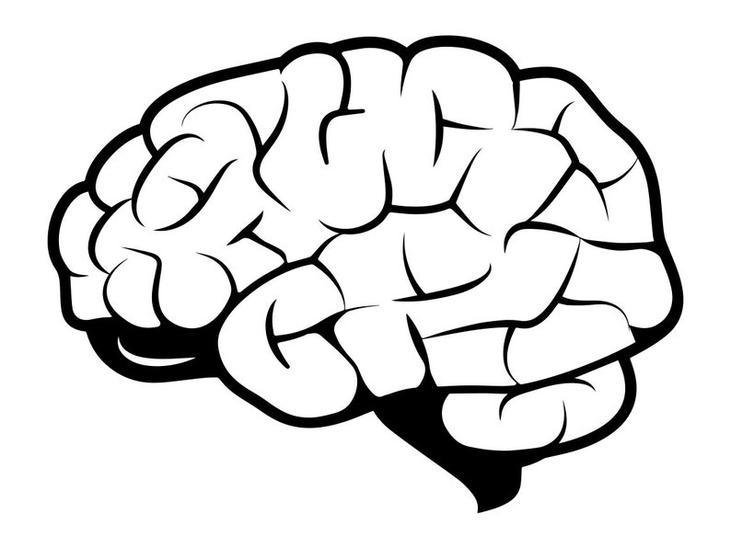
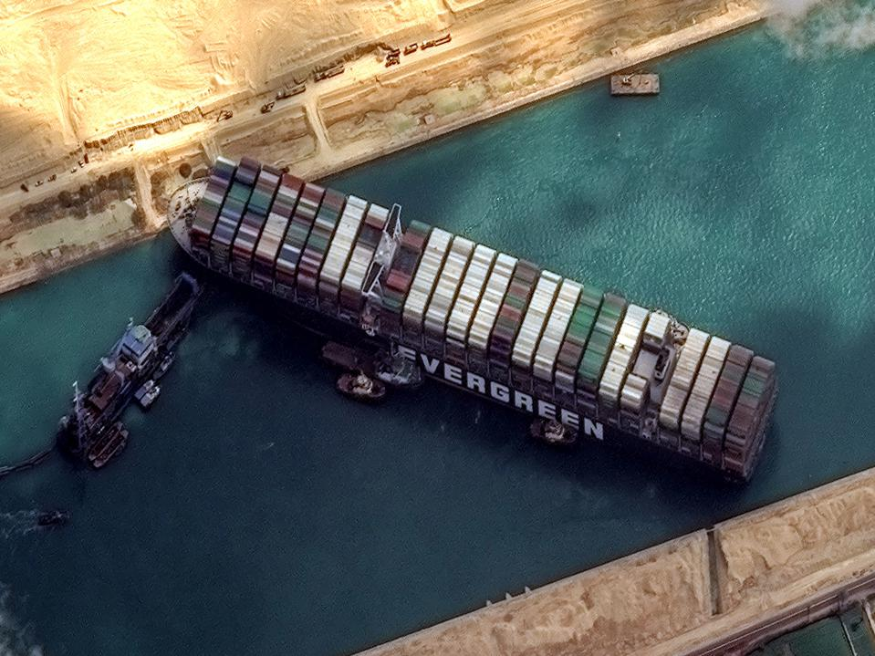
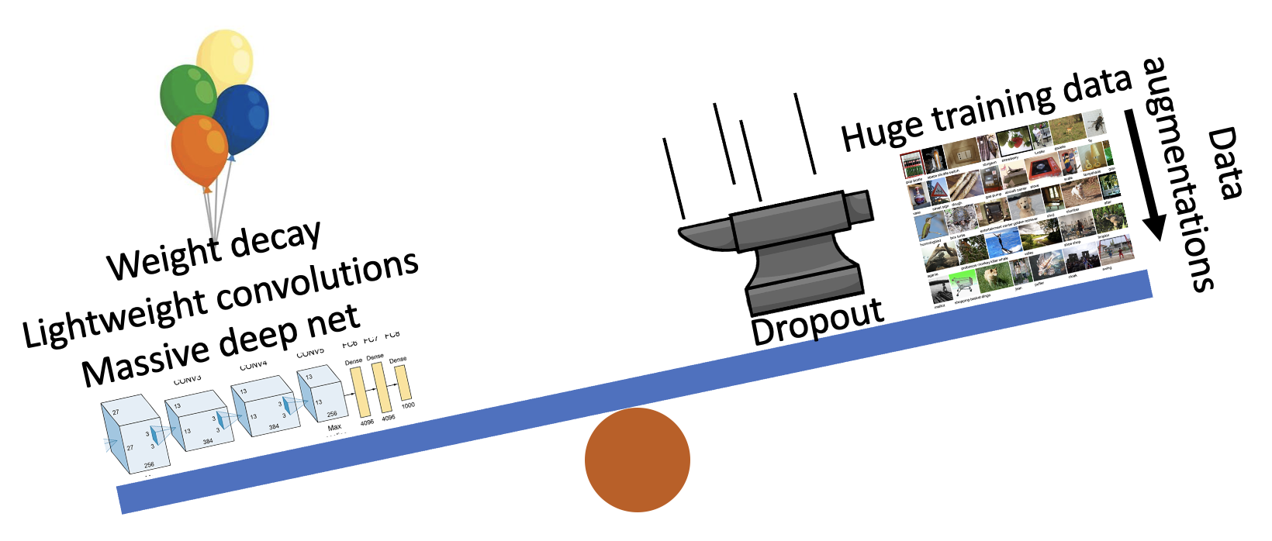
Three Big Concerns
Optimization needs to not get stuck
Generalization: avoid overfitting
Computation: learn good rules, good features

Slide 4
Our main question:
Now that we can learn a function....
... what kinds of functions should we learn?

Slide 5
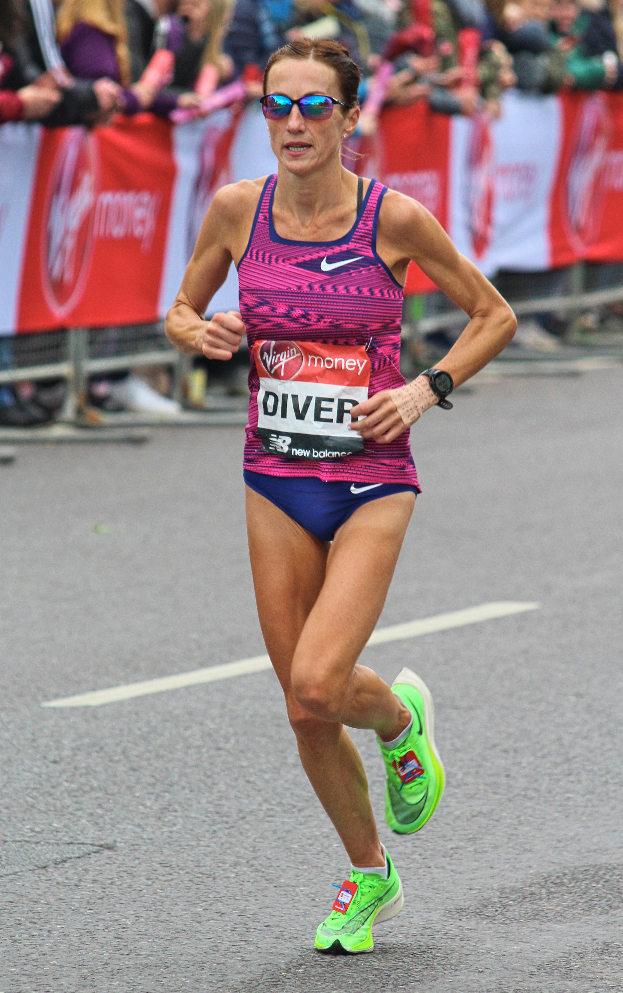
Two classical tasks
Representation
Classification
“Summarize this.”
“Which category is this?”
Species: human
Pose: upright
Activity: running
Direction: left
Location: road, outdoors
Color: pink, blue, lime
Looks like: Sinead Diver Sunglasses: yes
Marathon
800m Sprint
input image

Slide 6
How to go from task to training
1. By data:
2. By objective:
3. By architecture:
What are the inputs and the outputs?
How will we measure errors (loss)?
How will we parameterize the function?

Slide 7
Today’s Focus: Image Classification

Slide 8
Today’s focus: image classifiers
Marathon
800m Sprint
1. What is the input and the output?
2. How is error measured (what is the loss)?
3. How is it parameterized (what is the architecture)?

Slide 9
Image classification: input and output
$$f:X→Y$$
Marathon
800m Sprint
✓
“RGB” encoding of an image as a $3×h×w$ tensor
$$→$$
“one-hot” encoding of an N-way choice as an N-dim vector
1
.3
.0
.0
.1
.0
.0
.1
.5
.2
.5
.2
.1
.1
.1
.1
.2
.1
.2
0
.3
.3
.7
.2
.0
.7
.0
.0
.1
.0
.0
.0
.0
.0
.2
.3
.5
.2
0
.1
.3
.0
.1
.1
.1
.2
.2
.2
.3
.2
.2
.1
.0
.1
.4
.3
.1

Slide 10
Discuss: why one-hot vector vs just one number?
0
0
0
or
1
3
or
2
1
0
One-hot encoding
Class-number encoding
n dimensions [0...1], for n classes
1 dimension [1...n], for n classes

Slide 11
Some reasoning behind one-hot encoding
Unlike class-number encoding, leads to a probability distribution
Symmetry argument:
Should $\left\|y_{1}−y_{2}\right\|<\left\|y_{1}−y_{3}\right\|$?
One-hot gives us $\left\|y_{i}−y_{j}\right\|=$ $\left\|y_{i}−y_{k}\right\|$ for all $i≠j≠k$
What other symmetries should our neural networks reflect?

Slide 12
What is a symmetry?

Slide 13
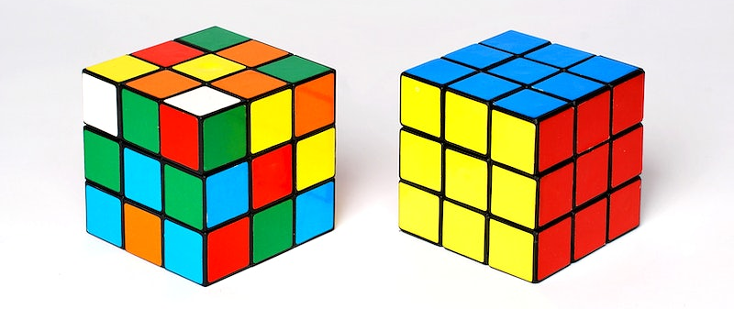
What is a symmetry $S(x)$?
Definition of invariance under a symmetry S:
$$f\left(S\left(x\right)\right)=f(x)$$
“When you change the data by S, the output remains unchanged.”
$f\left(x\right)=$“is x a Rubik’s cube?”
$f\left(S(x)\right)=$ yes; $f\left(x\right)=$ yes also.
A Rubik’s cube has 2125922464947725402112000
ways of changing it and it remains a Rubik’s cube
We don’t have trillions of separate neurons for Rubik’s cubes. Mostly we think of them all the same.

Slide 14
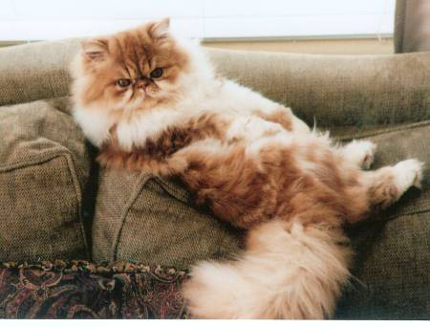
What is a symmetry $S(x)$?
Definition of invariance under a symmetry S:
$$f\left(S\left(x\right)\right)=f(x)$$
“When you change the data by S, the output remains unchanged.”
$f\left(x\right)=$“is x a photo of a Persian cat?”
$f\left(S(x)\right)=$ yes. $f\left(x\right)=$ yes too.
There are just 2 horizontal reflection images
A “cat recognizer” should treat the two reflections the same

Slide 15
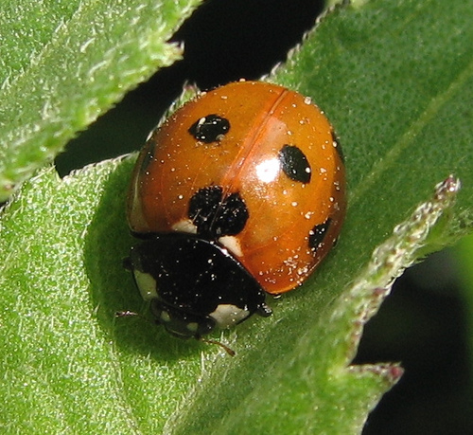
What is a symmetry $S(x)$?
Definition of invariance under a symmetry S:
$$f\left(S\left(x\right)\right)=f(x)$$
“When you change the data by S, the output remains unchanged.”
$f\left(x\right)=$“is x a photo of a ladybug?”
$f\left(S(x)\right)=$ yes. $f\left(x\right)=$ yes too.
Every image has many translations, rotations, resizes
These symmetries (almost) never change the classification

Slide 16
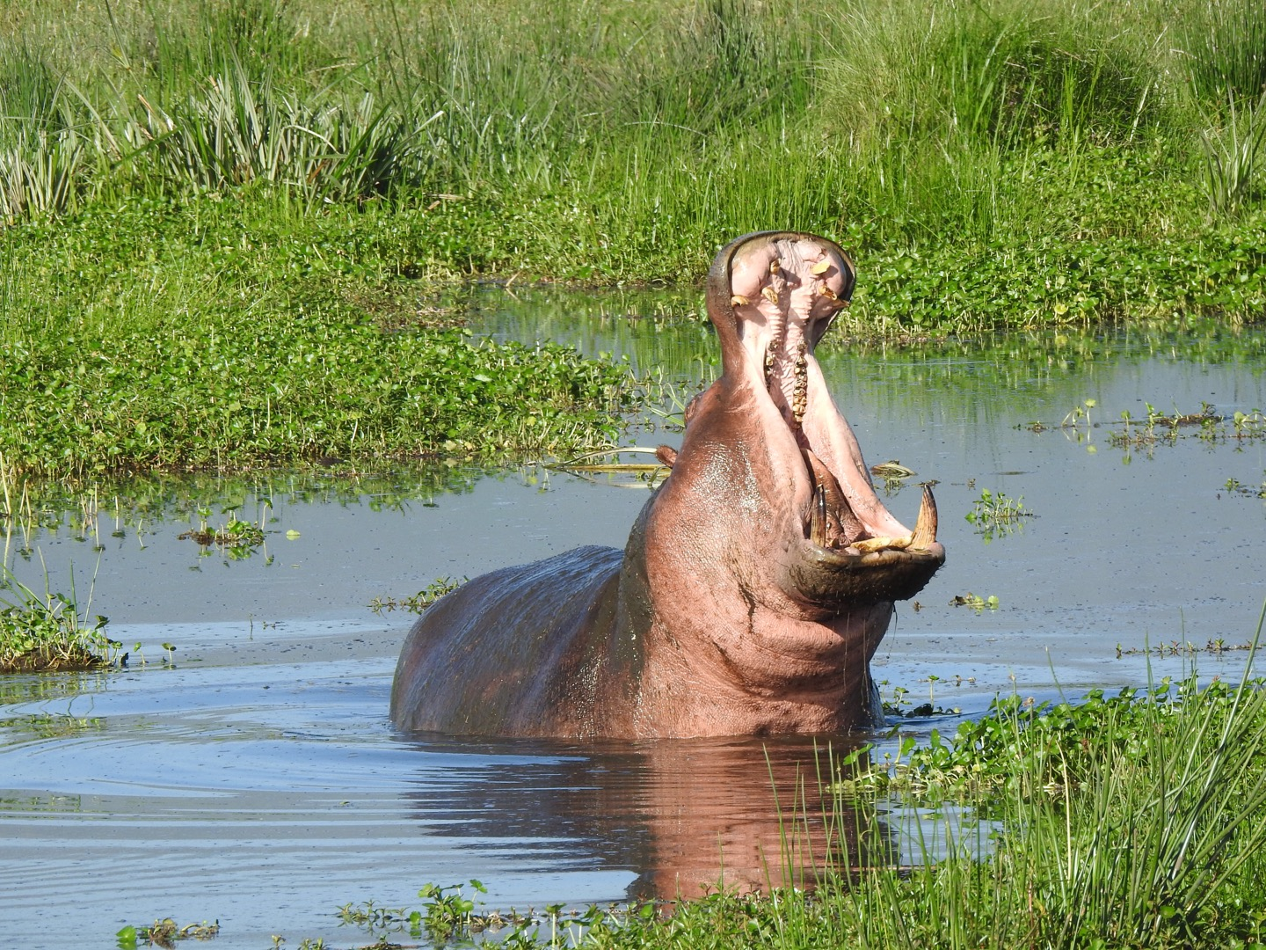
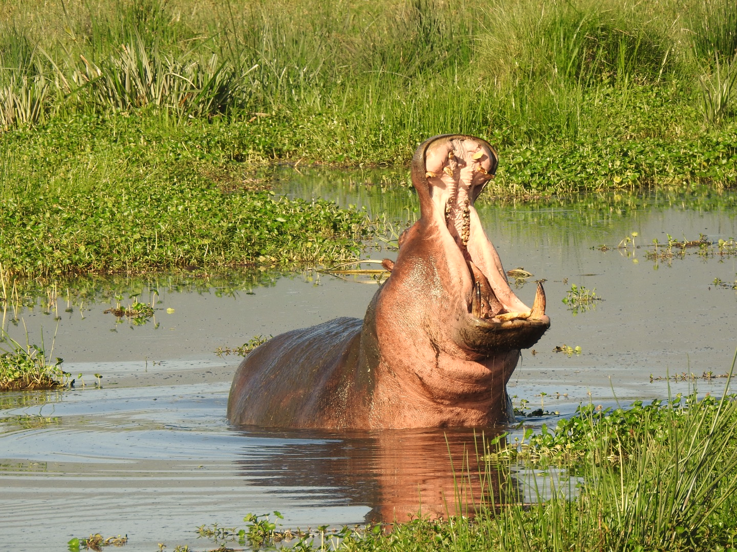
Symmetries are used for data augmentation
Hippo
Hippo?
Hippo?
Hippo?
Horizontal
Flip
Color
Jitter
Image Cropping
Original imagenet image
Equivalent to thousands of extra hippo pictures!
Slide credit: D Fouhey & J Johnson

Slide 17
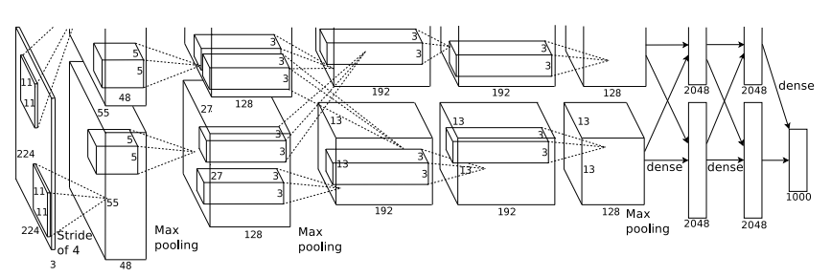
Regularizing through data augmentation
Apply random transformations to input images during training
Artificially “inflate” the size of your dataset
Hippo
Hippo
Training Image
Augmented images
Slide credit: D Fouhey & J Johnson

Slide 18
Can we guarantee symmetry in our network?
Definition of invariance under a symmetry S:
$$f\left(S\left(x\right)\right)=f(x)$$
Are there computations that are inherently symmetric?
$f\left(x\right)=$“does x contain vertical lines?”
$f\left(S(x)\right)=$ yes. $f\left(x\right)=$ yes too.
Actually, the precise idea is slightly more subtle...
What about convolutions?

Slide 19
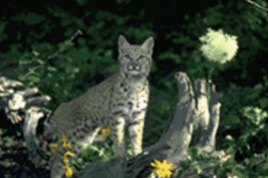
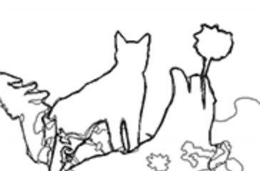
What if $f\left(x\right)$ outputs an image?
$$S_{1}$$
reflection
$$x$$
$$S_{1}(x)$$
$f\left(x\right)=$“trace the edges”
$$f$$
$$f$$
We don’t want the output to be exactly the same...
$$f(x)$$
[Image from Xe and Tu 2015]

Slide 20
What if $f\left(x\right)$ outputs an image?
$$S_{1}$$
$$S_{2}$$
reflection
translation
$$x$$
$$S_{1}(x)$$
$${S_{2}(S}_{1}(x))$$
$f\left(x\right)=$“trace the edges”
$$f$$
$$f$$
$$f$$
$$S_{1}$$
$$S_{2}$$
reflection
translation
$$f(x)$$
${f(S}_{1}(x)$)
$$f({S_{2}(S}_{1}(x)))$$
${=S}_{1}(f(x)$)
$${=S_{2}(S}_{1}(f(x)))$$
[Image from Xe and Tu 2015]

Slide 21
What operations will guarantee symmetry
Definition of equivariance under a symmetry S:
$$f\left(S\left(x\right)\right)=S(f\left(x\right))$$
“When you change the data by S, the output also changes by S’.”
$$S$$
translation
$$f$$
$$f$$
$$S$$
translation

Slide 22
Discussion: what equivariances does convolution have?
weighted sum
INPUT
OUTPUT

Slide 23
Reasoning about translation equivariance
$$x_{i−1}$$
$$x_{i}$$
$$x_{i+1}$$
0
0
0
0
0
0
1
2
1
0
1
1
0
0
0
0
0
0
0
0
weighted sum
$$y_{i}=\sum_{j}{w_{j}x_{i+j}}$$
-0.5
+1.0
-0.5
0.0
0.0
0.0
0.0
0.0
-0.5
0.0
+1.0
0.0
-1.0
+0.5
+0.5
-0.5
0.0
0.0
0.0
0.0
0.0
0.0
0.0
$$y_{i}$$
$${y′}_{i+K}=\sum_{j}{w_{j}{x′}_{i+K+j}}=\sum_{j}{w_{j}x_{i+j}}$$
$${x′}_{i+K}=x_{i}$$
$${=y}_{i}={y′}_{i+K}$$
translate the input...
gives weighted sums of shifted data...
translates output!

Slide 24
“Max pooling” is also equivariant
$$x_{i−1}$$
$$x_{i}$$
$$x_{i+1}$$
0
0
0
0
0
0
1
2
1
0
1
1
0
0
0
0
0
0
0
0
max over a window
$$y_{i}=\max_{−1≤j≤1}{x_{i}}$$
$$≤$$
$$≤$$
$$≤$$
0.0
0.0
0.0
0.0
0.0
+1.0
+2.0
+2.0
+2.0
+1.0
+1.0
+1.0
+1.0
0.0
0.0
0.0
0.0
0.0
0.0
0.0
$$y_{i}$$
$${x′}_{i+K}=x_{i}$$
$${y′}_{i+K}=\max_{−1≤j≤1}{{x′}_{i+K}}=\max_{−1≤j≤1}{x_{i}}$$
$${=y}_{i}={y′}_{i+K}$$
translate the input...
gives windowed max of shifted data...
translates output!

Slide 25
Convolutions

Slide 26
Image classification: architecture
$$f:X→Y$$
“RGB” encoding of an image as a $3×h×w$ tensor
?
1
“one-hot” encoding of an N-way choice as an N-dim vector
.3
.0
.0
.1
.0
.0
.1
.5
.2
.5
.2
.1
.1
.1
.1
.2
.1
.2
0
.3
.3
.7
.2
.0
.7
.0
.0
.1
.0
.0
.0
.0
.0
.2
.3
.5
.2
0
.1
.3
.0
.1
.1
.1
.2
.2
.2
.3
.2
.2
.1
.0
.1
.4
.3
.1
What architecture to deal with large RGB pixel inputs?

Slide 27
A problem with RGB inputs....
.3
.0
.0
.1
.0
.0
.3
.0
.0
.1
.0
.0
.1
.5
.1
.2
.2
.1
.1
.1
.2
.1
.2
.1
.1
.1
.1
.3
.1
.2
.1
.1
.1
.0
.1
.2
.3
.4
.5
.2
.0
.4
.3
.3
.6
.2
.0
.1
.0
.0
.1
.0
.0
.0
.0
.1
.1
.0
.0
.0
.0
.0
.2
.3
.5
.2
.0
.0
.2
.3
.5
.2
.1
.3
.0
.1
.1
.1
.1
.3
.0
.1
.1
.1
.2
.2
.2
.3
.2
.1
.2
.2
.2
.6
.2
.2
.1
.0
.1
.4
.3
.1
.1
.0
.1
.4
.3
.1
.3
.0
.0
.1
.0
.0
.3
.4
.0
.1
.0
.0
.1
.5
.1
.0
.2
.1
.1
.5
.2
.5
.2
.1
.1
.1
.1
.2
.1
.5
.1
.1
.1
.2
.1
.2
.1
.3
.6
.2
.0
.7
.3
.3
.2
.2
.0
.1
.0
.0
.1
.0
.0
.0
.0
.0
.3
.0
.0
.0
.0
.1
.2
.3
.5
.2
.0
.0
.4
.3
.5
.2
.1
.0
.0
.1
.1
.1
.1
.3
.0
.1
.1
.1
.1
.2
.2
.3
.2
.2
.2
.2
.2
.3
.2
.2
.1
.0
.1
.4
.3
.1
.1
.0
.1
.4
.3
.1

Slide 28
Discussion: which image (B, C) is more similar to A?
A
B
C
As tensors, why is C much closer to A than B is?

Slide 29
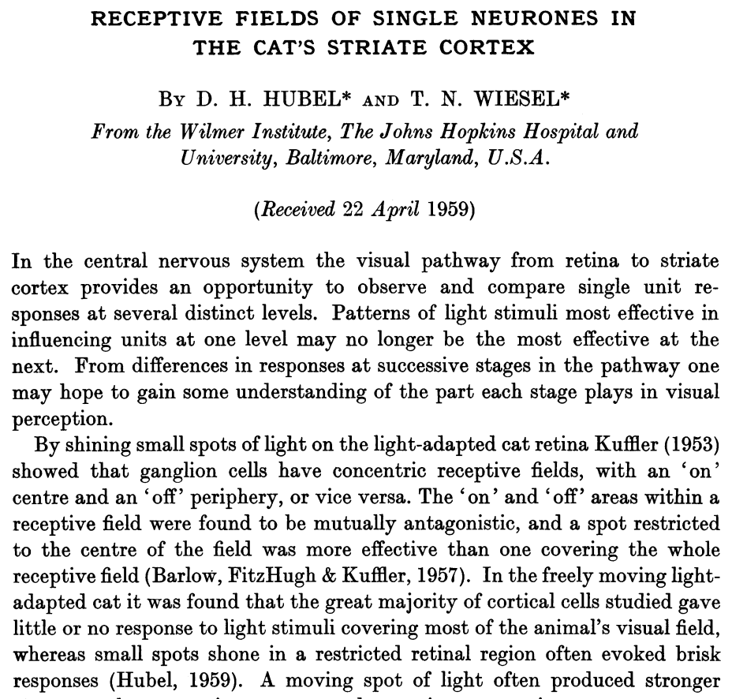
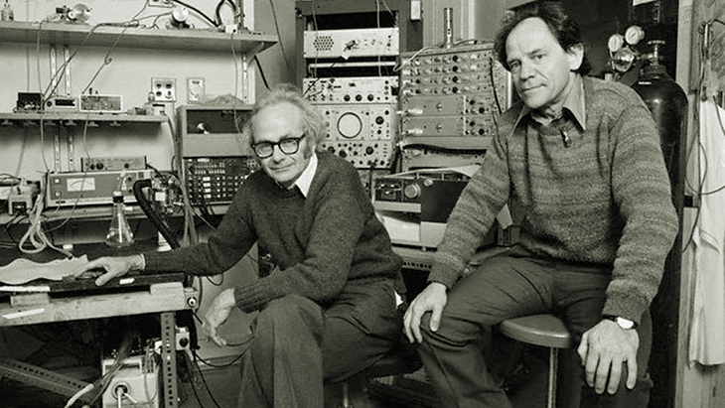
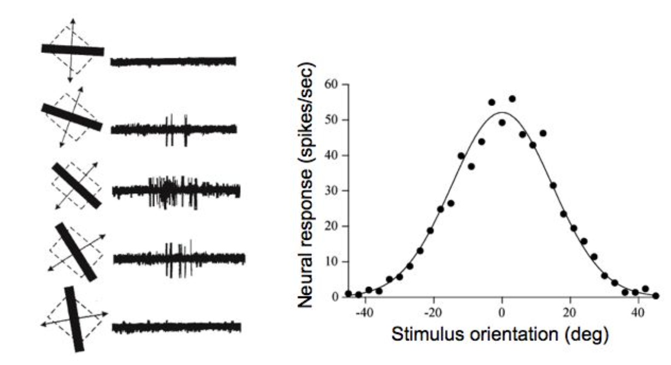
1959, 1968: Hubel and Wiesel measure cat visual system

Slide 30
Retinal neurons are sensitive to angle
Cat (Hubel and Wiesel 1968)
-0.5
+1.0
-0.5
-0.5
+1.0
-0.5
-0.5
+1.0
-0.5
Measurement of angle sensitivity
Layout of angle-selective receptors

Slide 31
Computational solution: the convolution
0
0
1
0
0
0
1
1
0
0
-0.5
+1.0
-0.5
-0.5

Slide 32
Computational solution: the convolution
0
0
1
2
1
0
1
1
0
0
-0.5
+1.0
-0.5
-0.5
0.0

Slide 33
Computational solution: the convolution
0
0
1
2
1
0
1
1
0
0
-0.5
+1.0
-0.5
-0.5
0.0
+1.0

Slide 34
Computational solution: the convolution
0
0
1
2
1
0
1
1
0
0
-0.5
+1.0
-0.5
-0.5
0.0
+1.0
0.0

Slide 35
Computational solution: the convolution
0
0
1
2
1
0
1
1
0
0
-0.5
+1.0
-0.5
-0.5
0.0
+1.0
0.0
-1.0

Slide 36
Computational solution: the convolution
0
0
1
2
1
0
1
1
0
0
-0.5
+1.0
-0.5
-0.5
0.0
+1.0
0.0
-1.0
+0.5

Slide 37
Computational solution: the convolution
0
0
1
2
1
0
1
1
0
0
-0.5
+1.0
-0.5
-0.5
0.0
+1.0
0.0
-1.0
+0.5
+0.5

Slide 38
Computational solution: the convolution
0
0
1
2
1
0
1
1
0
0
-0.5
+1.0
-0.5
-0.5
0.0
+1.0
0.0
-1.0
+0.5
+0.5
-0.5

Slide 39
Computational solution: the convolution
-0.5
+1.0
-0.5
Two-dimensional case
-0.5
+1.0
-0.5
-0.5
+1.0
-0.5
0
0
1
2
1
0
1
1
0
0
0
0
1
2
1
0
1
1
0
0
0
0
1
2
1
0
1
1
0
0
+3.0
0
0
1
2
1
0
1
1
0
0
0
0
1
2
1
0
1
1
0
0
0
0
1
2
1
0
1
1
0
0
0
0
1
2
1
0
1
1
0
0
Notes:
`

Slide 40
Computational solution: the convolution
-0.5
+1.0
-0.5
Two-dimensional case
Vertical edge-finder
-0.5
+1.0
-0.5
-0.5
+1.0
-0.5
0
0
1
2
1
0
1
1
0
0
0
0
1
2
1
0
1
1
0
0
-1.5
0.0
+3.0
0.0
-3.0
+1.5
+1.5
-1.5
0
0
1
2
1
0
1
1
0
0
-1.5
0.0
+3.0
0.0
-3.0
+1.5
+1.5
-1.5
0
0
1
2
1
0
1
1
0
0
-1.5
0.0
+3.0
0.0
-3.0
+1.5
+1.5
-1.5
0
0
1
2
1
0
1
1
0
0
-1.5
0.0
+3.0
0.0
-3.0
+1.5
+1.5
-1.5
0
0
1
2
1
0
1
1
0
0
-1.5
0.0
+3.0
0.0
-1.0
+1.5
+1.5
-1.5
0
0
1
2
1
0
1
1
0
0
Notes:
`

Slide 41
Computational solution: the convolution
-0.5
-0.5
-0.5
Horizontal edge-finder
Two-dimensional case
+1.0
+1.0
+1.0
-0.5
-0.5
-0.5
0
0
1
2
1
0
1
1
0
0
0
0
1
2
1
0
1
1
0
0
0
0
1
2
1
0
1
1
0
0
0.0
0
0
1
2
1
0
1
1
0
0
0
0
1
2
1
0
1
1
0
0
0
0
1
2
1
0
1
1
0
0
0
0
1
2
1
0
1
1
0
0

Slide 42
Computational solution: the convolution
-0.5
-0.5
-0.5
Horizontal edge-finder finds no edges
Two-dimensional case
+1.0
+1.0
+1.0
-0.5
-0.5
-0.5
0
0
1
2
1
0
1
1
0
0
0
0
1
2
1
0
1
1
0
0
0.0
0.0
0.0
0.0
0.0
0.0
0.0
0.0
0
0
1
2
1
0
1
1
0
0
0.0
0.0
0.0
0.0
0.0
0.0
0.0
0.0
0
0
1
2
1
0
1
1
0
0
0.0
0.0
0.0
0.0
0.0
0.0
0.0
0.0
0
0
1
2
1
0
1
1
0
0
0.0
0.0
0.0
0.0
0.0
0.0
0.0
0.0
0
0
1
2
1
0
1
1
0
0
0.0
0.0
0.0
0.0
0.0
0.0
0.0
0.0
0
0
1
2
1
0
1
1
0
0

Slide 43
Computational solution: the convolution
+1.5
-0.8
-0.5
The key:
Learning a filter is faster+better than per-pixel neurons
Two-dimensional case
-0.1
+1.0
+0.9
-0.5
+1.2
-0.3
0
0
1
2
1
0
1
1
0
0
0
0
1
2
1
0
1
1
0
0
0.0
0.0
0.0
0.0
0.0
0.0
0.0
0.0
0
0
1
2
1
0
1
1
0
0
0.0
0.0
0.0
0.0
0.0
0.0
0.0
0.0
0
0
1
2
1
0
1
1
0
0
0.0
0.0
0.0
0.0
0.0
0.0
0.0
0.0
0
0
1
2
1
0
1
1
0
0
0.0
0.0
0.0
0.0
0.0
0.0
0.0
0.0
0
0
1
2
1
0
1
1
0
0
0.0
0.0
0.0
0.0
0.0
0.0
0.0
0.0
0
0
1
2
1
0
1
1
0
0

Slide 44
Try it – making convolutions by hand
https://bit.ly/vis-conv

Slide 45
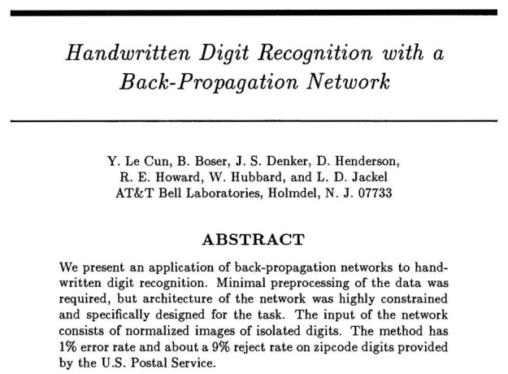
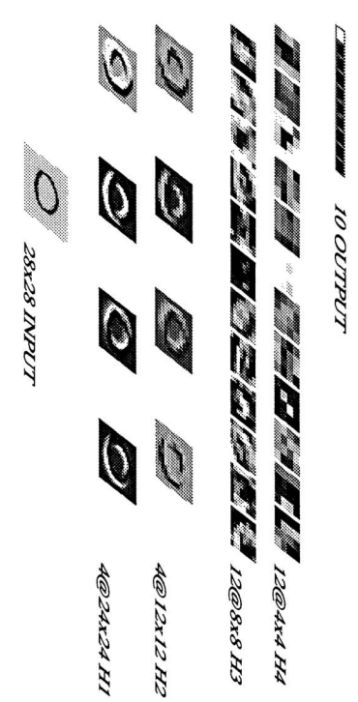
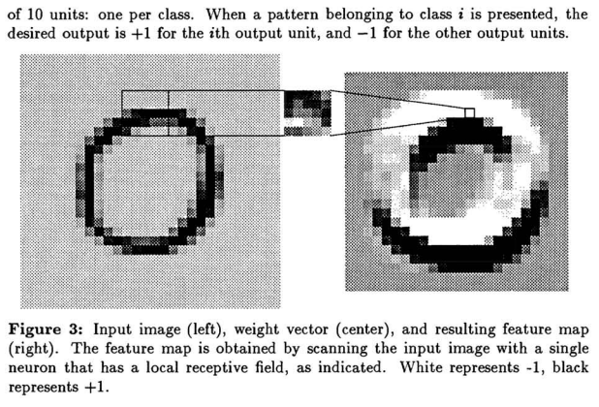
1989 LeCun et al. Convolutional Neural Nets

Slide 46
Convolution Layer
3x32x32 image: preserve spatial structure
32
height
32
width
3
depth / channels
Slide credit: D Fouhey & J Johnson

Slide 47
Convolution Layer
3x32x32 image
3x5x5 filter
Convolve the filter with the image: “slide over the image spatially, computing dot products”
32
height
32
width
3
depth / channels
Slide credit: D Fouhey & J Johnson

Slide 48
Convolution Layer
Filters always extend the full depth of the input volume
3x32x32 image
3x5x5 filter
Convolve the filter with the image: “slide over the image spatially, computing dot products”
32
height
32
width
3
depth / channels
Slide credit: D Fouhey & J Johnson

Slide 49
Convolution Layer
3x32x32 image
3x5x5 filter
1 number:
the result of taking a dot product between the filter and a small 3x5x5 chunk of the image
(i.e. 3*5*5 = 75-dimensional dot product + bias)
32
32
3
$$w^{T}x+b$$
Slide credit: D Fouhey & J Johnson

Slide 50
Convolution Layer
1x28x28 activation map
3x32x32 image
3x5x5 filter
28
convolve (slide) over all spatial locations
32
28
32
1
3
Slide credit: D Fouhey & J Johnson

Slide 51
Convolution Layer
1x28x28 activation map
3x32x32 image
3x5x5 filter
28
convolve (slide) over all spatial locations
32
28
32
1
3
Convolution Layer vs Image Filtering:
>1 input and output channels
Forget about convolution vs cross-correlation
Slide credit: D Fouhey & J Johnson

Slide 52
Convolution Layer
two 1x28x28 activation map
3x32x32 image
Consider repeating with a second (green) filter:
3x5x5 filter
28
28
convolve (slide) over all spatial locations
32
28
32
1
1
3
Slide credit: D Fouhey & J Johnson

Slide 53
Convolution Layer
6 activation maps,
each 1x28x28
3x32x32 image
Consider 6 filters, each 3x5x5
Convolution Layer
32
32
6x3x5x5 filters
Stack activations to get a 6x28x28 output image!
3
Slide credit: D Fouhey & J Johnson

Slide 54
Convolution Layer
6 activation maps,
each 1x28x28
3x32x32 image
Also 6-dim bias vector:
Convolution Layer
32
32
6x3x5x5 filters
Stack activations to get a 6x28x28 output image!
3
Slide credit: D Fouhey & J Johnson

Slide 55
Convolution Layer
28x28 grid, at each point a 6-dim vector
3x32x32 image
Also 6-dim bias vector:
Convolution Layer
32
32
6x3x5x5 filters
Stack activations to get a 6x28x28 output image!
3
Slide credit: D Fouhey & J Johnson

Slide 56
Convolution Layer
2x6x28x28
Batch of outputs
2x3x32x32
Batch of images
Also 6-dim bias vector:
Convolution Layer
32
32
3
6x3x5x5 filters
Slide credit: D Fouhey & J Johnson

Slide 57
Convolution Layer
N x C_{out} x H’ x W’
Batch of outputs
N x C_{in} x H x W
Batch of images
Bias: C_{out}-dim vector:
Convolution Layer
H
W
C_{out}
C_{in}
Weight:
C_{out} x C_{in}x K_{w} x K_{h}
Slide credit: D Fouhey & J Johnson

Slide 58
One-Minute Questions
Help us!
Answer the questions on the form here:
https://bit.ly/cs7150-f022-4

Slide 59
Stacking Convolutions
32
28
26
….
Conv
Conv
Conv
W₁: 6x3x5x5
b₁: 6
W₂: 10x6x3x3
b₂: 10
W₃: 12x10x3x3
b₃: 12
32
28
26
3
6
10
Input:
N x 3 x 32 x 32
First hidden layer:
N x 6 x 28 x 28
Second hidden layer:
N x 10 x 26 x 26
Slide credit: D Fouhey & J Johnson

Slide 60
Stacking Convolutions
Q: What happens if we stack two convolution layers?
32
28
26
….
Conv
Conv
Conv
W₁: 6x3x5x5
b₁: 6
W₂: 10x6x3x3
b₂: 10
W₃: 12x10x3x3
b₃: 12
32
28
26
3
6
10
Input:
N x 3 x 32 x 32
First hidden layer:
N x 6 x 28 x 28
Second hidden layer:
N x 10 x 26 x 26
Slide credit: D Fouhey & J Johnson

Slide 61
Stacking Convolutions
(Recall y=W₂W₁x is linear)
Q: What happens if we stack two convolution layers?
A: It’s equivalent to just one convolution layer!
32
28
26
….
Conv
Conv
Conv
W₁: 6x3x5x5
b₁: 6
W₂: 10x6x3x3
b₂: 10
W₃: 12x10x3x3
b₃: 12
32
28
26
3
6
10
Input:
N x 3 x 32 x 32
First hidden layer:
N x 6 x 28 x 28
Second hidden layer:
N x 10 x 26 x 26
Slide credit: D Fouhey & J Johnson

Slide 62
Stacking Convolutions
Q: What happens if we stack two convolution layers?
A: It’s equivalent to just one convolution layer!
32
28
26
….
Conv
ReLU
Conv
ReLU
Conv
ReLU
W₁: 6x3x5x5
b₁: 6
W₂: 10x6x3x3
b₂: 10
W₃: 12x10x3x3
b₃: 12
32
28
26
3
6
10
Input:
N x 3 x 32 x 32
First hidden layer:
N x 6 x 28 x 28
Second hidden layer:
N x 10 x 26 x 26
Solution: Add a nonlinearity between each conv layer
Slide credit: D Fouhey & J Johnson

Slide 63
Fully-connected Layer vs Convolution Layer
Input
$$w^{T}x$$
Output
1
3072
1 x 3072
weights
1
3x32x32 image
3x5x5 filter
$$w^{T}x$$
1 number:
the result of taking a dot product between the filter and a small 3x5x5 chunk of the image
32
32
What if the kernel size is 32*32? What is the number of parameters?
3
A fully-connected layer is equivalent to a convolution layer.

Slide 64
Fully-connected Layer vs Convolution Layer
Fully connected layer
Convolution layer
feature map
image
image

Slide 65
What do Conv Filters Learn?
Linear classifier:
One template per class
32
28
Conv
ReLU
W₁: 6x3x5x5
b₁: 6
32
28
3
6
Input:
N x 3 x 32 x 32
First hidden layer:
N x 6 x 28 x 28
Slide credit: D Fouhey & J Johnson

Slide 66
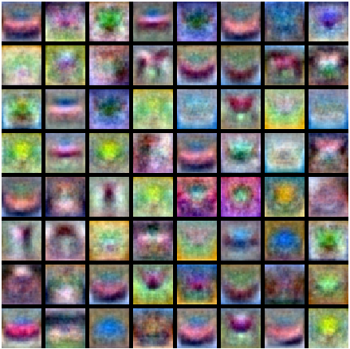
What do Conv Filters Learn?
MLP: Bank of whole-image templates
32
28
Conv
ReLU
W₁: 6x3x5x5
b₁: 6
32
28
3
6
Input:
N x 3 x 32 x 32
First hidden layer:
N x 6 x 28 x 28
Slide credit: D Fouhey & J Johnson

Slide 67
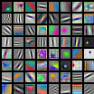
What do Conv Filters Learn?
First-layer conv filters: local image templates
(Often learns oriented edges, opposing colors)
32
28
Conv
ReLU
W₁: 6x3x5x5
b₁: 6
32
28
3
6
Input:
N x 3 x 32 x 32
First hidden layer:
N x 6 x 28 x 28
AlexNet: 64 filters, each 3x11x11
Slide credit: D Fouhey & J Johnson

Slide 68
Convolution Spatial Dimensions
Input: 7x7
Filter: 3x3
Q: How big is output?
7
7
Slide credit: D Fouhey & J Johnson

Slide 69
Convolution Spatial Dimensions
Input: 7x7
Filter: 3x3
Q: How big is output?
7
7
Slide credit: D Fouhey & J Johnson

Slide 70
Convolution Spatial Dimensions
Input: 7x7
Filter: 3x3
Q: How big is output?
7
7
Slide credit: D Fouhey & J Johnson

Slide 71
Convolution Spatial Dimensions
Input: 7x7
Filter: 3x3
Q: How big is output?
7
7
Slide credit: D Fouhey & J Johnson

Slide 72
Convolution Spatial Dimensions
Input: 7x7
Filter: 3x3
Output: 5x5
7
7
Slide credit: D Fouhey & J Johnson

Slide 73
Convolution Spatial Dimensions
Input: 7x7
Filter: 3x3
Output: 5x5
Problem: Feature maps “shrink” with each layer!
In general:
Input: W
Filter: K
Output: W – K + 1
7
7
Slide credit: D Fouhey & J Johnson

Slide 74
Padding: 1D Case
0
10
12
9
11
10
11
12
0
Signal
1/3
1/3
1/3
Filter
7.33
10.33
10.66
10
10.66
11
Output
Slide inspired by : J Johnson

Slide 75
Padding: 1D Case
0
10
12
9
11
10
11
12
0
Signal
1/3
1/3
1/3
Filter
7.33
10.33
10.66
10
10.66
11
7.67
Output
Input: 7 vs output: 7
Slide inspired by : J Johnson

Slide 76
Convolution Spatial Dimensions
Input: 7x7
Filter: 3x3
Output: 5x5
0 | 0 | 0 | 0 | 0 | 0 | 0 | 0 | 0
0 |  |  |  |  |  |  |  | 0
0 |  |  |  |  |  |  |  | 0
0 |  |  |  |  |  |  |  | 0
0 |  |  |  |  |  |  |  | 0
0 |  |  |  |  |  |  |  | 0
0 |  |  |  |  |  |  |  | 0
0 |  |  |  |  |  |  |  | 0
0 | 0 | 0 | 0 | 0 | 0 | 0 | 0 | 0
Problem: Feature maps “shrink” with each layer!
In general:
Input: W
Filter: K
Padding: P
Solution: padding
Add zeros around the input
Slide credit: D Fouhey & J Johnson

Slide 77
Convolution Spatial Dimensions
Input: 7x7
Filter: 3x3
Output: 5x5
0 | 0 | 0 | 0 | 0 | 0 | 0 | 0 | 0
0 |  |  |  |  |  |  |  | 0
0 |  |  |  |  |  |  |  | 0
0 |  |  |  |  |  |  |  | 0
0 |  |  |  |  |  |  |  | 0
0 |  |  |  |  |  |  |  | 0
0 |  |  |  |  |  |  |  | 0
0 |  |  |  |  |  |  |  | 0
0 | 0 | 0 | 0 | 0 | 0 | 0 | 0 | 0
In general:
Input: W
Filter: K
Padding: P
Output: W – K + 1 + 2P
Very common: “same padding”
Set P = (K – 1) / 2
Then output size = input size
Slide credit: D Fouhey & J Johnson

